Slide 1
Induction toolkit
2. What does my trust look like?
© GovernWell 2020. All Rights Reserved.
Notes:
Welcome the group.
Tell them what the session is about today.
Tell them how long the session will take.

Slide 2
Toolkit overview
Introduction
What does my trust look like?
What is my role?
How do I carry out my role?
What type of information am I going to see?
Notes:
If you have governors who haven’t used the toolkit yet:
Give them a short overview of the GovernWell induction toolkit.
Explain that it aims to complement the trust’s local induction by bringing the national perspective and attempts to answer some of the Frequently Asked Questions about the governor role.
Each section has a separate workbook.
Explain how you intend to work through them in your trust (when, will they be linked to other events, will they do it all in groups or some on their own etc.)
If you have governors who have already used the toolkit:
Remind them of the toolkit structure and where this session fits

Slide 3
Objectives
Understand what makes foundation trusts different
Understand what your foundation trust looks like
Find out who you will interact with and an overview of what their role(s) are
Be clear how your trust fits into the wider NHS structure
Familiarise yourself with some of the other NHS organisations you will hear about and how you will come across them in your role as governor
Notes:
Go over the objectives for the session and make sure they are clear about what the aim of the session is.

Slide 4
Contents
2.1 Facts and figures
2.2 Types of service
2.3 Our trust
2.4 Our mission
2.5 Our values
2.6 Organisation structure
2.7 With whom will I interact?
2.8 The role of the chair
2.9 Members and constituencies
2.10 The structure of the NHS
2.11 Regulating foundation trusts

Slide 5
2.1 Facts and figures
Every foundation trust is different in shape and size
Understanding the shape and size of your own foundation trust will help you make informed decisions about what is best for your constituency
Notes:
Depending on the level of knowledge in the group you may want to spend a little time explaining why all FTs are different
Make the link between understanding the trust and representing members – with a note that this will be covered in more detail in later chapters
You could open up a discussion about what the things are that make a trust different – geography, demography etc.
Direct them to the questions in their workbook for this section and allow about 15 minutes for them to try and complete this individually or in groups. They will either need internet access or for you to provide some materials that they can look at to find the figures.
Draw the group back together to share answers

Slide 6
2.2 Types of service
Different foundation trusts provide a different range of services
Foundation trusts and other types of NHS organisations work together to provide the full range of services patients need
Notes:
Following on from all FTs being different, they also provide a different range of services
Using the information provided in the workbook give a short summary of what each type of service is – many people will know that ambulance services provide emergency patient transport but may not know about the other services they offer
This is about encouraging them to understand the healthcare sector and how it works together, and not to think of their trust in isolation
Direct them to the questions in their workbook for this section and allow 5-10 minutes for them to complete them individually or in groups
Draw the group back together to share their answers
Provide a written of details of the foundation trust’s main services, so governors have this for reference

Slide 7
2.3 Our trust
Which services are provided by your foundation trust?
Who does your trust work with for services you don’t provide?
What are your trust priorities for this year?
Notes:
Explain a little, at high level, about what the trust does
Include some human interest statistics – no of babies delivered / number of emergency calls answered / number of home care appointments delivered / number of hearing aids fitted etc etc

Slide 8
2.4 Our mission
A mission statement is a formal written summary of the core purpose and focus of your trust.
What is the mission of your trust?
Notes:
Trusts use a variety of terms to describe their mission statements – adapt this slide to reflect terminology in your trust
Explain the mission how / why it was developed

Slide 9
2.4 Our mission
Governors help us to deliver our mission by:
Bringing the voice of our key stakeholders – patients, carers, staff and the public into our decision-making processes
Using local knowledge to help us understand what their constituents think of us and how we’re doing
Using local connections and opportunities to promote the trust
Holding us to account for delivery against our own and national targets
Notes:
Trusts use a variety of terms to describe their mission statements – adapt this slide to reflect terminology in your trust
Explain the mission how / why it was developed

Slide 10
2.5 Our values
Values are a guiding set of principles within your trust
Values drive behaviours
What are the values of your trust?
Notes:
Go through the values and explain how they were developed and when / if they are reviewed

Slide 11
2.5 Our values
Governors play a key part in helping the trust live up to its values
by providing feedback about how patients, carers and the public experience our services
by participating in reviews of practice and observing whether or not the values are reflected
by demonstrating and modelling the values in interactions with each other, trust staff, patients, carers and other stakeholders
Notes:
Mention something about governors’ opportunities to provide feedback
Explain the mechanisms you have for Governors to participate in reviews of practice (eg Ward Walks / departmental visits / whatever you do in your trust
Talk about examples of modelling the values

Slide 12
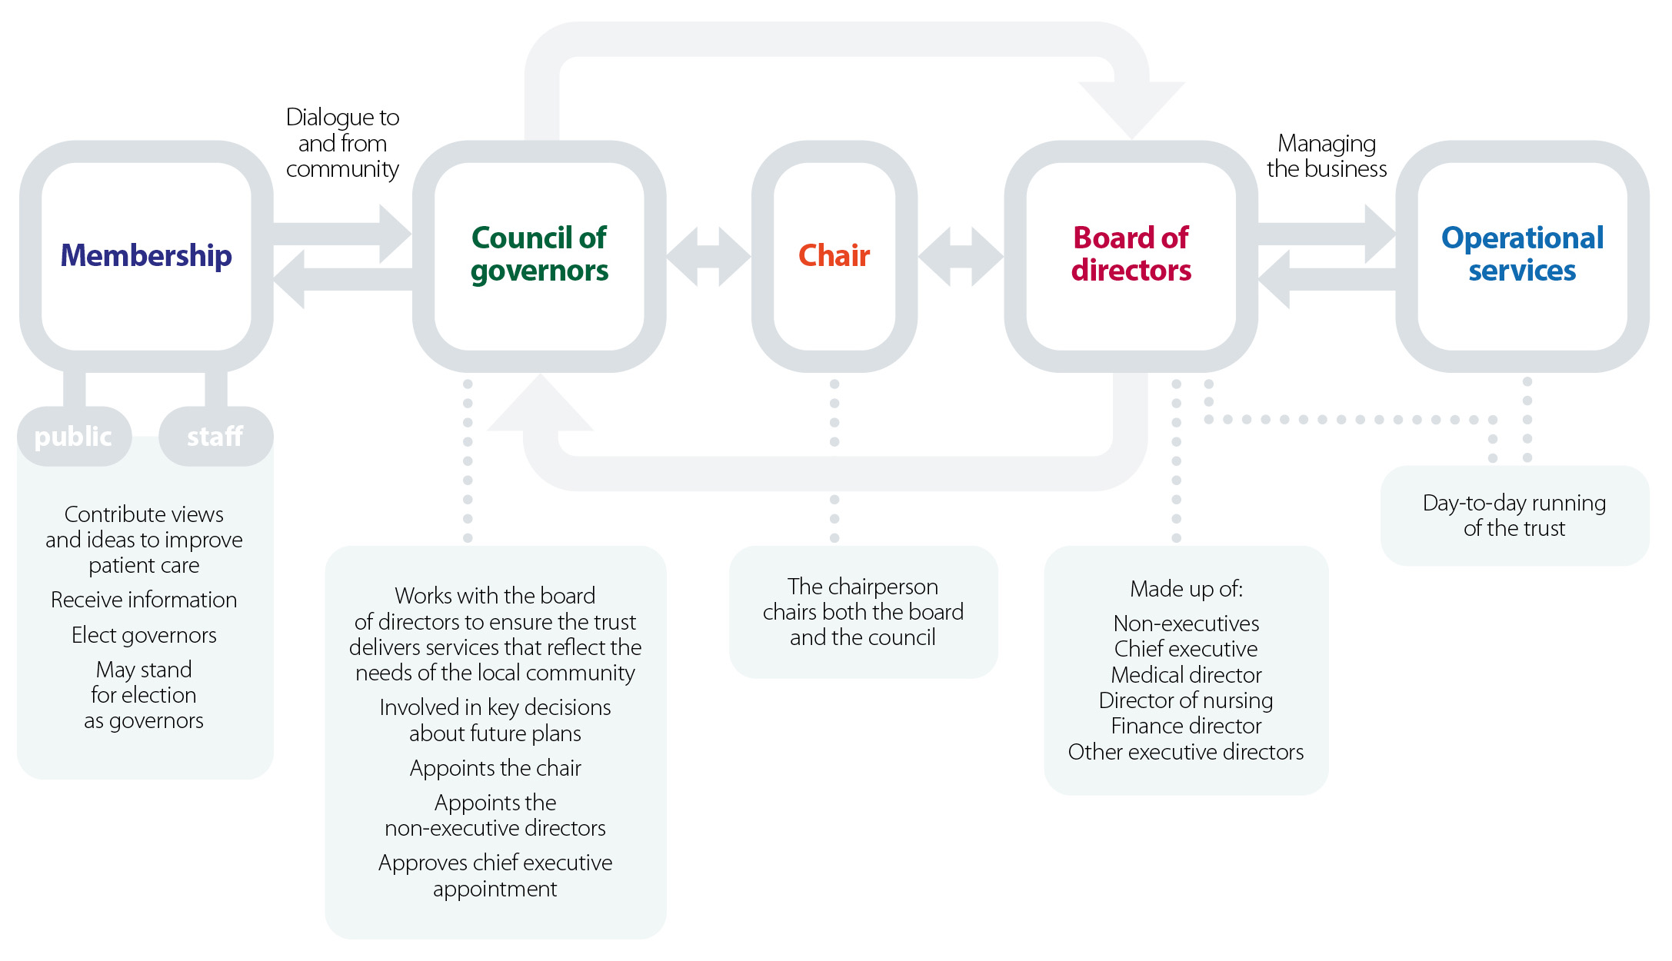
2.6 Organisational structure
Foundation trusts can decide how they are structured to suit the population they serve and the services they provide
The structure of each trust is set out in its constitution
Notes:
Another way that FTs are different is in their structure
To enable them to work as efficiently and effectively as possible for their local area they can tailor their management structure
The structure will be set out in the trust’s constitution – it would be good to make sure the governors have a copy of this for this session
Using the diagram explain the different roles that make up the management structure, we will look more at what each role entail in the next section
Direct them to the task in their workbook and give out the ‘How is my trust organised?’ cards
Allow 5-10 minutes for the group to complete the first task of laying out the organogram of their trust
Prompt them to move on to the second task of adding names, allowing a further 10 minutes for this. You may find it helpful to provide them with some trust documents that they can use to get the information from.
Draw the group together and help them to fill in any gaps Another way that FTs are different is in their structure
To enable them to work as efficiently and effectively as possible for their local area they can tailor their management structure
The structure will be set out in the trust’s constitution – it would be good to make sure the governors have a copy of this for this session
Using the diagram explain the different roles that make up the management structure, we will look more at what each role entail in the next section
Direct them to the task in their workbook and give out the ‘How is my trust organised?’ cards
Allow 5-10 minutes for the group to complete the first task of laying out the organogram of their trust
Prompt them to move on to the second task of adding names, allowing a further 10 minutes for this. You may find it helpful to provide them with some trust documents that they can use to get the information from.
Draw the group together and help them to fill in any gaps

Slide 13
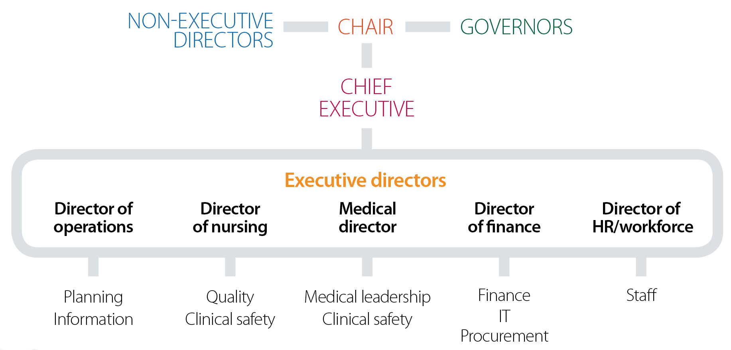
2.6 Organisational structure
Foundation trusts can decide how they are structured to suit the population they serve and the services they provide
The structure of each trust is set out in its constitution – here is an example
Notes:
Another way that FTs are different is in their structure
To enable them to work as efficiently and effectively as possible for their local area they can tailor their management structure
The structure will be set out in the trust’s constitution – it would be good to make sure the governors have a copy of this for this session
Using the diagram explain the different roles that make up the management structure, we will look more at what each role entail in the next section
Direct them to the task in their workbook and give out the ‘How is my trust organised?’ cards
Allow 5-10 minutes for the group to complete the first task of laying out the organogram of their trust
Prompt them to move on to the second task of adding names, allowing a further 10 minutes for this. You may find it helpful to provide them with some trust documents that they can use to get the information from.
Draw the group together and help them to fill in any gaps Another way that FTs are different is in their structure
To enable them to work as efficiently and effectively as possible for their local area they can tailor their management structure
The structure will be set out in the trust’s constitution – it would be good to make sure the governors have a copy of this for this session
Using the diagram explain the different roles that make up the management structure, we will look more at what each role entail in the next section
Direct them to the task in their workbook and give out the ‘How is my trust organised?’ cards
Allow 5-10 minutes for the group to complete the first task of laying out the organogram of their trust
Prompt them to move on to the second task of adding names, allowing a further 10 minutes for this. You may find it helpful to provide them with some trust documents that they can use to get the information from.
Draw the group together and help them to fill in any gaps

Slide 14
2.7 With whom will I interact?
Governors do not work in isolation, there are a number of people in your trust you will interact with on a regular basis
Understanding their roles will help you work with them efficiently and direct questions to the right people
Chair
Chief executive
Executive directors
Non-executive directors
Senior independent director
Company secretary
Governor lead
Members and the public
Notes:
Building on the organogram, we’ll now think about what those people do
Emphasise the importance of directing questions to the right people
Explain each role, using the information from the workbook to help, with a focus on how the governors work with each person.
Direct them to the questions in the workbook and all 5 minutes to complete.
Draw the group together to share answers.
Highlight the role of membership manager (if applicable) to advise and support individual governors on procedural matters and to oversee governor training and development Building on the organogram, we’ll now think about what those people do
Emphasise the importance of directing questions to the right people
Explain each role, using the information from the workbook to help, with a focus on how the governors work with each person.
Direct them to the questions in the workbook and all 5 minutes to complete.
Draw the group together to share answers.
Highlight the role of membership manager (if applicable) to advise and support individual governors on procedural matters and to oversee governor training and development

Slide 15
2.7 The role of the board
The board should demonstrate leadership by undertaking three key roles:
Formulating strategy for the organisation
Ensuring accountability by:
holding the organisation to account for the delivery of the strategy
being accountable for ensuring the organisation operates effectively and with openness, transparency and candour
seeking assurance that systems of control are robust and reliable.
Shaping a healthy culture for the board and the organisation
A general duty on the directors is to promote the success of the NHS foundation trust so as to maximise the benefits for the members of the trust as a whole, and for the public
All members of the board of directors have collective responsibility as a unitary board for every decision of the board, regardless of their individual skills or status.
Notes:
Effective governance includes setting the corporate strategy and organisational culture, taking those decisions reserved for the board and being accountable to stakeholders for those decisions.
The board of directors is collectively responsible for taking actions which legally bind the trust.
All the powers of the NHS foundation trust can be exercised by the board of directors on its behalf. The board of directors must include executive and non-executive directors, and the Code of Governance requires that a majority of the board of directors are independent non-executive directors.
Provide details of any policies, protocols and procedures dealing with the relationship between the board of governors and council of governors.

Slide 16
2.8 The role of the chair
The chair is a non-executive director
They are the chair of the board of directors and the council of governors
The chair sets the agenda for the meetings and ensures relevant information is provided to the council to help with discussion and decision making
Notes:
Explain the key role the chair has, using the information in the workbook to help
If you have existing governors: it would be good to find a willing volunteer or two to come in at this point to talk about how the council work with the chair, emphasising the importance of a good working relationship
If you don’t have any existing governors: ask them to think as a group about how they would want the relationship to work and how they can achieve this
If the discussion is slow to get started use the examples in the workbook to prompt them

Slide 17
2.9 Members and constituencies
Foundation trusts have members from local constituencies who can play a part in shaping local health services.
Governors are elected by members to represent the views of the local population and to act as a conduit for information between them and the board.
Foundation trusts have systems and processes in place for recruiting and involving members which governors may have a role in.
Notes:
The other key relationship for governors is with members
Remind them why trusts have members
At this point it would be good to include your trusts aims and objectives with regard to members, talk to them about any existing means of engagement and ways for them to get involved
Direct them to the questions in the workbook and allow 5-10 minutes to complete, you will need to provide access to the trust website or some documents for them to find the answers in.
Draw the group together to share answers
Provide a copy of the communications with members strategy

Slide 18
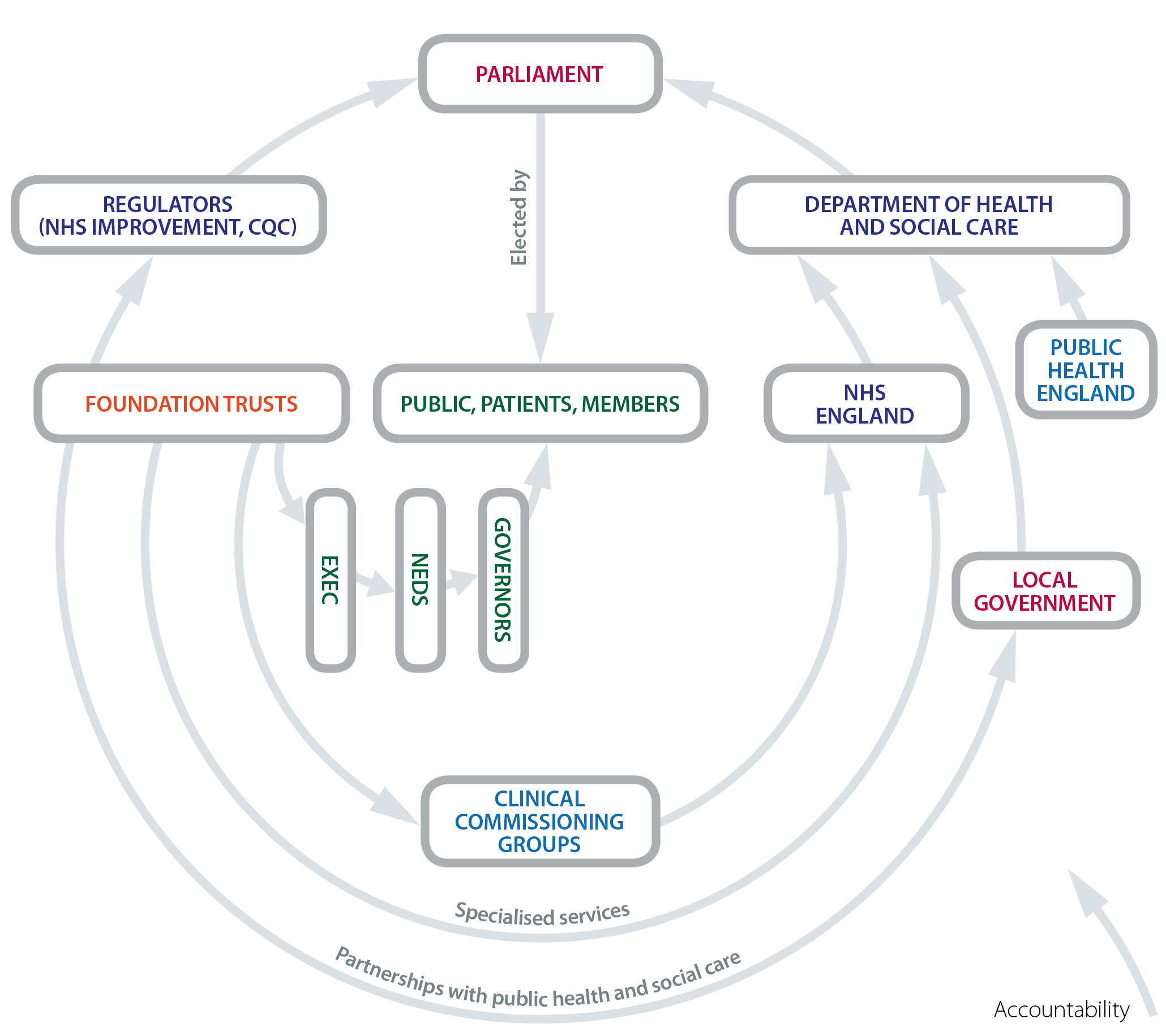
2.10 The structure of the NHS
Notes:
Having talked about how FTs are different and focussed on what your trust looks like we want to finish by looking at how your trust fits into the wider NHS
Using the diagram, briefly explain each organisation
Direct them to the quiz in their workbook, allow 10 minutes to complete (if you are short of time at this point encourage them to do it at home, answers are at the back of the workbook)

Slide 19
2.11 Regulating foundation trusts
NHS Improvement is responsible for overseeing NHS foundation trusts, NHS trusts and independent providers, helping them give patients consistently safe, high quality, compassionate care within local health systems that are financially sustainable.
The Care Quality Commission (CQC) regulates all health and social care services in England. The Commission ensures the quality and safety of care in hospitals, ambulances, care homes, dentists and the care given in people’s own homes.
Notes:
Building on the previous slide, elaborate on the roles of Monitor and CQC
Briefly explain what their role is and then what this means for the governors
Remind them they can find out more about them on their websites

Slide 20
Reflection questions
What have you learnt about your foundation trust?
How do you plan to work with the different people in your foundation trust?
Do you know how your foundation trust will work with other partner organisations?
Notes:
Give them 5 minutes to reflect on the session
Ask if there are any further questions

