Slide 1
Realising the benefits and bringing people with you
Dr C I Okocha
Chief Executive
Oxleas NHS Foundation Trust

Slide 2
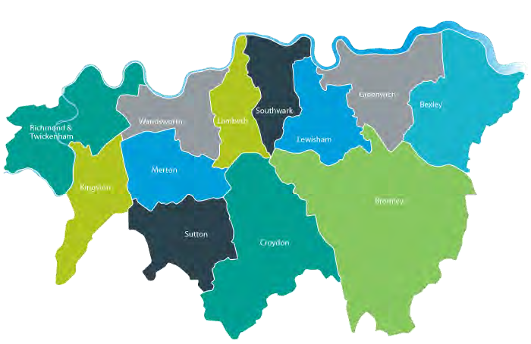
South London Partnership
Working together to tackle the big challenges
Collaboration not competition: Oxleas, SLaM, SWLStG via SLP making a difference for patients and staff at scale
Ambition: more care closer to home, transform patient experience and outcomes, better commissioning, value for NHS
  3.6 million+ population
  12 boroughs
  2 ICS/STPs
  High demand
  c10.000 staff

Slide 3

SLP vision and goals
Vision
Right care, right time, right place - for each patient as an individual.
Mental health services working together efficiently to deliver seamless, patient-centred pathways
Strategic goals
Increase population health
Significantly decrease the gap between years of life
Agree best practice approaches across the partnership and roll them out using QI methodology
Ensure no one will be sent out of area by 2020/21
Ensure everyone has access to care in good time
Deliver savings by working in partnership

Slide 4
Our Population
Combined south London population of 3.7 million (2.0 million south east London; 1.7 million south west London)
  Diversity: highly diverse – 32% of south London population is black and minority ethnic (BAME) and this varies markedly across 12 boroughs; Southeast London has a higher-than-average proportion of residents identifying as LGBTQI+.
  Deprivation: Four south east London boroughs – Lambeth, Southwark, Lewisham and Greenwich are in the 15% most deprived local authority areas in the country. Deprivation in Southwest London is lower although Croydon and Wandsworth are outliers; Life expectancy/ healthy life expectancy at birth remain below the national and London averages for many of our boroughs, especially for males.
  Mental health: In south London, there are similar rates of mental illness to the national average; 18.1% of the population aged 16+ (479,688 people) have a common mental illness e.g. anxiety and depression. This is above the England benchmark with an upward trend.
Population is growing and will exceed 4 million by 2029; with particular growth in older adults.

Slide 5
Specific population issues for consideration – Children and young people
0-25 Population: 1,051,715 - Male 54% Female 46%
1 in 220 admitted for self harm
1 in 113 admitted for mental health Disorder
Over 30k referral to CAMHs
13.1% have a mental health disorder of which:
25% of 11-16 years old reported self harm or suicide attempt.
69% have a physical health condition
37.4% have special educational needs
54.3% were bullied in the past year
66.4% had any professional service contact
25.2% had contact with a mental health specialist
48.6% had informal support
3.0% without a disorder reported self harm or suicide attempt
11% of children in Reception and 29% of children 10-11 years old are obese
48.7% unhappy with their body image
19.3 per 1,000 pregnancy in 17-year-olds

Slide 6
Specific population issues for consideration – Adults
19-65 Population: 1,051,715 - Male 55% Female 45%
9.5% population predicted growth by 2029
Life Expectancy: Males 78 Females: 85
18% have a mental health disorder
15.4% suffer from Anxiety and depression
894 New episodes of psychosis
1 in 3 adults are from BAME groups of which:
4:1 detentions for the ‘Black to British’ group.
1in 3 admissions to acute and secure
54,272 admissions for alcohol related conditions
25% of people with MH & LD have a LTC comorbidity
56% of people are obese or overweight
160,484 people with diabetes
Only 29.2% of people on the SMI register had a physical health check
4.6% of people known to services had a crisis plan
26,325 (1 in 94) people are homeless
1 in 45 people are subject to violent crime
79,026 (1 in 31) people experience domestic abuse
27% of the population are smokers

Slide 7
SLP – the story so far…
Then (2016) | Now
Two pilot NHSE New Care Models Programmes – forensic and CAMHS Nursing Development Programme Memorandum of Understanding | The SLP Provider Collaboratives (PCs) went live in the first wave in October 2020 with the expectation that the whole of England is live by 1st October 2021 managing a commissioning budget of £110m for Forensics, CAMHS and Adult Eating Disorders Complex Care Programme commission services across 11 boroughs and 2 ICS managing a budget of £30m Acute Care Pathway Programme Corporate Services Programme Award-winning Nursing Development Programme Specialist Projects

Slide 8

SLP – the story so far (1)
From competition to collaboration
Sharing pathways, resources and knowledge
Influencing national policy and Integrated Care Systems (ICSs)
Taking on commissioning budgets to transform patient outcomes
Then | Now
Two pilot NHSE New Care Models Programmes – forensics and CAMHS Nursing Development Programme Memorandum of Understanding | Three of 10 Provider Collaboratives (PCs) nationally; managing £100m+ commissioning budget – forensics, CAMHS and adult eating disorders Complex Care Programme managing £40m+ budget Acute care Programme Corporate Services Programme Award-winning Nursing Development Programme Specialist Projects
Effective partnership working – what we have learned
Empowering clinician and patient-led development and delivery of improvements and innovation
Being flexible and responsive; with robust but not-bureaucratic governance
Establishing clear aims and principles; improving patient care, outcomes and experience; collaboration at South London scale; true partnership and joined up working; bringing people together; achieving best value and reinvesting savings; tailoring solutions to local partners and populations

Slide 9
SLP – the story so far (2)
Our joint programmes - benefits for patients, staff and partners and value for the NHS
Forensic
Transformed outcomes: Overall 36% reduction in out of area patients; 66% reduction in readmissions FY 2019-20: 43 repatriations; out of area beds used down from 82 to 60; 6 new OOA placements all year
Investment in new services: Out of Area Assessment Team, Central Single Point of Access referral hub,
Expanded Community Forensic Outreach services, Additional Adult Low Secure inpatient beds in south London, Quality Improvement projects to strengthen dual diagnosis support for patients across the partnership and specific support for carers, Dedicated discharge coordinators
Innovative new teams: Community Forensic LD/ASD; Specialist step-down support accommodation for women unsuitable for general community placements (10-bed Mariposa House), Community Forensic Support + working with specialist housing providers to support male patients with high LOS
CAMHS
32% reduction in South London CYP’s use of MH hospital beds; 93% reduction in out of area bed use; average distance from home from 73 to 7 miles
Reduced PICU LOS, crisis escalations, resulting A&E attendances of known service users
New Oxleas DBT service impact: suicide attempts 1 (was 24), A&E attendances 2 (23), OBDs 0 (605) New joined-up approaches to complex cases with Children’s Social Care and CCGs
250+ calls per month to Crisis Line: average duration 20.5 mins, average age 14.5 yrs
Rapid Covid response: optimising wards, staff to keep patients safe; stepped-up expanded Crisis Line service and community support for discharged patients
Investment in new services: Community Forensic CAMHS, Shared Bed Management, Out of Hours Crisis Line, Adolescent PICU
Complex Care
115 complex patients stepped down to less restrictive settings on proactive rehabilitation care pathways 1,000+ new assessments of previously ‘funded and forgotten’ patients completed
Unique partnership programme - Single Point of Access for new referral and consistent South London-wide Assessment Panels in place
£40m+ budgets for health-only CCG patients devolved to SLP clinicians

Slide 10
SLP – the story so far (3)
Our joint programmes - benefits for patients, staff and partners and value for the NHS
Nursing Development Programme
5%+ improvement in overall nursing workforce retention
Led the way nationally in training, developing and introducing Band 4 Registered Nursing Associates into teams Shared career development pathways, frameworks and competencies across all Trusts
Unique Employee Passport for easier movement across SLP Trusts Leadership Career Development Programme for ethnically diverse Nurses
Innovative new development programmes: Advancing Careers at Band 7+, Growing Community Band 5 MHN workforce
Adult Eating Disorders
New Single Point of Access service introduced for referrals: consistent assessment and access to right care, right time, right place Covid response – optimising inpatient capacity, resources and staff to keep patients safe
National recognition for system leadership, transformation, clinical outcomes, workforce development HSJ Awards, Nursing Times Workforce Awards, RCPysch, HSJ Value Awards, Burdett Trust Nursing Awards NHSE/I Best Practice Guides
HSJ and NHS Provider national conference speeches and more…..
Savings for the system
£9m+ saved already on commissioning budgets – enabling reinvestment in local mental health services + transformed care outcomes for local people!

Slide 11

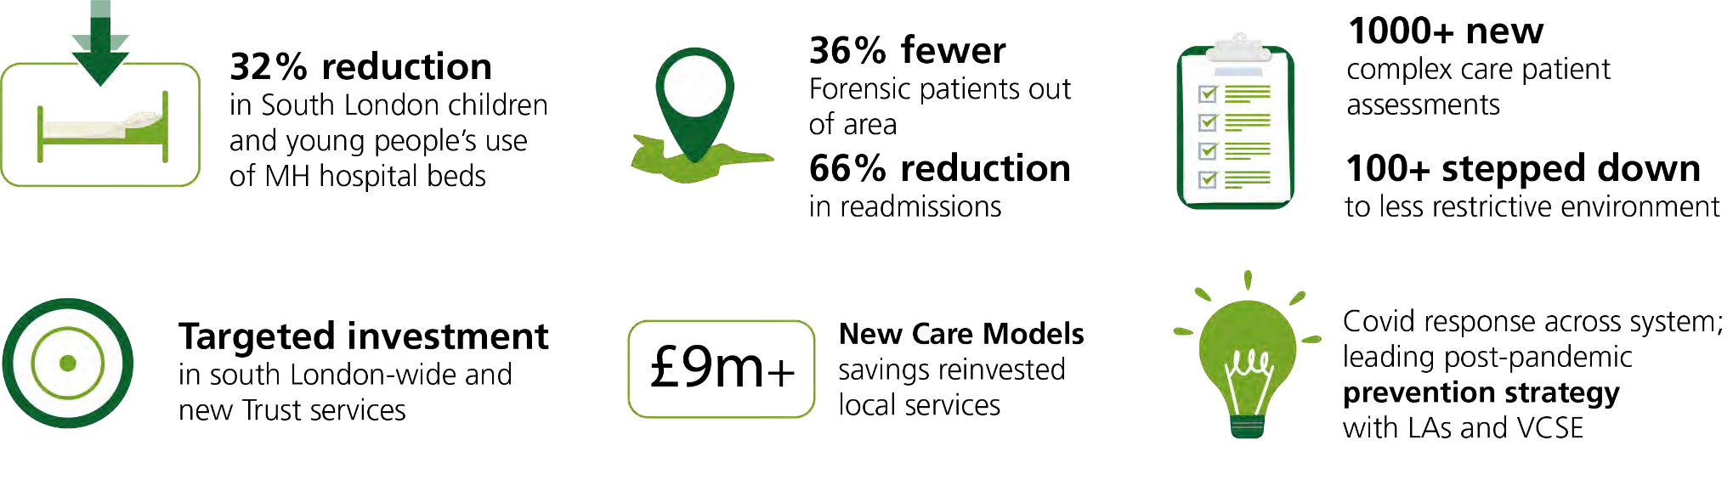
Key achievements: transformed patient outcomes, improved performance, better value for NHS
Workforce improvements
5%+ improvement in overall nursing workforce retention
National leadership shaping future workforce inc: Band 4 Nursing Associates, Advanced Clinical Practitioners, leadership career development for ethnically diverse Nurses, community nursing workforce
Shared career development pathways, frameworks and competencies
Unique employee passport easing movement between SLP trusts
19

Slide 12
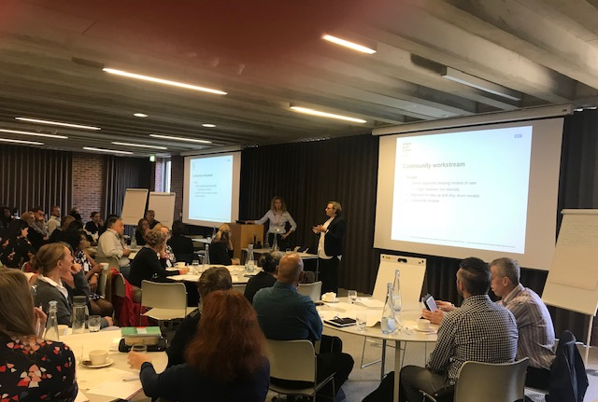
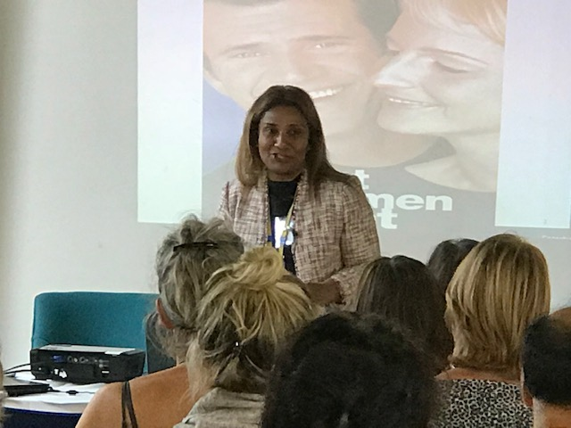
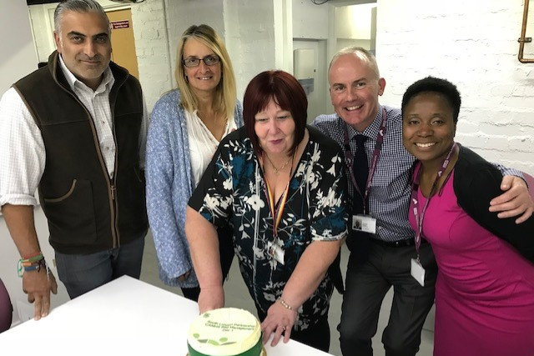
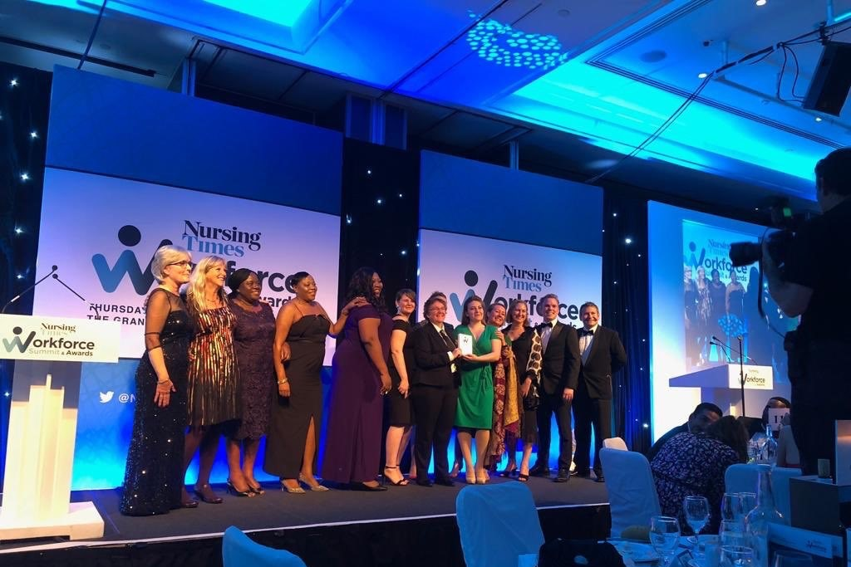

Effective partnership working – what have we learned?
Empowering clinician and patient- led development and delivery of improvements and innovation
Flexible and responsive; robust but not-bureaucratic governance
Clear aims and principles
  Focus on improving patient care, experience and outcomes
  Collaborate at South London scale where we can best solve problems, drive efficiencies make best use of resources and new technologies, genuinely transform services
  True partnership - integration, joined-up working
  Bring people together: events, workshops, project groups, shared pathways, joint teams
  Achieve best value; reinvest savings in new, more effective community services
  Solutions tailored to local partners, populations and their needs

Slide 13
Service User Engagement
Service user representatives on all Pathways/Programme Boards
Co-production on key pieces of work – E.g. Women’s PICU
Service User feedback - Agenda item at all meetings
Patient Story at all ‘Partnership Committees in Common’ meetings
SLP portal on all Trust websites
Work on Peri-natal has started with service users
SLP Commissioning Intentions developed with partners and stakeholders

Slide 14
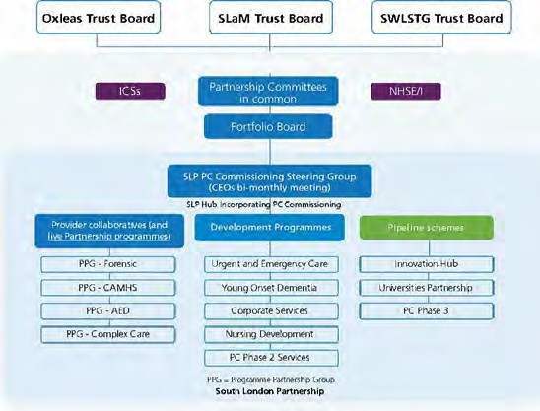
SLP principles - strong culture and governance
Robust partnership governance has evolved while maintaining a positive culture, enabling innovation and collaboration to thrive
Shared principles and culture change drives transformation
Collaboration, not competition
Shared values, goals, savings + risk
Clear vision and aims; robust outcome measures
Focus on better patient care, experience and outcomes
Agile programme management; purposeful engagement
Population and partnership view - aligned objectives with partners outside Trusts
Clarity of purpose + strategic, agile approach
Shared risk and savings; commitment to reinvest
South London-wide + ICS / system partners’ commissioning goals + targeted Borough-level needs
Evolved from NHSE/I Specialised Commissioning New Care Models through full budget devolution
Expanded where collaboration drives benefits including devolved CCG MH commissioning (Complex Care); workforce development (Nursing), corporate services unique to MH; further specialist pathways; system/south London-wide projects
25

Slide 15
Thank you!

