Slide 1


Squaring the circle: governing provider collaboratives in the new era
31 March 2022
Christian Dingwall, Partner
brownejacobson.com
linkedin.com/company/brownej

Slide 2
Policy and legal basis for collaboration
    NHS required provider arrangements for -
    Place-based Partnerships
    Provider Collaboratives
    Health and Care Bill – new provisions for -
    Joint working and delegation arrangements
    Joint committees and pooled funds
    NHS England guidance about joint working and delegation / joint appointments
    Treatment of delegation arrangements
    Potential amendment of s75 partnership regulations for NHS/LA arrangements

Slide 3
Options for developing provider collaboratives
Loose Arrangements Tight Agreements Merger
Loose Collaboration
Working Group
Joint Committee
Contractual Joint Venture
Corporate Joint Venture
Lead Provider
Shared /Joint
Leadership
Single Provider/ Merger
Leadership Group
MoU
ToR for Leadership Group
Shared principles for working together / collaboration
No shared decision-making - advisory / recommendations only
Enables a more strategic approach to collaboration
Leadership Board
MoU
ToR for Board
Individual exercise of delegated authority
Shared information to discuss relevant matters.
Individuals make decision for their own organisation
Aligned decision making but not shared decision making
Leadership Board
MOU / Collaboration Agreement
ToR for joint committee
Collective exercise of delegated functions
Shared information to discuss relevant matters.
Joint decisions by unanimous or majority voting
Shared decision-making for joint approach to collaboration
JV partnership board
Contractual JV agreement which mimics corporate joint venture approach
Services Agreement
Principally a mechanism for service delivery
Can permit joint decision making on JV management
JV corporate board of directors
Articles of Assoc / Constitution
Members Agreement
Services Agreement
Principally a mechanism for service delivery
Can permit joint decision making on JV management
NB restricted NHS trust powers
Main Contract held by lead NHS provider
Alliance / consortium agreement
Sub contracts between lead provider and other NHS / non-NHS providers
Principally a mechanism for service delivery
Can permit joint decision making on alliance / consortium management
Shared / Joint leadership structure
Same person or people lead each provider involved
Boards of NHSTs or FTs appoint same person to multiple posts
Enables aligned or virtual (but not actual) joint decision making
Governance and legal advice required to determine feasibility
Will need to demonstrate patient benefit
Heads of Terms
Due Diligence Questionnaire
Due Diligence Report
Interim Management Agreement
Transaction Agreement
Dissolution Order / Transfer Order

Slide 4
Some frequently asked questions about provider collaboration
    Is there a prescribed process to establish a provider collaborative?
    What legal steps are needed for a ‘formal’ provider collaborative?
    Can providers choose / restrict who they collaborate with?
    Are all providers equal in a provider collaborative?
    How can providers share decision-making when they collaborate?
    How do providers manage conflicts of interest when they collaborate?
    How do providers enter / exit an existing provider collaborative?
    What are the accountability and liability of a provider collaborative and its members?
    What is the legal relationship between an ICB and a provider collaborative?

Slide 5
MSE Community Collaborative: Progress to date
Paul Scott, Chief Executive
Essex Partnership Foundation Trust

Slide 6

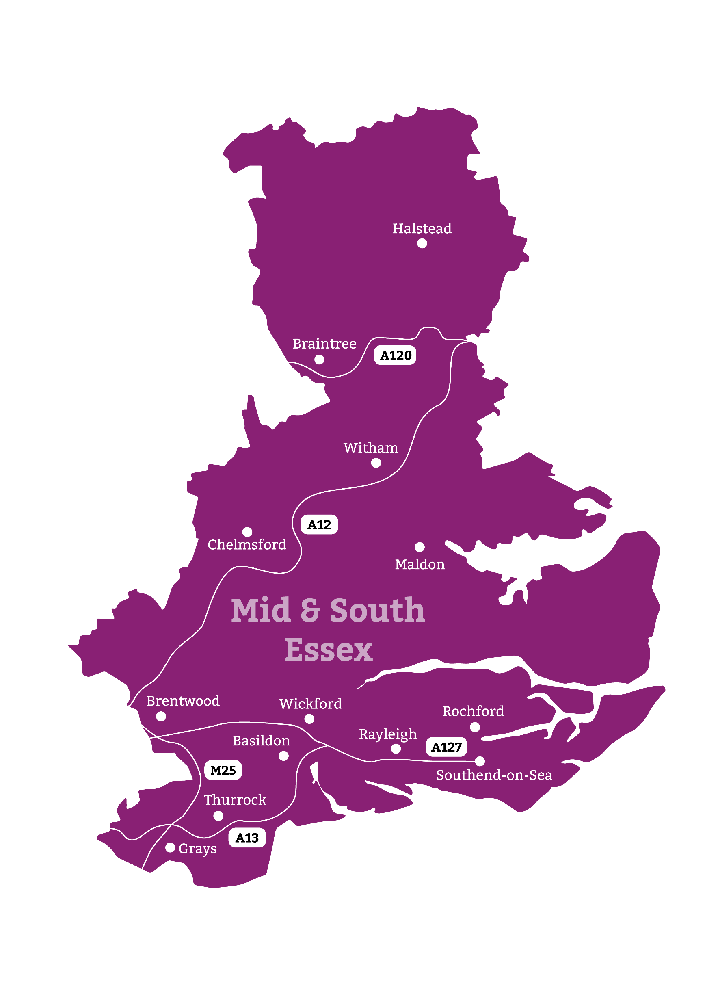
The Mid and South Essex (MSE) ICS serves a population of 1.2 million
3 x Community service providers
1x Mental health service provider
1 x Acute trust operating across three main sites
3 X ‘Upper Tier’ local authorities
5 x CCGs transitioning to the ICB
28 x Primary care networks
150 x GP practices

Slide 7



The vision for the MSE Community Collaborative is to deliver:
“A consistent and outstanding Community Health and Care service for residents across Mid and South Essex.”

Slide 8
Overview
Mid and South Essex Community Collaborative fully established from Oct 2021
Priorities
  Improve patient outcomes, by reducing variation and ensuring sustainability
  Establish place based integrated health and care services wrapped around primary care networks
Delivered through
  Joint programme of change
  Shared delivery teams
  Integrated place based leadership (mental health and community)
  Joint governance with delegation
  Contractual Joint Venture agreement underpins

Slide 9
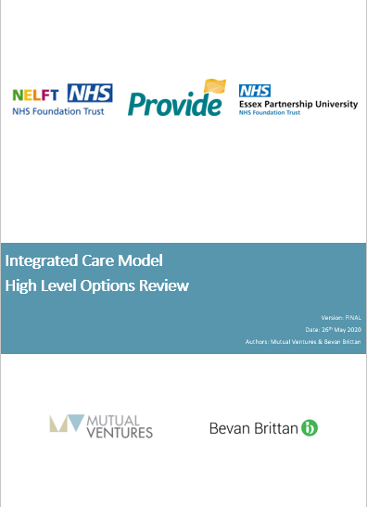
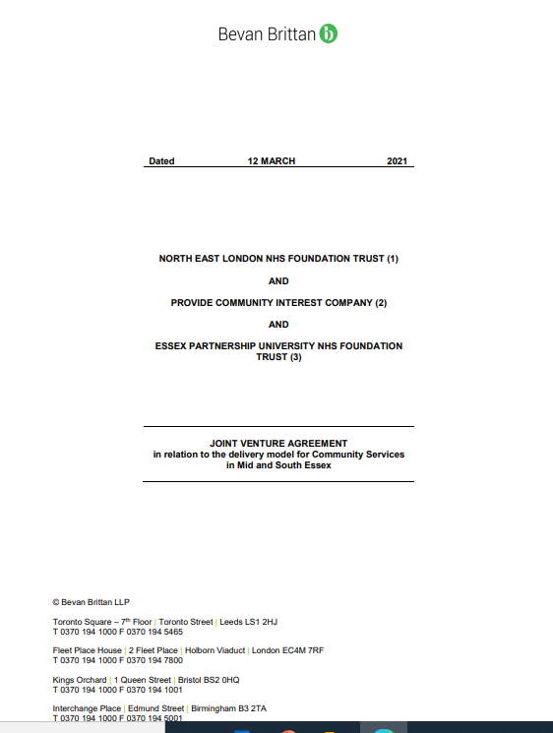



Governance Journey
Strategic options review on Collaborative model
( May 2020)
Shadow Board formed (Sept, 2020)
Contractual JV signed (Mar 2021)
Target operating model agreed (May 2021)
Board takes on delegated authority (Oct 2022)
Strategic board priorities agreed for 2022/23 (Oct 2022)

Slide 10

What has helped?
Collaborating for the right reasons
Investing in relationships
Taking the time to build trust
Investment in joint resources
Clear focus on operational delivery
Always nudging forward

Slide 11
Delivery
  Recent highlights include:
  Establishment of four place based joint director roles covering community and mental health services to drive locality integration
  Transitioning the Lighthouse children's service into the collaborative to enable improved outcomes via redesign across children's community services
  Winter/Covid pressures: rapid development of Virtual Hospital , with four community Emergency Departments (UCRT remodelled), three Frailty and three Respiratory wards established

Slide 12
Ongoing Challenges
1. Ensuring focus on improving service delivery
2. Strategic alignment with emerging ICB
3. Balancing the multiple Collaborative demands vs organisational drivers and capacity

