Slide 1
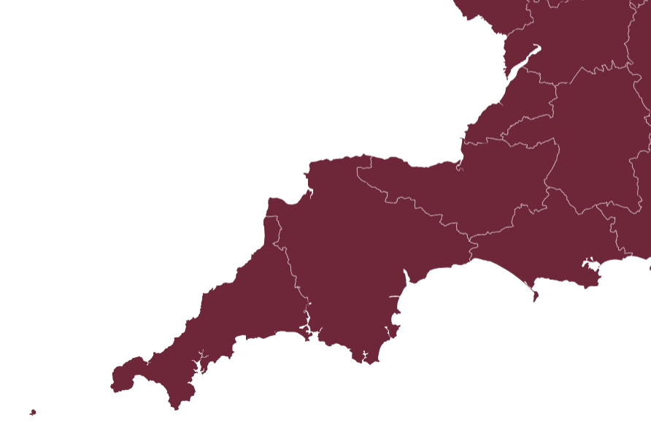
Provider Collaboration - Lessons learned and challenges ahead for provider collaboratives at scale
Melanie Walker MBE
Chief Executive
Devon Partnership NHS Trust

Slide 2
Key facts and figures
Wave one New Care Model – October 2016
Fast Track Mental Health Provider Collaborative – October 2020
5 million population
22 000 km²
South West covers 7 ICSs in total
c£130 million

Slide 3
Purpose and key priorities
Our shared ambition is to transform outcomes for people with mental health conditions by working collaboratively, at-scale.
Commissioned pathways of care
Regional collaboration
Current commissioned services:
Adult Secure
CAMHS (tier 4)
AED (tier 4)
Working in conjunction with (within and across) ICS
Future commissioned services:
Perinatal (tier 4)
Remaining specialised services
Areas for possible consideration:
Services where operating at scale could make sense clinically and financially
We also lead collaborative working as follows:
Alongside NHSE/I, develop our plans and priorities for MHLDA
System working with lead ICSs re £40.5m capital investment to deliver inpatient services for CCG commissioned LDA patients
Optimisation programmes – such as workforce planning in conjunction with HEE
Shared learning and shared clinical pathways

Slide 4
Benefits
Service User
Engaged and coproduced solutions
Care closer to home
Improved access to community orientated care, least restrictive principle
Decreased inpatient length of stay
Variations reduced and quality of experience increased
Outcomes focused care
Organisations (all provider partners)
  Clinically led and clinically informed solutions
  Shared learning and shared risk
  Mutual support
  Opportunities to lead collaboratively
  Service investment
Staff
  Part of the solution
  Shared learning
  Investment in staff
    Increased training opportunities
    upskilling key areas
  Job opportunities

Slide 5
Key lessons, challenges and opportunities
Lessons and challenges
Relationships – trust and confidence
Collaborative-wide leadership and ownership at all levels
Detailed due diligence of patient activity and financial values
Opportunities
Engage patients/carers in innovative whole pathway redesign
Freedom to flexibly meet patient need
Develop and deliver services at-scale and at-pace
Integration at a regional level across and within systems eg £40.5m LDA capital bid

Slide 6
Reflections
Next steps
Learning from regional provider collaborative into ICS provider collaborative
Opportunities to build on formal provider collaborative into wider areas such as workforce, benchmarking and regional discussions
Need to connect pathways from Specialist Commissioning, DPT, local authority admissions
Real opportunity to drive change through the whole pathway
National financial position for mental health, learning disability and neurodiversity is a risk

