Slide 1
BSW Acute Hospital Alliance
Provider Collaborative
July 2022

Slide 2
Contents.
Acute Hospital Alliance: Journey so far…
AHA next phase of development
Provider Collaboratives in BSW
Delegation Considerations/ Experiences/ Opportunities
Discussion

Slide 3
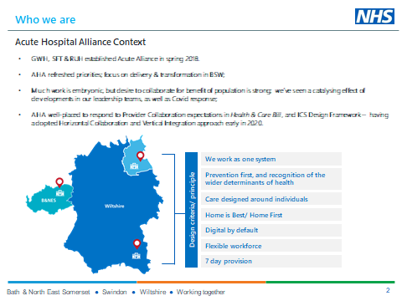
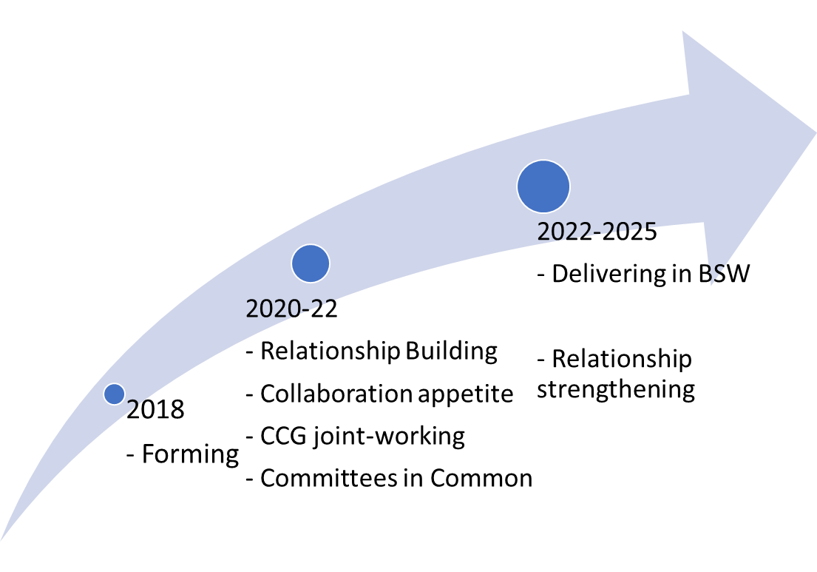
1. Acute Hospital Alliance: The Journey so far…
Salisbury, Great Western and RUH Bath FTs;
Active since 2018; Maturing; Relationships enhanced; Progress made in key schemes; Collaborative appetite increasing;
National ICS & Provider Collaboratives agenda;
Series of Workshops in 2021 – refreshed priorities; affirmed role of AHA in BSW;
Trusts approved new MOU and creation of Committees in Common in Q3 2021-2.

Slide 4
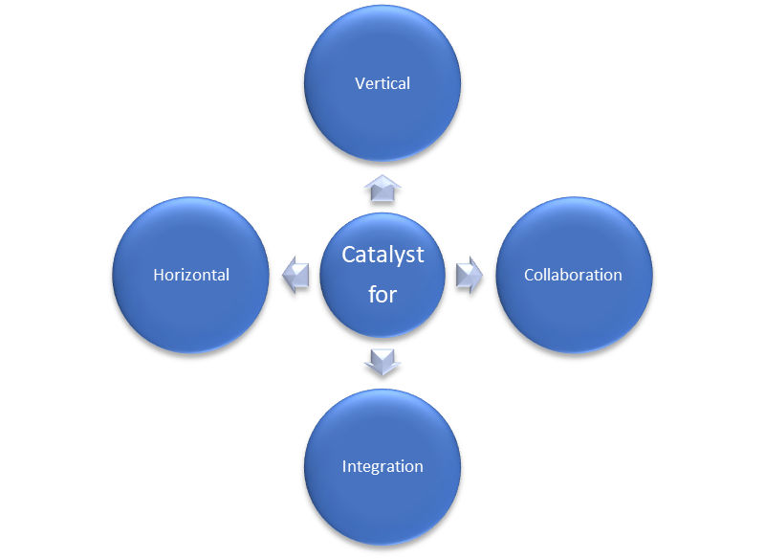


1 cntd. Where we are now and how we work together
How we work together
How we behave
We work together on things that support:
Equity – for our local population
Sustainability – for our services
Improvement – to learn from each other to do better
Transparency between organisations; working together & learning from each other has become our start point.
Relationships between executive leads – and with CCG, foundation for collaboration have improved significantly. CEOs developing together – regular facilitated sessions.
Leadership – Exec Director sponsorship of key programmes to drive pace and visibility supported by clinical leadership where required. Three Trusts investing in Clinical leaders – 3 x Associate Medical Directors to lead system transformation work.
Exec Teams – Sharing of Exec roles – Estates (SFT& RUH), and Chief Digital Officer (GWH,SFT and RUH option after year 1); Also recruitment to exec teams now features representation from us all to ensure we recruit to ensure system fit and alignment with our goals.
Clarity - We are open with each other an acknowledge the ‘red lines’ for our organisations or places
Pace - Genuine progress made across a number of areas.
Layers of responsibility – we recognise our multiple roles in Organisation, Place & System.

Slide 5





Delivery of a Secondary Care Clinical Strategy for BSW
2. Our next phase
of development
Vision & Goals
Consistent Methodology For Staff Modelling
Regardless of where treated, the BSW population should expect to be cared for on same pathway.
Outcomes and quality standards to be the same - for the population to have consistency in experiences of services.
Financial flows, digital, workforce and capital strategies support delivery of clinical strategy and associated outcomes in a defined period.
Where we think Acute Provider Collaborative can have strategic impact in BSW.
CEO Sponsors and Executive teams leading programme development.
Underpinned by a common Improvement methodology.
Trusts will deliver benefits of working at scale – using collective resource more efficiently to improve population health.
Open Book Financial Baseline
Delivery of a Single Capital Strategy
Delivery of a Single EPR

Slide 6
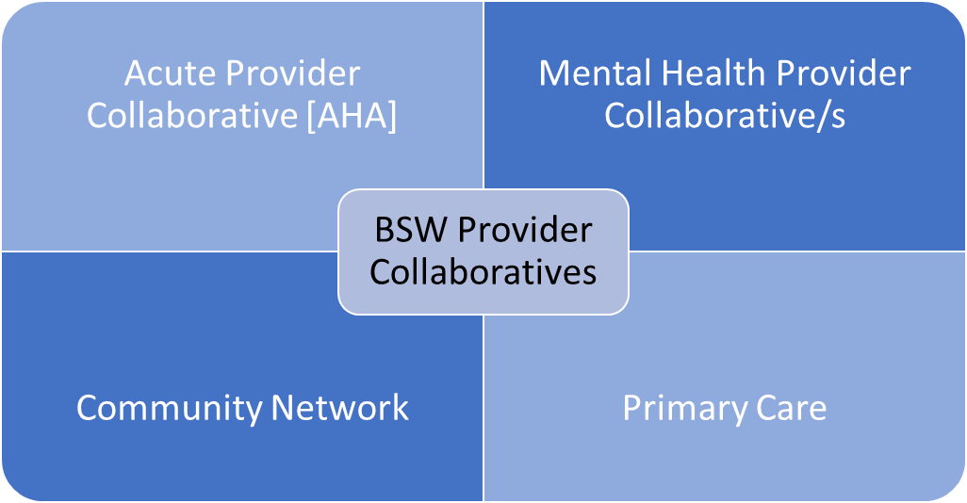

3. Provider collaboratives in BSW
Provider collaboratives
Bringing together organisational resources and expertise to better plan for and deliver services.
Responding to performance challenges (e.g. elective recovery, mutual aid, workforce resilience and service transformation)
Valued component within our BSW operating model
Acute Hospital Alliance is an established provider collaborative…also have emerging partnerships in mental health, primary and community care.
Potential for delegation on horizon.
Emerging sense of conditions for success…

Slide 7
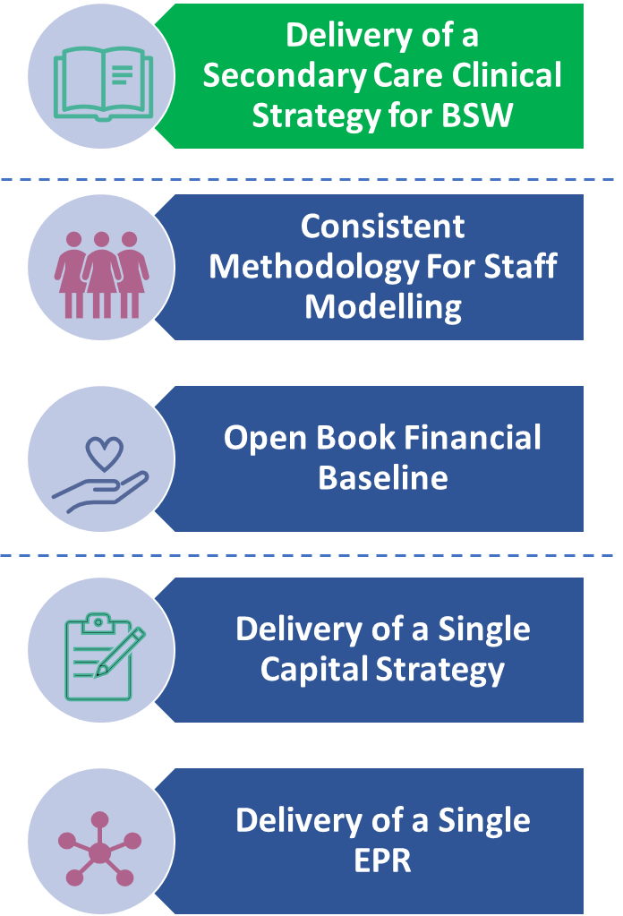
4. Delegation considerations, opportunities & risks.
Potential Opportunities
Relationships & Behaviours
Appetite
Expertise &. Capability - Commissioning
Vertical & horizontal opportunities
Collective & Individual view of £
Collective view of capacity
Warranted & Unwarranted variation
Enabling approach of ICS and Region
Enabling System Oversight
Locally driven timing
E.g. Elective pathways in context of BSW Care Model
Mgt of single waiting list across BSW.
Networked provider model
Paediatric oral surgery.
Risks
Covid; Elective recovery as a catalyst – but also creates short/ medium/long term model tension.
Managing scenarios of deteriorating performance and quality
Choice and consolidation tension
Membership of multiple collaboratives likely. Bandwidth. Coordination.

Slide 8
Discussion

