Slide 1


Welcome to the Provider Collaboration virtual event
Relationships with Primary Care
Thursday 22 September 2022
This virtual event will be recorded and published to our website.

Slide 2

NHS Provider Collaboration: Relationships with Primary Care
Case Study 1:
Greater Manchester Provider Federation Board
Silas Nicholls
22 September 2022

Slide 3
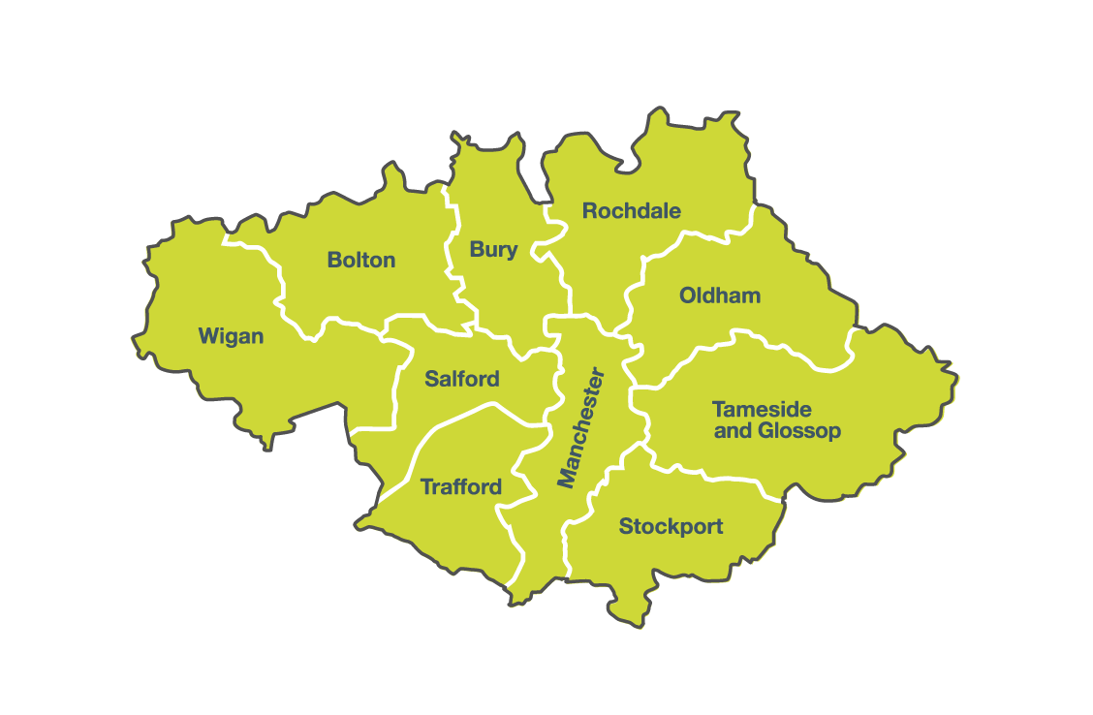
1.1 Context - Greater Manchester Health & Care system
Greater Manchester
2.8 million population
10 Local Authorities
City Region Mayor
Greater Manchester Health and Care
10 Place Based Leads (8 LA CEOs, 1 Trust CEO, 1 ICB Direct Employee)
One NHS Provider Collaborative: PFB
Consolidation of provider organisations over the last few years (PAHT, GMMH, Stockport/Tameside, Pennine Care community services)

Slide 4
1.2 Provider Federation Board (PFB)
PFB was established to:
  Build on previous strong collaboration (Acute Trusts Group) and enable providers to have a (single) voice in the Greater Manchester Health and Social Care Partnership;
  Enable collective decision-making across provider trusts;
  Provide a strategic approach to transformation;
  Address provider quality and efficiency;
  Enable providers to fulfil their co-production role with partners;
  Provide a clear mandate to provider representatives in GM wide structures.
A model of provider collaboration which gave a strong platform for our COVID-19 response and now our recovery.

Slide 5
1.3 PFB membership: all 11 GM & EC Trusts
Bolton NHS Foundation Trust
The Christie NHS Foundation Trust
East Cheshire NHS Trust
GM Mental Health NHS Foundation Trust
Manchester University NHS Foundation Trust
Northern Care Alliance NHS Foundation Trust
North West Ambulance Service NHS Trust
Pennine Care NHS Foundation Trust
Stockport NHS Foundation Trust
Tameside & Glossop Integrated Care NHS Foundation Trust
Wrightington, Wigan and Leigh NHS Foundation Trust

Slide 6
1.4 PFB CEOs Meeting
PFB CEOs meet twice a month (second and fourth Friday mornings).
Each CEO has a leadership portfolio on behalf of PFB.
Focused on delivery and action, rather than over-engineering the governance.
Regular briefings to GM Provider Chairs

Slide 7
1.5 PFB’s Supporting Structures
As well as the CEOs meeting PFB is supported by:
  PFB COOs PFB DOFs
  PFB EMDs PFB CIOs
  PFB DONs PFB DOSs
  PFB HRDs PFB CDOs
  Throughout the last 2 ½ years PFB have run the GM Gold Command Cell meeting at least three and up to seven days a week.
  Working with the ICB, post 1 July, to agree the resources to support these programmes and structures.
The Core Secretariat is funded via a membership model, with annual contributions from GM trusts

Slide 8
1.6 GM Recovery Strategy
PFB have led the development of the GM Health and Care Recovery Strategy
The scale of the challenge requires us all to work together, and we will be judged together
Recovery is long term, so our approach looks beyond immediate operational planning
A series of programme boards and sub-groups exist across GM already – we are working together to develop this recovery strategy, which will then inform a shared system workplan
Eight system level work programmes in the Strategy, six which PFB will be leading on for the system, plus Children & Young People and Community Services

Slide 9
1.7 Provider Led Innovation and Leadership
Through the PFB structures there are many examples of innovation and leadership:
  The response to the Omicron wave, with additional capacity sourced across the GM system via Trusts
  Digital innovation through the Digital Transformation Group and Health Innovation Manchester (HInM)
  Practical pathway-based working, taking days of the pathway through focused action.
  Regularly transferring patients across the system to match demand and capacity in critical, urgent and elective care.

Slide 10
2.1 Supporting the Development of the GMICS
History of significant provider consolidation in GM.
CCGs unconsolidated before July 2022.
New single cell (SORT) arrangements from 1 August, supported by PFB.
Notes:
Options
Transfer of patients across trusts e.g. to surgical hubs
Maximising use of independent sector
Sharing best practice to improve productivity

Slide 11
2.2 PFB’s Role in the GM ICS
PFB has agreed the following to support the development of the GM ICS:
  We are a key part of the ICS
  The GM ICS model confirms we run the delivery programmes for the system for:
    Elective Care - Mental Health
    UEC - Clinical Support Services
    Cancer - Vulnerable Services
  We have an agreed codified methodology for delivery.
  We are clear on the areas where we do not lead but we have a contribution to make (for example, the determinants of population health).

Slide 12
2.3 Relationships with Primary Care
Joint chairing arrangements with Primary Care colleagues around a number of key workstreams such as elective recovery.
New single joint delivery cell between Provider FTs, Primary Care and Local Authorities. Early days though!
Joint Medical Director model for the ICB:
  Primary Care
  Mental Health
  Acute Sector

Slide 13
Any Questions
?

Slide 14
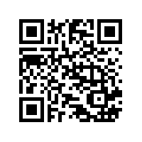
Thank you for attending the webinar today
Please complete our quick event evaluation by scanning this
QR code with your phone:
Book now
These upcoming events are now open for bookings on our website:
Peer learning forum | Wednesday 28 September, 1.30pm-3.00pm
Peer learning forum | Wednesday 9 November, 1.30pm-3.00pm

