Slide 1

Welcome
November 2022

Slide 2

Housekeeping
Please note this session is recorded and the recording will be available on our website post event. We encourage cameras to be kept on wherever possible but appreciate some of you may need to turn them off for GDPR reasons.
If you lose connection to the session, please re-join using the link in your joining instructions email.
Please ensure your microphone is muted during speakers’ presentations to minimise any background noise.
Following the presentations there will be opportunities to pose your questions to our speakers. However, do feel free to add comments and questions to the chat throughout the session.
Once the Q&A session opens, you can submit a question by typing through the chat box or by using the raise hand function in Zoom. During the Q&A sections, we ask that you that you keep your camera switched on if possible.
You will receive a link to an evaluation form at the end of the day, and in the chat box. Please take the 5 minutes to complete this as your feedback helps shape our future events.

Slide 3
Can we talk about race?
Chair: Sim Scavazza, Non-Executive Director, Imperial College Healthcare NHS Trust & Buckinghamshire, Oxfordshire and Berkshire West ICB
Speakers:
Patricia Miller, Chief Executive, Dorset ICB
Eniola Oladipo, Head of Support and Transformation, NHS England
Adam Doyle, Chief Executive, Sussex ICS
Steve Erskine, Chair, Hampshire Hospitals NHS Foundation

Slide 4
Patricia Miller, Chief Executive, Dorset ICB

Slide 5
Eniola Oladipo, Head of Support and Transformation, NHS England

Slide 6
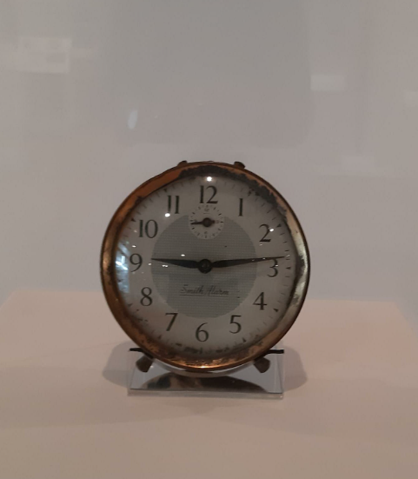
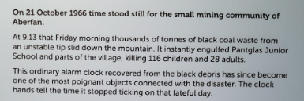

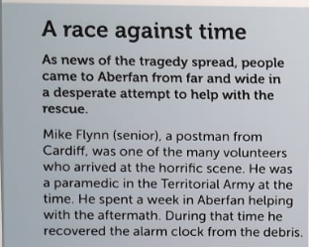
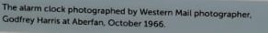
A race against time
Notes:
Let’s help move the clock again – with hope.
White – lean in and help, rescue. Let’s end this pandemic.
Black – receive help with grace. Let’s end this pandemic.

Slide 7
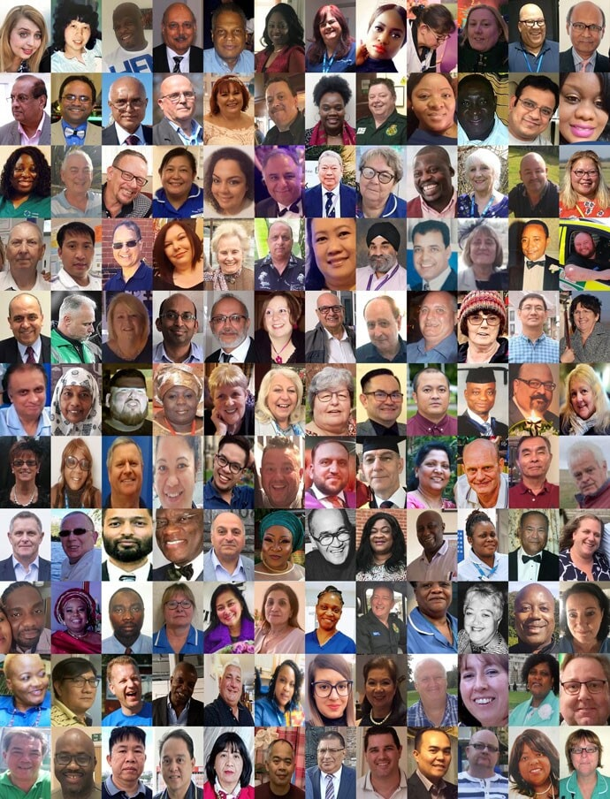
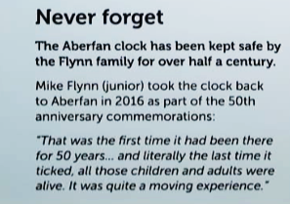
As an anti-racist…
Notes:
25th May 2020 – George Floyd died.
Anti-racism is the practice of actively opposing racism by advocating for changes that promote racial equity in society.
https://www.dpag.ox.ac.uk/work-with-us/equality-diversity-inclusion/anti-racism-working-group/anti-racism-resources-october-2021-what-is-anti-racism

Slide 8
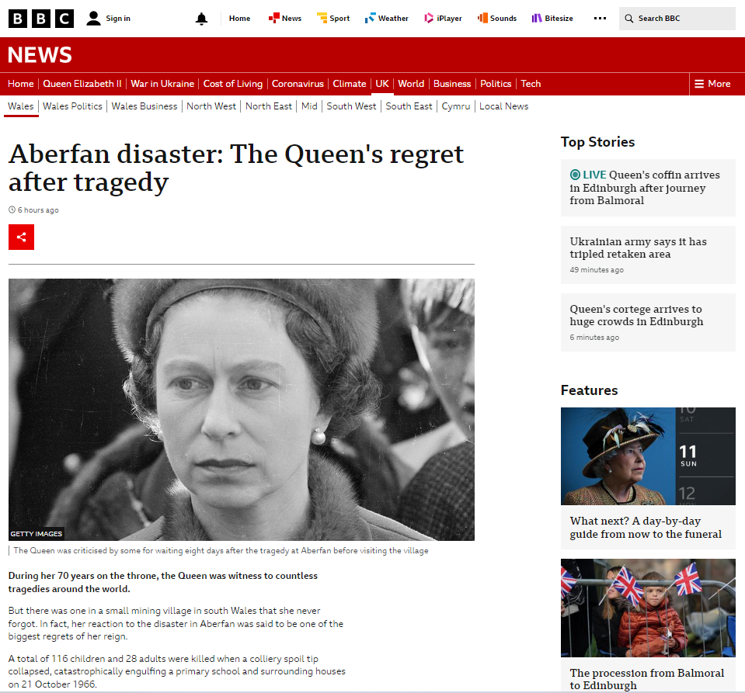
“In the end, we only regret the chances we didn’t take”
Lewis Carroll

Slide 9
What chances will you take to become a better anti-racist?
“Injustice anywhere is a threat to justice everywhere”
MLK

Slide 10
Adam Doyle, Chief Executive, Sussex ICS

Slide 11
Can we talk about race?
NHS Providers Seminar
Adam Doyle
Chief Executive Officer

Slide 12
About NHS Sussex and our Sussex system
We cover a population of 1.7 million;
We have a growing population, with the main reason being more people coming to live in Sussex. We also have an ageing population;
People living in more deprived areas have worse health and outcomes and there are big differences in life expectancy across Sussex which matches deprivation. Most deprivation in Sussex is along the coast and in south west Crawley;
Across Sussex, we are responsible for a budget of £3.5 billion;
Our ICS covers all NHS Trusts, 2 County Councils, 1 City Council, Voluntary Community and Social Enterprise, 3 Universities and 1 Medical School, and 3 Healthwatch organisations.

Slide 13
Acceptance and understanding
Race can be an uncomfortable subject;
Absolutely vital to understand how colleagues are feeling and what the issues are within an organisation;
Need to take time to listen to colleagues, share stories and hear from people across the organisation and teams;
Importance of data (Workforce Race Equality Standard);
In Sussex, we have been overt about the fact we want to make improvements and we have work to do. Listening to colleagues can be uncomfortable but is vital to enhance our understanding.

Slide 14
Accountability and action
We have worked with colleagues, listening to the action we could take to improve their experience, and providing safe spaces for people to share;
Across the system, we have established a system Race Equality Transformation Board, which focuses on our progress with regards to our people and our population;
Development of our system Workforce Race Equality Strategy setting our ambition, so we can move from being reactive to preventative;
Launched a system wide Sussex Anti Racism statement during Black History Month;
Organisationally, we launched the NHS Sussex ASPIRE programme earlier this year;
Establishment of an Equality, Diversity and Inclusion Taskforce to review how we are working within our organisation, benchmarking ourselves against Global Indicators, helping us to acknowledge what we need to differently.

Slide 15
The role of leaders
Responsible for setting the tone and direction for our organisations;
Personal pledge from our Integrated Care Board and Executive Team;
Objectives set for each member of the Executive Team;
To support organisations to talk about race and understand how it is working and where improvements can be made;
To help our staff to develop a better understanding of their own behaviour in the workplace;
To ensure focus remains despite other challenges within a system, such as operational delivery

Slide 16
Our Sussex Anti-Racism Statement
There is no place for racism in Sussex. We recognise the impact that racist behaviours have on our workforce is devastating. We want people to feel safe and to thrive. It is our responsibility to create safe, inclusive and supportive working environments and stamp out racism when we see it. We stand firmly together with our partners in being committed to tackling institutional and interpersonal racism in all its forms. We commit to listening, monitoring and continually evaluating our practice because we recognise that good anti racist practice for our workforce leads to better care for our patients and our population.

Slide 17
My own approach
Looking racism in the eye
Understand the consequences for people of colour who openly oppose racism
Taking a critical look at leader-allyship
Leadership that is bold, visible, present, vocal and doesn’t sit on the fence
Leadership that addresses indifference to racial justice
Leadership that challenges racism when people of colour are not present
Leadership that will not stand for racial segregation
Leadership that supports people of colour who speak truth to power and challenge the status quo
Be clear about your governance structures and accountability

Slide 18
Steve Erskine, Chair, Hampshire Hospitals NHS Foundation

Slide 19


Race equality at Hampshire Hospitals
STEVE ERSKINE,
CHAIRMAN
Notes:
Or equity?

Slide 20
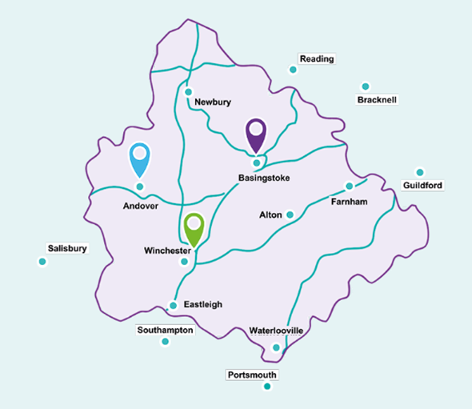
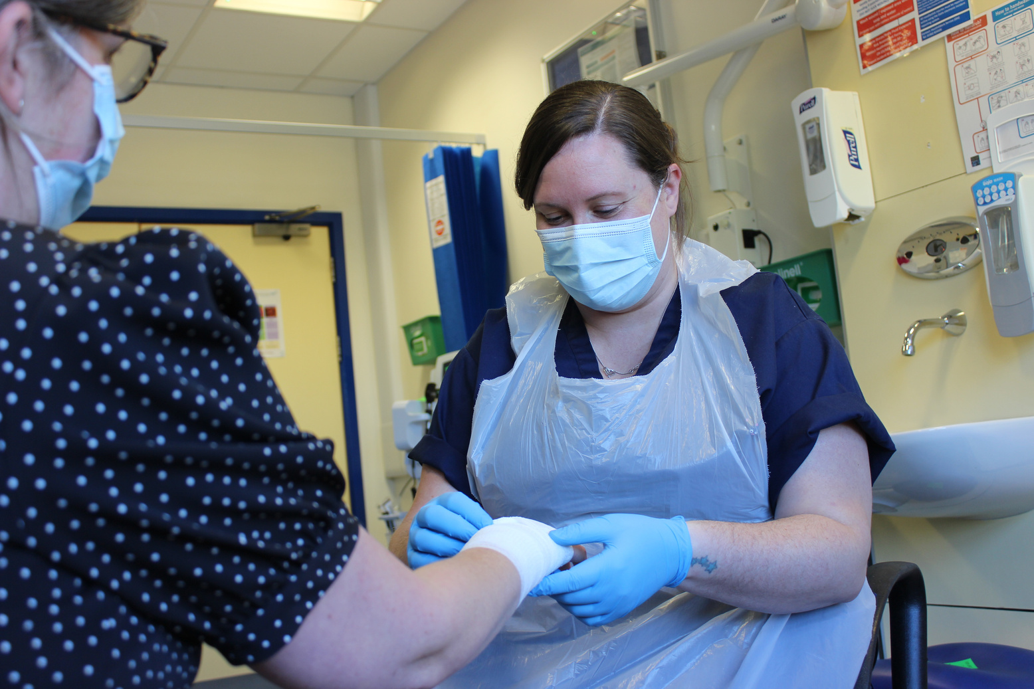
About hampshire Hospitals
We serve a rapidly growing population of more than 600,000 people across Hampshire.
HHFT provides care across hospitals in Andover, Basingstoke and Winchester, and in the wider community.
Within this area, ethnic minority population is concentrated in the North East of Hampshire, around Basingstoke and bordering Berkshire and Surrey.

Slide 21



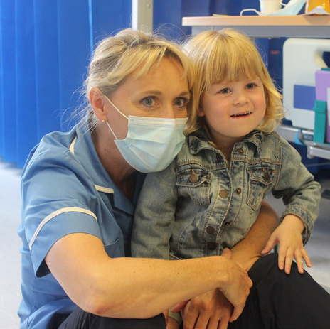
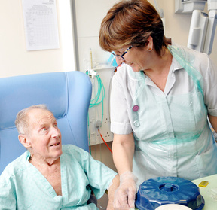




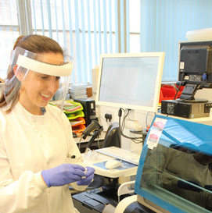

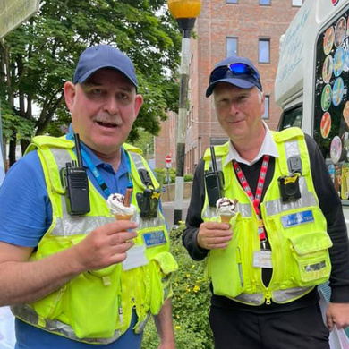


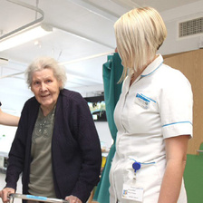
2,194
1,253
Who we are
Nursing, Midwifery and Health Visiting
Healthcare Assistants and other support staff
Team HHFT is made up of around 8,600 staff members.
Our staff proudly represent 95 nationalities.
24.5% of HHFT staff identify themselves as Asian, Black, or being from multiple or other ethnic groups.
60.6% staff report as being white, whilst 14.9% staff did not specify.
913
Medical and Dental
1,907
Administration and Estates
184
Healthcare Scientist
378
250+
Scientific, Therapeutic and Technical
Volunteers supporting us during Covid-19

Slide 22

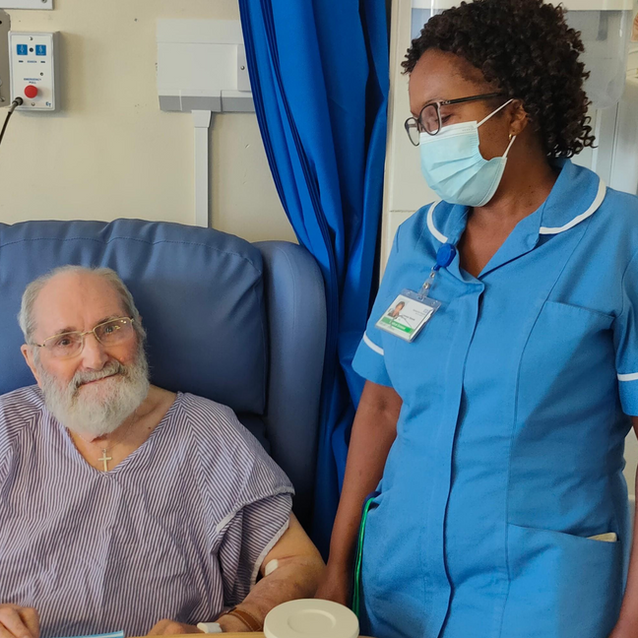
WRES DATA trends
Improvements
23% more substantive BAME staff in post (1972 BME Staff), an increase from 1600 in 2020.
25.7% of staff disclosed that they are BAME an increase from 14.6% in 2017 and remains above local census population of 5.23%.
The Trust’s BAME Board representation has increased from 7.70% (2020) to 18.75% (22.2% NEDs).
BAME representation across clinical and non-clinical senior roles (Band 7 and above) including medical and dental UP by 11.6%
Relative likelihood of BAME candidates being appointed after shortlisting UP by 7% since 2021
More BAME staff are accessing non-mandatory training and CPD (71.45%) which is more than their White colleagues at 63.91%
Areas to focus on
12.4% of staff disclose their ethnicity as unknown
Relative likelihood of BAME staff entering the disciplinary process has increased (0.44 in 2020 to 3.60 2021)
Our Board currently isn’t representative of our workforce (24.5% of total workforce is BAME).
There remains under representation of staff in BAME backgrounds at senior bands for both clinical and non-clinical roles, although there has been growth.
BAME staff are less likely to be shortlisted and appointed to roles than white comparators.
Notes:
Pulse data shows higher % of BAME staff feel engaged than white colleagues

Slide 23
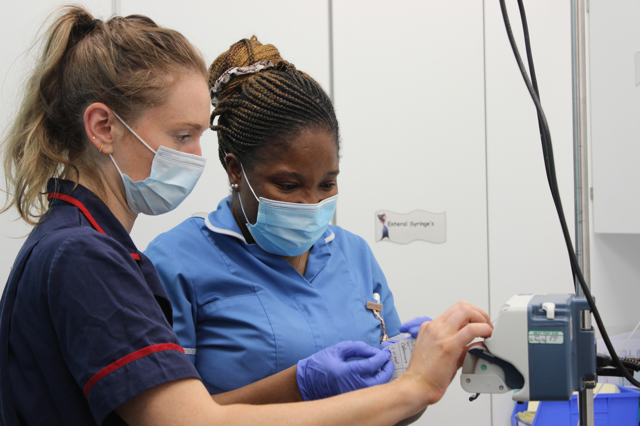


Our journey - improving race equality
  Sustainable improvements across the trust - not just one big programme
  We've made good progress, but it doesn't stop there. We have to do more
  Embedded culture change takes time
  Looking for an "always on" culture
50%
of nursing staff represent minority ethinc groups

Slide 24





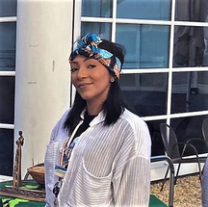

What has HHFT done?
MAP TO MANAGEMENT(SAFE SPACES)
CULTURE CHANGE
PROGRAMME
INCLUSIVITY ADDED TO TRUST CARE VALUES
EDI SCHWARTZ ROUNDS
EQUALITY, DIVERSITY AND INCLUSION STRATEGY AND ACTION PLAN
REVERSE MENTORING, COMPASSIONATE COFFEE, BACK TO THE FLOOR, ADOPT A SENIOR LEADER
BIG CONVERSATIONS
NO MORE TICK BOXES (BETTER RECRUITMENT WITH BAME REPRESENTATION)
INCLUSIVITY NETWORK, EDI CHAMPIONS & BUDDYING
REGULAR REPORTS AND BETTER USE OF DATA
Notes:
Authentic leadership
Paula Searle, Chair of Disability Champions Group
Rachael Beedham, Chair of LGBT+ Champions Group
Vanessa Mason & Natacha Jones, Joint Chairs of BAME Champions Group

Slide 25
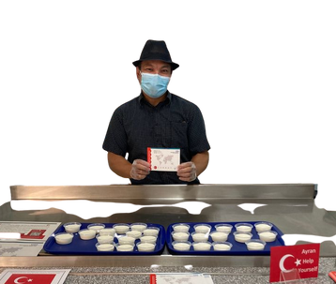
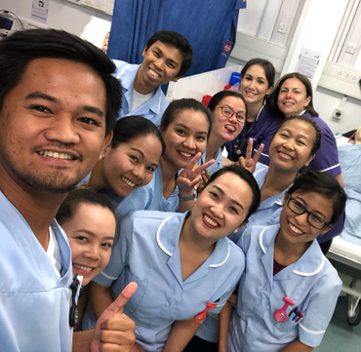
What has HHFT done?
INCLUSION CALENDAR, INCORPORATING DAYS OF CELEBRATION
BAME FREEDOM TO SPEAK UP GUARDIANS
ENGAGEMENT AND PARTNERSHIP WITH THE HAMPSHIRE AND ISLE OF WIGHT ICS ‘TURNING THE TIDE’ BOARD
ALLYSHIP TRAINING
EQUALITY, DIVERSITY AND INCLUSION STRATEGY AND ACTION PLAN
"TASTE OF"
SERIES
CELEBRATION OF AWARENESS DAYS/ MONTHS INC. BLACK HISTORY MONTH AND DISABILITIES HISTORY MONTH - INCLUDING SPEAKERS AND EVENTS
WELCOME EVENTS FOR INTERNATIONALLY EDUCATED NURSES
SAFE SPACE
DISCUSSIONS

Slide 26




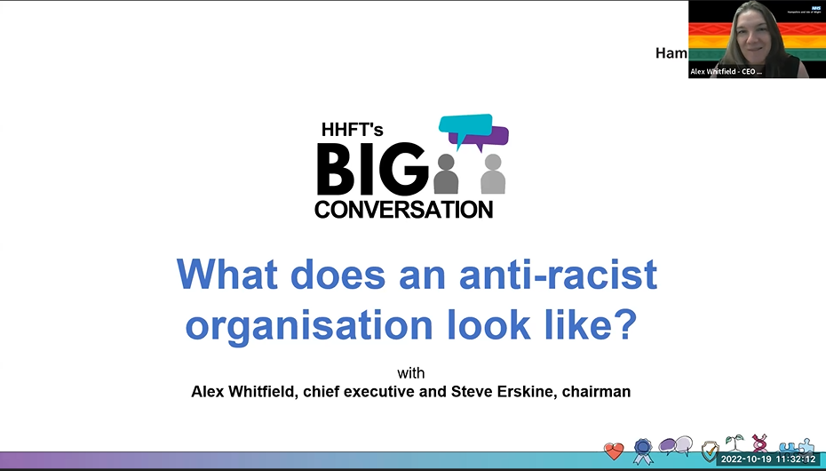
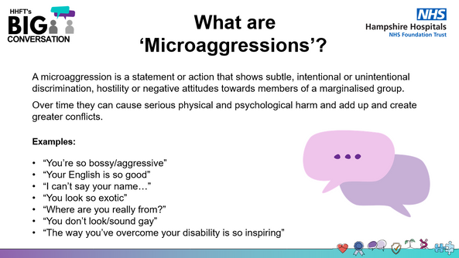
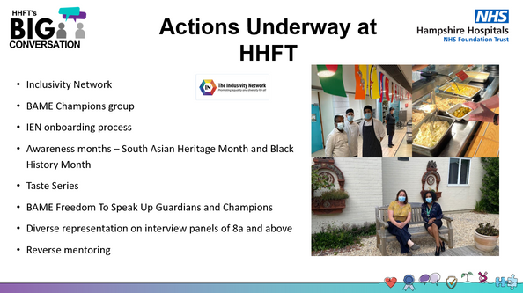

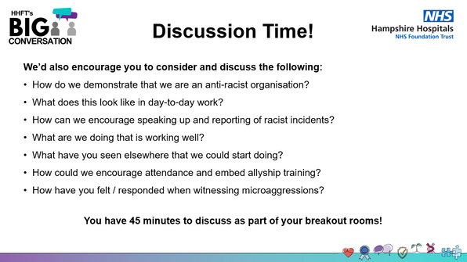
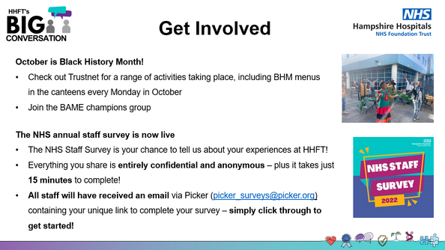
What has HHFT done?
Notes:
Next steps:
Race Code 2.0
Specific anti-racism statement

Slide 27

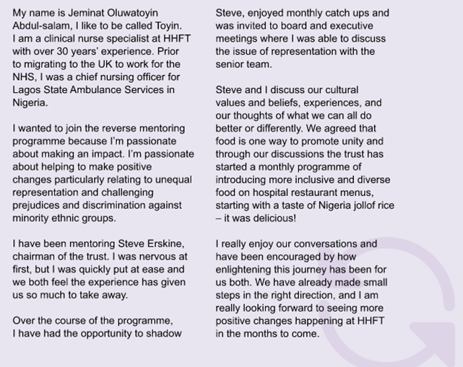


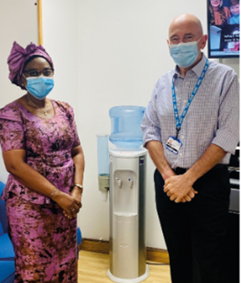
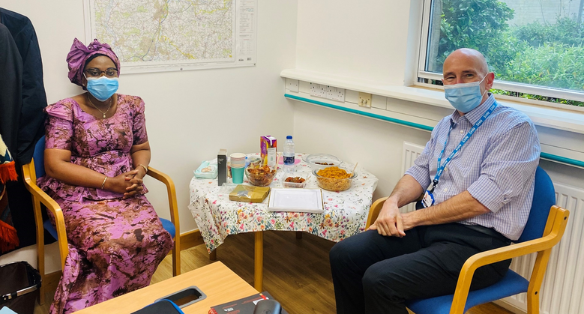
My Mentor
Jeminat Oluwatoyin Abdul-Salam
Haemophilia Clinical Nurse Specialist
Notes:
Toyin’s experience
Name
Culture
Homework

Slide 28

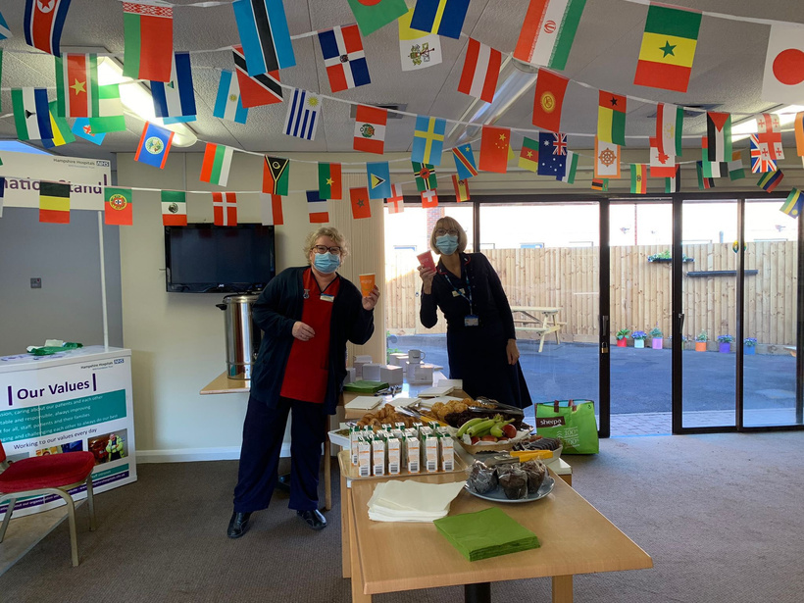
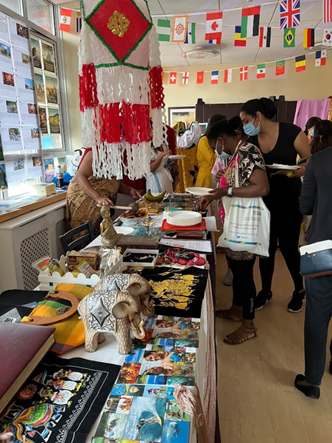
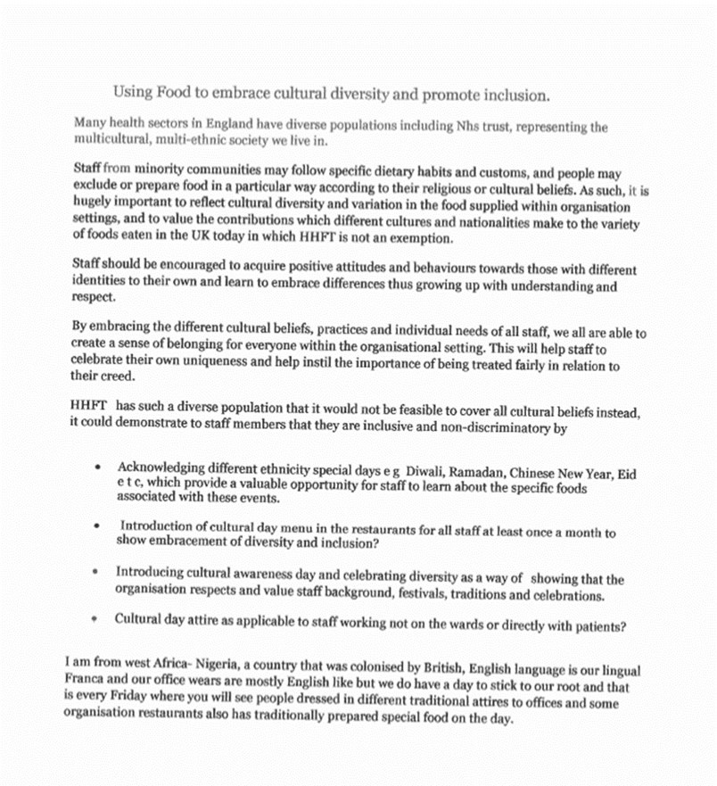

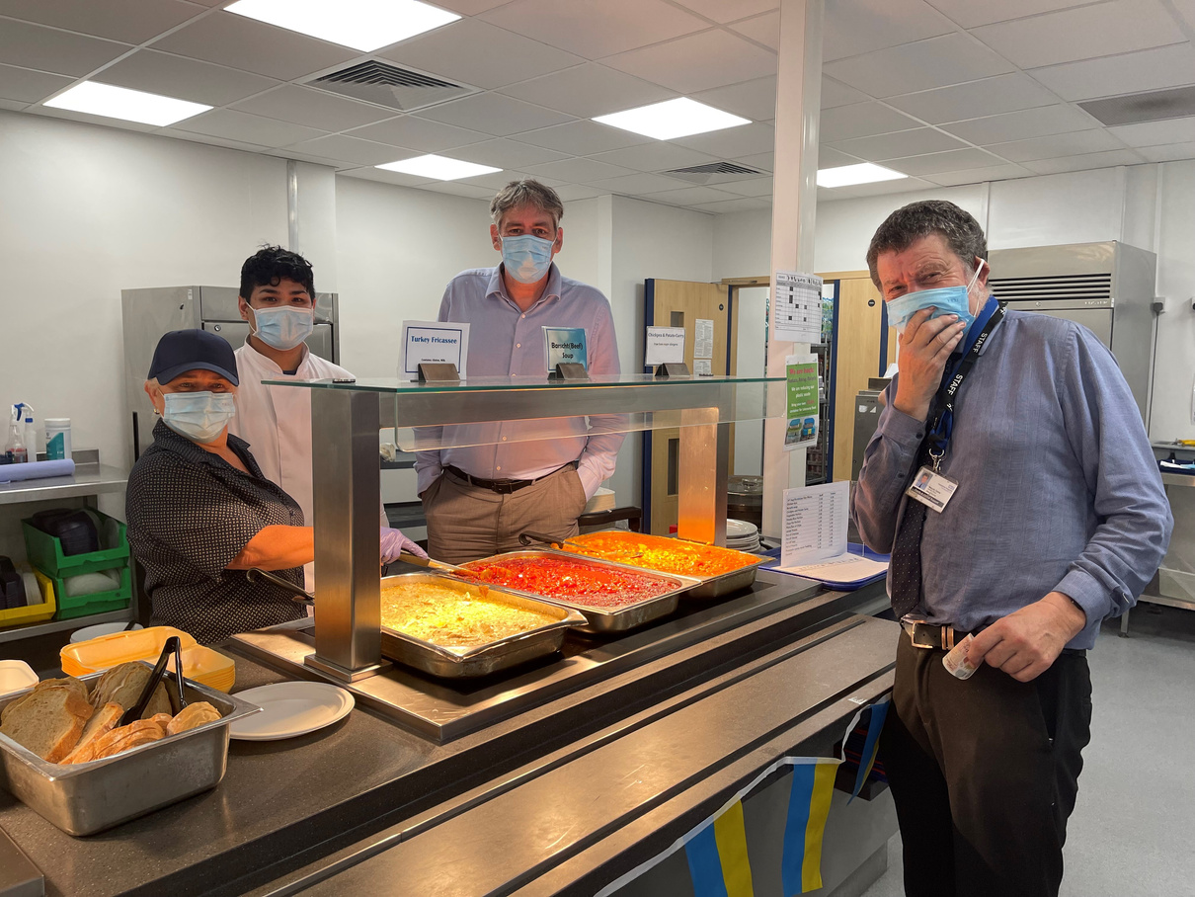

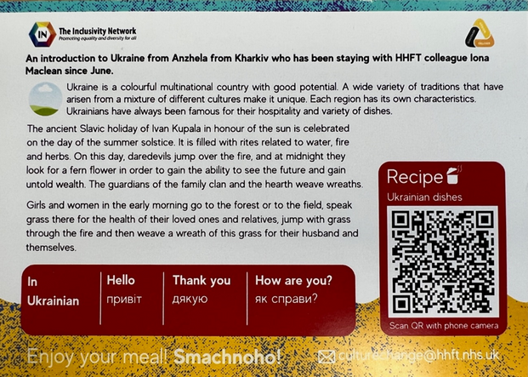
tHE START OF
SOMETHING BRILLIANT

Slide 29
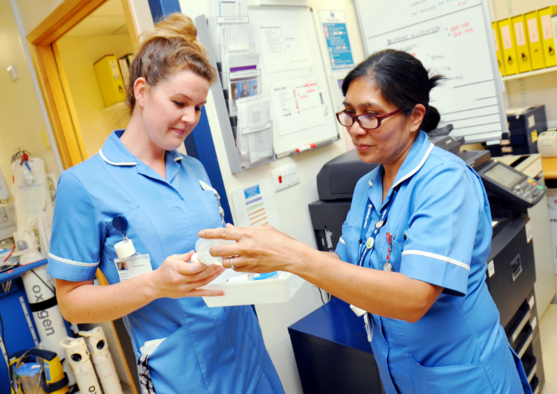
Our EDI strategy guiding principles
Meaningful and sustainable change… must take the time to get this right.
We will ask for help... partnership with our staff, patients, carers, local communities etc.
Ambition combined with action ... long term view to drive meaningful and sustainable change and commitment to immediate action
Everyone has a role to play... individual and collective responsibility driven by the leadership team.
A culture of sustained learning... provide the tools and training to strengthen our cultural competence … acknowledging that we are on a journey and the learning never stops.

Slide 30


Our EDI strategy outcomes
To meet and be in line with our Model Employer WRES targets
To improve our WRES results for indicator 8 – number of BAME staff who experience bullying
Our Patient Experience Survey results for dignity and respect and overall experience of care to achieve a rating of 9 or above
To improve and sustain a positive change in our staff engagement score for disabled staff
Workforce is representative of our communities at every level
To have BAME, disabled and LGBT+ staff representation on the Board

Slide 31
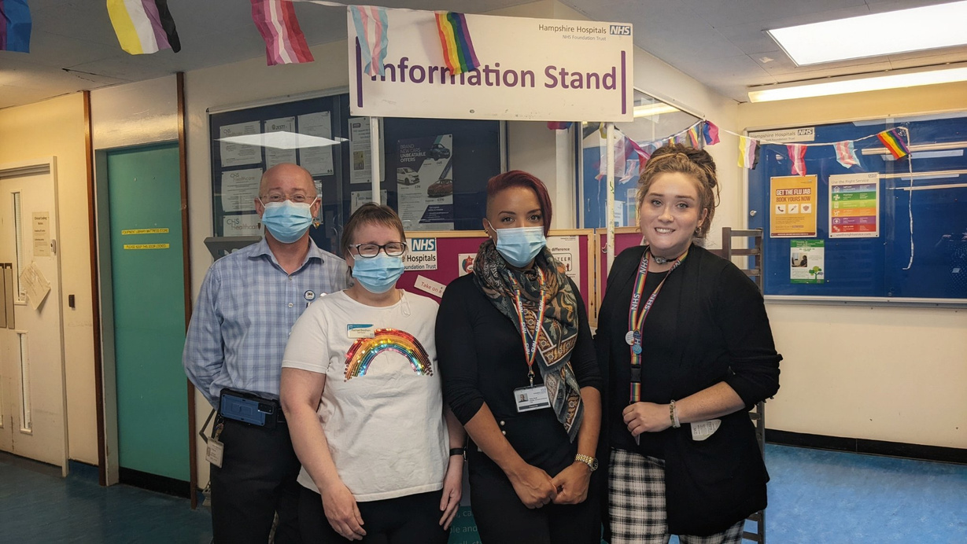



What does allyship mean to me?
  Listening to hear
  Acknowledging my own privilege (inc. role as chair)
  Taking action, not being a commentator
  Be an enabler/leader where appropriate
  Learning from mistakes
  Educating myself
  Treating people equally does not mean treating them the same
Not pretending to be superman!

Slide 32
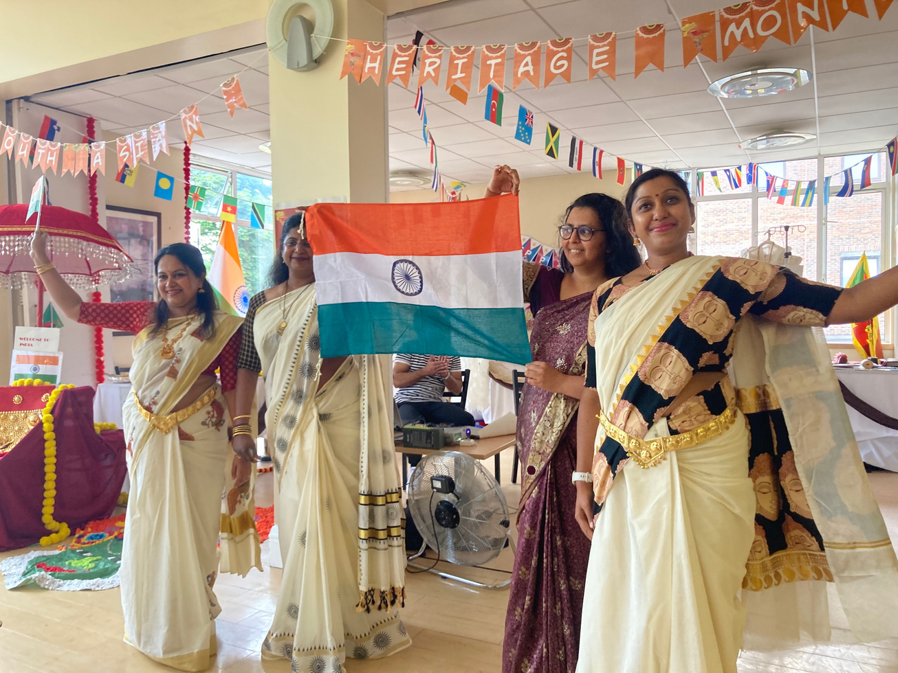
Tangible change at board level?
  Better representation – 22% BAME NEDs
  Positive action - recruiting to new NED role
  NED championing inclusivity
  Staff presentations to board - real stories from HHFT
  Role modelling
  Improved and more inclusive decision making

Slide 33
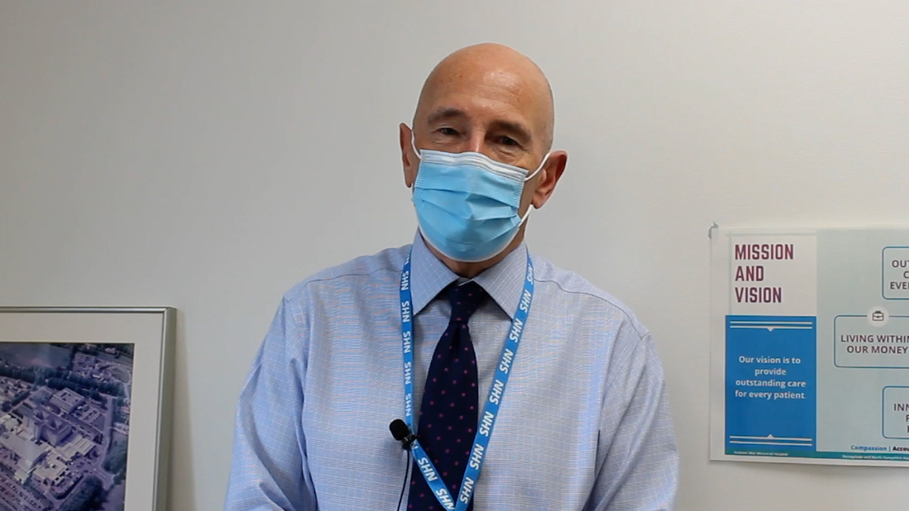
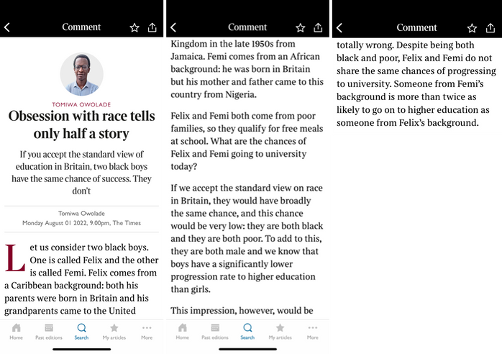
What have I done personally?
  Put people first
  Treat people differently to ensure inclusivity and equality
  Paying attention to nuance in race
  Challenging my own understanding and increased learning
  Continued mentoring relationships
  Joined NHS Providers Race Equality Board Advisory Group
Notes:
Black boys getting free school meals
Nigerian born parents: Twice as likely to go to Uni as British born

Slide 34














INCLUSIVITY • INCLUSIVITY • INCLUSIVITY •
thank you
ANY QUESTIONS?
CARE
BE PART OF THE CONVERSATION

Slide 35
Q&A
November 2022

Slide 36
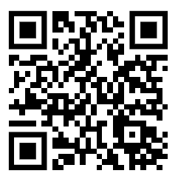
Evaluation
November 2022

Slide 37
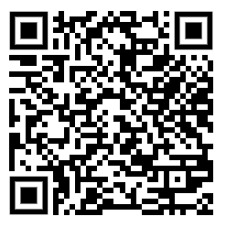
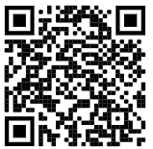
WRES driving improvement, 30 November ‘22
We'll examine what questions board members need to be asking, what knowledge they need regarding their own organisational action plans and help them to prioritise and hold each other to account on progress. Book now!
Visit our website for previous events and resources!
November 2022

Slide 38
Thank you!
November 2022

