Slide 1
West Yorkshire Association of Acute Trusts
NHS Confederation and NHS Providers: An introduction to Provider Collaboratives for NEDs
Dr Max Mclean – Chair Bradford Teaching Hospitals NHS Foundation Trust and current Chair WYAAT Committee in Common

Slide 2
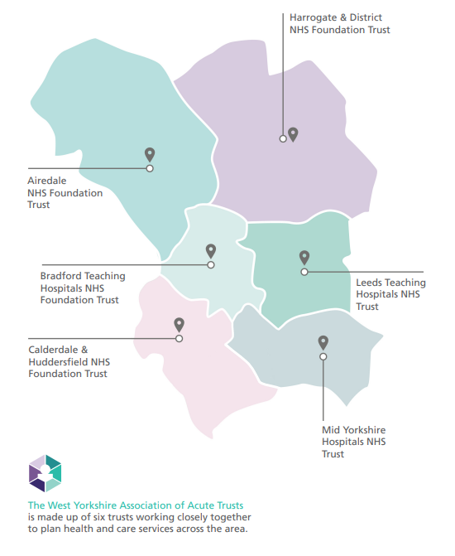
What is WYAAT and why does it exist?
Collaboration of the six acute trusts in West Yorkshire & Harrogate
Self-funded by the trusts
Forum for acute trusts; a single voice into the HCP
Providing a mechanism to share best practice and learn from each other to tackle unwarranted variation or inequalities in access, outcomes and experience
Delivery of acute trust focused change programmes
Leadership of wider programmes on behalf of the ICS
Facilitates clinical, operational collaboration & mutual aid
Prioritising and planning system investments in acute services
Only what the trusts do together and the decisions they take together
Not an organisation
Not “doing things to” the trusts

Slide 3
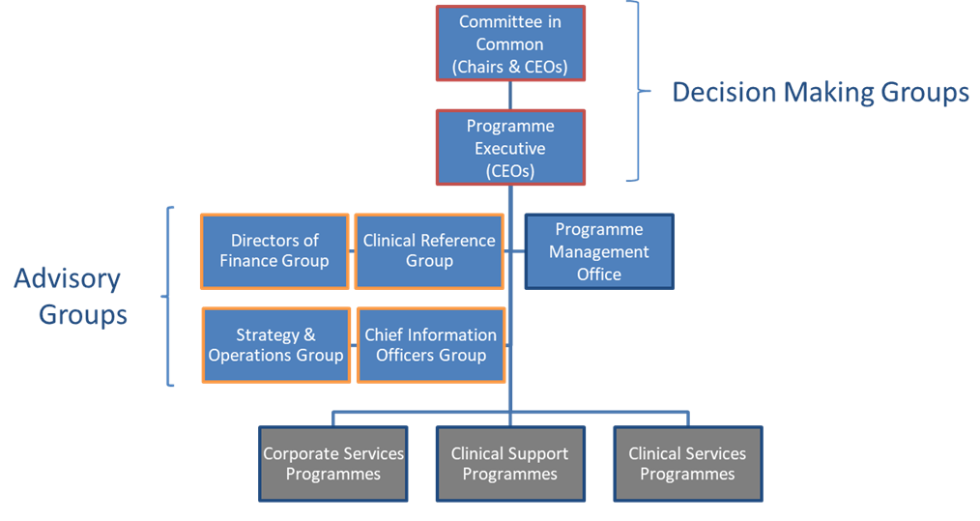
How NEDs are involved
WYAAT runs a Committee in Common structure
Committee in Common membership includes the Chairs and the CEOs of WYAAT’s member trusts
As a CIC, it confirms its support for business cases, investments and key decisions, with the formal approval retained by trust boards
Chairs and NEDs are therefore integral to collaborative decision-making
All WYAAT papers and updates from Programme Executive (CEOs) are shared with and discussed by Trust Boards on a monthly basis
Arrangements are formalised through the WYAAT MoU signed by Chairs and CEOs

Slide 4


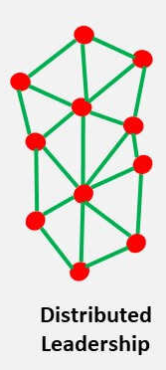

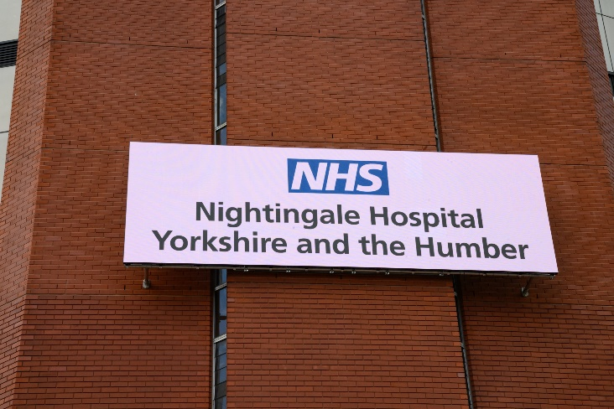

Benefits of collaboration
Formal:
Delivery
Informal:
Networks
Notes:
Vascular:
Single WY vascular service
Reconfiguration from 3 to 2 arterial centres
New clinical model reducing admissions and length of stay
Stroke:
Reconfiguration of Hyper Acute Stroke Services
Radiology:
Implemented a single PACS system and shared reporting solution with image and report sharing across all trusts.
Common scanning protocols.
Reducing repeat scanning and manual image sharing
Pathology:
Single laboratory information system (LIMS) and orders/results hub system (ICE).
To reduce clinical variation, increase visibility of results and reduce costs.
COVID-19:
Nightingale Hospital Y&H
WYH PPE system
Pathology testing
Operational escalation and mutual aid
Consistent approach to workforce issues
Informal networks
Trusted networks of peers
Ability to share challenges and good practice – shared understanding of issues and how to tackle these
Adopt distributed leadership across a range of system priorities
Single voice on acute issues – through Integrated Care System and with a representative on the Integrated Care Board and through to regional and national teams to influence policy

