Slide 1



Welcome to this Provider Collaboration webinar
Wednesday 30 November, 10.00am-11.15am
This virtual event is interactive.
Please ensure your camera is on and that you are ready to participate.

Slide 2
Provider Collaboration
Delegation from ICBs to provider collaboratives
30 November 2022

Slide 3

What is the opportunity?
NHS organisations can work together in new ways to meet the needs of their population and improve health outcomes
Approach to commissioning/provision can become more collaborative, innovative
Providers working together have a greater sense of whole population needs to inform delivery
Providers play a greater role in deciding what/how services are delivered; with clinical leadership and staff closest to patients more involved in designing services
ICBs can take a more strategic view of health needs and gain assurance that outcomes are being met
Potential for more efficient joint decision-making across providers

Slide 4
What is delegation?
Section 65Z5 of the Health and Care Act 2022
Relevant bodies - *NHS England, *ICBs, *NHS trusts, and *NHS FTs can “delegate” their functions to each other, and to local authorities (LAs) and combined authorities (Cas).
Sections 65Z5 and 65Z6
Relevant bodies can jointly exercise their functions with each other and/or with LAs and CAs; and to form joint committees and pool funds
Delegation = A relevant body (or bodies) takes responsibility for exercising the functions of another and will be held to account by the delegating body; ultimate accountability for the function remains with the delegating body

Slide 5
Different ways collaboratives can lead service design
Delegation allows, for example:
NHS England or ICBs to delegate their statutory commissioning functions (arranging services, with budget) to a provider or group of providers
Provider collaboratives can form joint committees to jointly exercise functions, take decisions on behalf of member organisations
Conferring discretions (Health and Care Act 2022)
NHS England and ICBs ‘may confer discretions’ on NHS providers
Confirms that NHS providers may lawfully take on wider population health activities relating to their contracted services
Does not technically achieve delegation – but allows ICB/provider contracts to give providers discretion to identify and decide the services necessary to meet the needs of the population, rather than just the logistics of service delivery
Example: Lead provider models; NHS-led provider collaboratives for specialised mental health, learning disabilities and autism services

Slide 6
Conditions and risks to consider
Clear case for benefits
Alignment with system / partner objectives
Provider collaborative resources, capacity and capability
Governance and leadership
Financial and clinical risks
ICB assurance
Managing potential COIs

Slide 7
National policy perspective
NHS England recommended that ICBs do not delegate functions to providers in 2022/23
Now considering updates to statutory guidance
What we’re working on:
Identifying systems and collaboratives interested in pursuing these models to understand challenges
Greater understanding of potential benefits and risks, and conditions for it to work well
Drawing together learning from other forms of delegation to share with wider sector to support these arrangements in future
Innovators scheme
Some technical issues to work through:
Assurance and accountability – how best to achieve through policy or delegation agreements
Alternatives to lead provider contracts
How NHS Standard Contracts may need to work alongside delegation agreements
How the Provider Selection Regime may impact delegation arrangements
Joint committees – how best to implement? is this decision-making model for collaboratives necessary to make it work?

Slide 8
NHS Providers & NHS Confed
Provider Collaboration Webinar
30th November 2022
North West London CAMHS Provider Collaborative
Dr Johan Redelinghuys
George Katsande
Richard Lyle

Slide 9
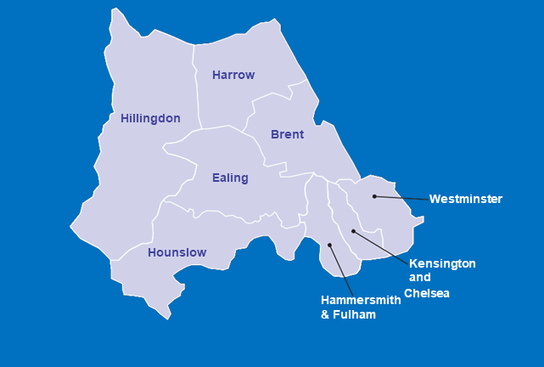

About the NWL ICS
We are:
65,000 NHS employees
ACUTE TRUSTS
Chelsea and Westminster
NHS Foundation Trust
Hounslow and Richmond Community Healthcare NHS Trust
1,500 Adult social care staff
Imperial College Health Care NHS Trust
London North West University Healthcare NHS Trust
The Hillingdon Hospitals NHS Foundation Trust
OTHER NHS ORGANISATIONS London Ambulance Service NHS Trust
1,500 Voluntary organisations
1,300 (FTE) GPs
350 GP practices
National Institute of Clinical Research Network North West London
276 Care homes
45 Primary Care Networks
COMMUNITY AND MENTAL
HEALTH TRUSTS
NHS England/London
8 London Councils
NHS Health Education North West London
West London NHS Trust
8 Boroughs
Central and North West London NHS Foundation Trust
1 ICS (ICB)
NW London is a diverse area with 2.4m people from more than 200 ethnicities.
Largest ICS in London
Central London Community Health Care NHS Trust

Slide 10
About the NWL CAMHS PC
Initially set up as part of the NMoC pilot in 2016 NWL CAMHS Provider Collaborative on the 1st October 2020 – first wave.
Responsible for CAMHS T4 inpatient & Crises/Urgent Care pathway
Current budget of c£18m
Formal partnership(risk & gain share) between WL Trust (Lead) and CNWL FT- working in close partnership with the NWL ICS(ICB), the 8 NWL local authorities; 3rd sector organisations; NWL Acute Trusts and ISPs such as the Priory Group.
1 of 3 CAMHS PC in London and works closely with the other 2 PC = pan London solutions

Slide 11
Purpose & Key priorities
Improve quality of care & experience for young people and their families
To commission and develop local specialist CAMHS interventions including T4 for children and young people; to provide care close to home and to increase capacity and capabilities(reinvesting) in our local community crises and home treatment services.
Our 5 key priorities/high impact areas for development:
  Increasing the supply and use of local T4 beds + reducing OOA admissions
  Strengthening the capacity and capability of our local Crisis and Home Treatment services
  Focusing on pathways in and out of T4 beds - ensuring that there were a range dispositions available including alternatives to inpatient care.
  Providing specialist support to people with ASD and other complex needs
  Eating Disorder- capacity and capabilities

Slide 12
Benefits
Empowering clinical leadership in CAMHS commissioning, driving quality improvement, efficiency and efficacy.
Accountability - The PC having control over the budget and pathways into/out of inpatient services.
Key performance indicators have improved very significantly e.g. a 40% reduction in admissions against 2018 baseline and 35% reduction in overall bed days since 2020.
Agility - Emphasis on collaborative work with rapid prototyping, testing and implementation of innovation with all savings and efficiencies reinvested.
Local accountability with system, place and neighbourhood level integrated working and decision making

Slide 13
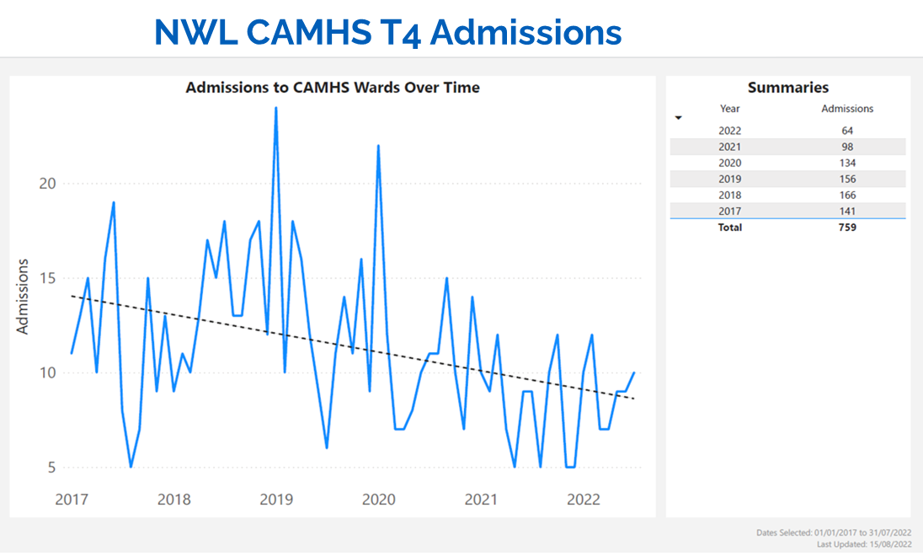
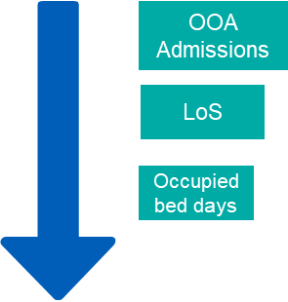
NWL Performance and activity
Impact

Slide 14
Key success criteria
  Clinical leadership and partnerships generating innovation, improvement and joint ownership = Tier 3 & 4 and wider system.
  Focus and clarity of ambition, and vision to be more than what went before – added value
  Agility and speed in execution and decision making
  Effective use of data and information
  Knowing what you don’t know and securing the right support - local/regional/national
  Focus on Provider Collaborative partnership accountability as well as commissioning leadership
  Being seen as a credible and effective partner - Developing trust … understanding constraints and strengths

Slide 15
West Yorkshire Association of Acute Trusts (WYAAT)
NHS Confed and NHS Providers Webinar: Delegation
30 November 2022

Slide 16
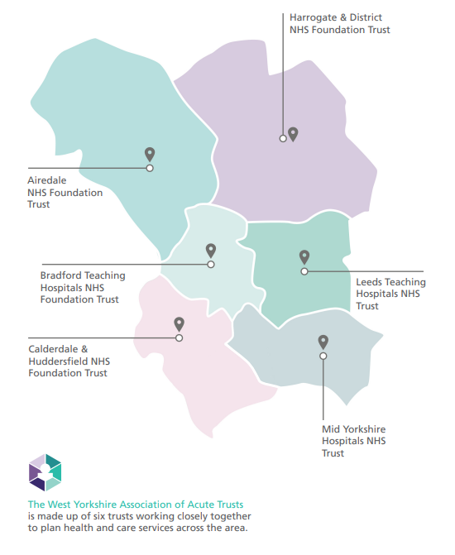
What is WYAAT and why does it exist?
Collaboration of the six acute trusts in West Yorkshire & Harrogate
Self-funded by the trusts
Forum for acute trusts; a single voice into the HCP
Providing a mechanism to share best practice and learn from each other to tackle unwarranted variation or inequalities in access, outcomes and experience
Delivery of acute trust focused change programmes
Leadership of wider programmes on behalf of the ICS
Facilitates clinical, operational collaboration & mutual aid
Prioritising and planning system investments in acute services
Only what the trusts do together and the decisions they take together
Not an organisation
Not “doing things to” the trusts
Notes:
Purpose: to achieve and sustain a collaborative, partnership model of integrated acute and specialist healthcare across WY&H
Vision: Outstanding, high quality acute and specialist healthcare for the whole population of WY&H: consistent, integrated and sustainable

Slide 17
WYAAT Collaborative Programmes
WYAAT
Corporate Services Programmes
Clinical Support Programmes
Clinical Services Programmes
Pharmacy Aseptics
Diagnostics
WY Vascular Service
Planned Care
Procurement
Service Sustainability
Workforce
Scan 4 Safety
Imaging
Pathology
Community Diagnostic Centres
Endoscopy
 | WYAAT acute focused programmes
 | Programmes led by WYAAT on behalf of the WY ICB
Notes:
WYAAT uses its governance structures (Committee in Common model) to make decisions on those initiatives which do not impact patient facing services or the way in which patients access these services e.g. for programmes like imaging sharing solution, scan for safety, and pathology Laboratory Information Management System.
For those programmes or initiatives impacting the way patients access services, WYAAT, engaging with partners, makes a recommendation with a decision taken by the Integrated Care Board or appropriate Committee with appropriate assurance from Joint HOSC e.g. vascular reconfiguration

Slide 18
Delegation…or not?
How we work
West Yorkshire ICS works on a principle of primacy of Place –commissioning and funding flows are delegated to place unless the ICB agrees a single commissioning approach
No formal delegation of budgets to WYAAT
Recognition by the whole system initiatives to benefit the whole population
Open and transparent standard work to baseline and model future cost of service delivery
True incremental cost is then shared by all Places
Our current ‘test case’ is the Aseptics programme
At a collaborative level, costs and benefits are dealt with through the ‘elevenths’ model
Open book and no trust left with a ‘loss’
Risks of delegation
Focus becomes governance of inputs and process rather than on outputs and outcomes
Capacity and capability to resource new function/s
Changing culture, relationships, and focus of WYAAT from peer support to contractual and performance management
Additional monitoring, reporting and accounting
Result – loss of impact?

Slide 19
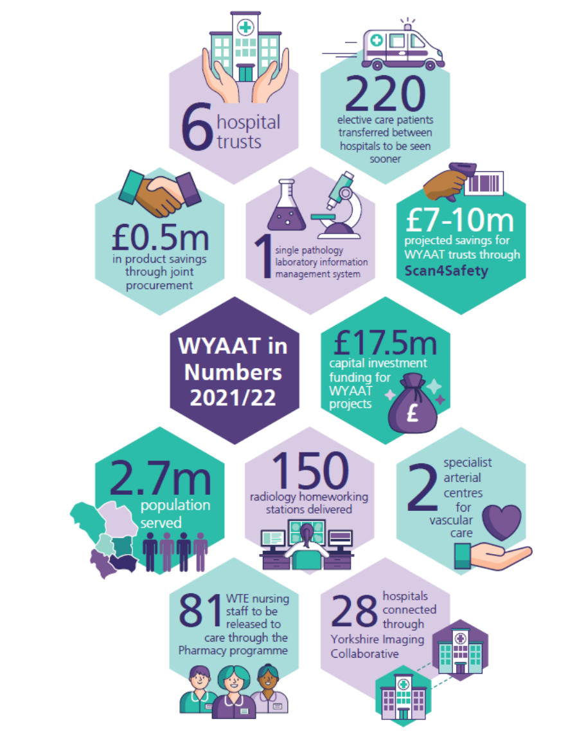



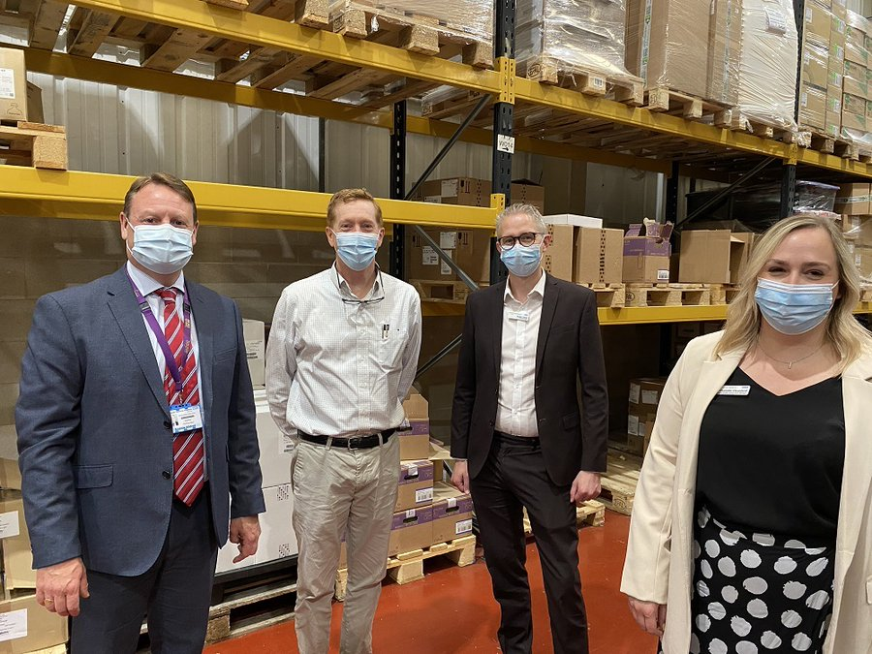
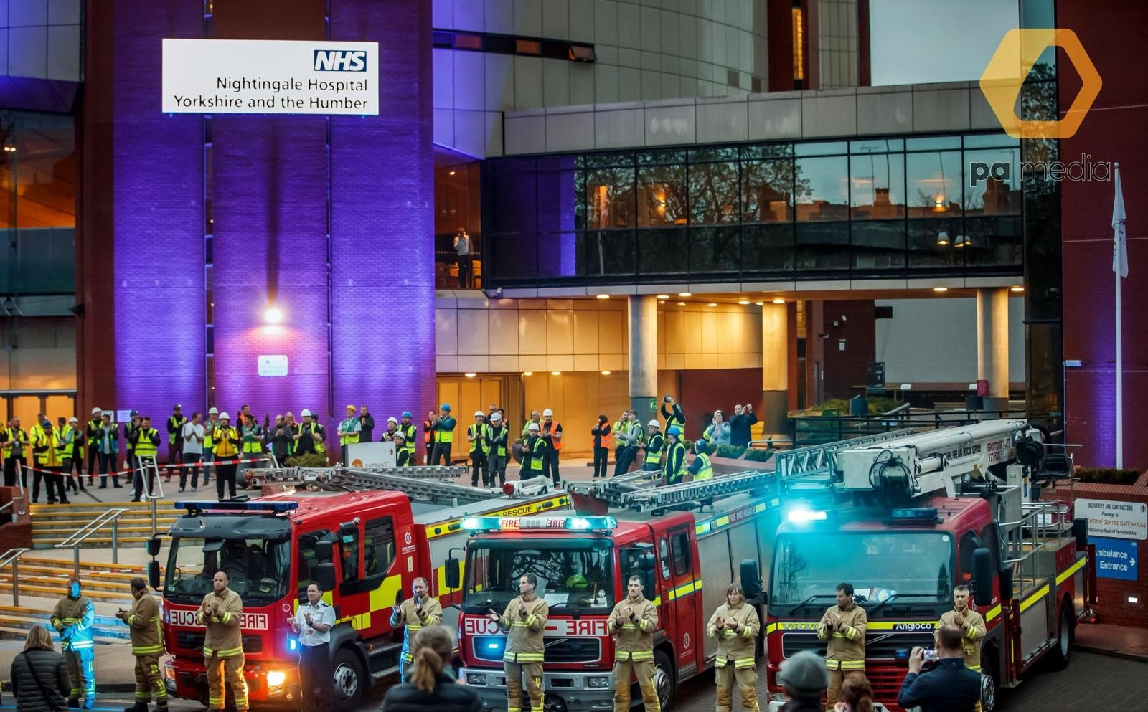

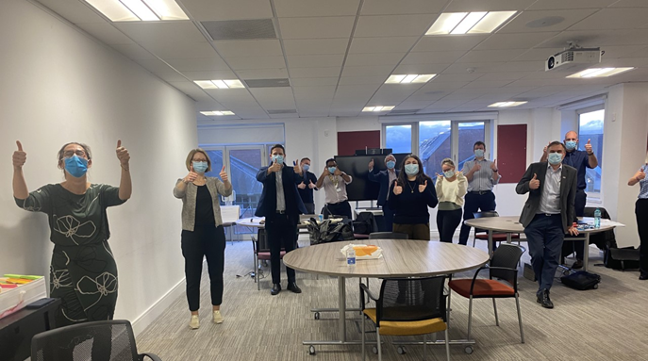
Impact
Notes:
Vascular:
Single WY vascular service
Reconfiguration from 3 to 2 arterial centres
New clinical model reducing admissions and length of stay
Stroke:
Reconfiguration of Hyper Acute Stroke Services
Radiology:
Implemented a single PACS system and shared reporting solution with image and report sharing across all trusts.
Common scanning protocols.
Reducing repeat scanning and manual image sharing
Pathology:
Single laboratory information system (LIMS) and orders/results hub system (ICE).
To reduce clinical variation, increase visibility of results and reduce costs.
COVID-19:
Nightingale Hospital Y&H
WYH PPE system
Pathology testing
Operational escalation and mutual aid
Consistent approach to workforce issues

Slide 20
Lessons learned
Collaboration only where it makes sense to do so – club vs country
Understanding when things don’t go to plan and what aspect needs repair
Be prepared to fail or withdraw

Slide 21

Thank you for attending the webinar today
Please complete our evaluation form by scanning this QR code
or click on the link in the chat.
Our next webinar is taking place on Thursday 8 December 2.30pm-3.45pm, How are provider collaboratives helping to reduce care backlogs across systems?

