Slide 1


Welcome to the Provider Collaboration webinar
Tackling pressing workforce challenges
Thursday 9 February 2023
This virtual event will be recorded and published to our website.

Slide 2
SWL Acute Provider Collaborative
Tackling workforce challenges – Recruitment Hub
Thursday 9th February 2023
David Williams, Kelvin Cheatle & Linda Dyson

Slide 3
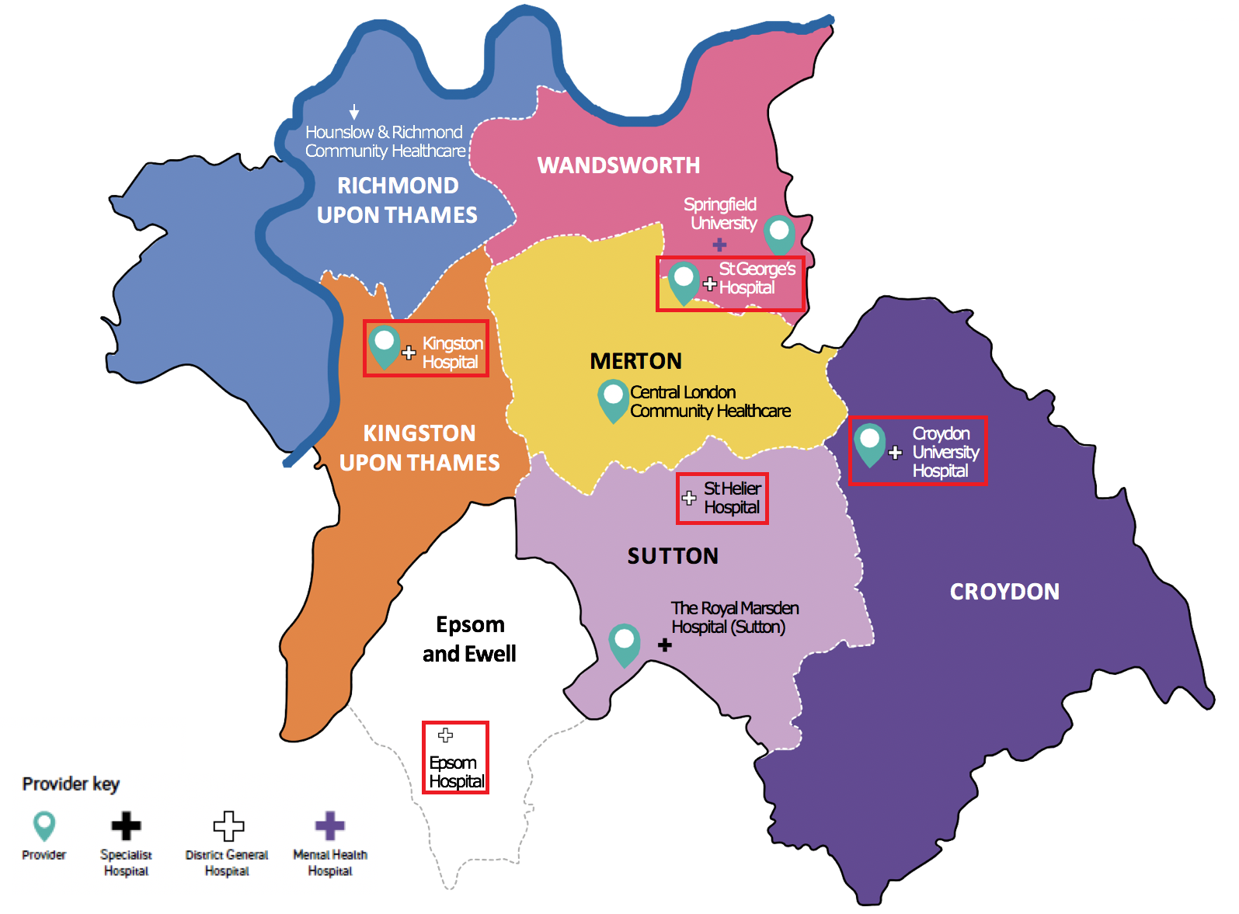
South West London
SWL Acute Provider Collaborative Members:
Croydon University Hospital NHS Trust
Epsom and St Helier University Hospitals NHS Trust
Kingston Hospital NHS Foundation Trust
St George’s University Hospital NHS Foundation Trust
Working closely with the Cancer Alliance:
RM Partners (Hosted by The Royal Marsden Hospital NHS Foundation Trust)

Slide 4
The SWL APC
We recognise our role as a key delivery arm of the ICS and we want to do more to ensure the SWL ICS remains at the forefront of delivery for the benefit of our patients and population. The formal collaborations within our portfolio – namely SWL Elective Orthopaedic Centre, SWL Procurement Partnership, SWL Pathology, SWL Recruitment Hub and SWL Picture Archiving Communication System (PACs) - illustrate that we have already started delivering on the stated benefits by coordinating our efforts and delivering services at scale in middle and back office functions. Through the Clinical Networks we have standardised pathways and reduced variation and provided mutual aid which has improved recovery performance. We recognise there is more to do. We are keen for the next stage of our development to build on our success and portfolio to address key gaps to ensure we continue to support the ICS to deliver on its role.
3 Major Work Programmes: looking at structural change across service areas to ensure maximum efficiency, transformation and capacity to ensure delivery of national targets.
Clinical Networks: looking across complete pathway from primary care to specialist; using upfront diagnostics to avoid acute care; moving more care into the community and using skills of all team members to the most.
Clinical Networks Wave 1
Clinical Networks Wave 2 & 3
Diagnostics
Outpatients
Elective Recovery
Workforce
Aim:
Collaboration to improve clinical outcomes, inequalities & unwarranted variation for patients.
To improve workforce health & wellbeing, with SWL as the best place to work.
To deliver top decile performance in quality, efficiency and national standards.
Deliver value for money to our populations & sustainability of our Trusts
Use innovation & research to improve productivity
Programmes: Collaboration to maximise on back office opportunities
Pharmacy
Recruitment Hub
Formal Collaboratives (hosted by individual Trusts): To collaborate in areas where working together gives more system benefit than working individually
Procurement
Pathology
SWLEOC

Slide 5
A Recruitment Hub for SWL – the Concept
A one stop shop for all SWL Acute Trusts recruitment needs
A shared service hosted by KHFT on behalf of KHFT, STGH, CUH, ESTH covering 25,000 staff
Single base in Epsom
Agreed service levels and shared ownership
TRAC and NHS Jobs as the key systems

Slide 6
Phase 1 – Integration
TUPE of staff(42) from 4 Trusts
Client roles and priorities….4 different approaches
Establishing common KPIs
Time to hire the key concept – 45 day target

Slide 7
Phase 2 – Performance Satisfaction
Client buy in
Staff identification with SWL
Further investment to “right size”
Bespoke client needs
Cohort and international recruitment

Slide 8
Phase 3 – Digitisation and Service Scope
Replacing TRAC
Robotics
Streamlining activity
New clients (HRCH)
Extending to DRs and VSMs
New service model

Slide 9
Lessons Learnt
Not an outsourced function
Consistency of performance
Focus on KPIs not anecdote
Estates and IT problem
Visibility of recruitment post pandemic
Challenge of collaboration

Slide 10
Any questions?

Slide 11



The People Services Collaborative
Programme in the Derby and Derbyshire ICB
9th February 2023

Slide 12
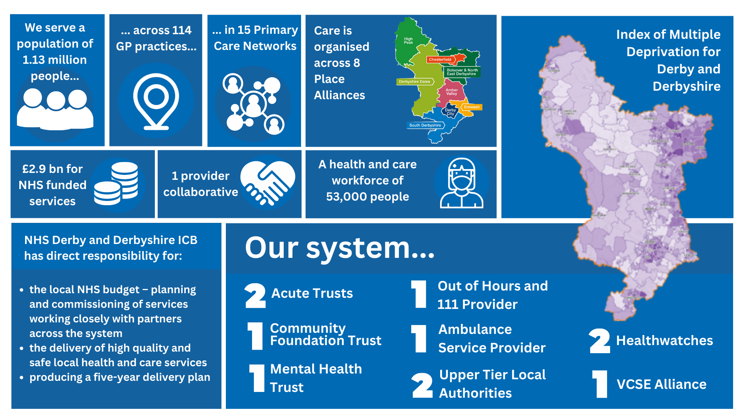

Slide 13









Provider Collaborative Members
Plus for People Services
GP practices represented by members of the Derby and Derbyshire GP Provider Board
Provider Collaborative Leadership Board - Chief Executive level group with attendance from relevant officers including chair of the Clinical and Professional Leadership Group

Slide 14
Why collaborate?
Our people and culture are integral and critical to the development of the Integrated Care Board (ICB), Integrated Care System (ICS), Provider Collaborative and Integrated Care Partnership (ICP/Place)
All NHS Providers need to deliver the NHS People Plan and embed the NHS People Promise
To deliver the NHS England and NHS Improvement ‘ten outcome-based people functions’
By ‘working together’ we can achieve much more and be more effective and efficient
To enable the ICS to develop a ‘One Workforce’ approach
To enable People Services to support the working and development of the Derby and Derbyshire Places
To achieve our potential as Anchor Institutions and address inequalities across our system

Slide 15
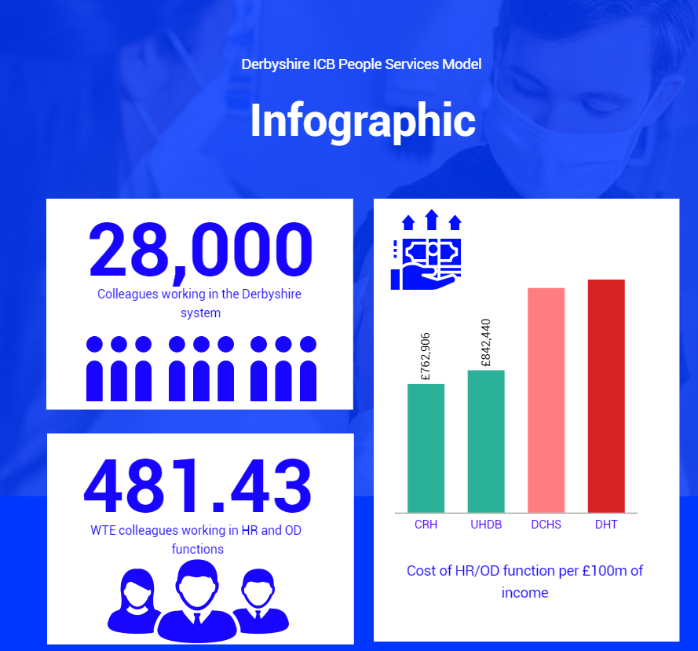
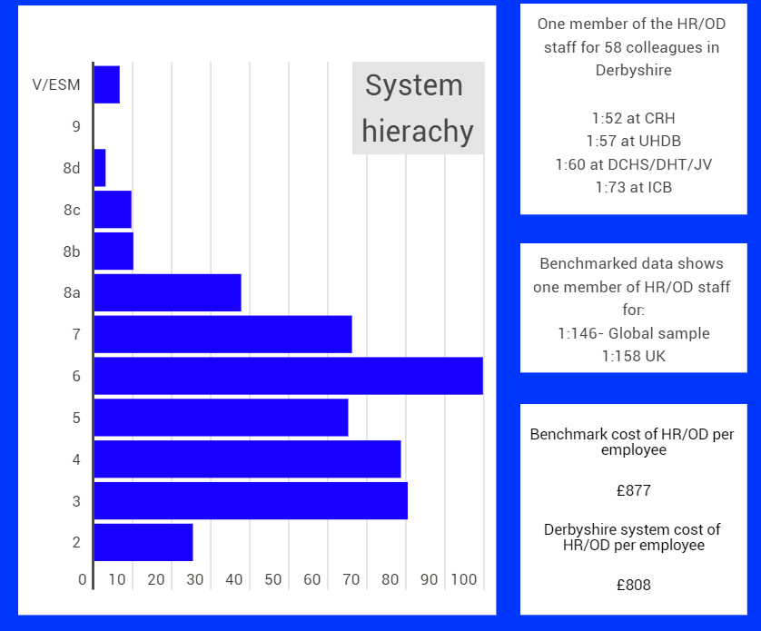
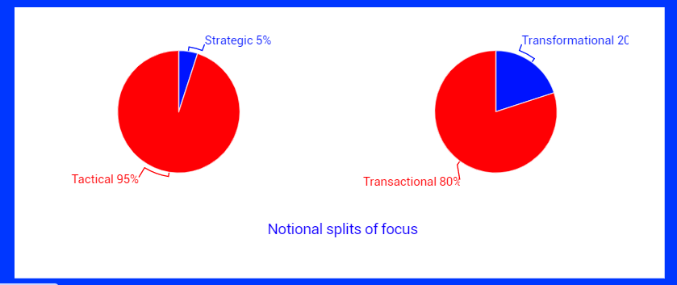
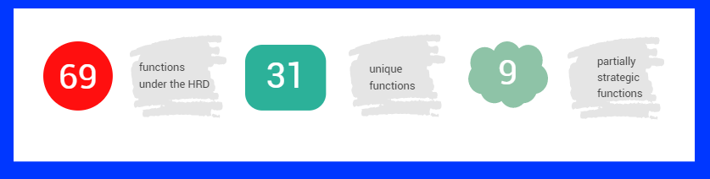

Slide 16

Following a time out HRDs and deputies identified the following principles to work to:
Create a common vision, common strategy, unifying purpose
Embed Inclusion throughout
Understand each organisations perspective
Deliver by:
  Collaboration
  “Do once”
  Call what is not adding value
  Look for quick wins and do now
  Move from transactional to transformational
  Develop contracting with each other
  Use all capacity we all have – be willing to free up
  Matrix management
Improve by:
  Challenge status quo
  Trust each other, have each other’s backs – trust that if we say we will do something we will
  All play our part – play to strength and skills of group – person with skill leads
  Find a way to empower and loosen control
  Look at other systems, trusts and external companies for good practice

Slide 17
We identified seven programmes of work
Workforce Development and Transformation
Digital, Data and Information
Equality, Diversity and Inclusion
Health, Safety and Wellbeing
Leadership Development and Talent Management
Workforce Intelligence and Planning
Resourcing and Recruitment
Which builds on existing Joint services and work programmes
  NHS OH service and system-wide collaborative wellbeing offer
  NHS payroll
  Joined Up Careers Team
  Joint venture between two providers for their transactional services

Slide 18
and five priorities for 2022/23:
Develop a collaborative recruitment and resourcing hub.
Develop a JUCD Induction programme – local organisational inductions to continue.
System wide aligned mandatory training (embedded into passport) include the training required for the care sector.
Commence Human Resource/people management policy alignment.
Evolve our MOU to enable effective movement of people across the system.
These priorities relate to ‘people activities’ that can best be delivered at scale, use resources across the system most effectively and support integrated care.

Slide 19



Achievements so far………
All 41 initiatives on ePMO
Temporary Workforce Communication Hub established
New system induction programme
New Leadership induction resources
Agreed core leadership development offer
Implementing learning from Cultural Intelligence (CQ) review of recruitment across the system, and training facilitators collectively to embed a CQ approach
Verbal agreement to recognise each other's mandatory training reached among all partners
Commenced HR policy alignment

Slide 20
Our governance has developed from this…….
Derbyshire and Derby ICS People & Culture Governance May 2022
ICB People & Culture Committee
ICB Board
Integrated Place Partnership Derby and Derbyshire
System Executive
Regional People Board
Provider Leadership Collaborative Board
System Oversight Delivery Group
Organisational People Committees or equivalent
People and Culture PMO
Workforce Advisory Group
P r o g r a m m e M a n a g e m e n t
P r o g r a m m e M a n a g e m e n t
P r o g r a m m e M a n a g e m e n t
System People Directors and Deputies
Workforce Intelligence & Planning
Resourcing and Recruitment
Workforce Development and Transformation
Digital, Data & Information
Equality, Diversity & Inclusion
Health, Safety & Wellbeing
Leadership Development & Talent Management

Slide 21
Integrated Care System governance
…….to this
Integrated Care Partnership
Integrated Care Board
Health and Wellbeing Boards
Statutory Provider Organisations
Derbyshire County Council
System Delivery of Strategy and Transformation
Delivery and Transformation Groups
MHALD Delivery Board
Planned Care Delivery Board
Integrated Place Executive
Urgent Emergency and Critical Care Delivery Board
Provider Collaborative Leadership Board
Primary & Community Delivery Board
Transformation Co-ordinating Group
Digital and Data Board
People Services Collaborative
Derby City Council
Children and Young People Delivery Board

Slide 22
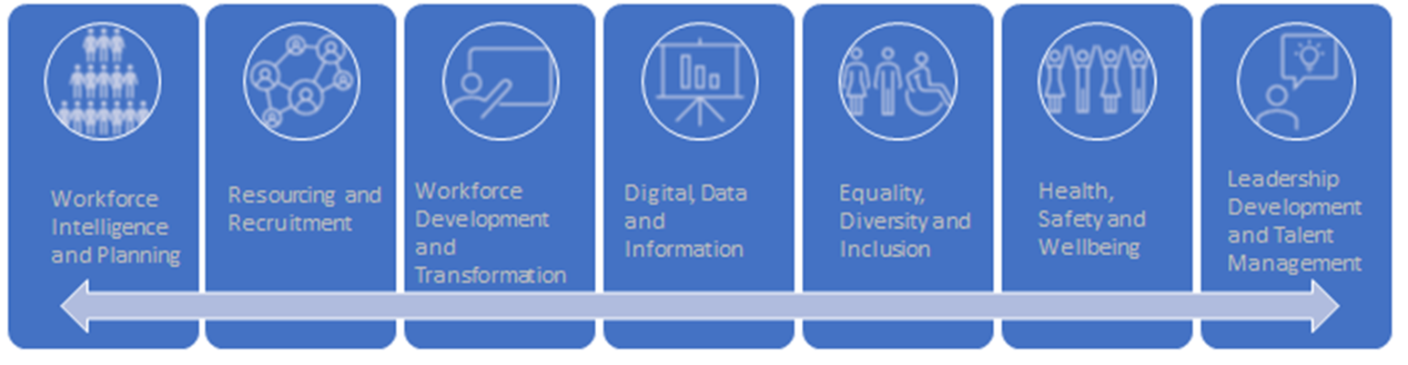
Plans for next year
In progress – to continue in 2023/24 | Focus 2023/24
Once Workforce Strategy and Plan in development Collaboration on recruitment underway Derbyshire Academy scoped Mandatory training alignment in progress Electronic training needs analysis Secured NHSBA/NHS England support on Derbyshire Digital Cultural intelligence recruitment pilot to commence roll out Staff Network collaboration System wide wellbeing offer Alignment of leadership and talent management offer and approach | Project Derbyshire Digital - ESR road map and enhancement - Derbyshire digital road map Support Domiciliary Care International Recruitment Accelerate recruitment collaboration Develop a Derbyshire approach to People Scaling for transactional efficiencies

Slide 23

One Piece of learning:
When you are frustrated at others because you have made your best case for change and “They just don’t get it!” …
Take a look in the mirror and ask yourself instead… “What is it that perhaps *I* don’t get
about them?”
Notes:
EMLA colour pallet found under font colour button.
Titles, sub titles and copy sizes can be changes to suit presentation / wording size.

Slide 24
Contacts:
Amanda Rawlings - amanda.rawlings2@nhs.net
Chief People Officer - Derby and Derbyshire ICB
Linda Garnett - linda.garnett1@nhs.net
Programme Director, People Services Collaborative
Tracey Robinson – tracey.robinson31@nhs.net
Project Manager, People Service Collaborative

Slide 25
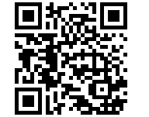
Thank you for attending the event today
Please complete our evaluation form by scanning this QR code
or click on the link in the chat.
Our next peer learning forums and webinars will be announced soon.

