Slide 1
Collaboration - Clinical transformation
Developing resilient and innovative services
Notes:
This is a section title slide

Slide 3
Our collaborative vision
To put children & young people at the centre of what we do
In order to achieve this, the approach to delivery is underpinned by a set of principles and core values which were co-produced at our stakeholder launch event on the 10 September 2019:
Keep children and young people at the centre of what we do
Relationships of trust (all stakeholders)
Collaborative team working practices
Culture of openness
Willing and pro-active peer support
Be a national leader for culture change
Stewardship of the whole East Midlands resource
Use the East Midlands Provider Collaboratives to influence the wider system
Involve and engage staff in the journey so that they can identify with the Provider Collaborative.
Notes:
Slides with lots of content should use this simple style

Slide 4
Our outcomes
Established a Single Point of Referral and single waiting list.
Quality oversight is managed by the independent Patient Safety and Quality Group.
Established a collaborative Clinical Activity Panel to review admission priorities.
Financial balance and stability.
Proactive management of a risk register.
Collaborative operations forum where all partners attend.
Secured £12m funding to implement a ‘Tier 3.5’ community model. *
Reviewed the pathway requirements and numbers of beds required for the collaborative.
* CAMHS 3.5 was an additional commissioned service by the collaborative implementing Intensive Outreach Teams in each of the five counties ensuring total regional coverage. This has a seen a 20% reduction in referrals for a Tier 4 bed, a 25% reduction in admissions, a 40% reduction in young people waiting for a bed and a reduction in length of stay. Care is also being provided closer to home as a result of this transformation.
Notes:
Slides with lots of content should use this simple style

Slide 5
Clinical Engagement
Clinical Engagement for operational delivery |  | Clinical Engagement for strategic development
Established a single point of referral for all potential in-patient admissions across 6 different units |  | Clinical Reference Group (CRG) meets monthly reviews the strategic development of the services, considers new ways of working and priorities
Clinical Activity Panel (CAP) clinical & operational meeting 3 times a week to review demand and capacity and to resolve any emerging operational issues |  | CAMHS Director of Nursing meeting, chaired by the Chief Nurse of the Lead provider. Seeking medium to longer term solutions to improve outcomes for young people
Clinical Escalation Group (CEG) meets as and when required, when a solution has not been found for a service user. Chaired by the clinical lead for the collaborative, or the lead provider’s Medical Director or Chief Nurse. |  | Monthly lunch and learn sessions where front line operational staff and clinical leaders come to present areas of transformation and development. This forum brings partners from the collaborative together to share learning, showcase transformation and good practice.
Young People & carers co production group supports operational and strategic delivery

Slide 6
Lessons learnt
Focus on the culture, getting this right supports everything else
Be an honest broker, a lead provider is a lead for all providers and a provider of services. Everyone provider must be treated equitably
Engagement with the providers and units within the collaborative is key, bring them along the journey, listen and adapt.
Share good practice and link local leaders to one another, Ward Managers, Service Lead, Consultants.
Agree a nominated Non-Executive Director to ensure the Board is informed and involved.

Slide 7
Focus on the future
Developing face to face access assessments, this will support better clinical decision making
Discharges are often delayed. Creating greater engagement with social services, working together on the right community provision for young people. Focus on the culture, getting this right supports everything else
Developing a new clinical roles, develop our workforce to improve recovery in CAMHS in-patients

Slide 8
Notes:
This is the title slide

Slide 9
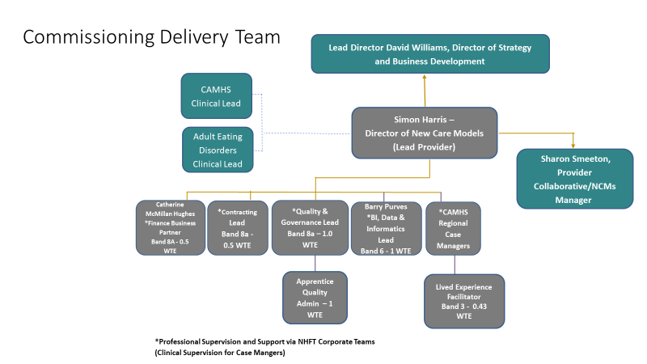

Slide 10
