Slide 1

Governance in the North East London Mental Health, Learning Disability and Autism Collaborative
Presented by: Selina Douglas, Executive Director of Partnerships, North East London NHS Foundation Trust

Slide 2
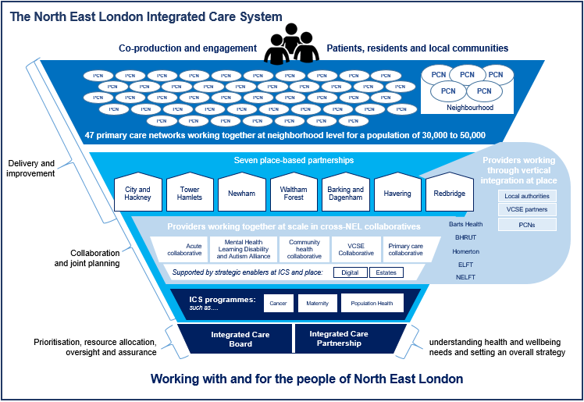
Our system context

Slide 3




MHLDA Collaborative – who we are
Local authorities and other place-based agencies
Communities, people with lived experience and service users
Community, voluntary & faith sector orgs
Carers, friends, families and people offering support
Primary care and other NHS providers
3

Slide 4
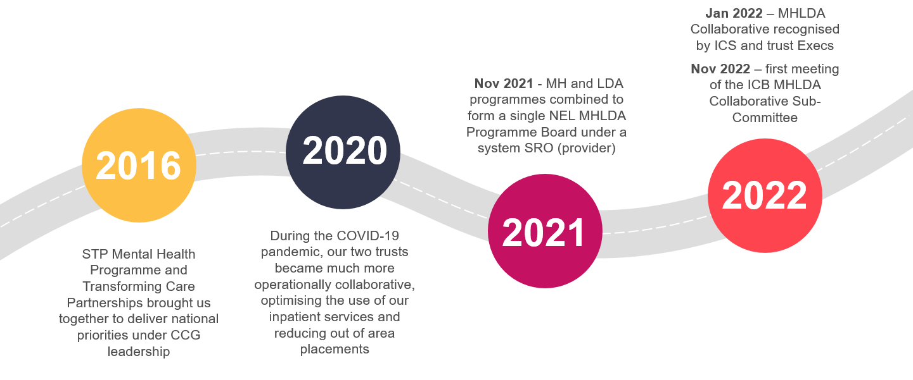
The history of our governance
2023
Where we’re heading next…
3

Slide 5
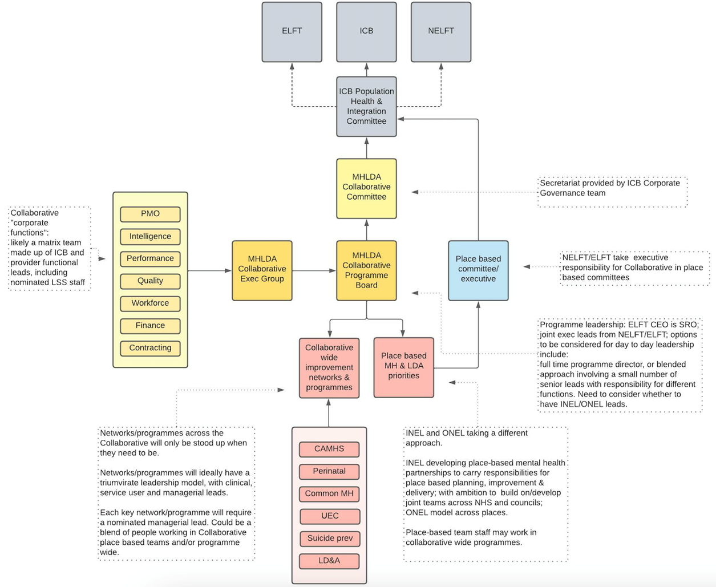
Governance today
Presently, the collaborative is governed via a sub-committee of the ICB which is chaired by the Joint Chair of ELFT and NELFT. The committee is attended by:
Chief Executive Officers from ELFT, NELFT and NEL ICB
Non-Exec Directors
Service users and carers with lived experience of MH, LD and Autism
Chief Medical Officer ELFT
Chief Nursing Officer NELFT
Representatives of places, local authorities and primary care
A representative of the NCEL CAMHS collaborative (new care models)
However, we are hoping to replace this with a joint committee of ELFT, NELFT and NEL ICB (exercising S65Z5 of the new Act)

Slide 6
Why a joint committee?
As the statutory responsibility for ICB functions remains with the ICB in this option (though they will be jointly exercised with trusts), the risks predominantly lie with the ICB rather than NHS Providers which may be preferable early on in a formal provider collaborative
This option enables the NELFT and ELFT Boards to also delegate functions of their own to the joint committee. This would enable all three statutory bodies to participate equally, share in risks together, and move towards a genuine joint exercise arrangement
A joint committee represents the best option for ‘earned autonomy’ in that it can facilitate an incremental delegation of responsibilities and functions from each of the members’ boards and become the legal decision-making body for those functions
It could also act as a prototype for enabling NELFT and ELFT to work together around an external delegation, and enable the creation of a pooled fund
It would also be possible for the ICB to withdraw from the joint committee at a future date, leaving the NHS providers to manage their joint committee – and an external delegation - themselves

Slide 7
Key points of learning / challenges
Lived experience perspectives within our sub-committee is valuable beyond measure… However, you have to be willing to fundamentally adapt the way you conduct business and offer a great deal of support to make this meaningful
Defining the delegation from each of the three statutory boards is contentious. Gaining the buy-in and support from Trust boards has been simpler than gaining agreement from the ICB
Our collaborative design intentionally seeks to integrate vertically into places as well as across the system to deliver things at scale where this makes sense. There is a great deal of complexity in this and risks making governance ambiguous
Our legacy arrangements around MHLDA programme delivery has given us a firm foundation on which to build but also means there are kinks and oddities still to iron out. We are having to adapt and change things while continuing to deliver, rather than being able to design / create something from scratch
We have been exploring what assurance, performance management and programme oversight could look like once the delegations have been made – however, it’s easier to define what you don’t want it to be like than to design something new

