Slide 1
West Yorkshire Association of Acute Trusts (WYAAT)
Governing provider collaboratives: Joint committees, decision-making and testing different models
28 June 2023

Slide 2
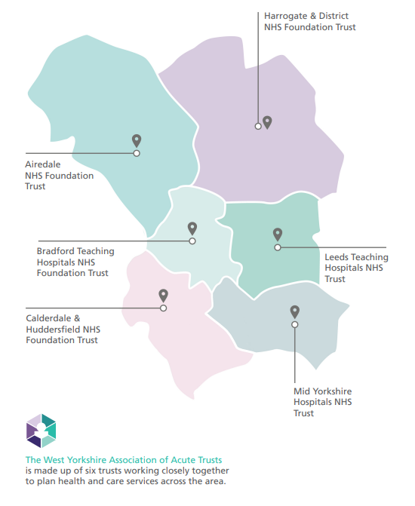
What is WYAAT and why does it exist?
Collaboration of the six acute trusts in West Yorkshire & Harrogate
Self-funded by the trusts
Forum for acute trusts; a single voice into the HCP
Providing a mechanism to share best practice and learn from each other to tackle unwarranted variation or inequalities in access, outcomes and experience
Delivery of acute trust focused change programmes
Leadership of wider programmes on behalf of the ICS
Facilitates clinical, operational collaboration & mutual aid
Prioritising and planning system investments in acute services
Only what the trusts do together and the decisions they take together
Not an organisation
Not “doing things to” the trusts
Notes:
Purpose: to achieve and sustain a collaborative, partnership model of integrated acute and specialist healthcare across WY&H
Vision: Outstanding, high quality acute and specialist healthcare for the whole population of WY&H: consistent, integrated and sustainable

Slide 3
Evolution of WYAAT
Small number of shared programmes
+ mutual aid, peer support and networked services
+ shared operational networks, large number of loose networks, leading on behalf of the ICS

Slide 4
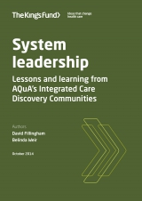
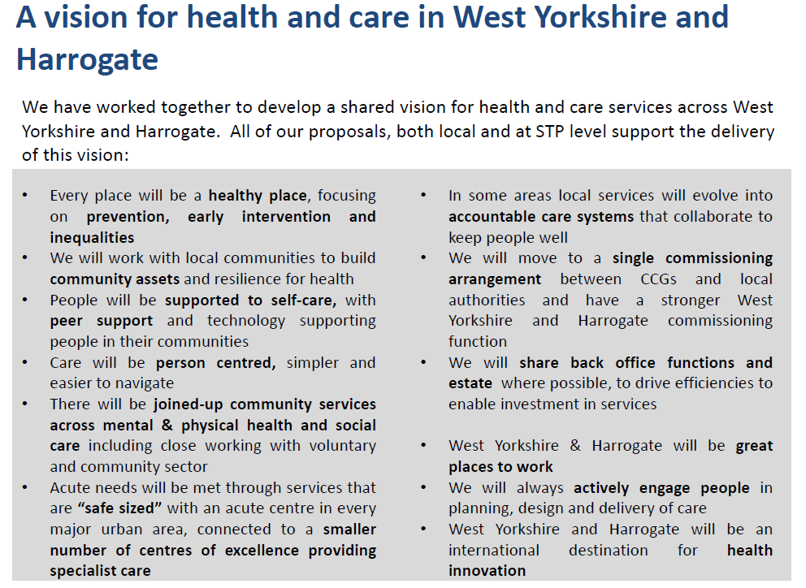
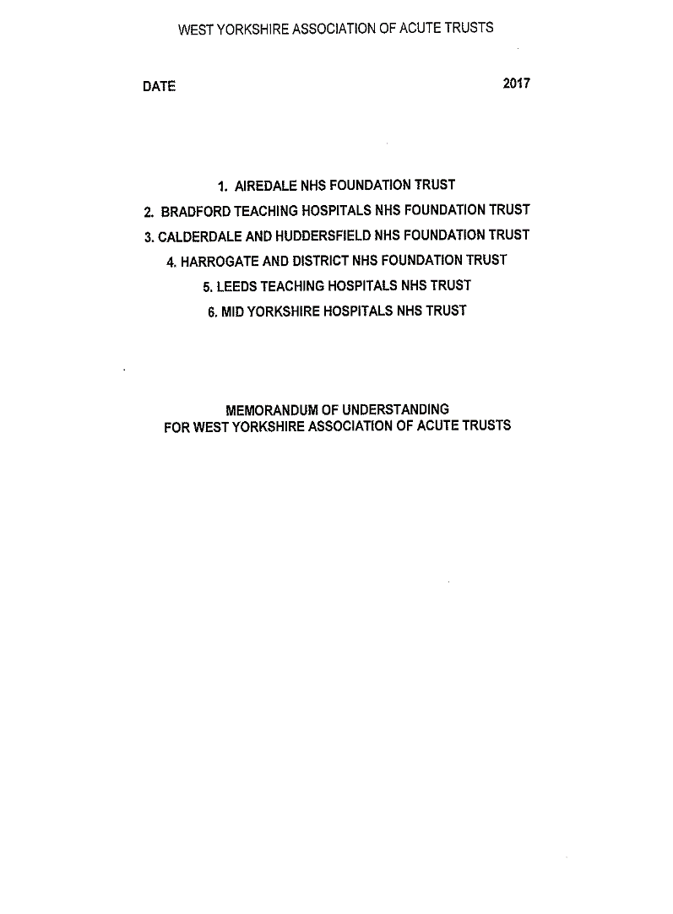
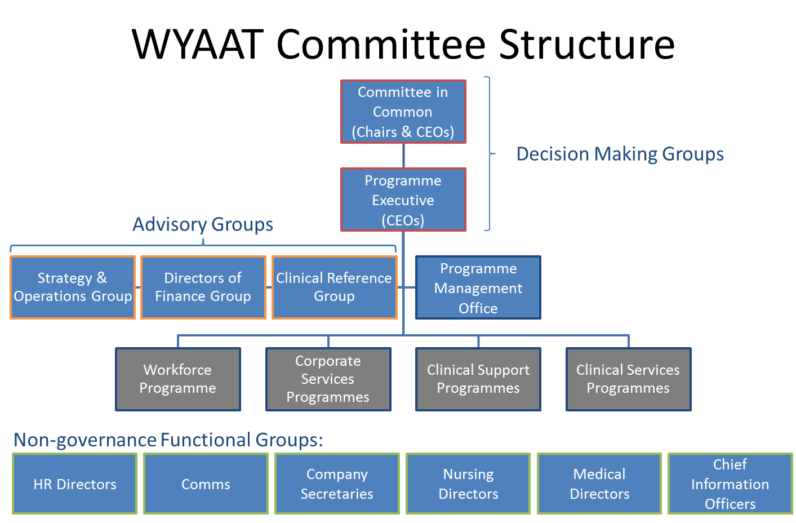
What makes WYAAT work?
Shared vision and common purpose
A “compact”:
  Expectations & behaviours
  Communication
  Relationships and trust
Collaborative, system leadership
Underpinned by:
Robust governance, systems and processes
Sufficient resources, realistic timescales

Slide 5
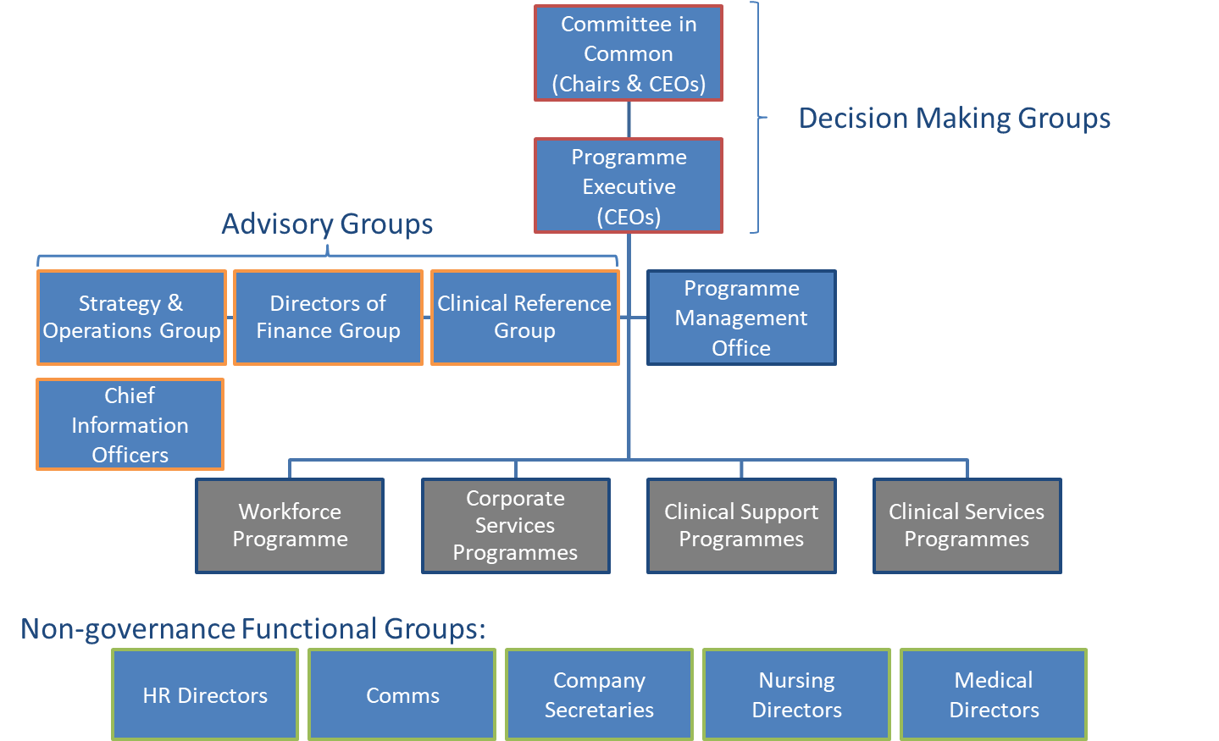
Governance Framework
WYAAT runs a Committee in Common structure
Committee in Common membership includes the Chairs and the CEOs of WYAAT’s member trusts
As a CIC, it confirms its support for business cases, investments and key decisions, with the formal approval retained by trust boards
Chairs and NEDs as well as execs are therefore integral to collaborative decision-making
All WYAAT papers and updates from Programme Executive (CEOs) are shared with and discussed by Trust Boards on a monthly basis
Arrangements are formalised through the WYAAT MoU signed by Chairs and CEOs

Slide 6
Decision making
WYAAT uses its governance structures (Committee in Common model) to make decisions on those initiatives which do not impact patient facing services or the way in which patients access these services e.g. for programmes like imaging sharing solution, scan for safety, and pathology Laboratory Information Management System.
For those programmes or initiatives impacting the way patients access services, WYAAT, engaging with partners, makes a recommendation with a decision taken by the Integrated Care Board or appropriate Committee with appropriate assurance from Joint HOSC e.g. vascular reconfiguration.

