Slide 1

Harnessing the power of quality improvement to address inequalities

Slide 2
Agenda
Welcome and introduction
Facilitated by chair: Jenny Reindorp – Interim director of programmes, NHS Providers
Case Study 1: Barnsley Hospital NHS Foundation Trust
Andy Snell – Consultant in public and global health and doctor in emergency medicine
Bob Kirton – Chief delivery officer and deputy chief executive
Reflections from an improver perspective
Beckie Burn – Associate director of transformation, Lewisham and Greenwich NHS Trust and Q member
Summary and close
Facilitated by chair
Close of event

Slide 3
Housekeeping
Please note, this event is being recorded
Please keep your camera on wherever possible
If you lose connection, please re-join using the link in your joining instructions or email TWI@nhsproviders.org
Please ensure your microphone is muted during presentations to minimise background noise
Please feel free to use the chat box for any questions or comments
If you would like to ask a question audibly, please use the raise hand function during the Q&A section and we will bring you in
Any unanswered questions will be taken away and answered after the event
You will receive a link to an evaluation form at the end of the day, please take the time to complete it, we really do appreciate your feedback.

Slide 4
Case Study: Barnsley Hospital NHS Foundation Trust
Andy Snell – Consultant in global and public health and doctor in emergency medicine
Bob Kirton – Chief operating officer and deputy CEO

Slide 5



Health Inequalities in the NHS: three why's, three how's
Take a quality improvement approach … & stop prevaricating. Bob Kirton & Andy Snell. 26 July 2023.

Slide 6
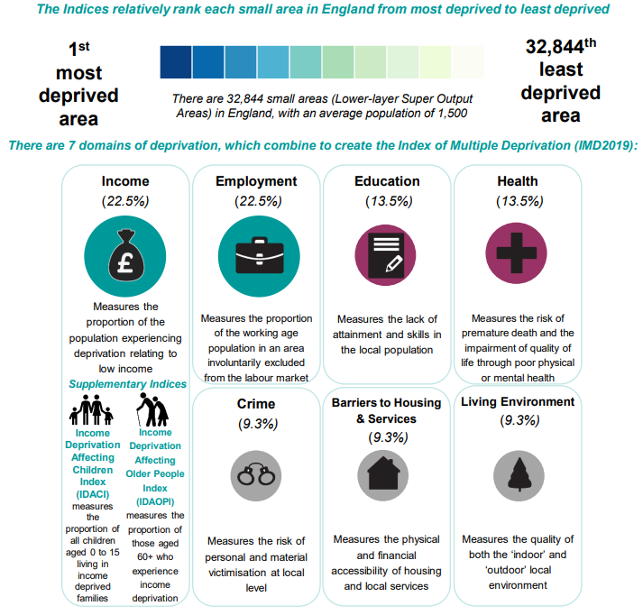
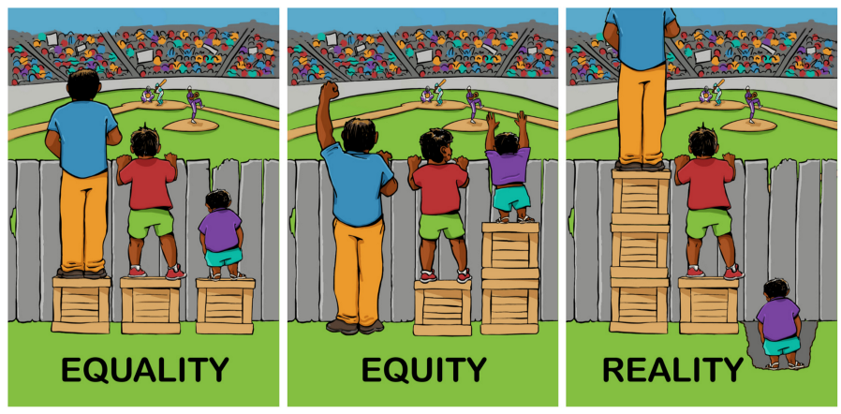
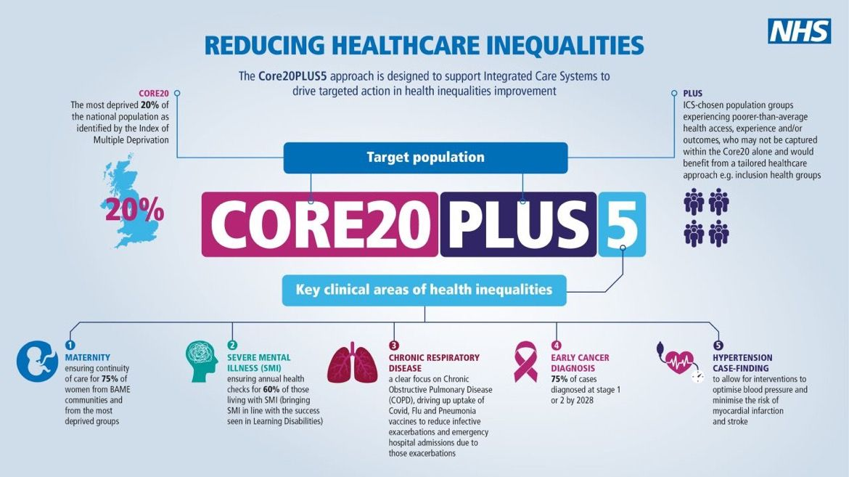
Equity vs equality
Who I am:
Personal characteristics
Where & how I live:
Social & economic factors
How others treat me:
Social exclusion
Notes:
In reality – we know that services and resources and money and power are not distributed equally or equitably and some in our society have enormous advantage over others who are left disadvantaged.

Slide 7
UNFAIR
SYSTEMATIC
AVOIDABLE
What are health inequalities? | The King's Fund (kingsfund.org.uk)

Slide 8
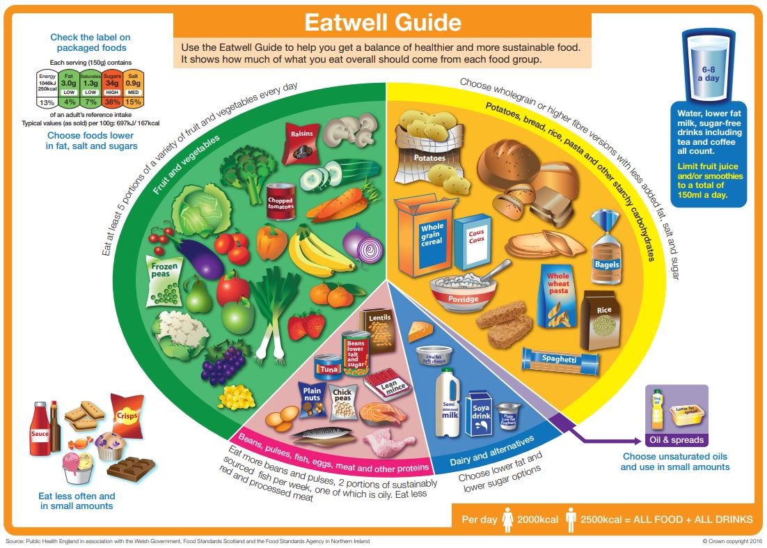
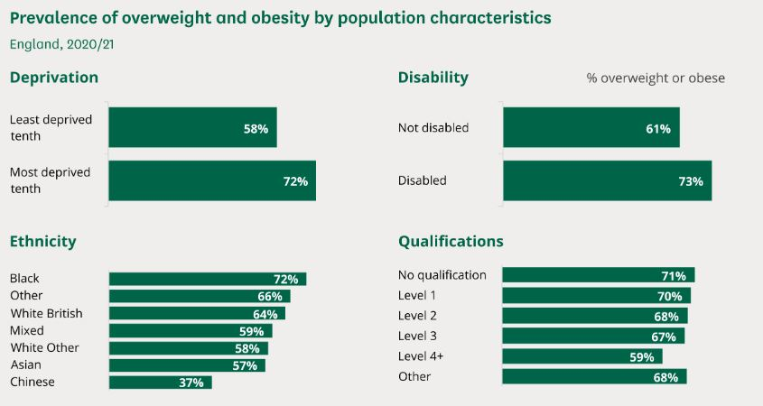
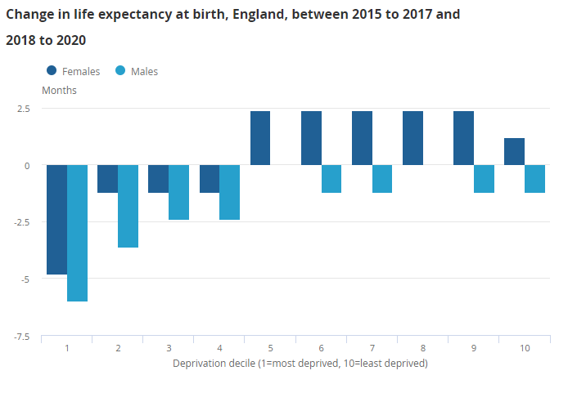
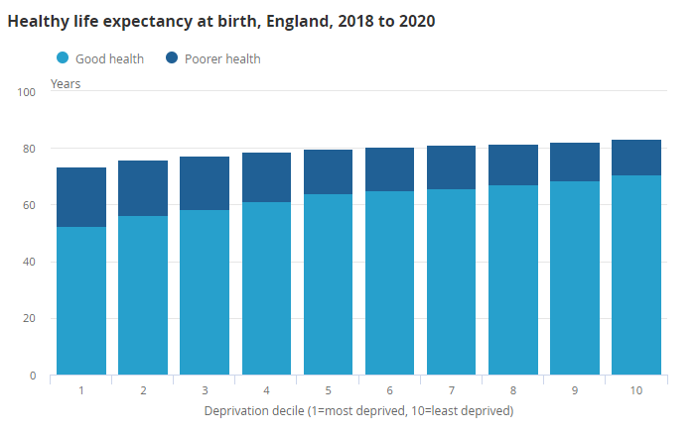
UNFAIR
72%
vs
58%
Health state life expectancies by national deprivation deciles, England - Office for National Statistics (ons.gov.uk)
https://eatforum.org/eat-lancet-commission/ and Obesity statistics - House of Commons Library (parliament.uk)

Slide 9
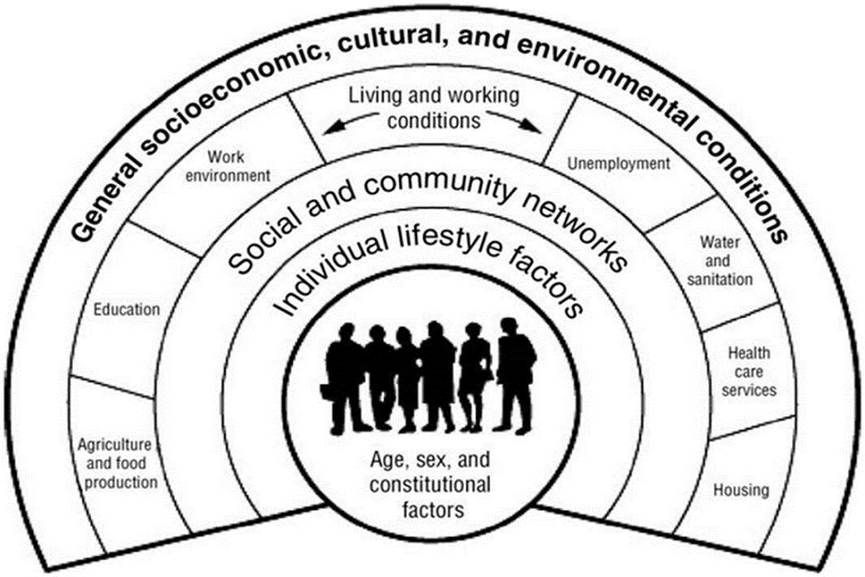
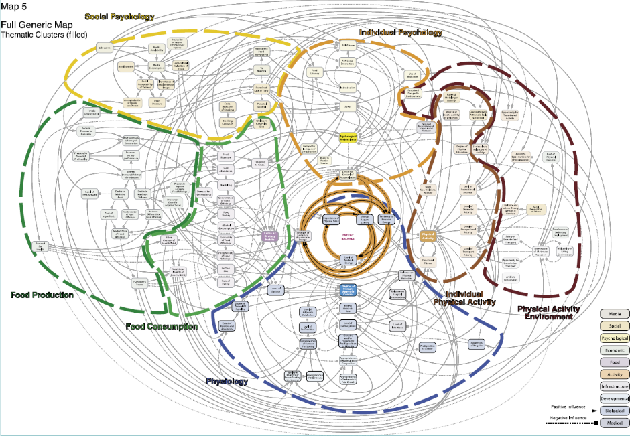
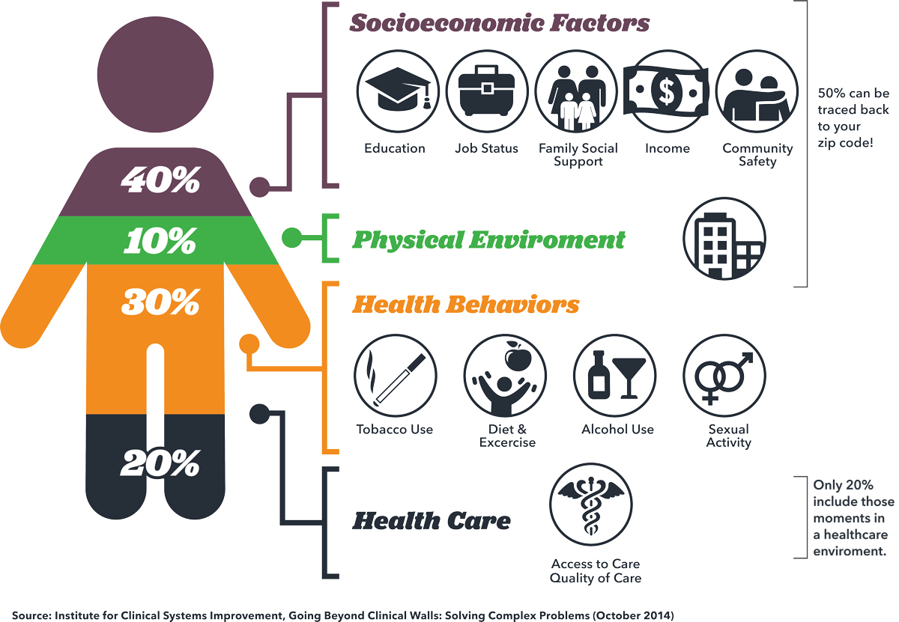
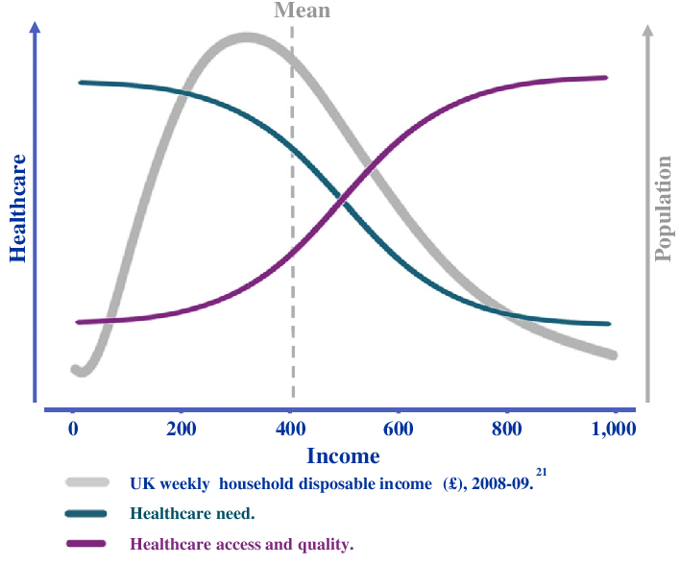
35% income security and social protection;
29% living conditions;
19% social and human capital (isolation, lack of control, trust, low educational outcomes);
10% access to and quality of health care;
7% employment and working conditions.
€980 billion pa
SYSTEMATIC
75% of income on food
Addressing health inequalities in the European Union (europa.eu)
Healthy, prosperous lives for all: the European Health Equity Status Report (who.int) and Achieving health equity in the European region - The Lancet Public Health

Slide 10

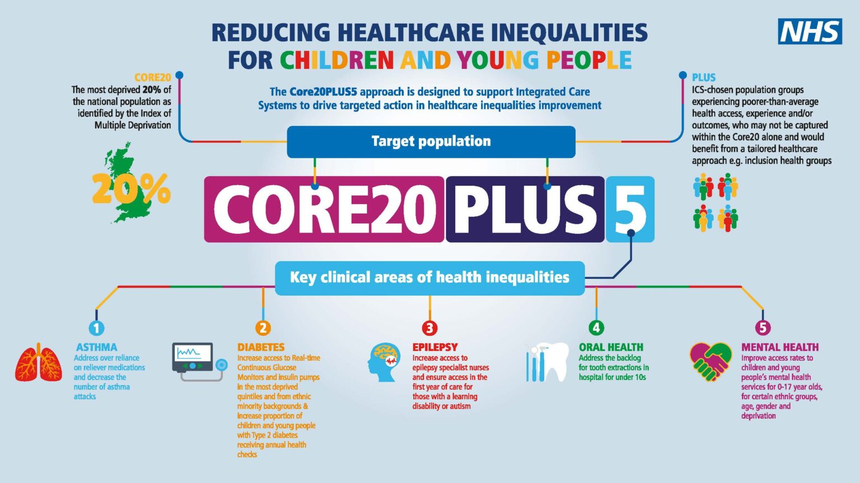
Early years interventions can save over €1.7 trillion in 20 years.
Tackling inequalities has potential efficiency gains of €72 billion per year.
AVOIDABLE
Tackling NCDs: 'best buys' and other recommended interventions for the prevention and control of noncommunicable diseases (who.int)

Slide 11

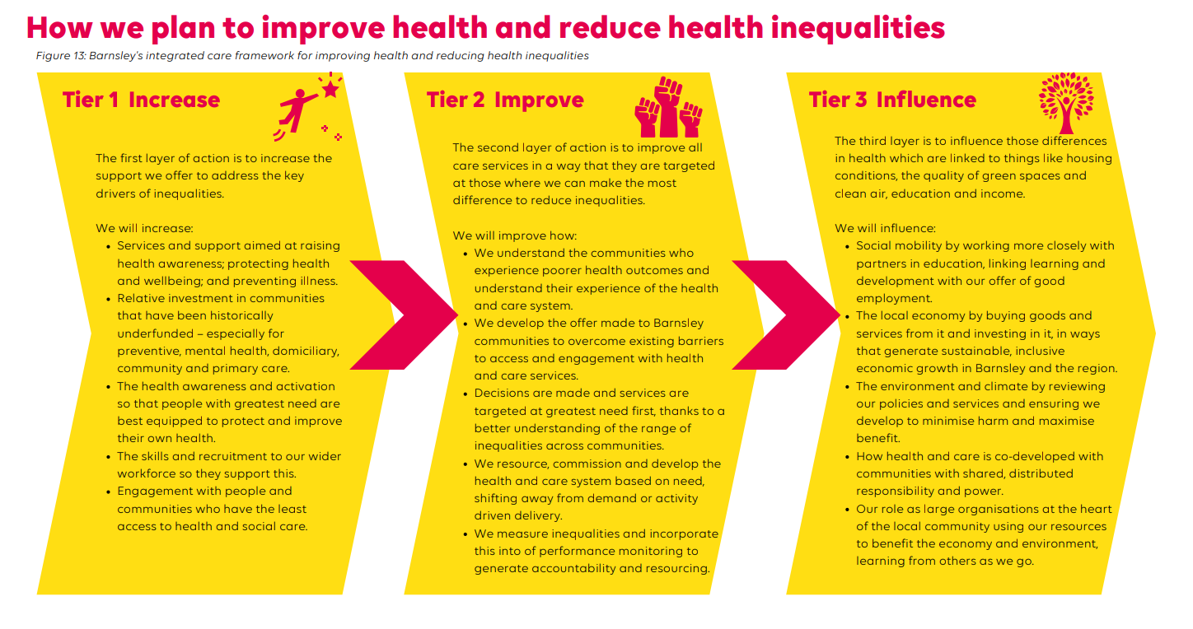
Three tiers of action
Tackling health inequalities in Barnsley FINAL (syics.co.uk)

Slide 12
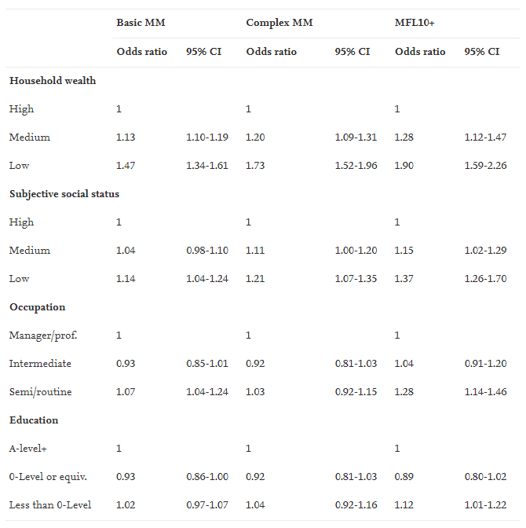
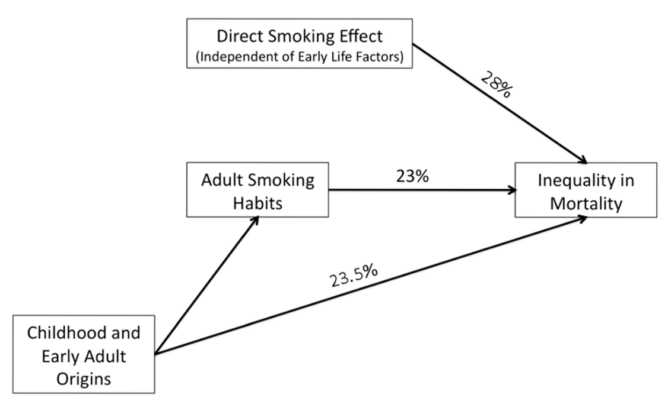
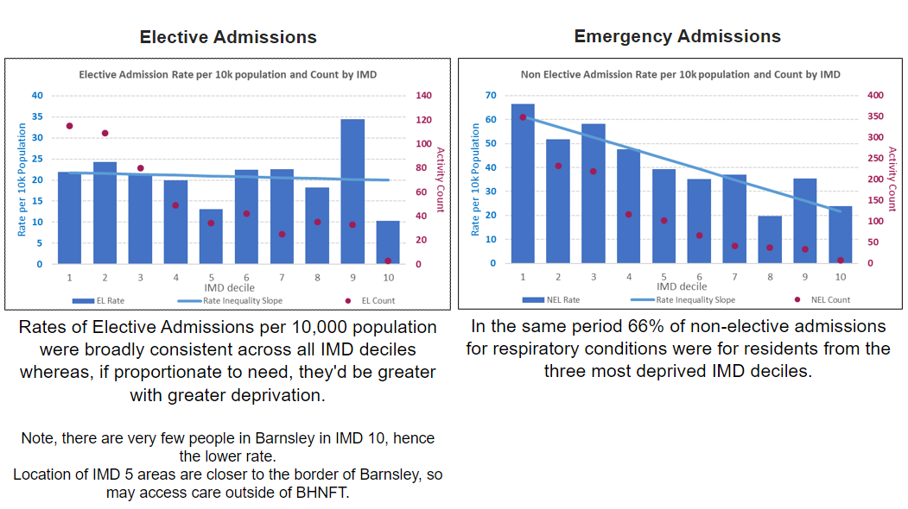
Equity of what – healthcare services
Why?
It’s the right thing to do (see above).
It’s a clinical risk factor (direct and indirect … to inform direct care at the point of care and its planning).
It’s crucial for sustainable demand management (associated with a predominance of unplanned care use, higher rates of DNA, later presentation of disease and a higher rate of reattendance and readmission).
Tackling health inequalities in Barnsley FINAL (syics.co.uk)
Notes:
In terms of equity in health services we are talking about fairness in four broad areas - access to our services, the provision of information, experience of services and health outcomes. Making things fairer is about identifying how the way our systems and services have been designed gives some people a significant advantage and means they are more likely to benefit.
We know that generally, people who are White, who speak English, who are well educated and have good literacy, who are on higher incomes and live in the least deprived areas find it easiest to access and navigate health services and have the best health outcomes.

Slide 13
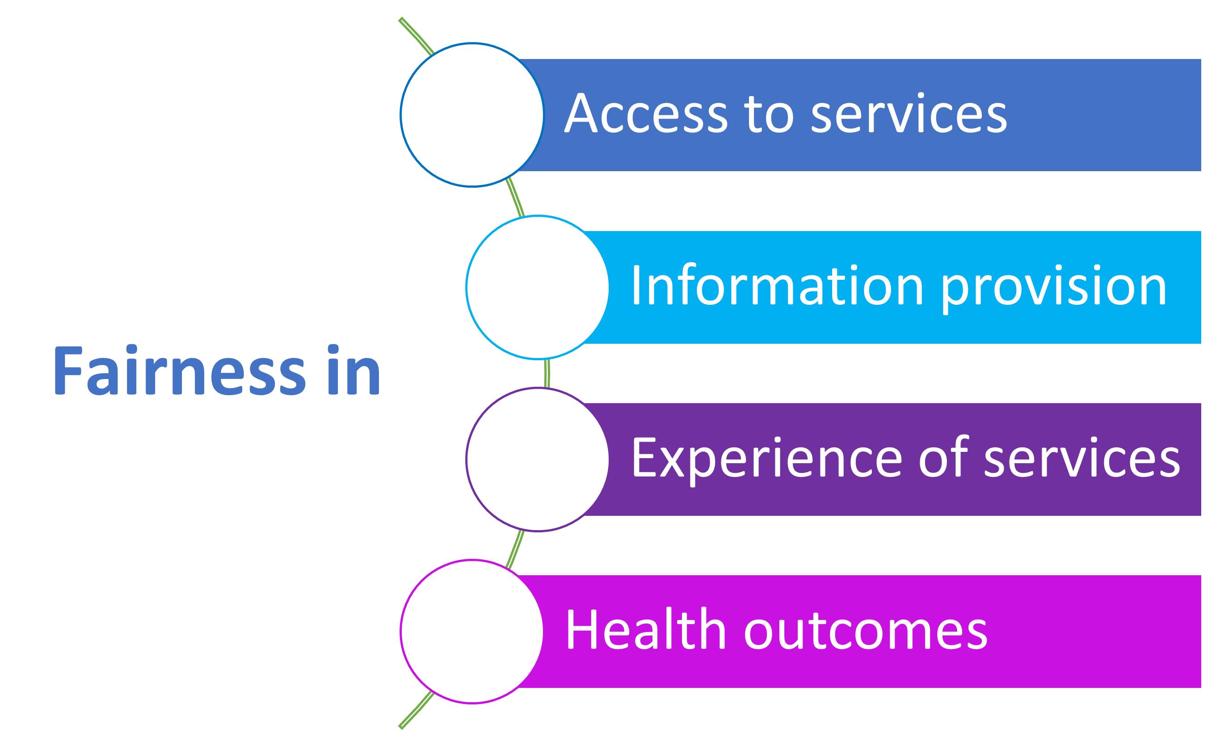
Equity of what – a QI approach
What’s the problem we want to improve?
Who do we need on board and what are the needs of the patients?
What can help us better understand the problem?
What is our aim statement?
How will we know that the changes we make are an improvement?
Notes:
In terms of equity in health services we are talking about fairness in four broad areas - access to our services, the provision of information, experience of services and health outcomes. Making things fairer is about identifying how the way our systems and services have been designed gives some people a significant advantage and means they are more likely to benefit.
We know that generally, people who are White, who speak English, who are well educated and have good literacy, who are on higher incomes and live in the least deprived areas find it easiest to access and navigate health services and have the best health outcomes.

Slide 14
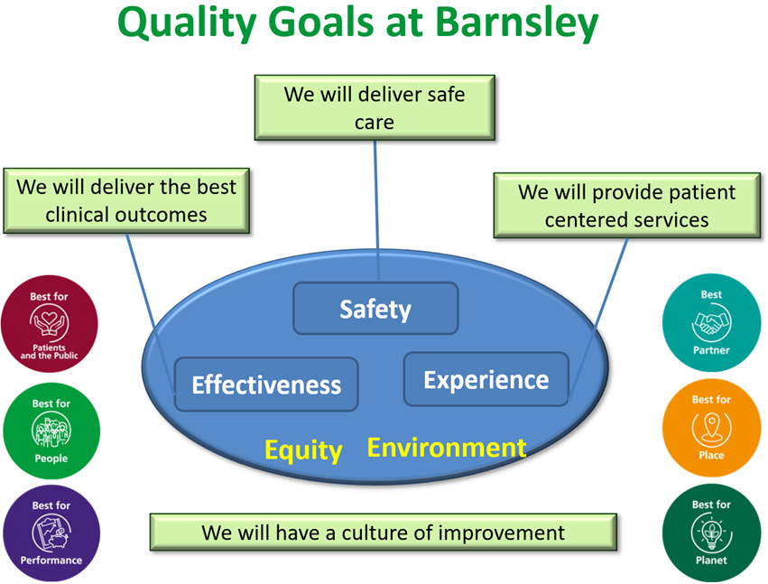
QI approach – problem definition
The problem we want to work on is…
that patients from most deprived areas have more missed appointments than those from the least deprived areas
It matters to work on this because…
this is not equitable (and the other two!)
We will make our services fairer
Notes:
In terms of equity in health services we are talking about fairness in four broad areas - access to our services, the provision of information, experience of services and health outcomes. Making things fairer is about identifying how the way our systems and services have been designed gives some people a significant advantage and means they are more likely to benefit.
We know that generally, people who are White, who speak English, who are well educated and have good literacy, who are on higher incomes and live in the least deprived areas find it easiest to access and navigate health services and have the best health outcomes.

Slide 15
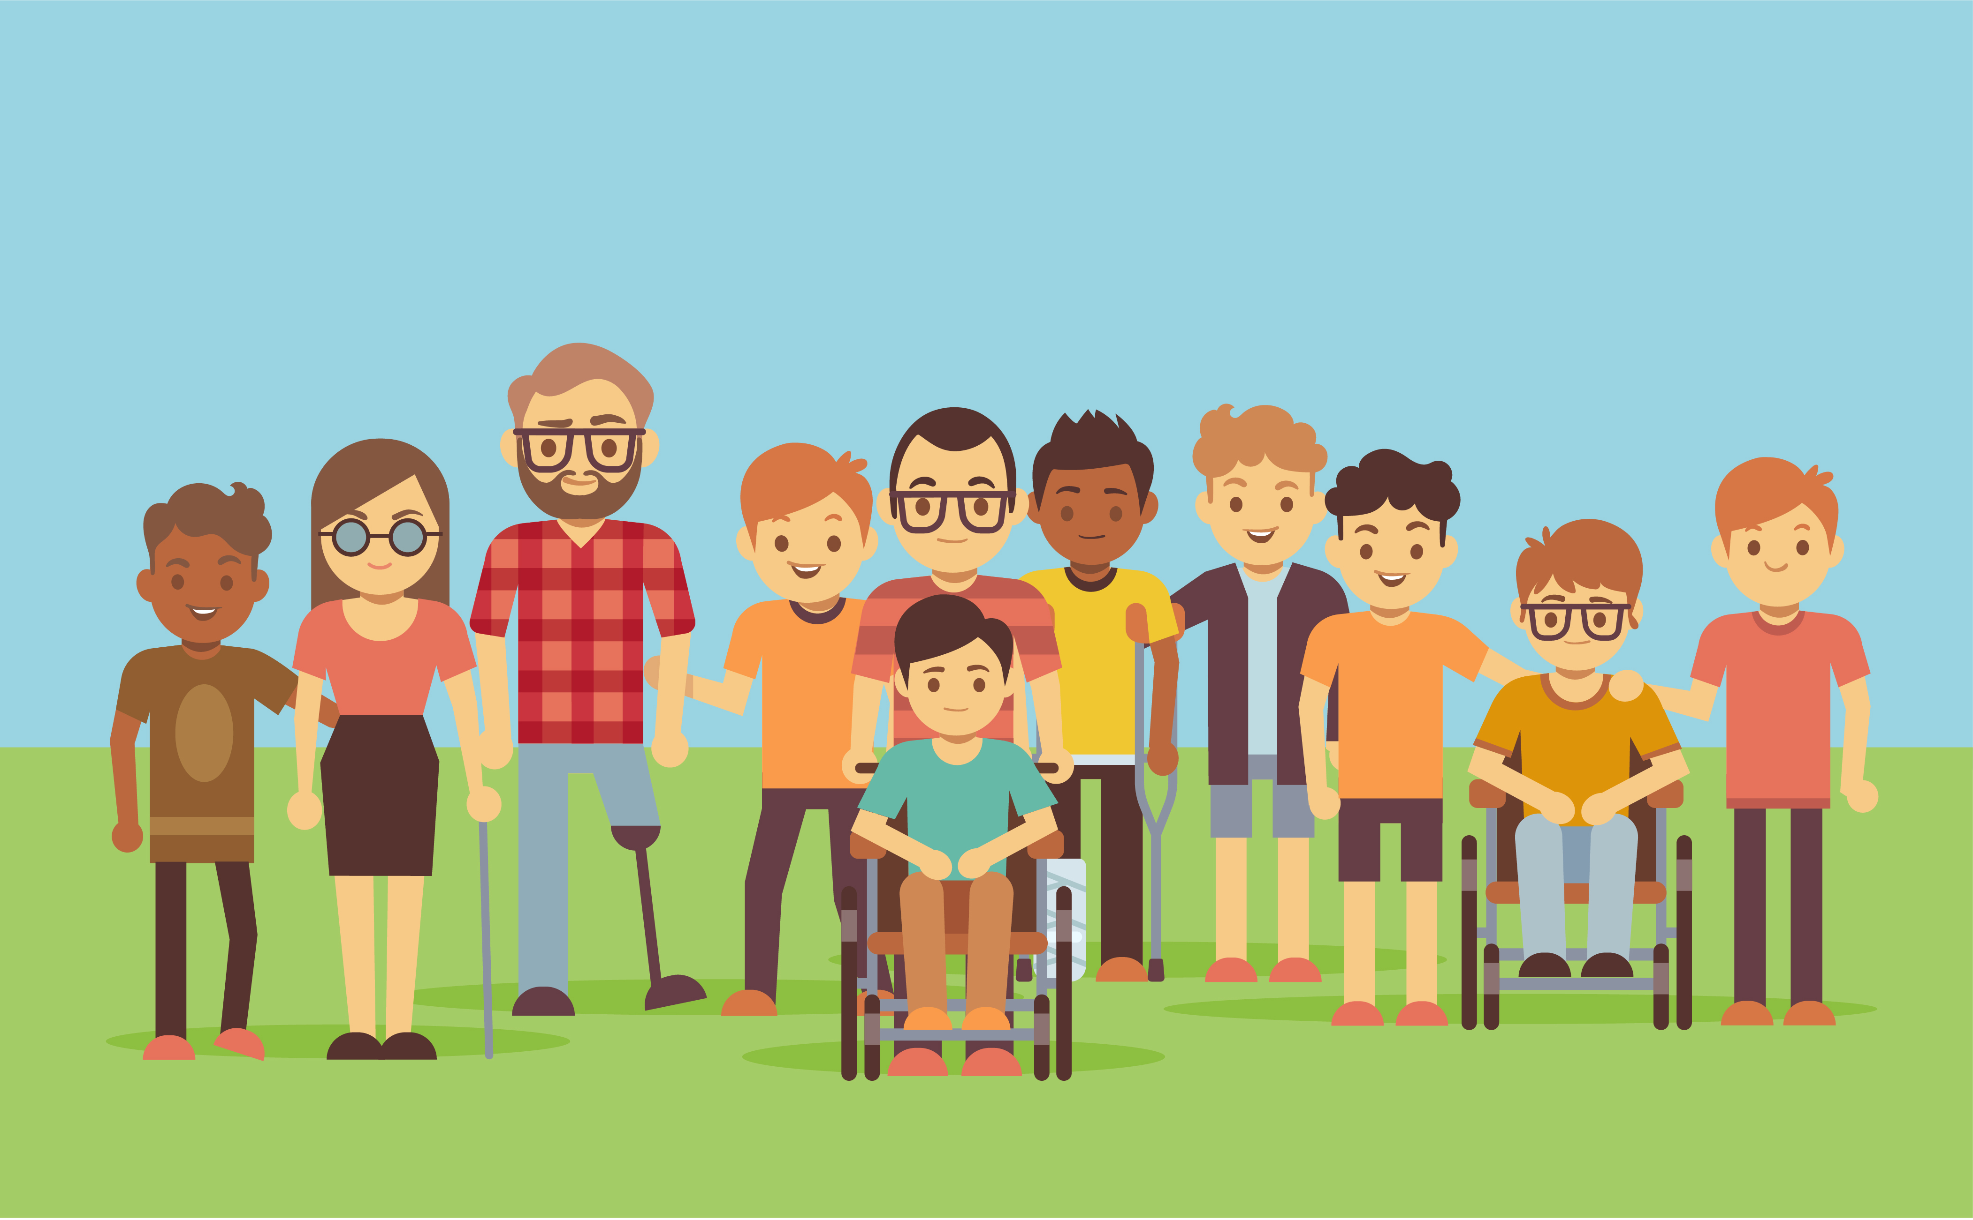
QI approach – stakeholders
Importance of engaging with the people experiencing healthcare inequity.
Understanding the drivers for missed appointments is key to addressing.
If a group is seldom heard then how can we listen better?
  Be inclusive – think about digital vs non-digital approaches, literacy levels, language needs and interpreting provision, days/times, accessible venues, transport and other costs, formal/informal settings, reasonable adjustments
  Build trust – work with VCSE partners and community leaders and networks, take time, be honest and realistic
  Value people’s input – reimburse time and costs, take action, give feedback
Notes:
In terms of equity in health services we are talking about fairness in four broad areas - access to our services, the provision of information, experience of services and health outcomes. Making things fairer is about identifying how the way our systems and services have been designed gives some people a significant advantage and means they are more likely to benefit.
We know that generally, people who are White, who speak English, who are well educated and have good literacy, who are on higher incomes and live in the least deprived areas find it easiest to access and navigate health services and have the best health outcomes.

Slide 16
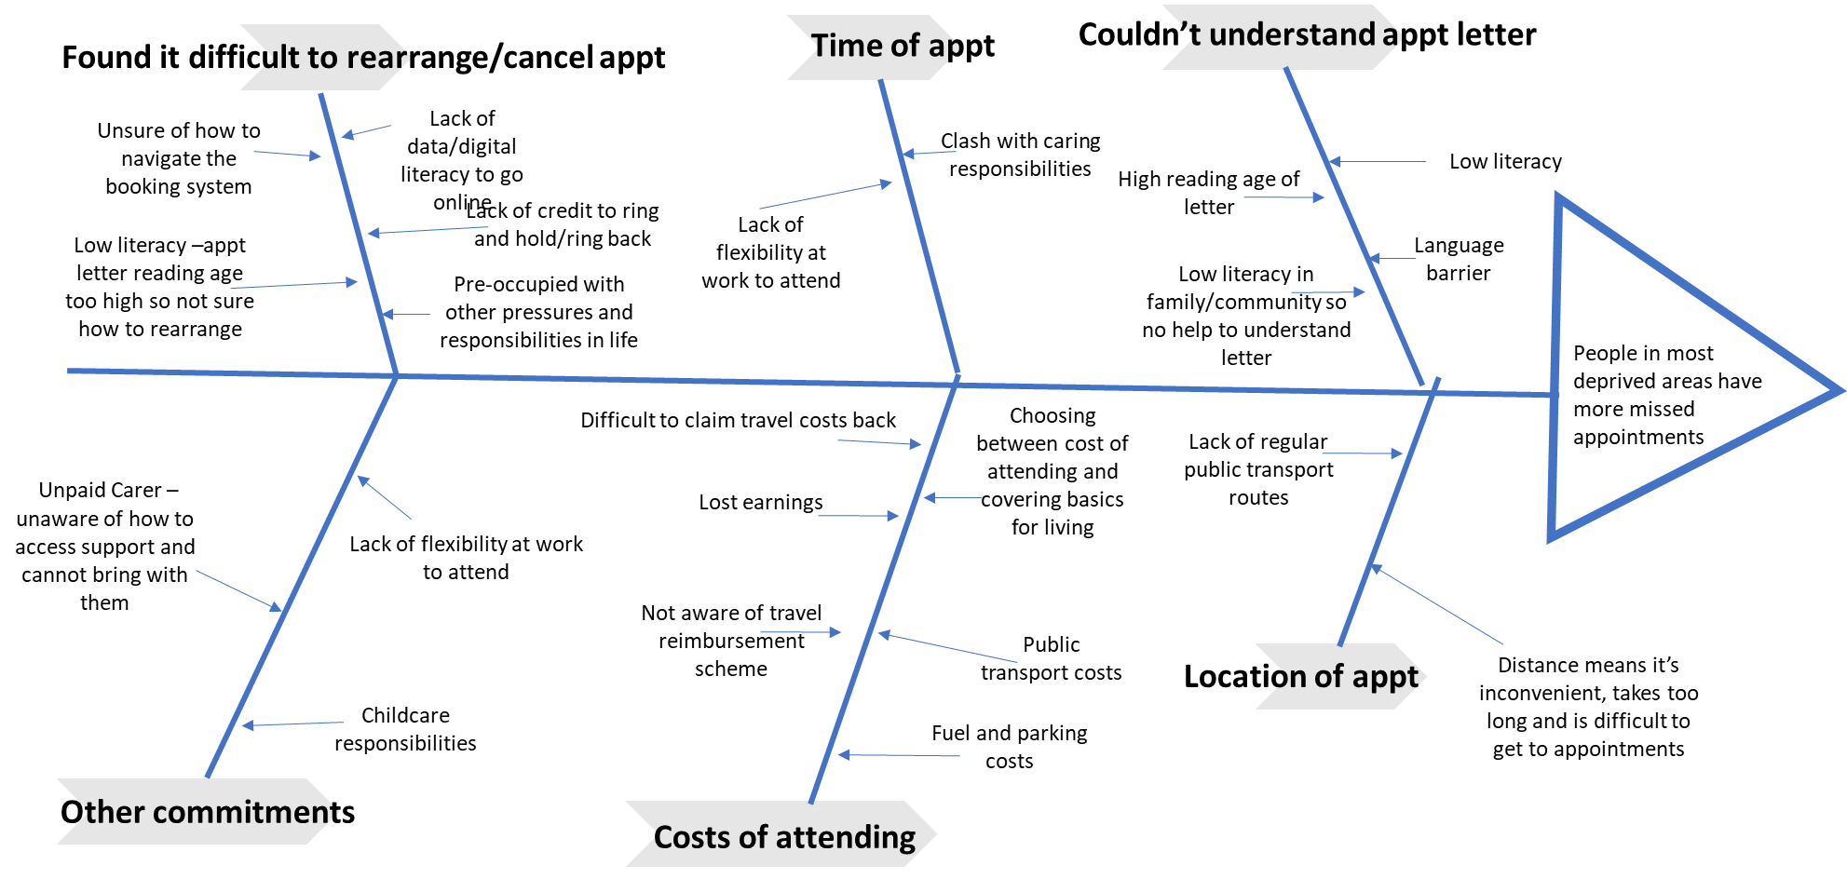
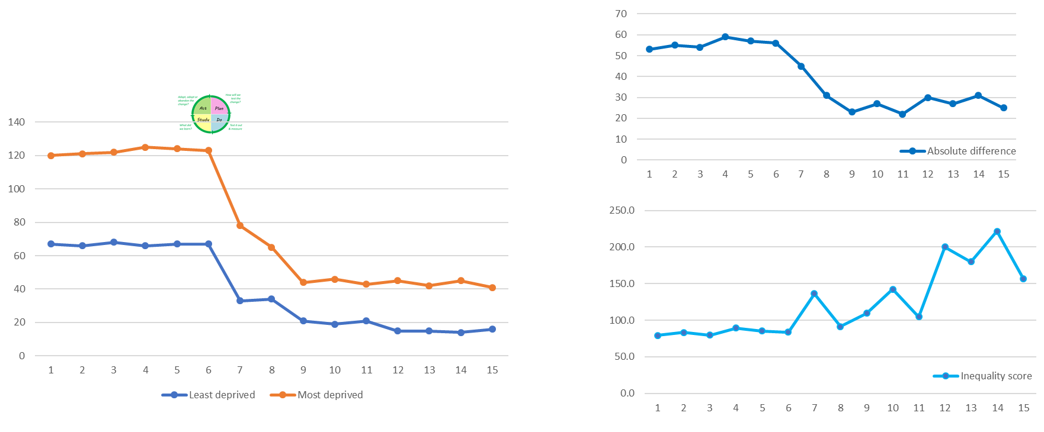
QI approach – understanding need
Gather baseline data on outcomes & access for target groups (Core20+).
Get help on the key skills required (BI, public health, invest in capacity/ development).
Develop monitoring tools such as run charts and integrate into quality & performance reporting.
Develop process maps to understand the problem, exploring barriers through engagement.
Notes:
In terms of equity in health services we are talking about fairness in four broad areas - access to our services, the provision of information, experience of services and health outcomes. Making things fairer is about identifying how the way our systems and services have been designed gives some people a significant advantage and means they are more likely to benefit.
We know that generally, people who are White, who speak English, who are well educated and have good literacy, who are on higher incomes and live in the least deprived areas find it easiest to access and navigate health services and have the best health outcomes.

Slide 17
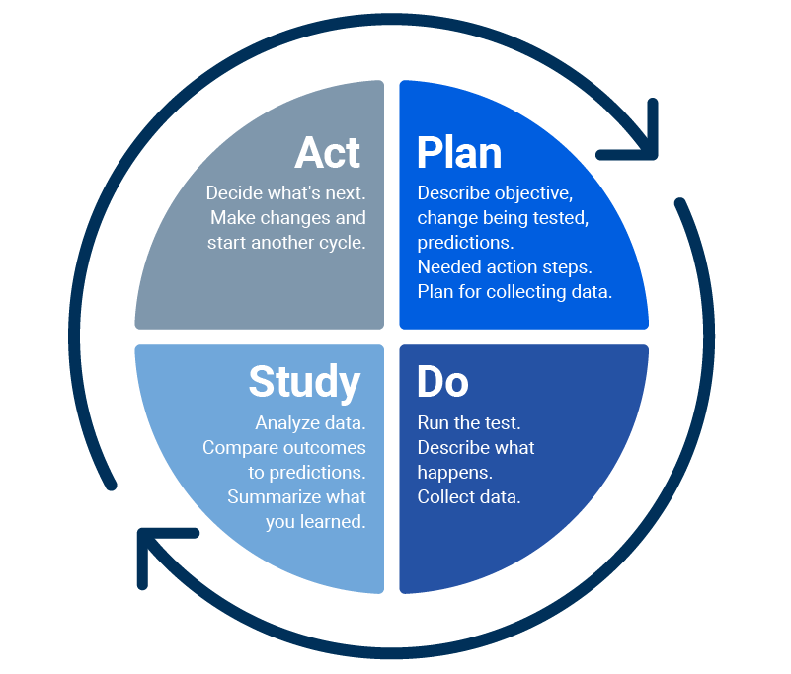
QI approach – aim statements
We aim to decrease the difference in the percentage of missed appointments between the most and least deprived patients by half, by July 2023.
Notes:
In terms of equity in health services we are talking about fairness in four broad areas - access to our services, the provision of information, experience of services and health outcomes. Making things fairer is about identifying how the way our systems and services have been designed gives some people a significant advantage and means they are more likely to benefit.
We know that generally, people who are White, who speak English, who are well educated and have good literacy, who are on higher incomes and live in the least deprived areas find it easiest to access and navigate health services and have the best health outcomes.

Slide 18
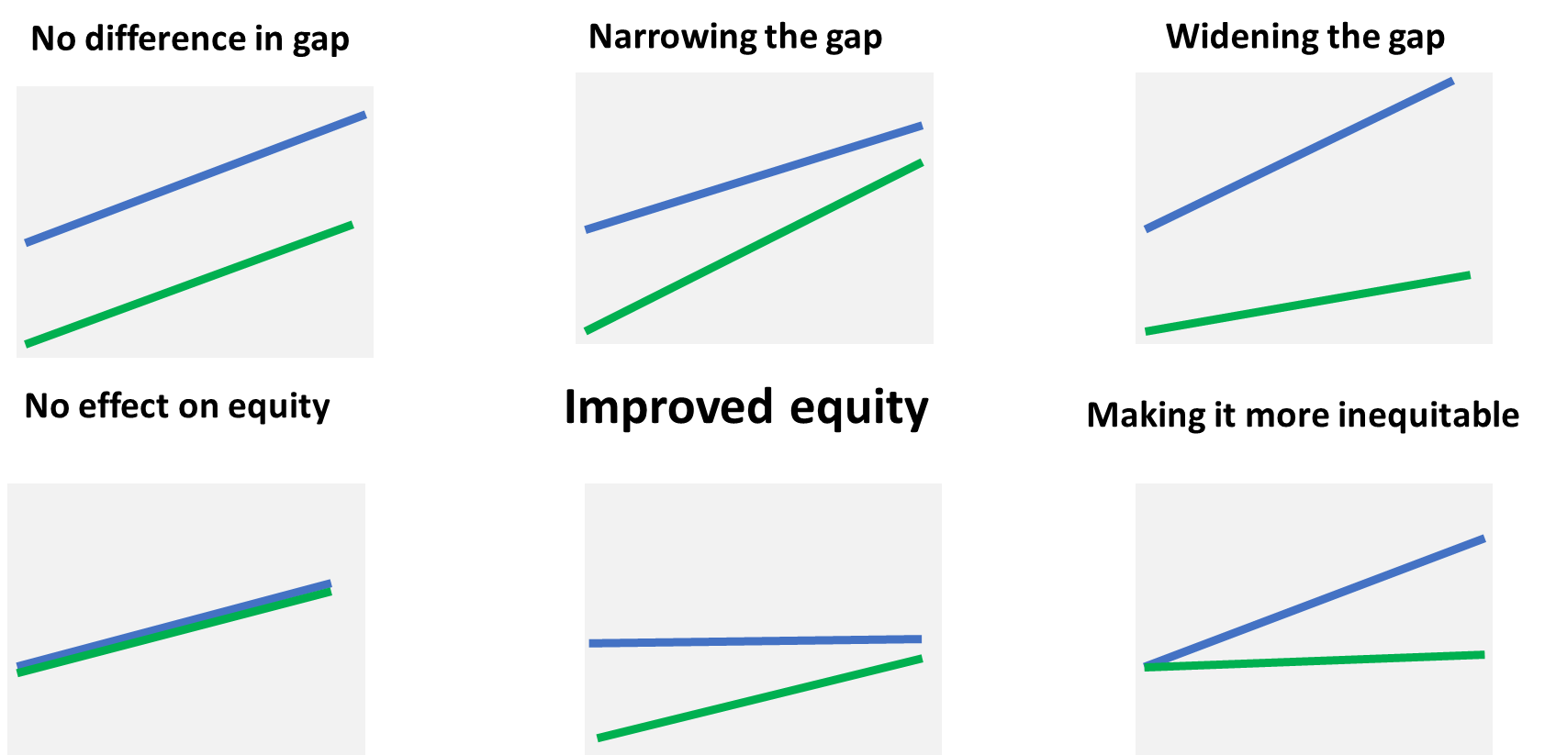
QI approach – how will we know
Notes:
In terms of equity in health services we are talking about fairness in four broad areas - access to our services, the provision of information, experience of services and health outcomes. Making things fairer is about identifying how the way our systems and services have been designed gives some people a significant advantage and means they are more likely to benefit.
We know that generally, people who are White, who speak English, who are well educated and have good literacy, who are on higher incomes and live in the least deprived areas find it easiest to access and navigate health services and have the best health outcomes.

Slide 19
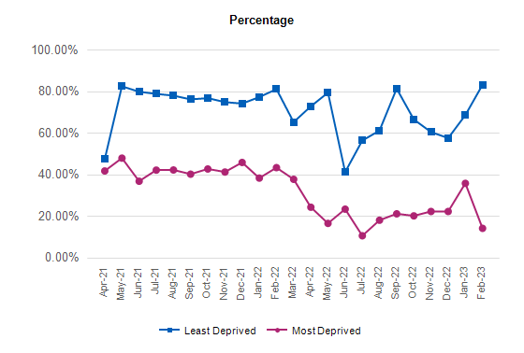

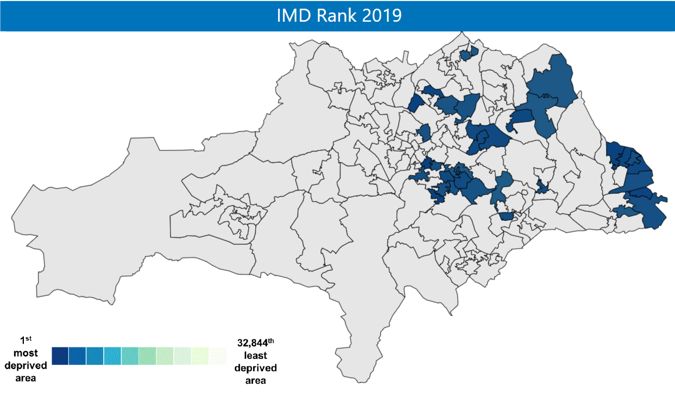
QI approach
Not only DNA rates associated with the pathway …
Maternal and household smoking associated with the pathway
Nutrition in early years associated with the pathway
“VOICES”
Notes:
In terms of equity in health services we are talking about fairness in four broad areas - access to our services, the provision of information, experience of services and health outcomes. Making things fairer is about identifying how the way our systems and services have been designed gives some people a significant advantage and means they are more likely to benefit.
We know that generally, people who are White, who speak English, who are well educated and have good literacy, who are on higher incomes and live in the least deprived areas find it easiest to access and navigate health services and have the best health outcomes.

Slide 20
Over to Bob!

Slide 21
Thank you.
This is only the beginning!
Bob Kirton & Andy Snell. 26 July 2023.

Slide 22
Improver perspective: Lewisham and Greenwich NHS Trust
Beckie Burn – Associate director of transformation, Lewisham and Greenwich NHS Trust and Q member

Slide 23
Reflections from an improver perspective
Beckie Burn beckie.burn1@nhs.net
26 July 2023

Slide 24












A bit about me

Slide 25



What it’s like to be an improver in complex systems
Before
During
After?

Slide 26




Some examples of our collaborative work
Eltham Community Diagnostic Centre
Lewisham Integrated Programme Team
Q Exchange health inequalities in waiting lists
High Volume Surgical Hub

Slide 27









High impact actions Board members can take
Although we’re not hitting the target do we know if the interventions we’re making are starting to have an impact? Could you bring back the data in an SPC to tell us more?
The best next step would be to arrange a process mapping session – can we bring that work back here in two months?
What training to do we have on improvement for leaders and how can I attend?
I’d find it really helpful to see this issue and the multiple projects addressing it in a driver diagram – do you need help from the improvement team to do that?
Ask for data in SPC charts
Make improvement an action from every meeting item
Attend improvement training
I was in a national session last week where this issue came up repeatedly, can we rescope this project with other providers and bring back a proposal for doing this jointly?
Learn and recommend a couple of useful improvement tools
Request Making Data Count training
Ask if internal projects could be done across providers / place
What does our data tell us about how this issue affects different populations? Can we focus this project on the groups most disproportionality affected?
Only sign off projects that embed addressing inequalities
Share training offer across your system
Sign up and stick to shared governance arrangements
As this is a system project, how much decision-making can we delegate to the project Board and how can we facilitate this?

Slide 28
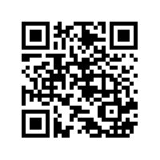
Evaluation
Tell us what you think
Scan here to access our evaluation or use the link in the chat

Slide 29
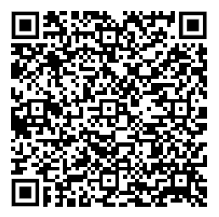
Upcoming events
Book now/save the date:
Bok now/Save the date:
Wednesday 13 September | 10.30am – 12.00pm
  Peer learning event - Improving access: The value of a data driven approach

Slide 30
Thank you for attending

