Slide 1

Improving waiting lists equitably: the importance of a partnership approach

Slide 2
Agenda
Welcome and introduction
Facilitated by chair: Penny Pereira – Managing director, Q Community
Presentation one:
Ruth Robertson, Senior Fellow, The King’s Fund
Presentation two:
Russell Nightingale, Chief Operating Officer, Harrogate and District NHS Foundation Trust and also West Yorkshire Association of Acute Trusts
Presentation three:
Chris McCann, Director of Communications, Campaigns, and Insight, Healthwatch
Reflections and interactive Q&A
Facilitated by chair
Summary and close

Slide 3
Reflections – fill in this slide to help you reflect on the event and consider your next steps
What insights are you hearing that relate to improvement?
What insights are you hearing that relate to collaborative working?
What insights are you hearing that relate to equity?
How is what you are learning relevant to work in your context? What actions might you take following this learning?

Slide 4
Housekeeping
Please note, this event is being recorded
Please keep your camera on wherever possible
If you lose connection, please re-join using the link in your joining instructions or email Improvement@nhsproviders.org
Please ensure your microphone is muted during presentations to minimise background noise
Please feel free to use the chat box for any questions or comments
If you would like to ask a question audibly, please use the raise hand function during the Q&A section and we will bring you in
Any unanswered questions will be taken away and answered after the event
You will receive a link to an evaluation form at the end of the day, please take the time to complete it, we really do appreciate your feedback.

Slide 5
Presentation one:
Ruth Robertson, Senior Fellow, The King’s Fund

Slide 6

Taking an inclusive approach to tackling the elective care backlog
Ruth Robertson
The King’s Fund
@RuthRobbo
Work funded by

Slide 7


What has the NHS been asked to do?
Inclusive recovery

Slide 8
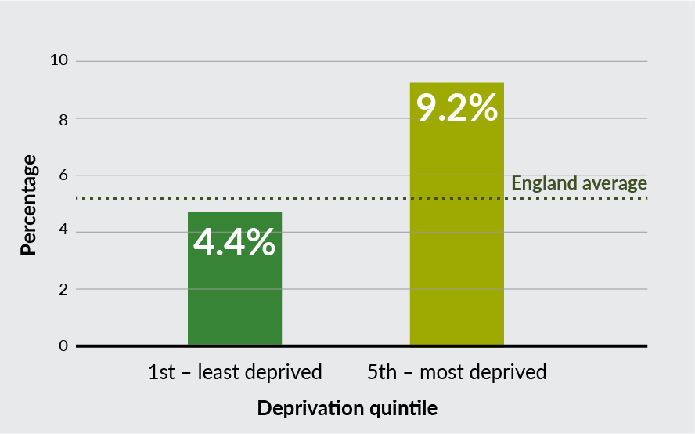
What are inequalities on waiting lists?
People living in the most deprived areas of England are more than 2x as likely to wait > a year for elective care than people in the least deprived areas, August 2022.
Why?
Social, economic and structural factors mean some people wait longer for treatment than others for non-clinical reasons or are more affected by the wait. It might be more difficult for some people to:
Attend appointments: offering, eg, support with transport costs or evening appointments might help
Navigate the system: offering, eg, longer appointments or support articulating health issues and advocating for treatment might help
Maintain their health while on the waiting list, offering, eg, pre-habilitation to support people to get the best outcomes from treatment when they reach the top of the list might help
Continue their daily activities while they wait: considering someone’s job or caring responsibilities as part of the decision to treat might help.

Slide 9

What we found
Method: Case studies in three trusts/ICBs and AI (n=39, Dec 2022 – June 2023), board paper review, data analysis, lit review
Found that this work is at an early stage – most trusts and ICBs they looked at were yet to disaggregate their data.
There are examples of targeted access and prioritisation interventions that are reducing inequalities on waiting lists, but these tend to be about stopping people falling down the list rather than pushing people up.
Reasons for a lack of progress include:
  a lack of analytical capability and good-quality data
  the need to engage clinicians and other staff more effectively in new approaches
  NHS organisations not being held to account for this work; their focus is on reducing long waits
  a lack of clear vision on why inclusive recovery is important to delivering better and fairer services.

Slide 10
There are opportunities to take an inclusive approach at various stages of the patient journey
Identification and referral of patients
Decision to treat
Treatment accessibility
Pre-treatment, assessment and management
Waiting list management
and prioritisation
Used AI to target prehabilitation support to people at highest risk of poor health outcomes from their treatment.
Cheshire and Merseyside
Integrated Care System
Developed an algorithm that prioritises people on the waiting list using a wider set of factors than date the person joined the list and broad clinical P codes.
University Hospitals Coventry
and Warwickshire NHS Trust
Identified inequalities in DNAs linked to deprivation and other factors and offered extra support to attend appointments – a pilot reduced DNA rates to 1% in the intervention group compared to 50% for those not contacted.
University Hospitals of Leicester
NHS Trust

Slide 11




Recommendations for integrated care boards
Make the case for change
Take action
Hold ICBs and trusts to account
Set local vision for inclusive recovery with clear goals.
Engage staff and communities in the vision.
Develop a quality data source to explore inequalities and bring together stakeholders to discuss.
Identify and act on inequalities in use of NHS-funded independent sector care.
Share best practice across partners.
Track inequalities on waiting lists as part of core elective recovery monitoring.
Work with ICP to consider what action should be taken in response at system level.

Slide 12
Recommendations for NHS trusts
Make the case for change
Take action
Hold ICBs and trusts to account
Work to engage board, clinicians, ops leads and communities in vision for inclusive recovery using local data to make the case for change.
Highlight specific actions that staff can take to support change, eg, approaches to data analysis, engaging communities, targeted work to reduce DNAs and pre-habilitation.
Work with local communities to understand why inequalities exist and what would work to address them.
Include performance measures relating to inequalities in operational performance dashboards, and monitor inequalities on waiting lists across the organisation.

Slide 13
Questions for ICB and NHS trusts
Is tackling health inequalities a priority within your elective recovery strategy?
What can the board and leaders do to signal the importance of this work?
What are the main barriers to change in your trust/organisation?
Who can you work with across the integrated care partnership on this?
What data do you need to see to understand inequalities on your waiting lists and be assured about progress in addressing them?

Slide 14

The team
Beth Sutherland
Danielle Jeffries
Lotte Row
Nicola Blythe
Nicole Moore
Ruth Robertson
Ros West
Sally Warren
Siva Anandaciva
Thank you

Slide 15

For more information visit:
www.kingsfund.org.uk/health-inequalities-nhs-waiting-lists
r.robertson@kingsfund.org.uk

Slide 16
Presentation two:
Russell Nightingale, Chief Operating Officer, Harrogate and District NHS Foundation Trust and also West Yorkshire Association of Acute Trusts

Slide 17
Improving Waiting Lists Equitably
Russell Nightingale
Chief Operating Officer @ HDFT
Elective Programme Lead
WYAAT & HNY CAP

Slide 18
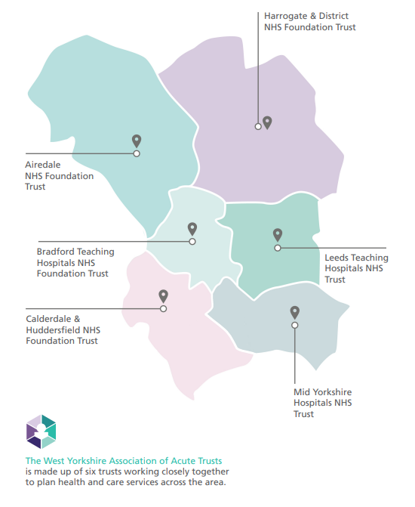
What is WYAAT and why does it exist?
Collaboration of the six acute trusts in West Yorkshire & Harrogate
Self-funded by the trusts
Providing a mechanism to share best practice and learn from each other to tackle unwarranted variation or inequalities in access, outcomes and experience
Leadership of wider programmes on behalf of the ICS
Facilitates clinical, operational collaboration & mutual aid
Prioritising and planning system investments in acute services
Only what the trusts do together and the decisions they take together
Not an organisation
Not “doing things to” the trusts
Notes:
Purpose: to achieve and sustain a collaborative, partnership model of integrated acute and specialist healthcare across WY&H
Vision: Outstanding, high quality acute and specialist healthcare for the whole population of WY&H: consistent, integrated and sustainable

Slide 19
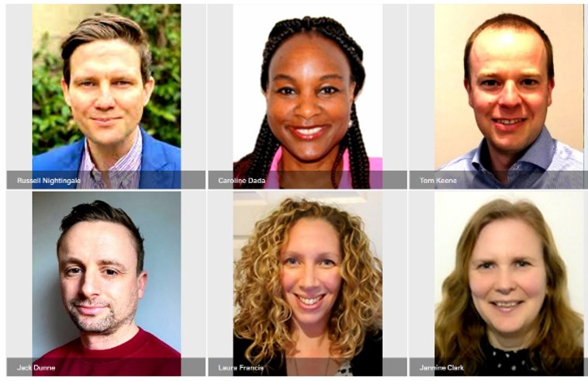
Elective Coordination Group

Slide 20
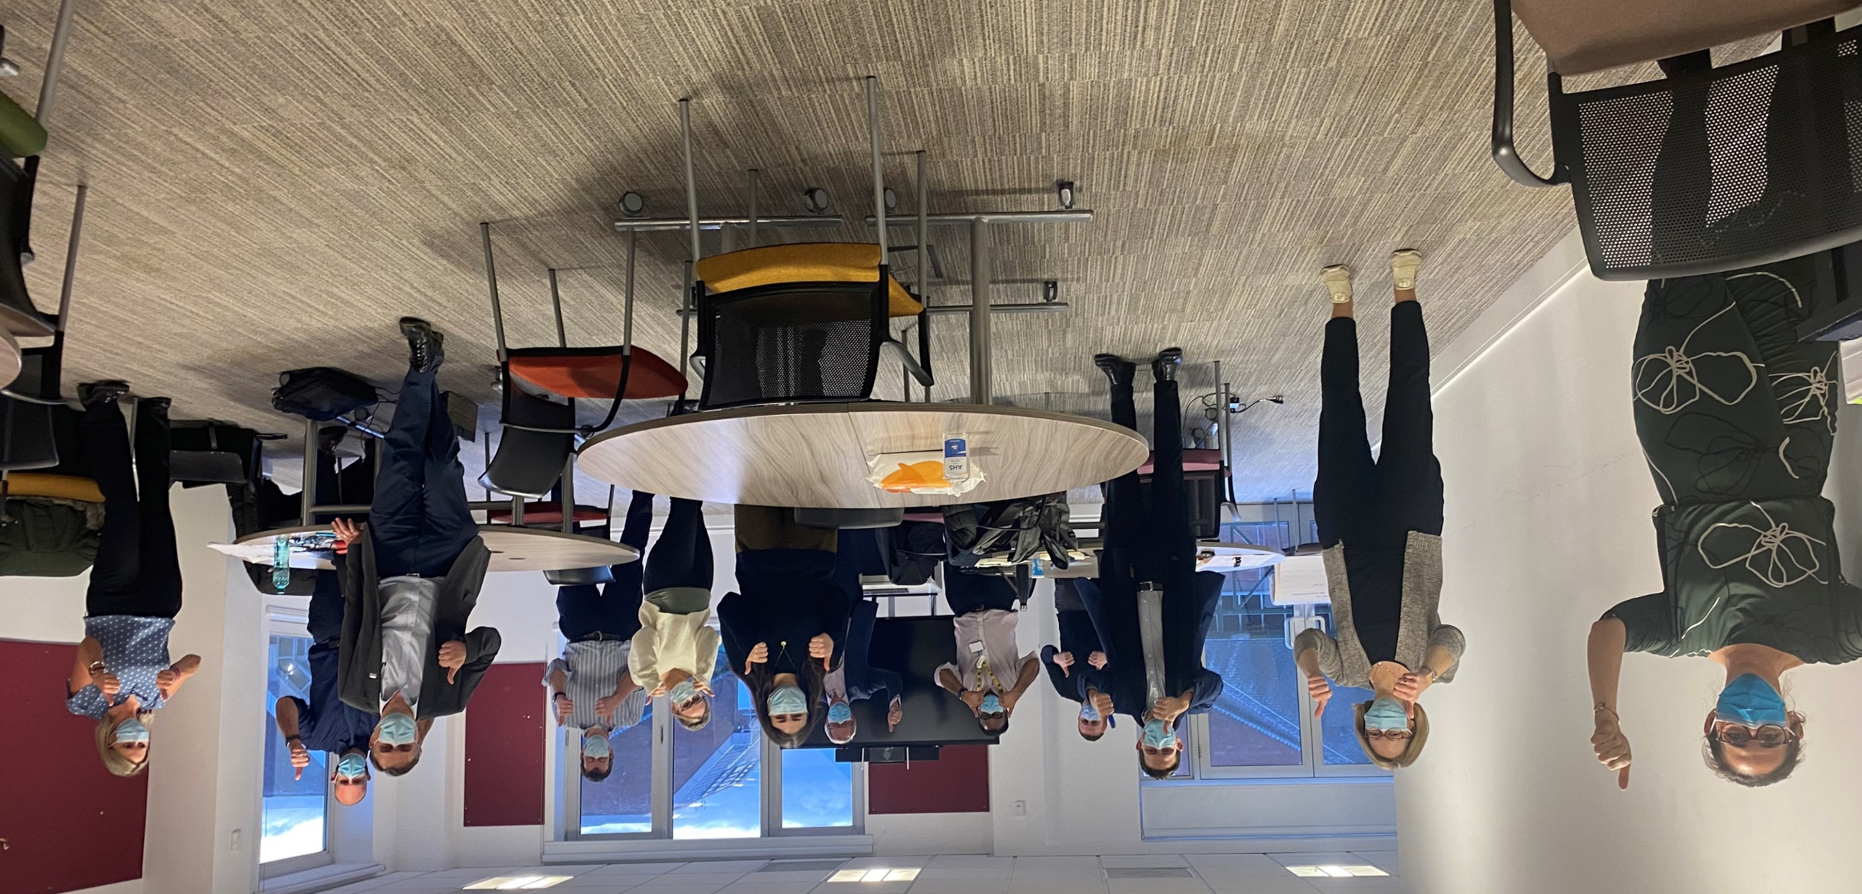
Elective Coordination Group: ECG

Slide 21
ECG Ethos
Overarching: We are in this together, one fails, we all fail.
Treating as many patients as we can as quickly and as safely as possible
Sharing best practice and replicate locally (utilisation of GIRFT/Model Hospital metrics)
Shared use of the Independent Sector (working grp established)
Collaborate on workforce
Consistent approach on prioritisation to ensure equity of access across WYAAT
Underpinning: Radical candour / do what we say we will do.
Notes:
"Failure isn't fatal, but failure to change might be" - John Woode
17 slides and this is number 3, so this hopefully won’t be death by powerpoint.
Fundamental spirit of a culture – ethos
Creating bullshit-free zones where people love their work and working together.
*in clinical and chronological order, where clinically safe to do so.

Slide 22
What have we achieved?
Designed script and process for patient transfers / removed £ as a barrier
Agreed mutual aid framework, IPT’d over 3,000 patients in 20 months
Collective approach to Independent Sector, separate weekly meeting
WYAAT Passport for staff to work on any hospital site
GIRFT action plan held by ECG – moved from individual trusts
Working up plans to collaborate on digital initiatives e.g., RPA and PIFU
Quarterly ER summit (f2f) to review positions against plans and support
Establish and run series of working groups to improve core functions of delivery (e.g., OP:PIFU, POA, IS, )
Shared Access Policy developed and implemented
Targeted work on colorectal at LTHT reduced RTT WL by 43% (5 to 1 Model)
Design and implement clinical networks to drive sustainable change
Notes:
To delvier on what we said we would delvier. ~ 320 patient transferred across providers
Designed script across the organisations and stepped over the funding issues.
Example of step ins.
Back to basics on system access – PTL. Utilisation..theory great, this is a patient where is that going.
GIRFT, best practise.
War on follow ups…more OP.
Orthopaedics:
LOS for Primary Hip is 3.3 days against benchmark of 2.7.
Significant variation within the system for patient with C&H top decile at 2.5 days, Airedale and Leeds are both also top quartile at 3.2 days and MYS are 3rd quartile at 3.7 days . Opportunity for sharing pathways and improvement.
LOS for knees top quartile as a system at 3.5 days against a benchmark of 2.7. Very similar picture to Hips with significant variation for patients. C&H top decile at 2.5 days, LTH 3.6 days and MYS 3.7 days both 2nd quartile and Airedale 3rd quartile 4.0 days.
5 year Hip Revision rates: System 2nd quartile at 0.9% against a target of 0.5% – wide variation within system Airedale top quartile 0.4%, MYS 0.9% quartile 3, LTH 1.4% quartile 4 and Bradford 3.1% 3rd highest trust nationally clearly worth reviewing
5 Year Knee revision rates: system is top decile and 2nd nationally at 1.0% – driven by C&H 0.4% (2nd Nationally) and LTH 0.8% (top quartile), Bradford 1.4% 2nd quartile and MYS 2.0% 3rd quartile. Clearly opportunity for learning within system with C&H exemplar
DC rate for elective hernia. Lowest quartile as a system 67.4%. All 5 trusts in lowest quartile nationally, again Harrogate and Northumbria are excellent against the metric are top decile..we’ve shared our pathways, setup conversations, shared data

Slide 23
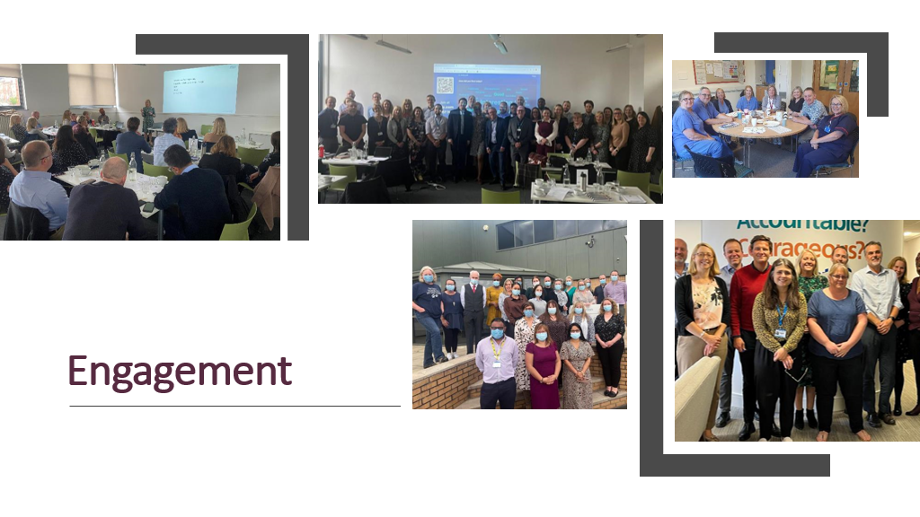

Slide 24
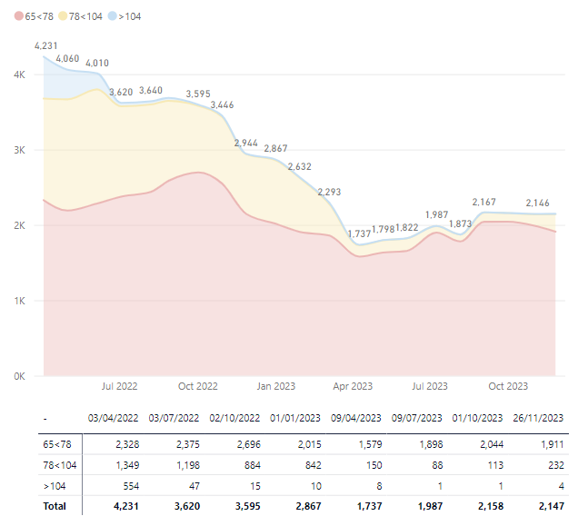
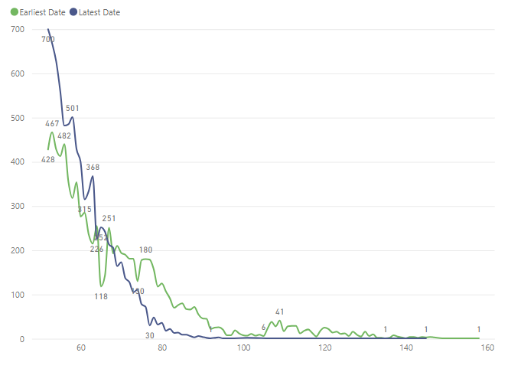
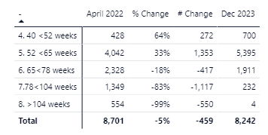
Long waiters list development Apr 22-December 23
52+ week waits comparison: April 2022 and December 23
104 reduction achieved and maintained, persistent small amount of 78 week waits following rapid reduction towards April 2023.
Overall reduction of 5% with marked increase in pathways between 40 and 65 weeks.

Slide 25
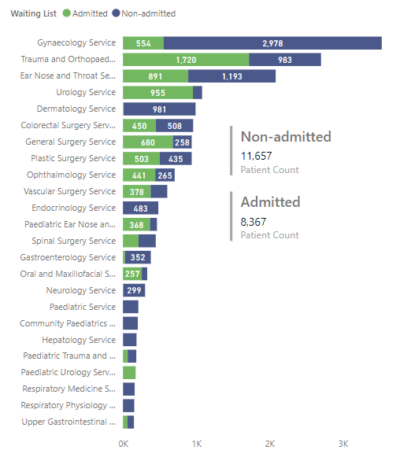
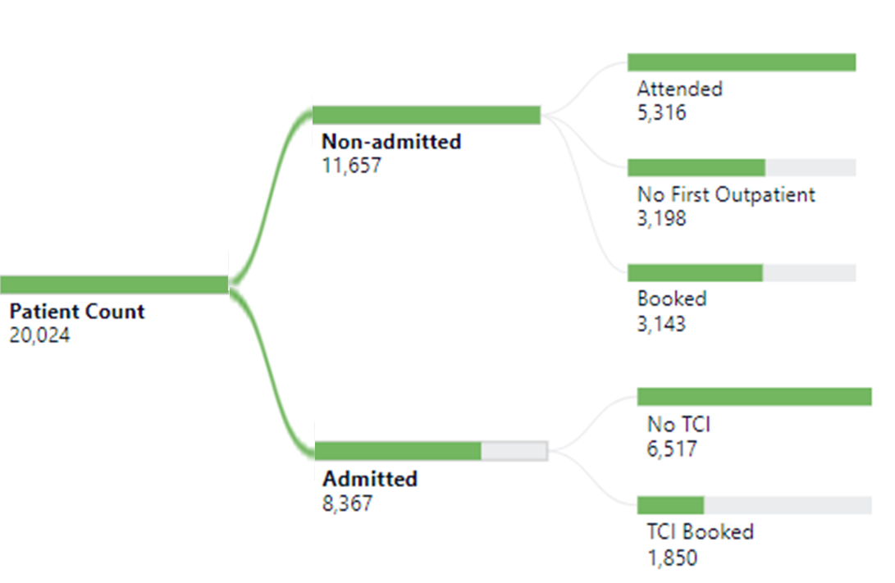
65-week cohort
Pathways that will breach 65w if not treated by 31st March
Notes:
11% / 1282 conversion
21,305
Majority of outpatients will have been given first OP appointment by end of October
Most challenged specialties have established clinical networks

Slide 26
Improving Waiting Lists Equitably

Slide 27
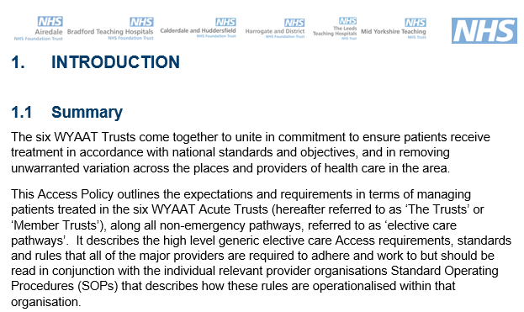
Access Policy

Slide 28


Slide 29
Access Policy

Slide 30
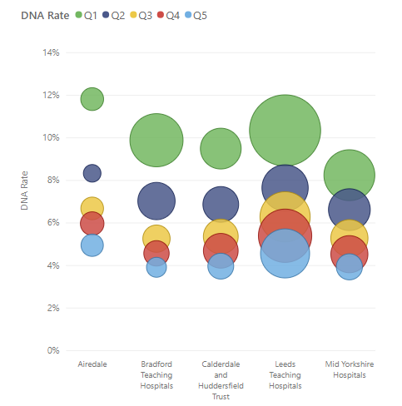
Reducing Missed Appointments (DNA / WNB)
WYAAT Group identified IMD 1-2 as group for focused intervention (47% of all OP DNAs)
RCA of non-attendance (use of volunteers)
DNA analyser algorithms
Review of letter content (Languages)
Patient transport (Claim back)
Reminders at 2, 7, 14, 21 days (OOH)
Action plan at Elective Coordination Group

Slide 31
Learning Disabilities
Learning Disabilities
LD Group & Trusts continue to ensure patients are flagged (inc. in primary care)
Data collection from Trusts showing prioritisation of patients, RTT waiting times and flagging % (prevalence is 0.5% - 1.75% of population)
  Monthly review at Elective Coordination Group

Slide 32
Any Questions

Slide 33
Presentation three:
Chris McCann, Director of Communications, Campaigns, and Insight, Healthwatch

Slide 34



The impact of waiting
Behind the numbers – December 2023

Slide 35

England’s health and social care champion
We make sure NHS leaders and other decision makers hear the public’s voice and use feedback to improve care.
.
We have the power to make sure NHS leaders and other decision makers listen to your feedback and improve care.
Wherever you live in England, you’ll have a local Healthwatch nearby.
We’re entirely independent and impartial.
We help people get the information and advice you need to make the right decisions for them.

Slide 36
The impact of waiting: behind the numbers
With the NHS under immense pressure, it’s important to look at the impact that waiting for a diagnosis, test, or treatment can have on individuals and some of the potential solutions that might help.
From the moment a patient gets referred by their GP for a specialist scan, test or treatment, some individuals may face delays due to the pressures the NHS currently faces.
It’s worth looking at each stage of this journey to highlight the impact that delays can have and the steps that services can take to help support people facing these issues.

Slide 37
Getting a referral
As this is often the first stage in a journey towards treatment, referral delays mean people can wait a long time before their concerns are addressed.
A delay is not only stressful. It can also lead to ongoing pain and sometimes make people’s condition worse than when they were originally referred.
Steps that would help
Our work on GP referrals suggests that people often must make several appointments before being referred. Our suggestions for improving people's experience of GP referrals include:
Better access to GP appointments, including through digital telephony;
More care navigators to ensure a smoother patient journey;
Greater appointment flexibility
Clear and regular communication between staff and patients.

Slide 38
Getting diagnosed
We heard how delays for scans and diagnostic tests mean people are left waiting to know whether they have a condition or the next steps.
People often feel pressured to find out for themselves what is happening rather than wait for further contact.
Searching for answers can lead to frustration as people find different services and departments manage parts of their referral journey. What people have been told about the urgency of their condition does not seem to be acted on.
Steps that would help
Clear and timely communication is important to help patients understand what tests are being done and why.
Once tests or scans have been completed, people need to know when they can expect results and what to do if they feel there is a delay.

Slide 39
Getting treatment
Elective care can also take some time to receive, with waiting times ranging from weeks to several months.
People also tell us about appointments being cancelled at short notice, creating further uncertainty around the expected treatment date.
The feedback shared with us highlights how people might accept waiting times for elective care whilst assuming they will be treated on that date. Life can end up on hold if waiting for procedures related to mobility.
Subsequent cancellations and delays make them feel forgotten, and the reasons for such changes to treatment plans are only sometimes clear.

Slide 40
Getting treatment
Experiences of people who had their care disrupted - this summer we carried out polling of people who had experienced delays to care (postponements of cancellations).
We found that:
39% of the 1,084 people had their care postponed or cancelled on two or more occasions, and
18% of people had their care cancelled or postponed at the last minute, which the NHS defines as on the day or on arrival to the appointment.
Steps that would help improve people's experience of waiting for care include:
Being clear about why appointments and elective care need rescheduling;
Providing a contact when care has been postponed to discuss the implications and what support is available until treatment is received for issues like pain relief or mental health; and

Slide 41
Inequalities
We need to focus on inequalities to address waiting lists
Long delays for treatment, last-minute cancellations, and a lack of personalised information and support are huge concerns for people, particularly for respondents from lower-income households.
Disabled people, those with lower levels of wealth, women, and people from ethnic minority backgrounds are the most likely groups to have experienced long waits for treatment and a delay or a cancellation.
Women and disabled people are also most likely to have been negatively impacted by their long wait for care, with relationships, socialising, ability to provide care for a loved one, and mental health and wellbeing suffering as a result.
People with lower levels of education are more likely than people with higher education to be unhappy with the information the NHS has provided them.
And for people whose identities intersect across several groups, the impacts of long waits can be much worse.

Slide 42
How to improve people's experiences of waiting
:
Provide personalised, clear, accurate and consistent communication to people waiting for NHS treatment, consultation and surgery, including where they are on the waiting list.
Keep people informed about the next steps for their treatment.
Provide a point of contact for people on waiting lists to turn to for advice and support.
Put in place interim support, such as physiotherapy, pain relief and mental health support.
Put in place a system to better manage waiting lists, with a focus on diagnostics to identify what is wrong and better prioritise urgent treatment.
Re-prioritise treatment if people’s needs change.

Slide 43
Reflections and Q&A

Slide 44
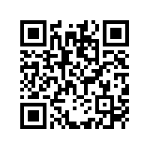
Evaluation
Tell us what you think
Scan here to access our evaluation or use the link in the chat

Slide 45
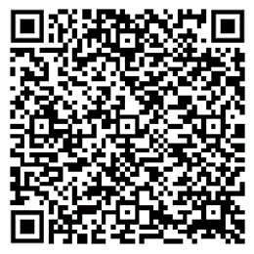
Future events
Upcoming dates:
Events will take place as part of our programme in February and March 2024, and you can access our events from webpage using the QR code below:

Slide 46
Thank you for attending

