Slide 1
Diagnostics Programme
Acute and Specialist Trust Collaborative
Diagnostics Programme
Our journey – developing capacity Ben Vinter
January 2024
Modernising Diagnostics

Slide 2
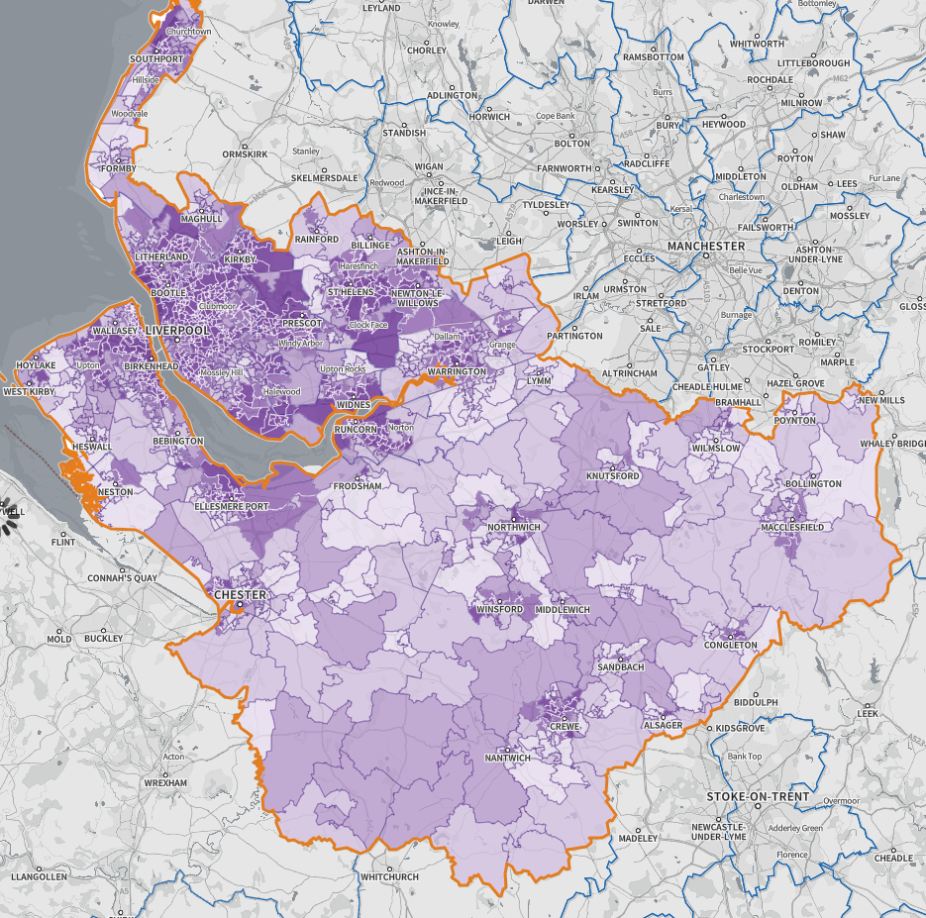
Cheshire and Merseyside Acute and Specialist Trust Collaborative
Population
2.7 million people
23% of neighbourhoods most
deprived in England
1.154 square miles
NHS Trust Hospital Sites
CDCs
Organisations
349 GP Practices
47 Primary care Networks (PCNs)
7 Acute Trusts
5 Specialist Trusts
9 Places
3 Community/Mental Health Trusts
1 Ambulance Trust

Slide 3
Orientation: Who are we
12 acute and specialist trusts in C&M
Developed from hospital cell and strong pandemic collaboration
Initial focus: mutual aid, resilience, improvement / transformation
Developmental focus on vision, values, relationships and behaviours and restoration and recovery priorities – for around a year
Alongside our development we established and implemented a programme approach – reflecting our priorities
Links with other forums through: place, programme boards, ICB etc – ongoing
Governance foundations well established through leadership behaviours, Chairs plus, culture and Joint Working Agreement and Committees in Common approach – 15 – 18 months through our journey. Now 3 years
CMAST is one of nine provider collaboratives across England to secure NHSE Provider Collaborative Innovator status – supported timely reflection and validation

Slide 4
CMAST Priorities
Working effectively with places, Partners and stakeholders to improve the health and wellbeing of the population of Cheshire and Merseyside by:
Reducing health inequalities
Improving access to services and health outcomes
Stabilising fragile services
Improving pathways
Supporting the wellbeing of our staff and developing more robust workforce plans
Achieving financial sustainability
Our work and programme delivery are governed through our established CMAST governance and networks

Slide 5
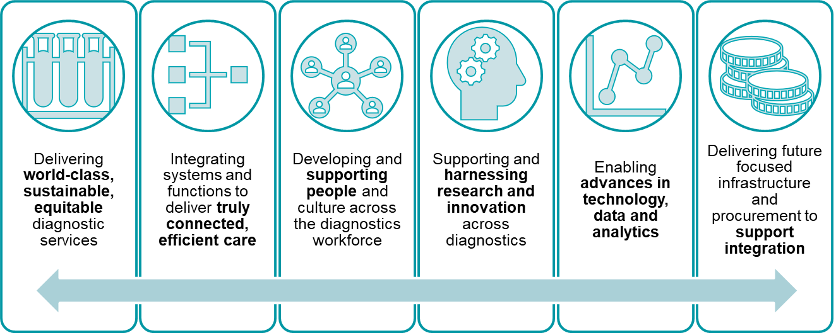
Strategic Direction
The Diagnostics Programme has set out an ambitious
5-year strategy (2023-28) to deliver against six key priorities:
Increase Capacity
Standardise Pathways
Reduce Demand
Maximise Productivity
Digitalise & Innovate
To deliver we will:

Slide 6
CMAST Governance
ICB
Committee In Common
CMAST Leadership Board
Trust Chairs
CMAST Programme SRO Group
Trust Boards
CMAST Operational Performance Group
Director of Strategy Group
CMAST PMO
Groups supporting the CMAST Programme SRO Group
HRD Group
CMAST Programmes (reporting to SRO Group)
MDs Group
DONs Group
Clinical Pathways
Elective Restoration & Transformation
Diagnostics
Workforce
Finance, Efficiency & Value
COOs Group
DOF Group
Notes:
Number of professional groups – meet with leads quarterly
Chairs monthly meetings, chairs attend leadership board quarterly
NED Development sessions
ICB weekly Exec meeting with the Place Directors / attend Place Partnership Boards as required
More work to be done as the system settles and operating models become clearer
Merit to being a newly formed collab

Slide 7
Our initial focus
We initially established 5 programmes and the means to govern and take system decisions when needed.
This work encompassed three core delivery programmes and two enabling programmes
Our programmes:
Elective Recovery
and Transformation
Finance, Efficiency and Value
Includes: Efficiency at scale with includes back office opportunities
Workforce
Clinical Pathways
Diagnostics
Delivery Programmes
Enabling Programmes

Slide 8
Our focus now
Our programmes for 2024 and beyond (emerging from 2023 focus, investment
and system prioritisation):
Elective Recovery
and Transformation
Finance, Efficiency and Value
Workforce
Clinical Pathways
Diagnostics
Efficiency @ Scale
Digital
Enabling Programmes

Slide 9
Our challenges…. Our ingredients for success?
Challenges | Ingredients for success
Inherited cultures and approaches to governance | CEO SRO
Data – access and standard | Shared SRO with Cancer Alliance
Diagnostic islands | System leadership – connectivity and alignment
Capital approaches and timeframes | Relationships
Operational and leadership capacity | Trust

Slide 10
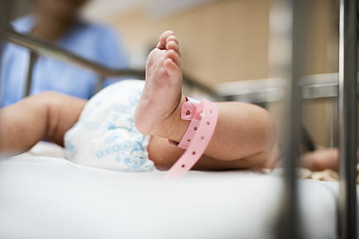
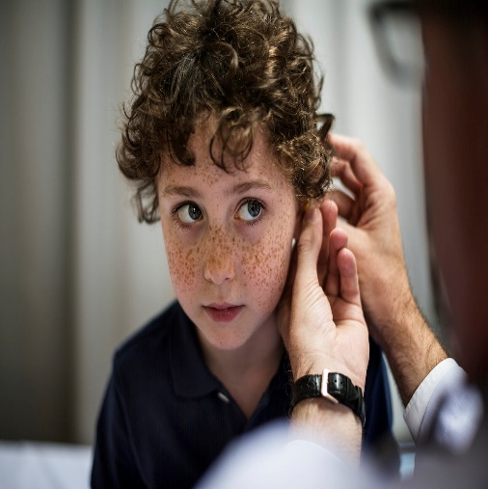
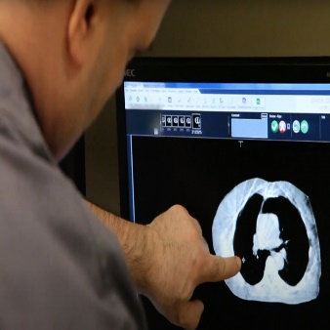
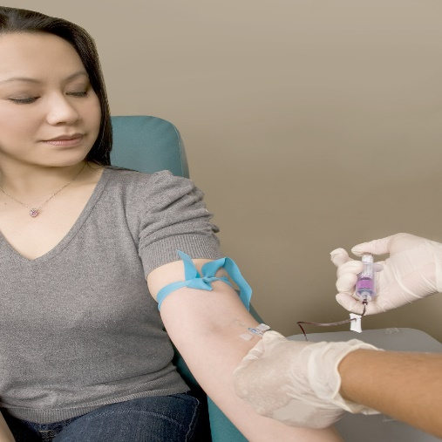
Diagnostics Programme
We have 2.7 million reasons to modernise diagnostics in Cheshire and Merseyside

