Slide 1
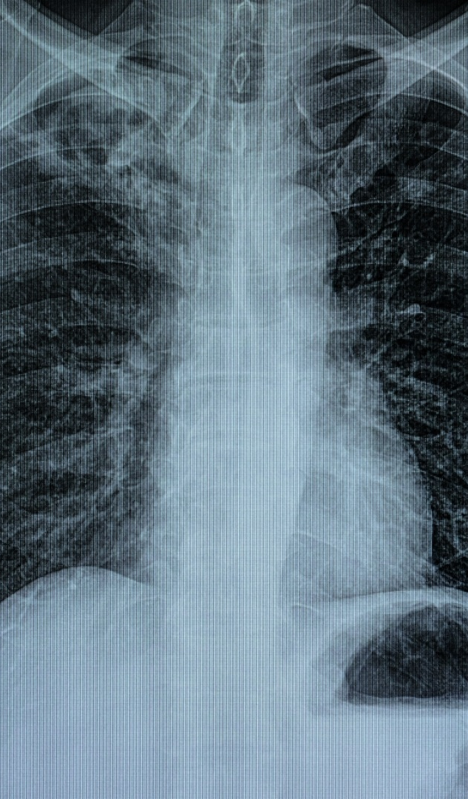


Diagnostics Programme
Tracey Cole
23 January 2024

Slide 2

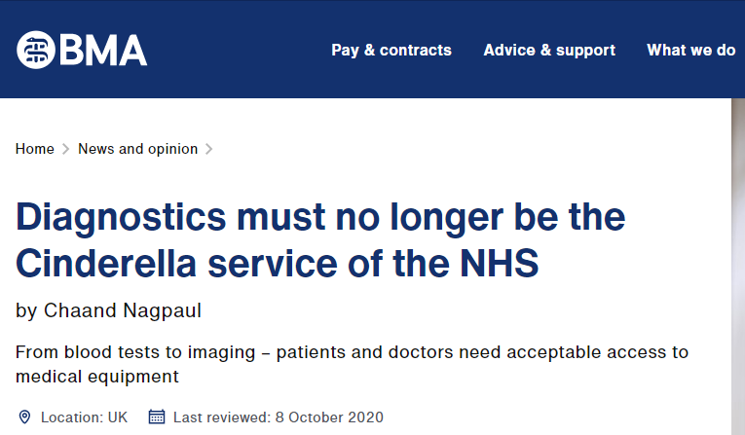
The Importance of Diagnostics
1.5 billion+ diagnostic tests undertaken annually
Diagnostics feature in 90% of patient pathways
Capacity in diagnostics has not kept pace with demand
We have fewer MRI and CT scanners per capita than most OECD countries
Over the last 5 yrs, diagnostic referrals have risen by 25%+
Source: The Long Term Plan
Diagnostics is not just about diagnosis
Prevention through surveillance
Monitoring of long term conditions
Patient experience and speed of pathway
Efficiency: fewer interventions, admission avoidance, reduced length of stay
Understanding outcomes from interventions

Slide 3
Ultimate Vision
Our vision for diagnostics in Cheshire and Merseyside is that everyone can:
Have the best possible start in life
Get the support they need to stay healthy and live longer
Have access to safe, equitable, clinically effective, efficient, innovative,​ timely and sustainable diagnostic services which represent best value for money

Slide 4
Scope
Type of Diagnostics: Incudes all diagnostic tests such as pathology, imaging, endoscopy, screening programmes, cardiorespiratory, neurophysiology and more.
​
Age: Includes patients of all ages ​
​
Geography: Includes all activity for patients registered with a GP in Cheshire and Merseyside noting that some diagnostics are delivered out of area and that not all trusts are members each network. ​Also includes the care delivered to non-C&M patients.
​
Physical & Mental Health: Includes both physical and mental health
Transformation: Includes responsibility for transformation at scale beyond a single organisation. ​
​
Performance and Outcomes: Includes responsibility for improvement against agreed trajectories, quality outcomes and reduced waiting and reporting times at C&M level. ​
Connectivity and Matrix Working: Includes interoperability with existing C&M Programmes such as Digital, Cancer Alliance, CVD and more.​
​
Triple Aim: To deliver the five year forward view triple aim of improved population health, quality of care and cost control.

Slide 5
Tests Covered by the Programme
Endoscopy
Gastroscopy
Colonoscopy
Flexi Sigmoidoscopy
Cystoscopy
Capsule Endoscopy
Cytosponge
Fibroscan
Hysteroscopy
Nasendoscopy
EBUS
Imaging
MRI
CT
CT Cerebral Perfusion
CT Colonography
CT Guided Biopsy
PET-CT
ECG-gated CT
Non-Obstetric Ultrasound
Obstetric Ultrasound
Trans-Vaginal Ultrasound
Plain Film Xray
Dexa
Fluoroscopy
Cardiac Catheterisation
CT Cardiac Scan (functional)
CT Coronary Calcium Scoring and CT Coronary Angiography
CT Coronary FFR (Fractional Flow Reserve)
Cardiac MRI
Adenosine Stress Cardiac MRI
Myocardial Perfusion Imaging (MIBI / stress MIBI)
Barium Enema
+ Interventional Radiology
Physiological Measurements
Echocardiography - Transthoracic (TTE)
Echocardiography - Transoesophageal (TOE)
Stress Echocardiography: Dobutamine Stress Echo (DSE) and/or Exercise Stress Echo (ESE)
Exercise Stress Test (Treadmill or Bicycle)
Echo - Bubble/Contrast
Echo - 3D/4D
ECG (12-Lead)
ECG Using the Kardia AliveCor Device
Implantable ECG Monitor (ILR Implantable Loop Reader)
Ambulatory Blood Pressure Monitoring (ABPM)
Home Blood Pressure Monitoring (HBPM)
24-72 hr Ambulatory ECG (Holter)
72 hr to 14 day ECG Monitoring
FeNO
Spirometry (Monitoring)
Spirometry + Reversibility (Diagnostic)
Multi-Channel Sleep Study
Inpatient Polysomnography
Bronchial Challenge Test
Cardiopulmonary Exercise Test
Field Walking Test
Detailed Lung Function Using a Gas Dilution Technique
Detailed Lung Function Using Plethysmography
Blood Gases (Arterial or Capillary)
GI Physiology
Urology (Urodynamics)
Audiology (Diagnostic)
EEG
Peripheral Neurophysiology
Pathology
Phlebotomy (Biochemistry and Haematology)
NT Pro BNP/BNP
Albumin to Creatinine Ratio (ACR) Urine Test
Protein to Creatinine Ratio (PCR) Urine Test
D-Dimer as Point-of-Care Test
Urea & Electrolytes as Point-of-Care Test
FIT Test
Microbiology
Biopsy / Histopathology

Slide 6







Variation & Duplication
15 Tests Reporting
Only 15 tests reported through national returns
18 Diagnostic Providers
18 significant providers of diagnostic services for C&M patients
30 Digital Systems
30 different digital systems identified (to date) in the booking, delivery, and reporting of diagnostics
24 Access Policies
24 access policies for diagnostics
20 Minimum Tests
CDCs deliver a minimum 20 tests
43 National Pathways
43 Prioritised Symptom Based Pathways
25+ Staffing Groups
25+ groups involved

Slide 7
Diagnostics Governance
C&M Integrated Care Board
National Assurance
NHSEI
National & Regional Diagnostics Board
CMAST
C&M Diagnostic Delivery Board
Local & Regional Assurance
1
2
5
Community Diagnostic Centres
Endoscopy
4
Imaging
3
Pathology
Physiological Measurements
Digital Transformation
Cross
Cutting Themes
Workforce
Procurement
Capital
Patient & Public Involvement

Slide 8

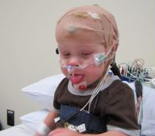

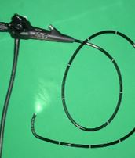
What Has Been Delivered?

Slide 9
Then... Now…
Diagnostics Programme
90%+ of patient pathways include a diagnostic test
X patients waiting longer than 6 weeks for a diagnostic test
Huge, complex, diverse programme
Mass variation in access and performance inequalities
Programme established November 2021
No system reporting
75% of patients seen
in 6 weeks
Chronic under investment
87,000
tests per month
Services working
in silos
Ranked 20th out of
42 ICSs
System oversight & reporting
83% of patients seen
In 6 weeks
£112m investment secured
112,000
tests per month
Overarching programme for all diagnostics
Ranked 12th out of
42 ICSs
0
Community Diagnostic
Centres
Fragmented governance
10
Community Diagnostic
Centres
Clear governance

Slide 10
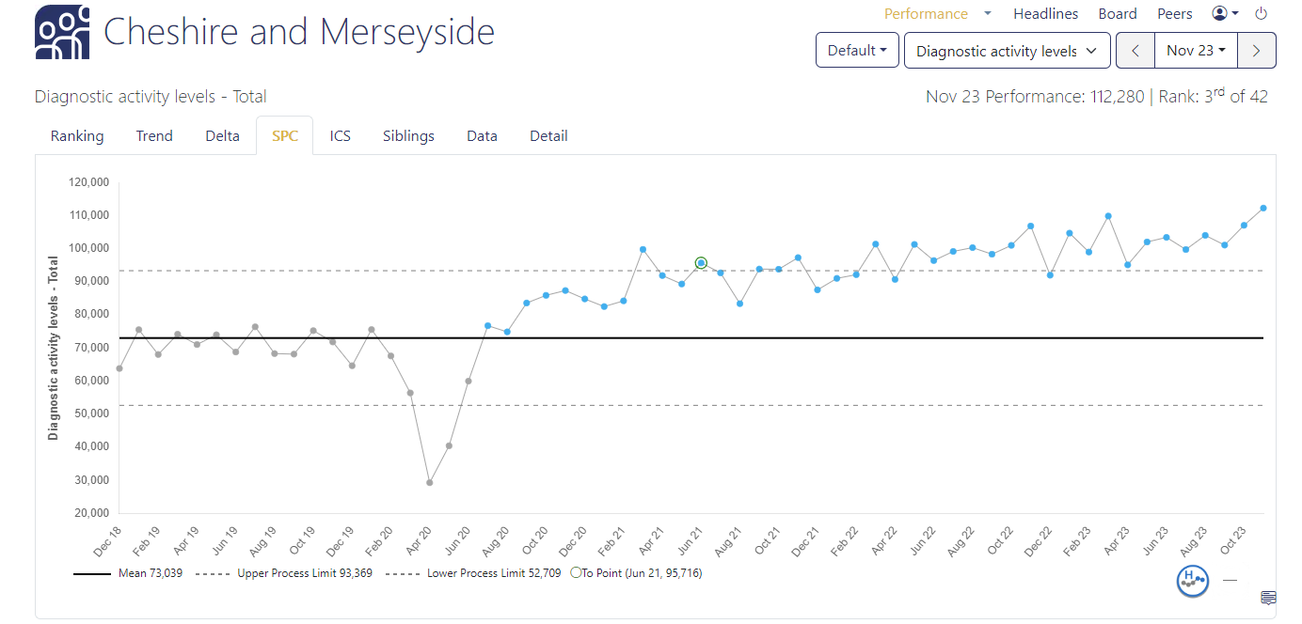
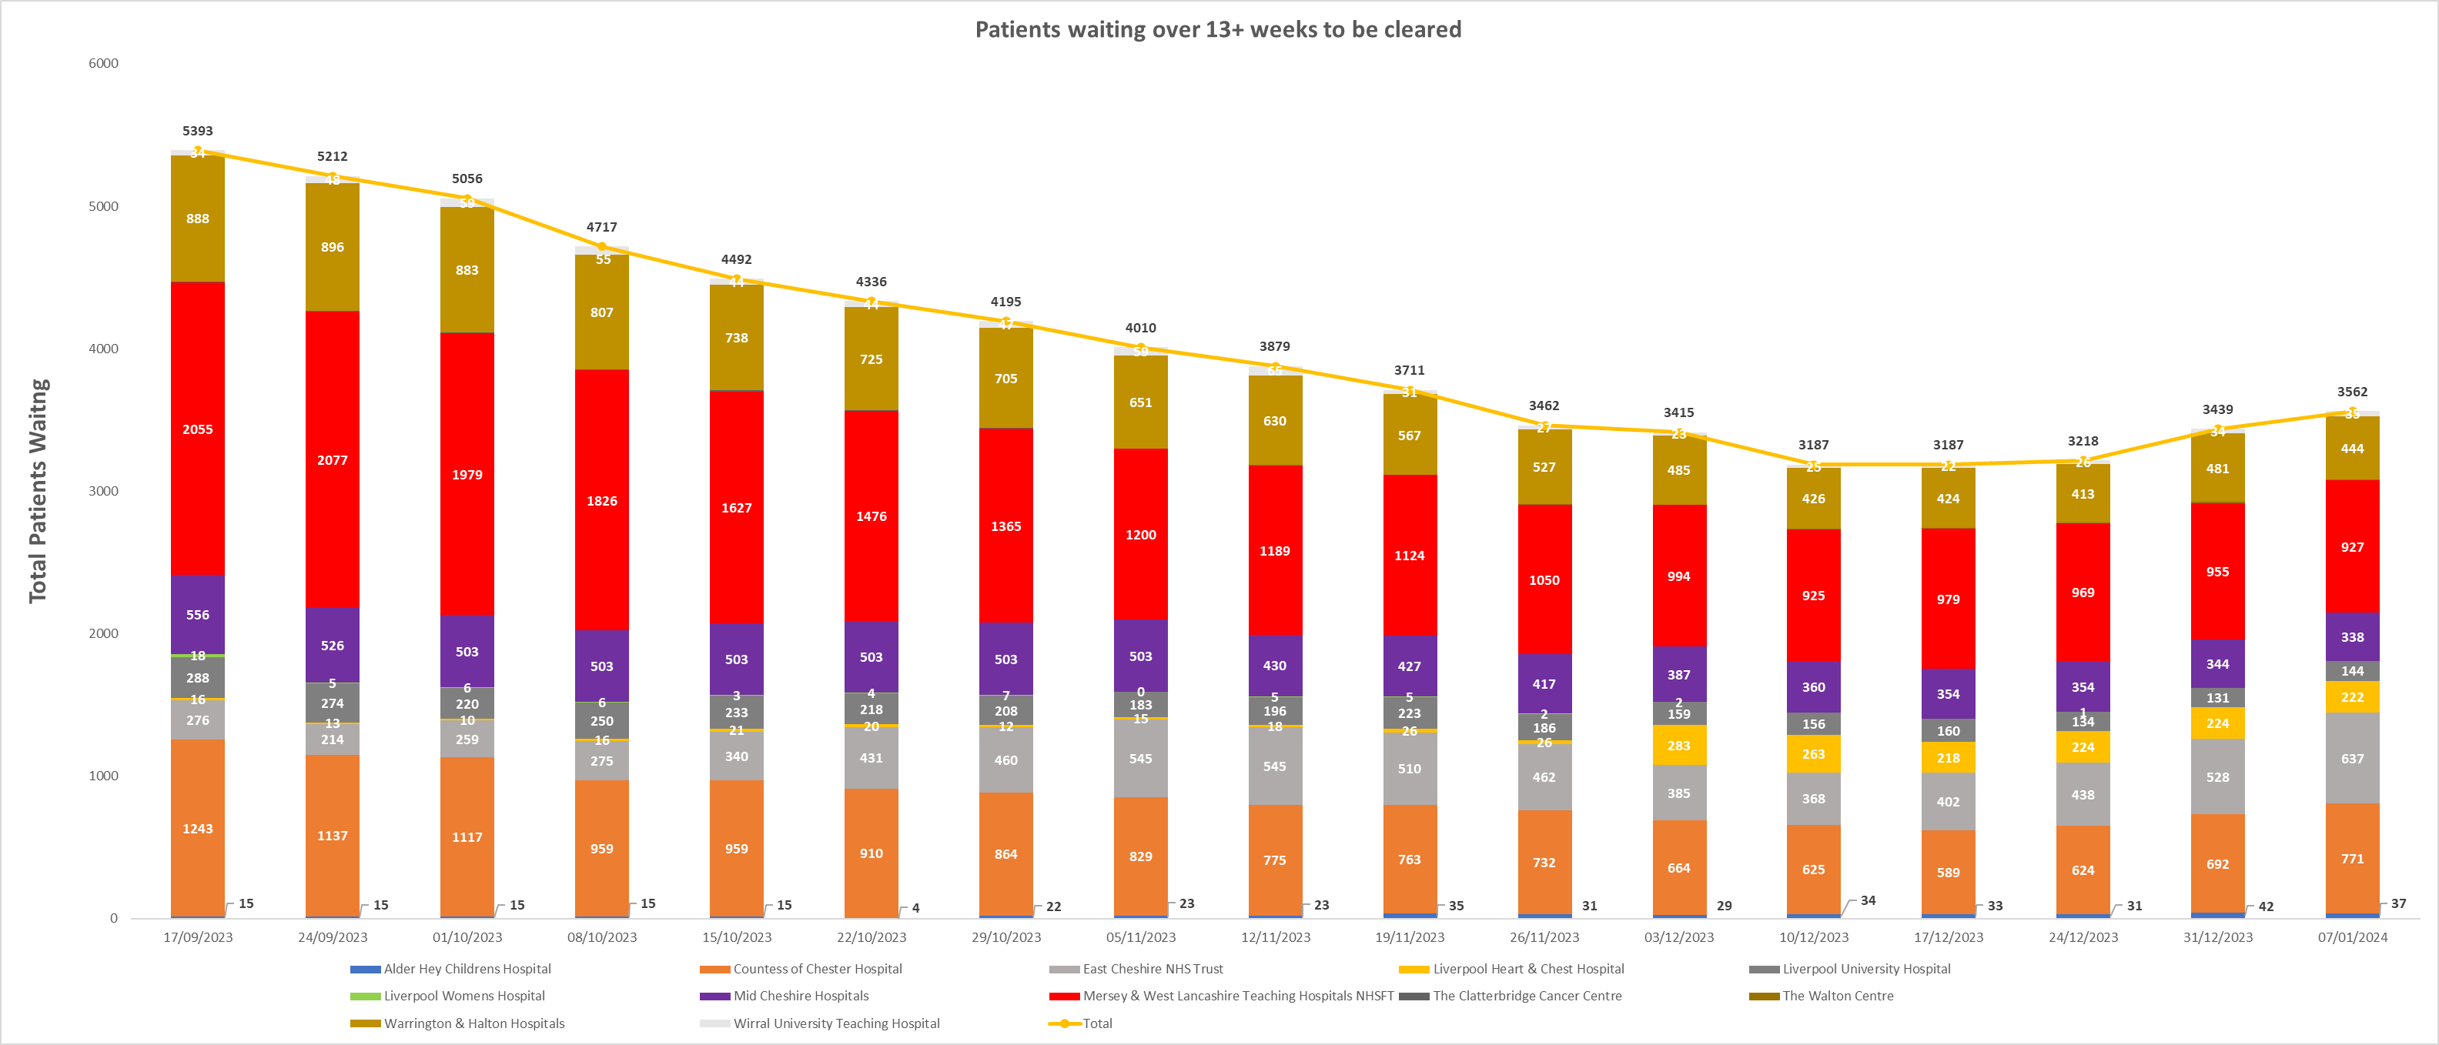
Building Capacity
Increased Activity
Reduced Waiting Times

Slide 11

Community Diagnostic Centres (CDCs)
10 CDCs in C&M
Selected on:
ability to mobilise
serving areas of deprivation
Additional Capacity
4000 tests per week
Modernisation
of sites rather than new build
Provision
of all test modalities especially ultrasound, echos and CT.

Slide 12

Endoscopy
Endoscopy Alternatives
FIT Testing
CT Colon
Pill on a string
Capsule endoscopy
Digital connectivity between sites
Surveillance Intervals
Validation of surveillance patient intervals to reduce unwarranted variation.
Real Time Productivity Monitoring in all Endoscopy Departments
Continuous improvement moving from 8% to 4% DNA rates
Reduced late start on lists
Increased number of patients booked per list
Polyp Detection Artificial Intelligence
Increased polyp detection during endoscopy
Endoscopy Hubs (In Progress)
£8.1m of in year capital investment.
1 endoscopy hub in addition to the 13 existing endoscopy sites.
Hub to focus on routine, surveillance and bowel cancer screening patients leaving existing sites to deliver scopes to 2 week wait patients, inpatients, complex patients and patients who do not wish to travel to a hub.
Endoscopy Staff Bank
Staff able to work across units
Alternatives to in/outsourcing
Biopsy Collection Guidance
Standardising the number of biopsies collected per endoscopy to minimise impact on patient and path labs.

Slide 13
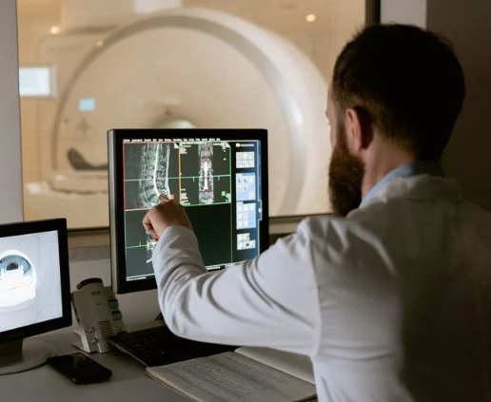
Imaging
Advancing Prostate Artificial Intelligence Pilot
Algorithm test complete to increase cancer detection rates.
Automated Monitoring of Activity Against National Productivity Rates:
CT – 4 scans per hour
MRI – 3 scans per hour
Ultrasound – 3 scans per hour
Imaging Prostate Artificial Intelligence Pilot
Algorithm test complete to increase cancer detection rates.
Collaborative Interventional Radiology Plan (In progress)
To resolve on call issues, explore options for equipment funding and ensure services are equitable, safe and sustainable.
Cardiac CT/MRI
Capital secured for an additional scanners
Review of networked staffing solutions
Chest X Ray AI
Will allow abnormal tests to be prioritised.
Advanced Acceleration Technology
Installed on 19 MRI scanners to increase productivity by 10%

Slide 14
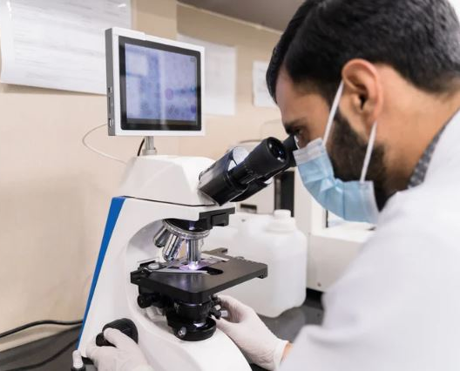
Pathology
Histopathology Sustainability Plan
Critical to support delivery of the Cancer Faster Diagnosis Standard (a CORE20PLUS5 priority).
Turnaround KPI for Prostate Biopsies 90% in 10 days.
Pathology Target Operating Model
Consolidation of existing laboratories into a 3 hub model.
Benefits include estimated £10m savings and removal of quality variation.
Repatriation of Pathology Tests
Processing more tests in C&M rather than sending them out of area. Will reduce cost.
Vitamin D
Guidelines agreed (as per NICE) which should reduce requests by c50%
Pathology LIMS
Currently 7 different Pathology Laboratory Information Management (LIMs) Systems.
- pathology results not visible in different trusts
- repeating blood tests/swabs
Progressing with single C&M collaborative procurement
Benefits include £7m+ (indicative) savings over 10 years
Digital Pathology
Slides can be sent worldwide allowing access to larger workforce
Allows automation technology or artificial intelligence to be applied
Pathology Order Comms
Single instance of Order Comms to roll out to all primary care sites where tests are ordered:
  Reduces percentage of tests repeated and destroyed due to label illegibility
  Allows patient choice re phlebotomy site
  Reduces turnaround times.

Slide 15
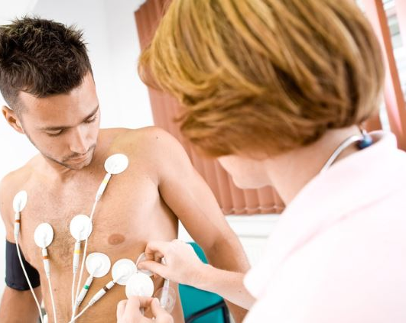
Physiological Measurements
Home Sleep Study Service
Standardised kit and methodology introduced across all sites which has reduced waiting times and improved patient experience.
Establish Physiological Science Network
One of first in England.
A network of networks to cover 8 key areas including cardio respiratory, audiology, ophthalmology, neurophysiology tests
British Society for Echocardiography Guidelines (40-45 min appointments)
All Trusts now using these appointment slots – 11% productivity gain
Piloting Artificial Intelligence Echos – appointment times could reduce to 25 minutes
Implement single cardio digital system to reduce duplication of tests.
Mapping of all Diagnostic Services including those in Primary care & Community
Heat maps to identify areas where inequity of access to services for places to address
Implementation of symptomatic pathways to ensure standard order test sets for key symptoms
Ability to maximise utilisation of all diagnostic services with fluidity across organisations
Ensuring same quality and productivity standards in place for all providers.

Slide 16
What Next?
Waiting
Times
Productivity
Turn around Times
System Wide Transformation
Workforce
Automation
&
Artificial Intelligence
Digital
Whole System Oversight
OD

Slide 17
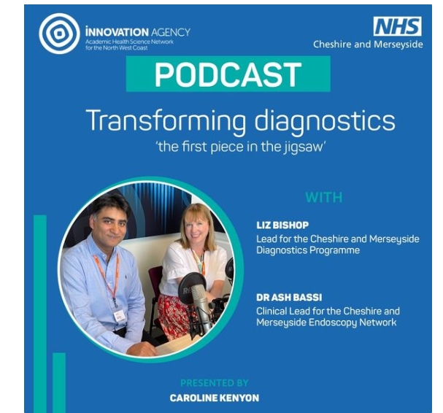
Podcast
A new podcast explores the impact of changes to the way diagnostic tests and screening are carried out in Cheshire and Merseyside.
A system-wide transformation programme (led by CMAST the Cheshire and Merseyside Acute and Specialist Trusts Provider Collaborative) has resulted in many more tests being carried out in more centres around the region.
The Innovation Agency podcast features Liz Bishop and Dr Ash Bassi.
Liz is Chief Executive of The Clatterbridge Cancer Centre NHS Foundation Trust; lead for the Cheshire and Merseyside Diagnostic Transformation Programme; and Senior Responsible Officer for Cheshire and Merseyside Cancer Alliance.
Dr Ash Bassi is Consultant Gastroenterologist and Divisional Medical Director at Mersey and West Lancashire Teaching Hospitals NHS Trust; Clinical Lead for the Cheshire and Merseyside Endoscopy Network; and North West Transformation Lead for Endoscopy.
To listen, go to this link: https://audioboom.com/posts/8324397-transforming-diagnostics-the-first-piece-in-the-jigsaw

