Slide 1

Welcome
Can we talk about race?
March 2024
1

Slide 2

Agenda
Agenda
Welcome and introduction
Facilitated by chair
Presentation from Cheryl Samuels
Cheryl Samuels – chief people officer, Evelina London’s Women’s and Children’s Services, Guy’s and St Thomas’ NHS Foundation Trust
Presentation from Peter Molyneux
Peter Molyneux – chair, Sussex Partnership Foundation Trust
Presentation from Ruchi Singh
Ruchi Singh – member and Young NEDs programme lead, The Seacole Group
Panel Q&A
Facilitated by chair
Summary and close
Facilitated by chair
Close of event
2

Slide 3
Housekeeping
Housekeeping
Please note, this event is being recorded
Please keep your camera on wherever possible
If you lose connection, please re-join using the link in your joining instructions or email race.equality@nhsproviders.org
Please ensure your microphone is muted during presentations to minimise background noise
We will come to questions once we have heard from all our speakers
Please feel free to use the chat box for questions and sharing examples of what has delivered sustained progress in your organisation
If you would like to ask a question audibly, please use the raise hand function during the Q&A section and we will bring you in
Any unanswered questions will be taken away and answered after the event
You will receive a link to an evaluation form at the end of the day, please take the time to complete it, we really do appreciate your feedback.
3

Slide 4
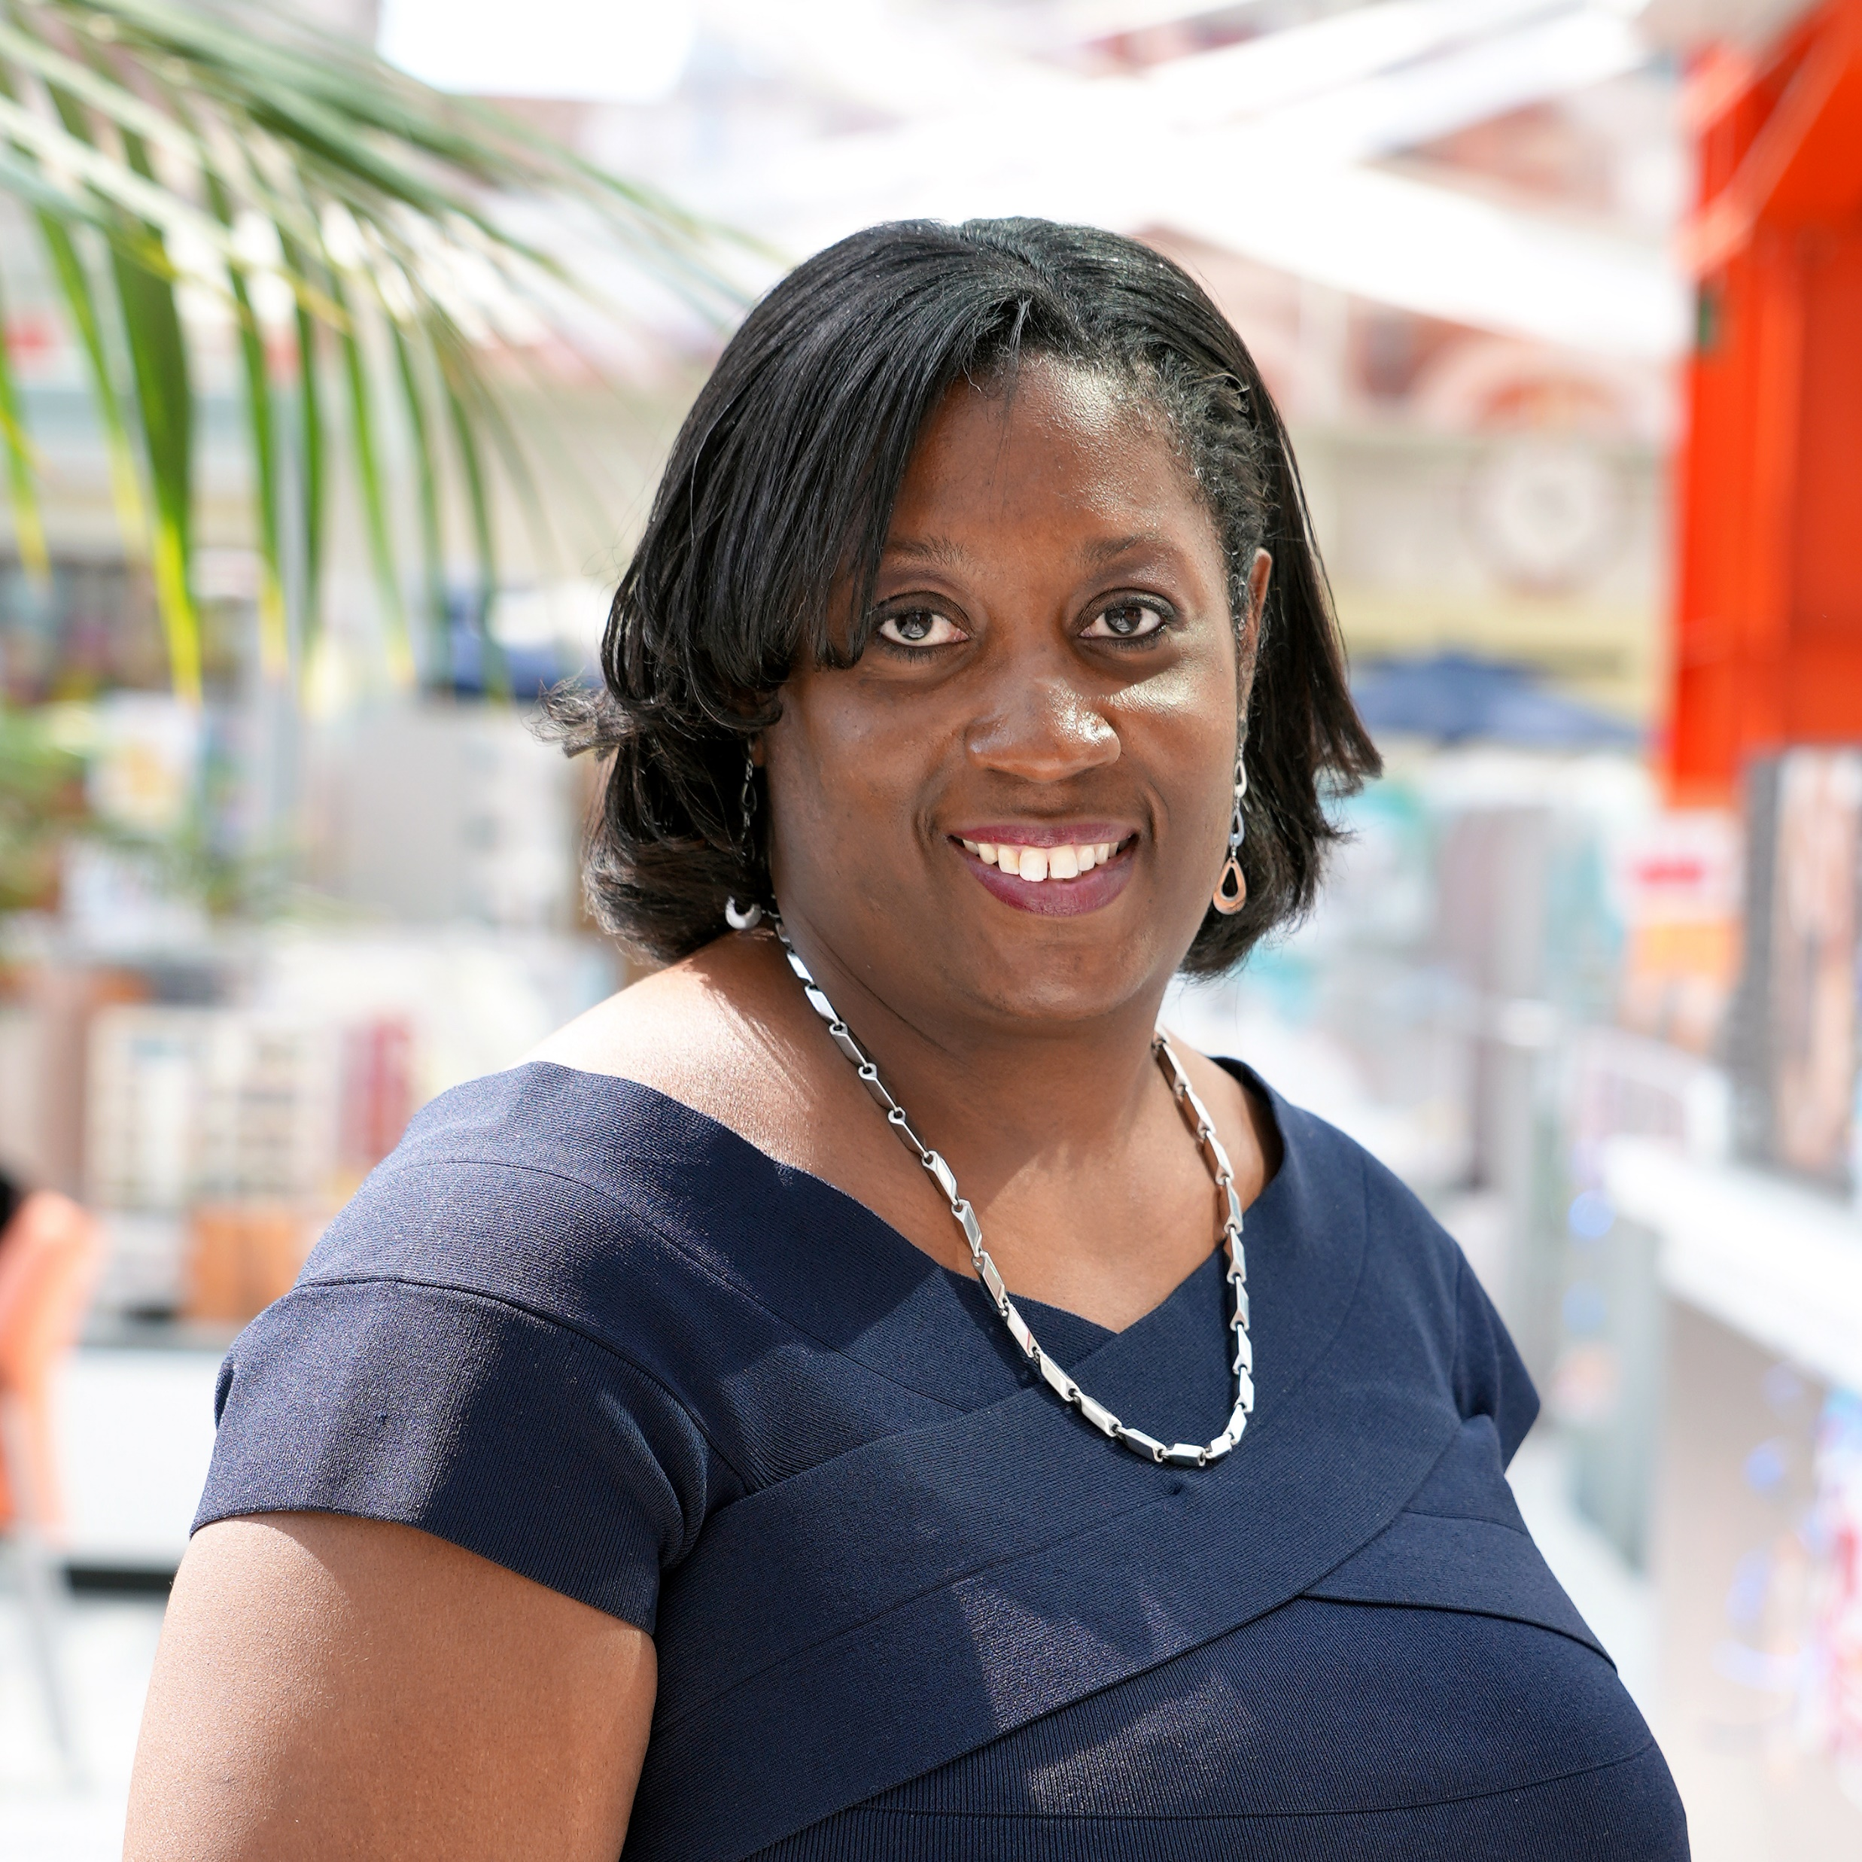
The Importance of Sponsorship in My Skin
Cheryl Samuels
People Director, Evelina London
NAMPS President
Co-Founder of #InclusiveHR

Slide 5
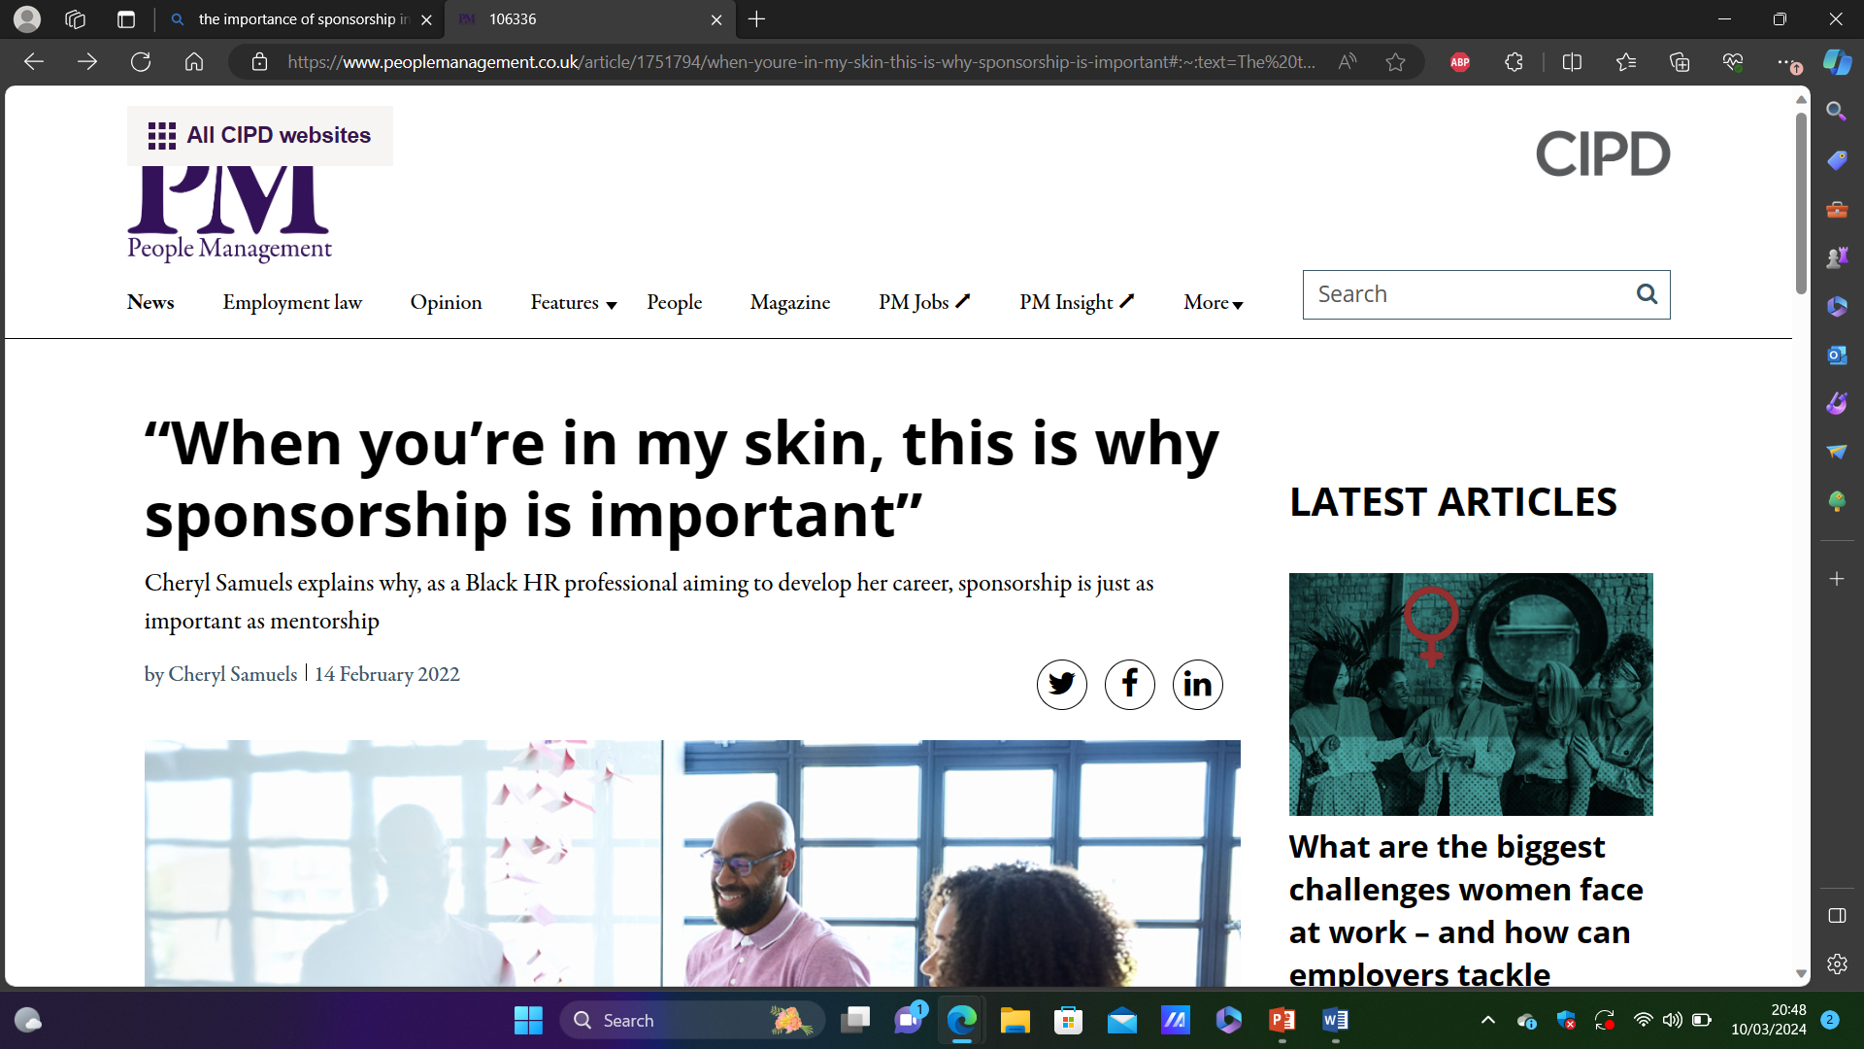
Overview
“When you’re in my skin, this is why sponsorship is important”
People Management, 14 February 2022, Cheryl Samuels
Link here:
Importance of Sponsorship in My Skin
A walk through my career and the importance of sponsorship which is just as important as mentorship.

Slide 6




My Career Journey

Slide 7
Introduction
When you're in my skin, society has conditioned the people that work in organisations to think, behave and judge people that look like me.
Looking beyond my ethnicity and race to see my capabilities, competence, traits, abilities in the here and now and beyond, even when I could not see them myself.

Slide 8

Act of Sponsorship
Working full time as a Deputy Director of HR at Kingston Foundation NHS Trust.
Director of HR that recognised the value of a network.
Director that gave permission for me to do this on top of my job and within work time on behalf of London HR community.
Legal firms that gave their time and resources without cost.
They believed in me and that was priceless.
Establishing the Deputy Directors of HR Network.
Chair of the Network for over 8 years.

Slide 9

Act of Sponsorship
Opportunity to be let into the various clubs that exist, which allow you to build networks, meet influencers, and be at the forefront of up and coming strategic work as a valued contributor.
London HR Directors Network
No accident that I know all HR Directors in London.
No accident I have relationships across the system
No accident that I am seen as an influencer, thought leader, blogger

Slide 10
Acts of Sponsorship
Led a high-profile project to reduce agency expenditure while maintaining safety.
Leaders and third party providers don’t often endorse your skills.
Leaders rarely consider you for high profile projects
Leaders rarely reward additional effort financially, so we are often expected to do more for little or no additional reward.
Leaders rarely recognise our efforts in the same way as other professional groups or our white counterparts.
A nursing agency endorsed my collaborative skills publicly on LinkedIn.

Slide 11


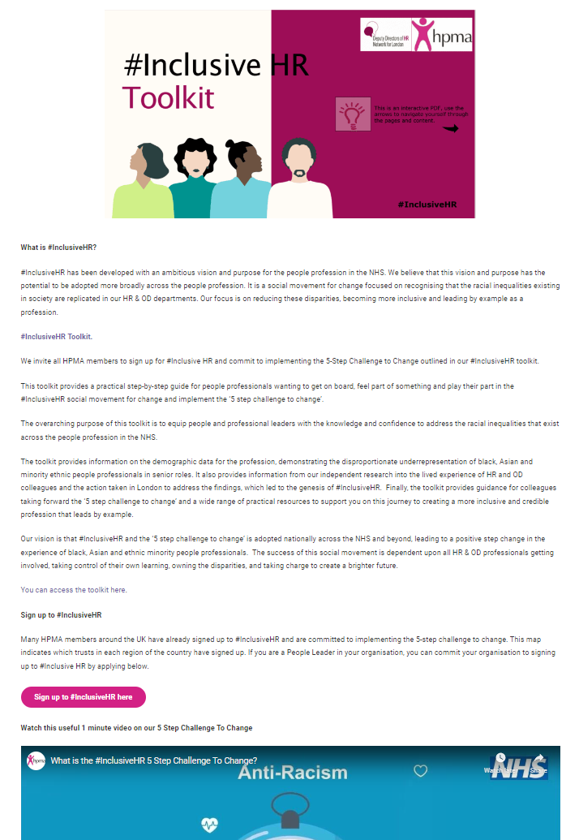
Act of Sponsorship
It is not often that you can expect compassion, empathy and to be listened to in a way that results in action being taken to improve the status quo.
#InclusiveHR a social movement for change was born.
Acknowledging inequalities in society are replicated in all our HR & OD departments. We must address the racial disparities, lead by example and with credibility.
60+ NHS Organisations – 5 Step Challenge to Change
HR & OD Anti Racist Programme – 3 Cohorts
*(NHS Trusts in London and the Midlands have completed it)

Slide 12
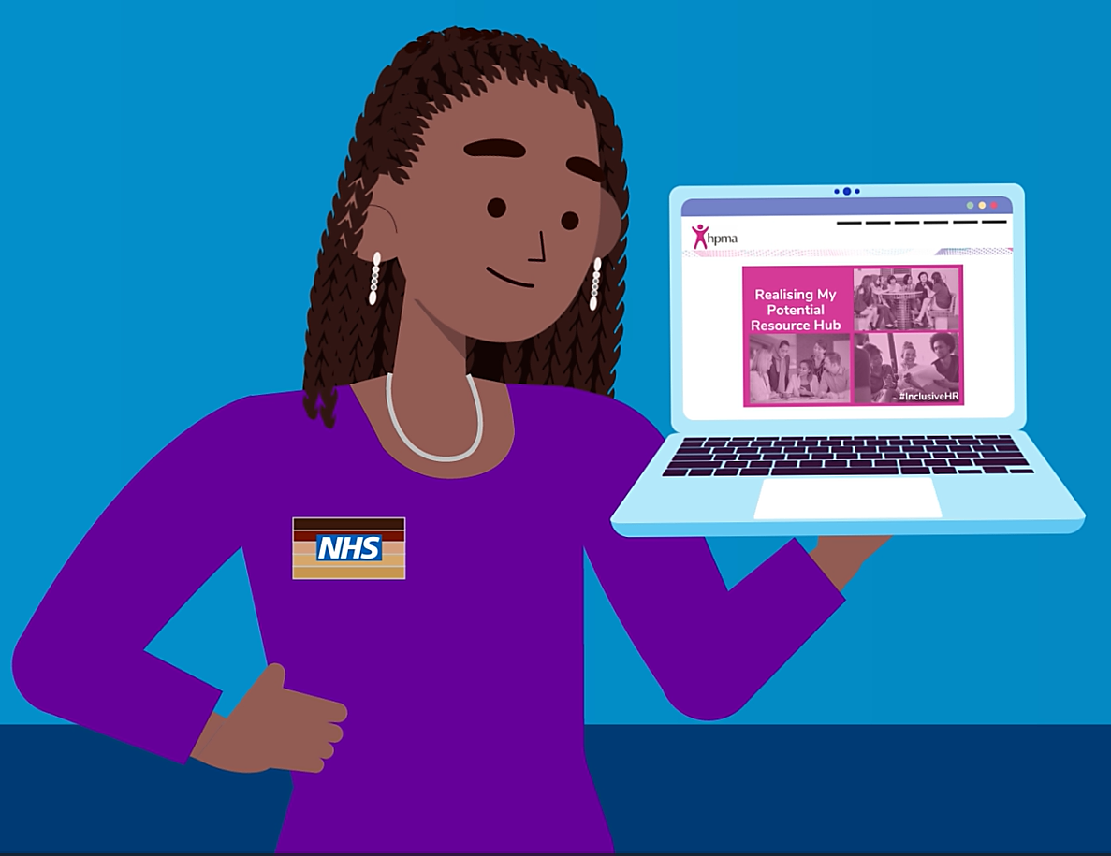

Support links
Here is a reminder of existing links and new resources to support your journey:
Video – What is the #InclusiveHR 5Steps Challenge to Change?
Video - #InclusiveHR Realising my Potential
Toolkit
Case Studies (Purple Square tag icons indicate existing viewable case study submissions)
National interactive map Case Study template – please submit your Case Study if at Step 4 or 5. We will also be in touch to request this and can share back the form response you left with us to support your completion.
Realising my Potential resources (RMP)
Join us on social media platforms for updates. Your engagement is key in driving change & inspiring others.
If not already, become a HPMA Member to gain access to our full resources and National/ Regional branch development programme aligned to the NHS People Profession Map supporting EDI and Anti-Racist agendas.
Initial 1:1 call with new sign-ups, we will be in touch
IHR Community of Practice Network, we will be in touch with calendar invitations

Slide 13

Your reflections on actions you can take
Reflect on your own career journeys.
What informal and formal support have you accessed?
Who stepped forward and recognised your value?
Who gave you stretch opportunities?
What can you do to extend the ladder to reduce the intersectional racial disparities we see in the workforce?
What are your biggest take-ways from today's session?

Slide 14



Cheryl Samuels FCIPD, BA (Hons)
NAMPS President
People Director
Evelina Women’s and Children’s Clinical Group
- @Chezzy319
Cheryl Samuels FCIPD | LinkedIn

Slide 15
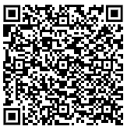
Upcoming events
Register now:
Is NHS England's EDI improvement plan an effective lever for trusts working as anchor institutions? | Friday 10 May 2024
Delivered by our Health Inequalities programme, this webinar will explore:
High impact action four (HIA4) of NHS England’s equality, diversity and inclusion (EDI) improvement plan: develop and implement an improvement plan to address health inequalities within the workforce
NHS trusts’ role as anchor institutions in tackling health inequalities faced by staff
Key challenges and practical solutions for trusts to meet the success metrics outlined in HIA4.
Scan here to access this event
1

Slide 16
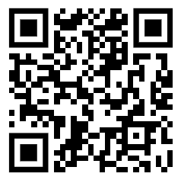
Evaluation
Tell us what you think
Scan here to access
our evaluation
16

Slide 17
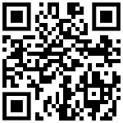
Marketing
Visit our website to find previous events and resources on the following topics:
Inclusive recruitment and talent management
Data and accountability
Allyship
Can we talk about race?
Health Inequalities
Internationally educated workforce.
Scan here to access our website
17

Slide 18
Evaluation
Thank you!
Scan here to access
our evaluation
18

