Slide 1
Welcome to today’s event:
Overcoming workforce challenges through provider collaboration

Slide 2
Agenda
Welcome and introductions
Facilitated by chair, Amber Jabbal - Head of Policy and Strategic Projects, NHS Providers
Part 1: North East North Cumbria Provider Collaborative (NENC)
Matt Brown, Managing Director, NENC
Interactive Q&A
Facilitated by the chair
Part 2: East Midlands Alliance for Mental Health, Learning Disabilities and Autism
David Williams, Group Director of Strategy & Partnerships Leicestershire Partnership NHS Trust & Northamptonshire Healthcare NHS Foundation Trust
Craig de Souza, Director of Workforce Supply Workforce, NHS England
Interactive Q&A
Facilitated by the chair, Amber Jabbal - Head of Policy and Strategic Projects, NHS Providers

Slide 3
Housekeeping
Please note, this event is being recorded
Please keep your camera on wherever possible
If you lose connection, please re-join using the link in your joining instructions or email provider.collaboration@nhsproviders.org
Please ensure your microphone is muted during presentations to minimise background noise
We will come to questions after each speaker
Please feel free to use the chat box for questions and sharing examples of what has delivered sustained progress in your organisation
If you would like to ask a question audibly, please use the raise hand function during the Q&A section and we will bring you in
Any unanswered questions will be taken away and answered after the event
You will receive a link to an evaluation form after today’s event. Please take the time to complete it, we really do appreciate your feedback.

Slide 4
Workforce Challenges and Collaboration
Matt Brown
Managing Director, NENC Provider Collaborative
15th April 2024

Slide 5
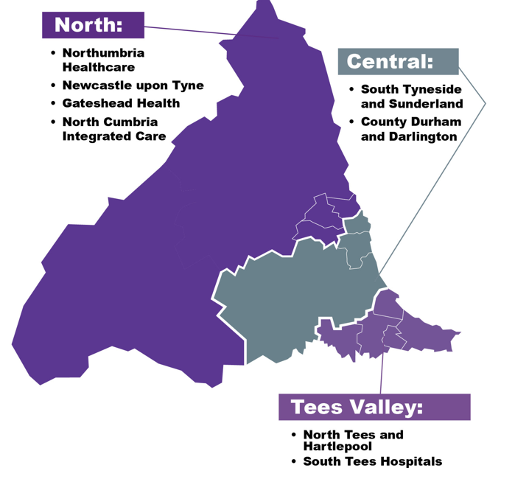
About our Provider Collaborative
A formal partnership of all 11 NHS FTs in the region…

Slide 6
NENC Provider Collaborative
Provider Collaborative = collaboration of providers
Focussing on things that it makes sense to work together on
Not “doing things to FTs”
Not a separate entity, but defined by what the eleven member FTs do together and the decisions they make together
Developing culture of collaboration, moving beyond collective individualism
Tackling strategic priorities and addressing unwarranted variation
Wicked issues all come back to workforce in some way

Slide 7
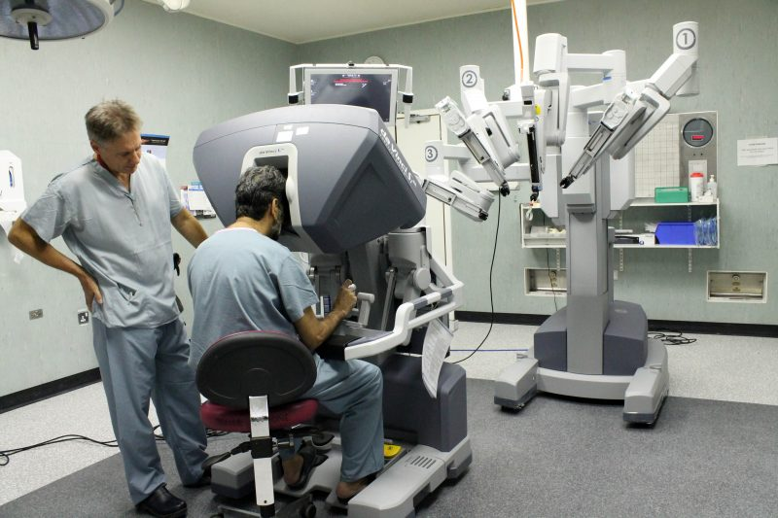
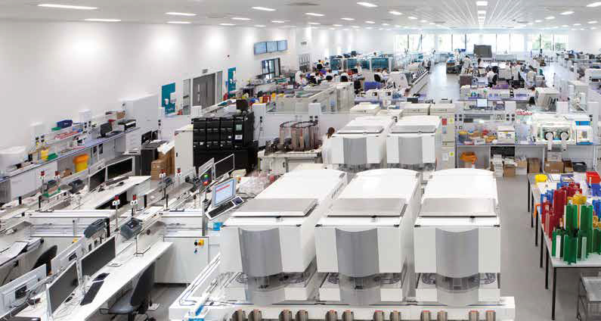
Work Programme
CLINICAL
CORPORATE
CLINICAL SUPPORT
DEVELOPMENT

Slide 8
Responsibility Agreement
Specific work programmes agreed between the ICB and the Collaborative :
Delivery of a comprehensive elective recovery plan and programme, including leading the work of the ICS with the Getting It Right First Time Programme
Support the development of the overarching ICB clinical strategy, as part of which, taking a lead on the strategic approach to secondary and tertiary clinical services to address quality and sustainability issues across the sector. This will include ad hoc clinical service improvement work and the oversight of relevant clinical networks.
Delivery of a diagnostics plan and programme
Continued implementation of the aseptic manufacturing hub
Leadership of the FT capital programme, supported by agreed capital priorities and goals for estates, equipment and digital
Delivery of a strategic workforce programme on behalf of the FT providers, linking to the ICB programme and to include action on agency spend and bank arrangements

Slide 9
Early Work
Implementation of Portability Agreement
Borrowed and adapted from WYAAT (with thanks!)
Simple premise but complex work in background to build confidence
Slow rollout, now well embedded and positive feedback
In some instances, reduced turnaround from 3 months to 3 days
First layer of the onion…
Corporate Programme Chairs informal monthly meeting
Chairs of directors’ professional groups
Connectivity across HR, Finance, Digital, Estates, People Digital
Seven small early priorities eg car parking, mileage, cost of living, pay rates
Small wins (and fast failures!)
Benefits inc compromise, data sharing, relationships, awareness of local nuances
Set the scene for what was yet to come…

Slide 10
Scaling Up Board
Leadership Development & Succession Planning
Job Evaluation
Collaborative Bank
Occupational Health and wellbeing
Workforce Planning
Recruitment
Payroll
Employee Relations/Policies

Slide 11
Workforce Governance
NENC ICS MTFP Oversight Mechanism
Provider Leadership Board
Relevant Board eg SECB, Clinical Strategy
Workforce Board
Workforce Board
WTE Oversight Group
Pay Rates Group
Pay Rates Group
Scaling Up Board
Review Effectiveness of Investment
Strategic Service Reviews
Specific action allocated to professional leadership groups
Medical pay rates and productivity eg DCC adherence
Medical pay rates and productivity eg DCC adherence
8 Workstreams eg OH, recruitment, collaborative bank

Slide 12
Principles
Clinically-led, managerially-supported
Collaboration at the right level for each project eg nested collaboratives
Transparency of information sharing
FTs may move at different pace but in the same agreed direction
Standardising unwarranted variation and data eg pay rates
New narrative around workforce

Slide 13
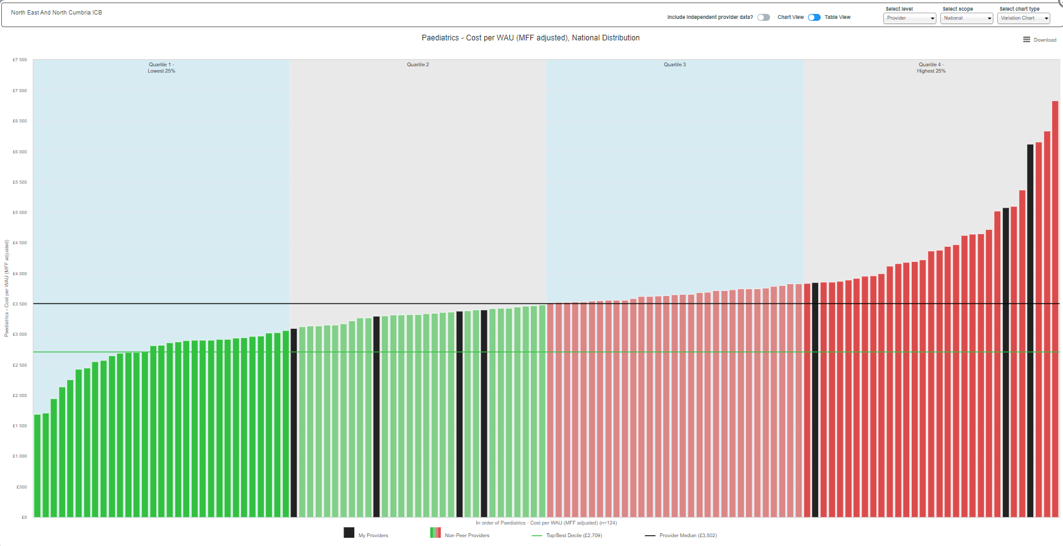
Paediatrics – Cost/WAU

Slide 14
Strategic Approach to Clinical Services
Specific services with challenges eg
OMFS
Pain
Neurology
Radiology
Principles to apply as services become challenged
Mutual aid and support
Mutual support coordination group
Starting with long wait patients, now widening to capacity (physical and workforce) and front-end of pathways

Slide 15
NHS Find Your Place
Traditionally the North East and North Cumbria had struggled to recruit enough medical trainees
Find Your Place campaign created to promote NENC as a place to live, train, work and thrive
One key goal - to attract more medical trainees (with a focus on specialty training)
Campaign used a research-led approach to understand what drives trainee decision making, and how we can influence them to step outside their comfort zones and head north
Collaborative approach with 11 FTs and HEENE allows work at scale eg as media & marketing are expensive individually
Fill rates up from 76% to 94% since NHSFYP launched

Slide 16
NHS Find Your Place
The campaign plays on our two strongest cards
Quality of training on offer (including how we support our trainees)
We are consistently top of the class for quality of training in the national GMC trainee survey and have great places to work and experiences; rivalling those people may think they can only find in London.
Quality of lifestyle (work/life balance and cost of living becoming increasingly important)
From breath-taking beaches, landscapes, a vibrant nightlife, arts and culture scene…to getting more bang for your buck, and a first step on the housing ladder….

Slide 17
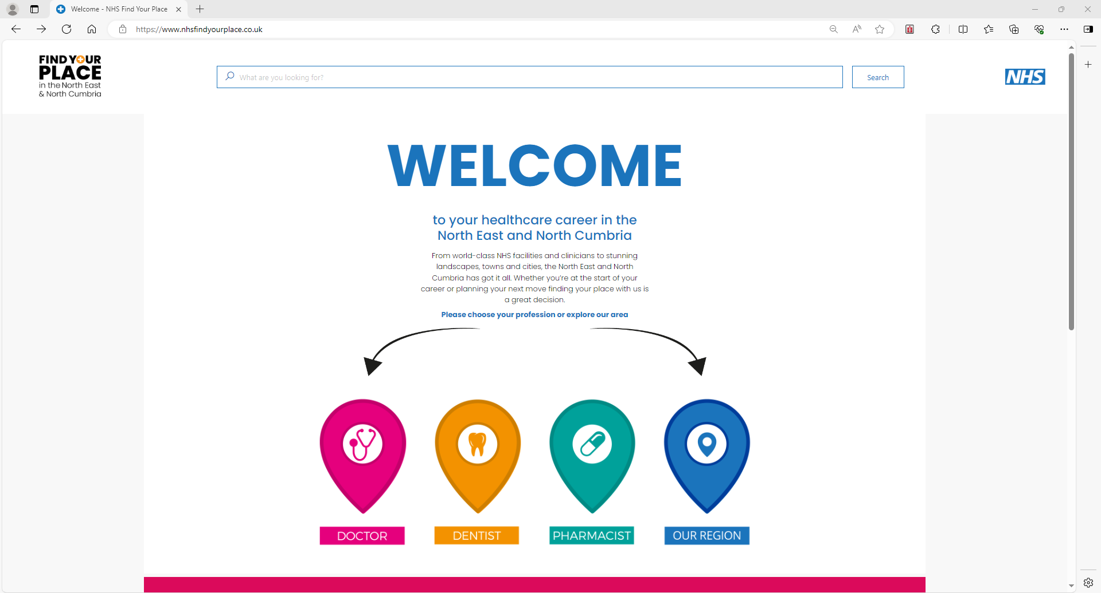
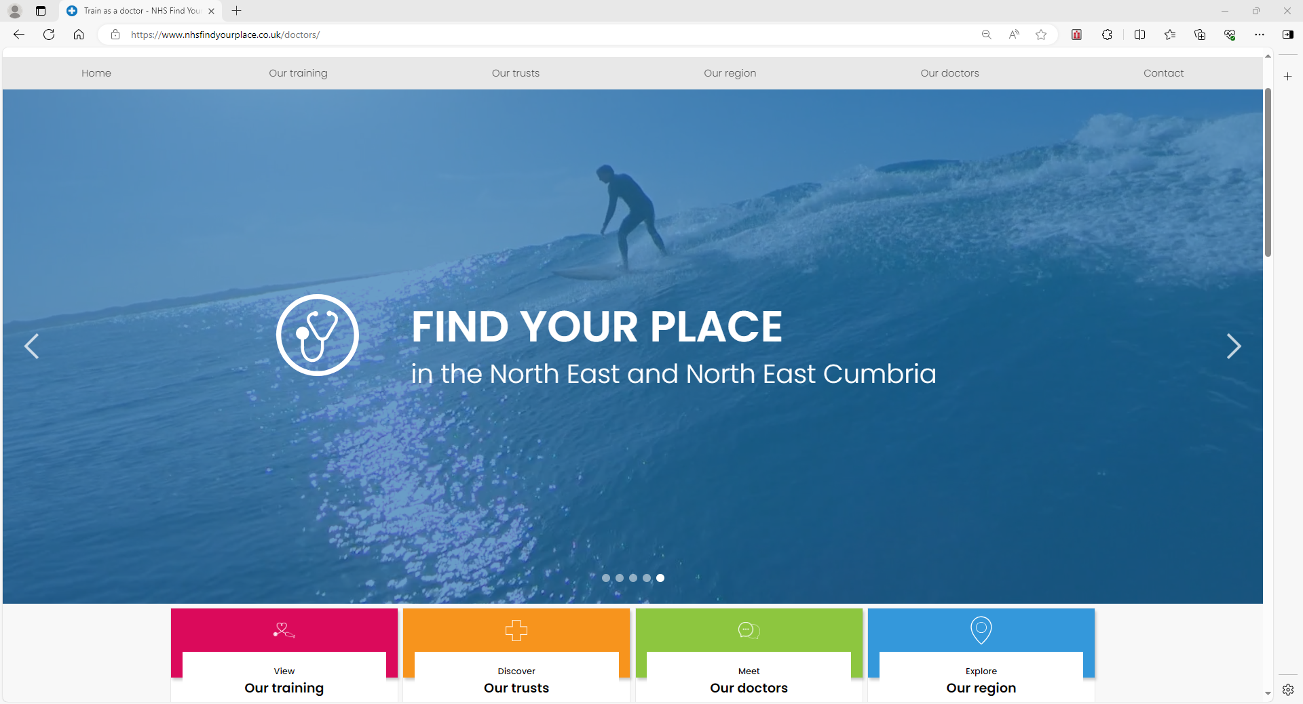
NHS Find Your Place

Slide 18
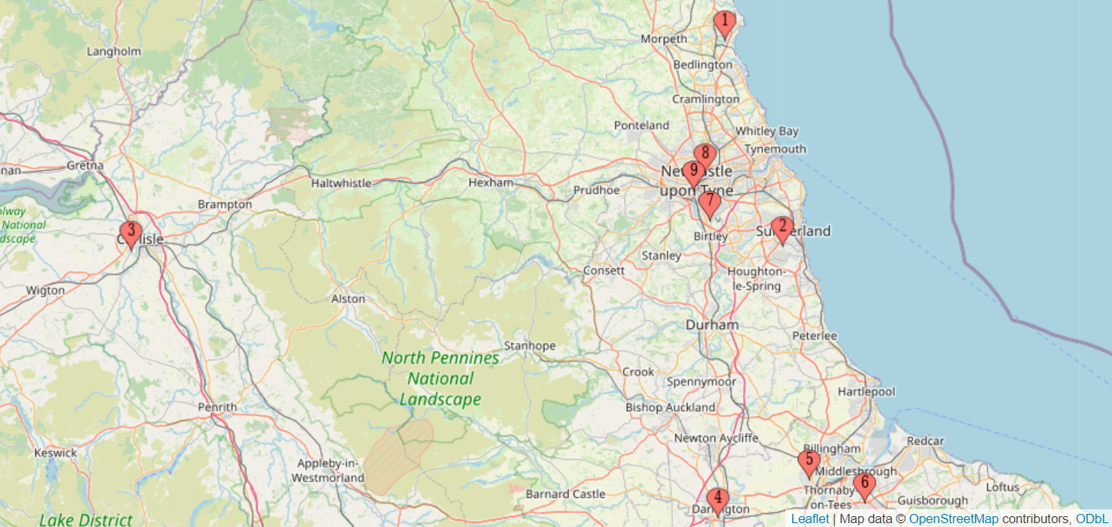
Aseptic Hub (Medicines Manufacturing Centre)
Medicines Manufacturing Centre

Slide 19
Personal Reflections on Our Journey
Clarity of shared purpose and intent far more important than governance – be clear about WHY we are doing this
BUT governance matters (and can be helpful neutral ground to start with)
Actively acknowledge how little we understand each other’s organisations and challenges
Find the ‘stones in your shoes’
Find the things that make sense for us to work together on
Go where the energy is
Perceived small steps worth their weight in gold in helping to set solid foundations
Collaborative work is hard, staff have a day job, organisational identity & the feeling of belonging are powerful
Mandate directors to lead across and give them really good people with dedicated time to drive the work

Slide 20
Any questions?

Slide 21
Workforce Flexibility
April 2024 NHS Providers Discussion

Slide 22
Provider Collaborative Innovator
Leicestershire Partnership NHS Trust and Northamptonshire Healthcare NHS Foundation Trust, were successful as 1 of 9 national provider collaborative innovators
3 key areas of work:
Moving delegation and collaboratives forward in Leicester, Leicestershire & Rutland
Moving delegation and collaboratives forward in Northamptonshire
Developing a new workforce model in the East Midlands Alliance (an alliance of NHS Mental Health Trusts and St Andrews Healthcare in the East Midlands)

Slide 23
To find easy, simple solutions to retain sufficient and specifically skilled CAMHS clinicians across organisations
Our agreed challenge statement

Slide 24
This is important because…..
The current employment model is limiting our ability to develop sufficient CAMHS specialist skills to deliver the needs of children and young people.
Specialised Services are supporting people with rare or complex needs. Within providers and systems the number of CYP needing support is small. There is the opportunity to maximise skills and knowledge when clinicians can provide CAMHS specialist care across organisations, CYP MH pathways or systems.
The current employment model lacks flexibility and rewarding career paths; and involves significant administrative burden.

Slide 25
The journey of our workforce MOU
Feb 23
Mar 23
May 23
May - Oct 23
Provider Collaborative Innovator start
NHS E & Group confirm scope
EMA Dirs. of HR meeting to confirm problem statement and goals
Task and finish group commence
Inc. change in manager of project & industrial action
Use case for Responsible Officer support identified
Presentation of final version to EMA Dirs. of HR
Presentation to CEOs for approval
Issue resolved and signed by CEOs
VAT and charity implications to resolve
Oct 23
Dec 23
Dec 23
Shared with ICB and others
Jan 24

Slide 26
Top tips for success
Without a shared vision that everyone supports success is limited
Building trust and understanding takes time, investing in that time is important
Individuals across organisations really welcome integrated working, with the right space and permission they can flourish
The conversations and meetings to produce an MOU/Contract etc are at least as important as the finished product
A collaborative creates the space to do something different, you have to be active in the space to “do different”

Slide 27
Any questions?

Slide 28
Book now:
Webinar | Using data to drive improvement and reduce clinical variation through provider collaboration| Monday 17 June 2024 2.00pm - 3.30pm
Webinar | Tackling the productivity challenge through provider collaboration | Monday 23 September | 2.00pm – 3.30pm
Peer learning forum | All sectors | Wednesday 8 May 2024 1.00pm-2.30pm

Slide 29
Tell us what you think
Scan here to access our evaluation or use the link in the chat

Slide 30
Thank you for attending

