Slide 1
Using quality improvement to enhance maternity and neonatal outcomes
10th July 2024

Slide 2
Agenda
Welcome and introductions
Facilitated by the chair, Miriam Deakin, Director of Development and Engagement, NHS Providers
Presentation One
Professor Naomi Chambers, Professor of Health Management, The University of Manchester
Presentation Two
Carla Jones-Charles, Director of Midwifery & Randeep Kular, Director of Strategic Projects, University Hospitals Birmingham
Presentation Three
Arnie Puntis, Research and Policy Manager & Dr Nandi Simpson, Director – Implementation, NHS Race and Health Observatory
Including speakers from the Learning and Action Network:
Noshin Menzies, Senior Project Manager, Health Innovation Network West of England
Tom Baker, Programme Manager – Perinatal Safety Improvement & Georgina Twist, Specialist Midwife Maternal Mental Health, University Hospitals of Leicester NHS Trust
Jennifer Carroll, Continuous Improvement Clinical Fellow & Jenny Craddock, Midwifery Team Leader, Lancashire Teaching Hospitals NHS Foundation Trust
Interactive Q&A
Summary and close

Slide 3
Housekeeping
Please note, this event is being recorded
Please keep your camera on wherever possible
If you lose connection, please re-join using the link in your joining instructions or email improvement@nhsproviders.org
Please ensure your microphone is muted during presentations to minimise background noise
We will come to questions after each speaker
Please feel free to use the chat box for any questions or comments.
If you would like to ask a question audibly, please use the raise hand function during the Q&A section and we will bring you in
You will receive a link to an evaluation form after today’s event. Please take the time to complete it, we really do appreciate your feedback.

Slide 4
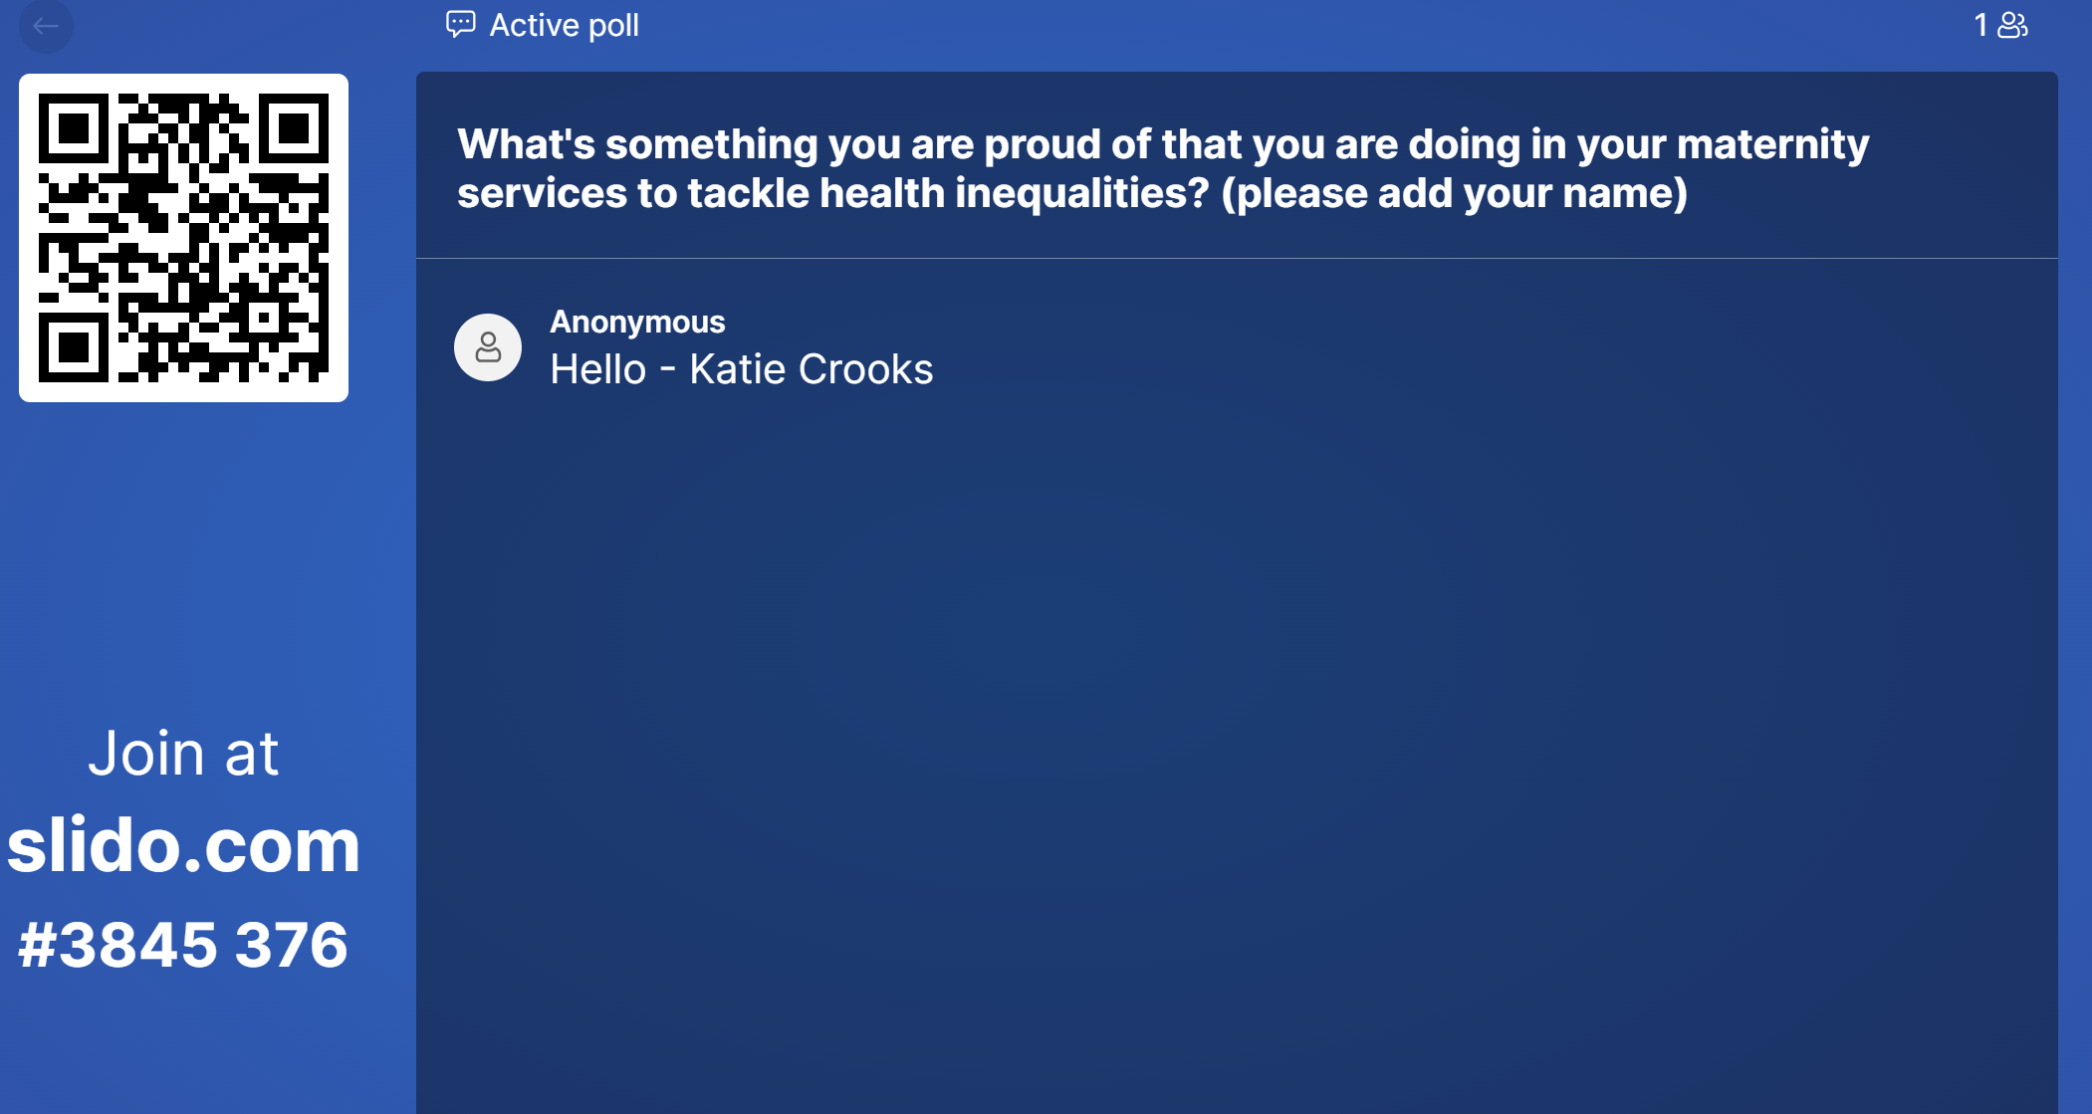
SLIDO

Slide 5
PART 1: PROFESSOR NAOMI CHAMBERS - PROFESSOR OF HEALTH MANAGEMENT, THE UNIVERSITY OF MANCHESTER

Slide 6


Using quality improvement to enhance maternity and neonatal outcomes: the role of NHS boards
Naomi Chambers
Professor of Healthcare Management July 2024
Naomi.chambers@manchester.ac.uk

Slide 7
SUMMARY
Issues for boards in relation to maternity services
Evidence from the governance literature
Evidence from an empirical research study about board leadership
Applying labour process theory to understanding maternity workforce cultures and behaviours
Questions for boards

Slide 8
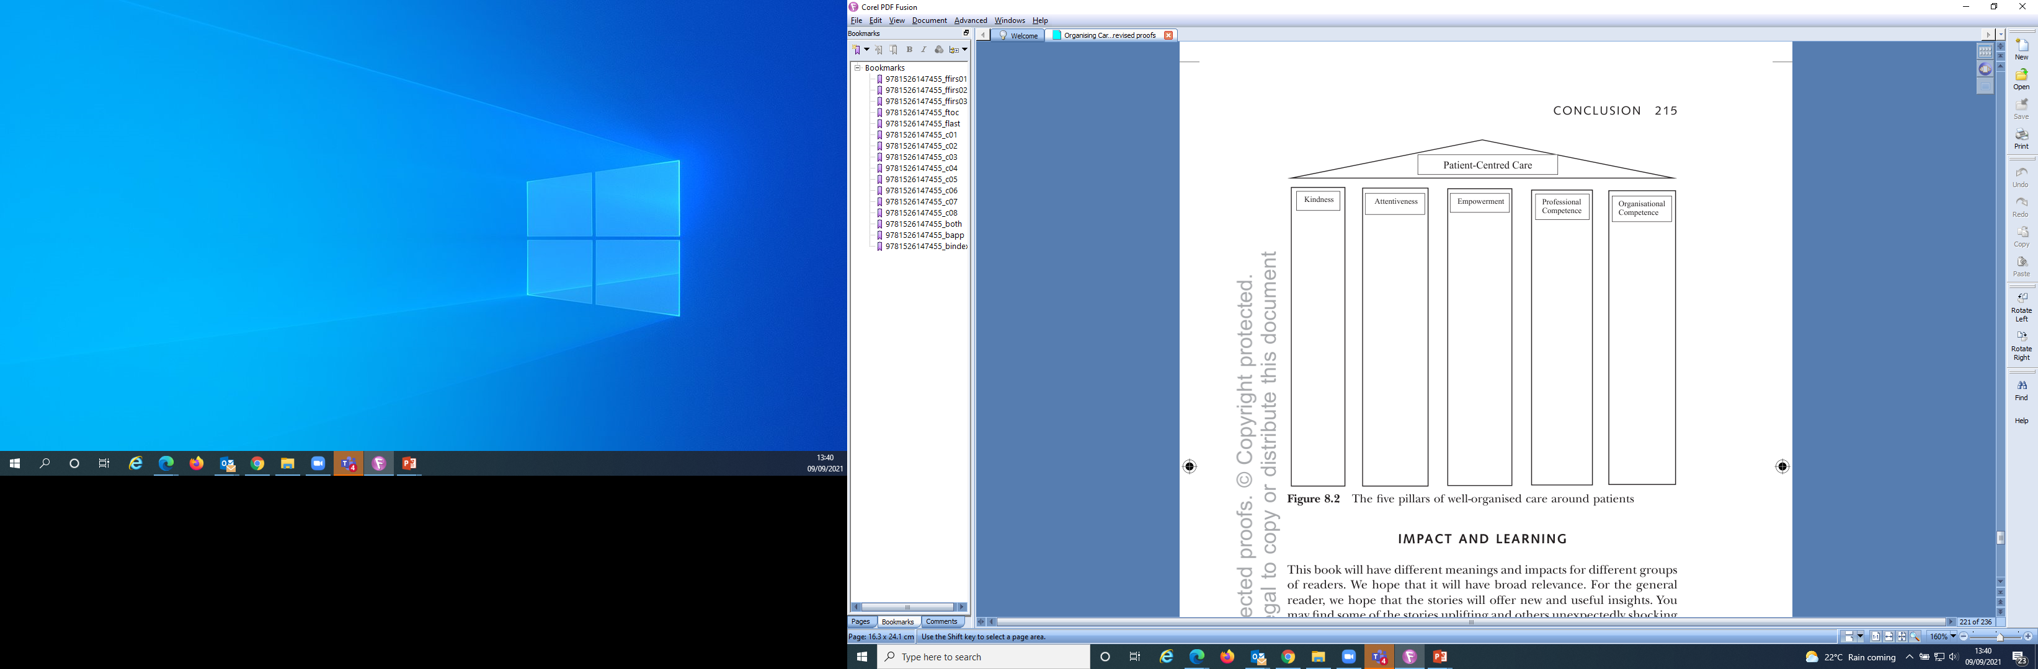
Principles of organising for patient-centred care
(from Organising Care Around Patients Chambers N and Taylor J 2021 p215)

Slide 9
ISSUES FOR BOARDS IN RELATION TO MATERNITY SERVICES
Multiple inquiries including Morecambe Bay, Shrewsbury & Telford, East Kent, Nottingham…
Common issues around not listening to women, poor inter-professional relationships, variation in clinical competence, clinical effectiveness ideologies
Lack of focus on this high-risk service by boards
What would Francis say if there was a Francis-style national public inquiry?

Slide 10
D E F I N I T I O N S O F C O R P O R AT E G O V E R N A N C E
‘System by which an organisation at all levels is directed and controlled’ (Cadbury)
Structure for setting, meeting, and monitoring organisation objectives (OECD)
Leaders at all levels exercise governance
At the apex is the governing body or board

Slide 11
W H AT I S T H E J O B O F A B O A R D ?
Strategy (direction)
Performance (control)
Shaping organisation culture (setting the tone)
Accountability

Slide 12
W H AT A R E B O A R D S F O R ?
E X P L A N ATO RY T H E O R I E S A B O U T B O A R D S
Agency theory – relates to compliance
Stewardship theory – leads to partnership
Resource dependency model – uses board members as boundary spanners
Stakeholder theory – leads to representative model
Power theory – responds to human desire for control
Engagement theory – relates to trust/challenge/grip

Slide 13
A N E F F E C T I V E B O A R D ?
’.....at a shipbuilding yard....I had lunch with the board, and we had grouse and salmon, & you knew that the salmon had been caught by the board, and the grouse had been shot by the board....but when you started to discuss what was happening in worldwide shipping, they were lost.....I went down and had tea with the union, there were incredibly well-informed....if in that shipyard, the shop stewards would become the board, and the board the shop stewards, you would have the ideal combination....’
Peter Walker, Secretary of State, 2004 in When the Lights Went Out Beckett A 2009

Slide 14
E V I D E N C E O F L I N K S B E T W E E N B O A R D S A N D O R G A N I S AT I O N P E R F O R M A N C E
Highly contingent
Smaller boards with concentration of power (public sector)
Majority of independent NEDs (private sector)
> NEDs with relevant expertise ( from study of 6 banks)
> Turnover of directors (ibid)
< Overboarding ( UK Corporate Governance Code, 2018)
Diversity
Focus on strategy, use of resources & talent management
Well-functioning board committees (public sector: avoiding ‘distant cordiality’)
The role of shadow boards
www.thecorporategovernanceinstitute.com/insights/guides/a-shadow-board-of-younger-employees-could-save-your-company

Slide 15




C A S E S T U D Y
S TA F F O R D H O S P I TA L:
W H AT H A P P E N E D ?
Investigation by the Healthcare Commission in 2008, because of apparently high mortality rates amongst admitted emergency patients, found appalling conditions & severely criticized management.
Press reports suggested that, because of poor care, between 400 & 1200 more patients died from 2005 to 2008 than would be expected for the type of hospital, based on figures from a disputed mortality model.
CEO was suspended and the chair resigned; other senior NHS executives who had responsibility for Stafford Hospital were promoted.
The Francis Report in 2013 listed 290 recommendations for culture change and promotion of patient centred care

Slide 16
J U D G E M E N T O F F R A N C I S
“Aspects of a negative culture have emerged at all levels of the NHS system. These include: a lack of consideration of risks to patients, defensiveness, looking inwards not outwards, secrecy, misplaced assumptions of trust, acceptance of poor standards and, above all, a failure to put the patient first in everything done”
(Francis 2013a: 1357).

Slide 17




Selected findings from study on NHS Board leadership responses to Francis Inquiry into the failures of care at
Mid Staffordshire NHS Foundation Trust
Naomi Chambers, Professor, University of Manchester (lead) Ruth Thorlby, Assistant Director of Policy at the Health Foundation Alan Boyd, Research Fellow, University of Manchester
Nathan Proudlove, Senior Lecturer, University of Manchester Judith Smith, Professor University of Birmingham
Russell Mannion, Professor University of Birmingham
This presentation is based on independent research commissioned and funded by the NIHR Policy Research Programme ((PR-R11-0914-12003 Learning from leadership changes made by boards of hospital NHS trusts and foundation trusts following the Francis Inquiry report June 2015-June 2017)). The views expressed are those of the authors and not necessarily those of the NHS, the NIHR, the Department of Health, ‘arms’ length bodies or other government departments

Slide 18
Aims of the study
To identify how boards and senior leaders of NHS acute hospital trusts have sought to implement the recommendations on organisational leadership in response to the 2013 Francis Inquiry report
To explore the intended and unintended effects of implementing recommendations of the Francis Inquiry
To uncover the enablers and barriers to improving senior leadership To advance theoretical understanding of effective healthcare boards
To synthesise findings to inform a set of practical and evidence-based learning points for boards and senior leadership teams

Slide 19
Methods
Literature review
Interviews with national policy makers( 2015-16 n=13) National survey of board members in 2016 (n=381)
Six anonymous in-depth case studies of hospitals (2016-17) : interviews (n=12 per site), surveys of ward and department managers, focus groups with staff and patient groups, board observations (n=2 per site) and feedback

Slide 20
Desirable characteristics of healthcare boards from scoping interviews with 13 national opinion leaders (2015)
Are palpably focussed on patient care
Give priority to quality, safety and learning for improvement
Are more problem sensing than comfort seeking
Know what’s going on (worries of patients, staff, regulators) Receive detailed and timely data on patient and staff concerns Hardwire quality improvement through the organisation
Support staff, heed concerns & protect from negative pressures
Promote a certain culture, insist on certain behaviours, ensure good governance, enable climate for compassionate care
Use data and information as the basis for improvement

Slide 21
Selected findings from national survey (2016 n=381)
’The Francis report has acted as a reminder of what sort of an organisation we don't want to be like, and continues to be a reminder’ [non-executive director]
Trusts have developed or revised a raft of policies including in relation to the handling of
complaints, serious incidents, listening to patients & staff engagement
The main self-reported challenges for trusts are patient safety, finances, dealing with regulator demands, and some poor relationships in the local health economy
Big efforts to improve patient experience & staff engagement but
Board members felt they knew more about what was important to regulators than to patients & staff
Duty of candour has had a positive impact on culture of openness, patient confidence & opportunities for organisation learning
Higher Care Quality Commission ratings ( Good and Outstanding) are related to greater board diligence

Slide 22
Selected findings from case studies (2016/17)
Board members are exercising leadership that is more visible to staff and patients
Patient safety deemed more important than long-term financial sustainability, despite tensions, and increasing workforce pressures
Quality improvement culture is work in progress & systems & processes are variable Middle managers report greater board commitment to candour than to transparency and
openness, and differences in opportunities for training and development and in encouragement to innovate
Differences in leadership cultures in the case studies: classy, courageous, defiant, ramshackle, recovering and shiny
Continuing problem of variation in the ability to provide patient centred care

Slide 23
Suggested roles for ‘full service’ boards (Chambers et al 2020)
Board as conscience of the organisation: leading the development, upholding and review of a core set of cultural values and behaviours
Board as sensor: discerning and acting upon performance issues and problems drawing from a diverse range
of internal and external sources of intelligence
Board as diplomat: listening, gauging and attending to the various stakeholder interests and perspectives that have a bearing on the organisation
Board as shock absorber: supporting the organisation when subject to regulatory scrutiny, offering motivation and encouragement, and helping prioritise areas for action
Board as coach: setting ambition and direction, assessing performance, agreeing areas for development, & instilling a restless urge for the achievement of higher ambitions

Slide 24
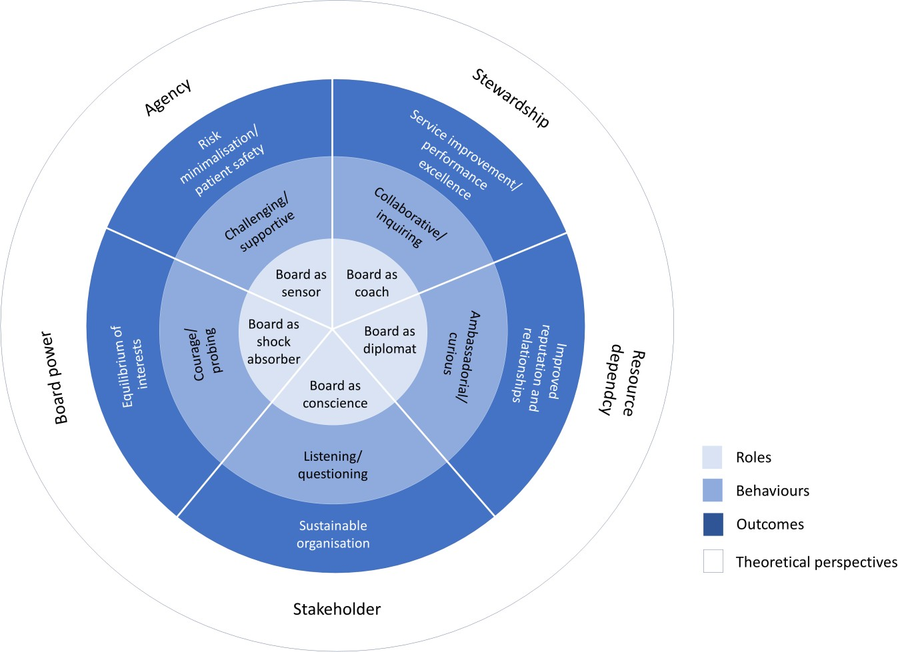
I N T E R C O N N E C T E D N E S S O F R O L E S , B E H AV I O U R S
A N D O U T C O M E S O F T H E D Y N A M I C B O A R D
( C H A M B E R S E T A L 2 0 20 )

Slide 25
Learning for boards
The diverse, diligent, dynamic ‘full service’ board
Senior leadership teams with a moderately high internal locus of control: policy implementers/entrepreneurs, not policy victims or saboteurs
Balancing assurance with quality improvement
Organisation focus on improving patient experience & staff engagement
Having effective human resource & organisational development
Capacity & capability of middle management
Using complaints and incidents as part of a programme of learning & improvement
Senior leadership teams who are able to sustain (in the eyes of staff) reliable, consistent and clear messaging and behaviours

Slide 26
LABOUR PROCESS THEORY AND MATERNITY SERVICES
This theory looks at how people work, who controls their work, what skills they use in work and how they are paid for work
Established theoretical framework that illuminates the pressures faced by service workers and suggests consequent ‘workaround’ behaviours
A different theoretical lens for understanding why staff behave in a dispassionate, unkind and often selfish way towards patients and each other
Value of a specific focus on maternity services – key priority for quality improvement in the UK

Slide 27
RESEARCH PROJECT
(started 2024; Lise Elliott & Naomi Chambers)
Research Question
What are the experiences of staff delivering care in organisations where maternity services have been shown to have failed?
Methodology
Analysis of data from the 3 inquiry reports of Morecambe Bay, Shrewsbury & Telford and East Kent using narrative review through labour process lens and grounded theorising
Potential to triangulate with focus groups conducted with maternity healthcare professionals in selected NHS Trusts

Slide 28
EARLY FINDINGS
Frontline worker voices relatively muted
Inter and intra professional dynamics
Inequitable treatment of members of different professional groups
Fear of speaking out / repercussions
Bullying
Cabals
Defensive routines and feelings of alienation
Examples of work intensification, extensification and expansification

Slide 29
We make no criticism of staff for individual errors, which, for the most part, happen despite their best efforts and are found in all healthcare systems. Where individuals collude in concealing the truth of what has happened, however, their behaviour is inexcusable, as well as unprofessional. (Kirkup 2015:8)
A senior obstetrician told the Panel that the staff were fundamentally good people who were placed in an impossible position because of the pressures of the roles they were asked to perform. (Kirkup 2022:74)
A woman who was 35 weeks pregnant and thought her waters had broken attended…The woman needed a speculum examination…the SHO hadn’t been trained on how to do it. Although the consultant was called, they did not attend and the SHO sought advice from YouTube on how to do the procedure. (Kirkup 2022:86)

Slide 30
QUESTIONS FOR BOARDS
As commissioners and providers, how often do you visit maternity wards and outpatients?
What is the morale like in your maternity service?
How well do you understand what matters to the women, the midwives, the doctors, other healthcare professionals, & the regulators?
How often is maternity services discussed at board meetings?
What mechanisms do you use to track service improvement strategies, objectives, actions and impacts in maternity services?
How does the quality of your maternity service compare with others in the UK?
How do you and maternity healthcare professionals in your organisation learn from others?
References:
Chambers et al (2020) Roles and behaviours of diligent and dynamic healthcare boards
https://journals.sagepub.com/doi/pdf/10.1177/0951484819887507
Chambers N and Taylor J (2021) Organising Care Around Patients Manchester University Press https://www.manchesterhive.com/display/9781526147448/9781526147448.xml Open Access
Elliott L (2019) Discretion, Commitment and Invisible Work: An Exploration of the Labour Process of Coummunity Nurses University of Manchester

Slide 31
Thank you for listening

Slide 32
Presentation TWO:
CARLA JONES-CHARLES, DIRECTOR OF MIDWIFERY, UNIVERSITY HOSPITALS BIRMINGHAM
RANDEEP KULAR, DIRECTOR OF STRATEGIC
PROJECTS, UNIVERSITY HOSPITALS
BIRMINGHAM

Slide 33
Focus on health inequalities within maternity services
Carla Jones-Charles
RN, RM, BSc Hons, MSc. Nye Bev Graduate
Director of Midwifery
University Hospitals Birmingham

Slide 34

University Hospitals Birmingham – BLACHIR Health Inequalities Programme of Work
Randeep Kaur Kular (Director of Strategic Projects)

Slide 35
Addressing health inequalities
BLACHIR ACTIONS
01
02
03
04
Do Not Attend (DNA) Focus
Sickle Cell…No One’s Listening Inquiry
Cultural Safety & Humility training
Maternity Neonatal Improvement Programme
Aim: To reduce Health Inequalities and also DNA rates for Black and Asian patients
Aim: To improve the experience of Sickle Cell patients at UHB, by increasing the understanding of the management plan for these patients
Aim: To increase clinical staff awareness of patient cultural religious needs
Aim: To improve the experience of service users including those from Black African and Black Caribbean individuals
Notes:
Priority 1:
Measure- Achieve a reduction of 10% of DNA amongst BME groups by April 2024.
Priority 2:
Measure- Roll out of training on Sickle Cell via Early learning for healthcare (Elfh) Moodle package to senior clinical decision makers by October 2023
Priority 3:
Roll out of training across clinical areas by December 2023
Priority 4:
To reduce Health Inequalities of services users within Maternity and Neonatal Services

Slide 36
1.DNA Focus
2.Sickle Cell and Thalassaemia
Measure & Date: Achieve a reduction of 10% of DNA amongst BME groups by April 2024
Part 1
March 2021 – Implementation of patient experience provider (PEP), delivering digital appointment letters & text reminder service in advance of an outpatient appointment
Data has been analysed and segmented to focus on Black African and Black Caribbean patients: reduction of 10% achieved for BLACHIR population then.
Part 2
Focus on outpatients – all specialties
Prospective look has taken place (January - March)
Currently at just above 12% (a 25% reduction).
Part 3
Want to continue the progress made, so Diabetes being focused on as a speciality which has a high DNA rate
DNA rate for Black African and Black Caribbean patients
Pilot scheme for bus tickets currently taking place in Paediatrics and Obstetrics.
Measure & Date: Roll out of training on Sickle Cell via Early learning for healthcare (Elfh) Moodle package to senior clinical decision makers by October 2023
Sickle Cell Moodle package has been launched and available
Working with Consultant Haematologist to progress work
Clinical audit has taken place identifying patients who have been treated and have Sickle Cell or Thalassaemia
This data is then being analysed to see how it can be used to benefit the patients journey through our hospital
Work ongoing with colleagues from the Sickle Cell and Thalassaemia All Party Parliamentary Group to identify other work which is taking place
Advise being sought from the University of Birmingham on using their patient reported outcomes to help validate and capture information from patients.
Notes:
*Chart on next slide

Slide 37
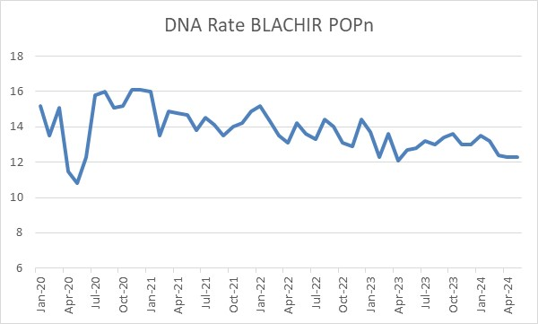
Chart for DNA Rates by Targeted Population
COVID START
PATIENTS CALLED TO CONFIRM APP’T
DR DR STARTED
Notes:
Unfortunately, there has not been a statistically significant change, so an SPC chart hasn’t been pulled together
There has been reductions some of which have been highlighted in the chart
The drop of 1% following the telephone calls is interesting (although not statistically significant)
Understanding the key drivers for not attending appointments through communication with a representative community group is key to making some additional progress

Slide 38
3.Cultural Safety & Humility Training
4. Maternity Neonatal Improvement Programme
Measure and Date: Roll out of training across clinical areas by December 2023
Dedicated Task and Finish group has been meeting to progress work at UHB
Moodle package has been uploaded looking at Cultural Competency (consists of 3 modules, including Maternity)
Video due to be recorded with patients family highlighting a situation and the outcomes from this
Video to be part of Induction, with a promotional piece to create awareness for staff
Faith and Community Compendium document to be developed further (this is currently on the Intranet)
Simple Do’s and Don'ts guide for staff being worked through
Link for the NHS Education for Scotland Spiritual Care A multi- faith resource for healthcare staff to be uploaded onto the Intranet
Paper to be pulled together for CNO (Senior Responsible Officer) showing outcomes from this group
Measure & Date: To reduce Health Inequalities of services users within Maternity and Neonatal Services
Work is ongoing and progress is being tracked via the governance arrangements for MNIP including working with NHS England.
Birmingham City Council Cultural Competency, Humility and Intelligence (Framework) to potentially be trialled in LMNS (Maternity)
MNIP includes:
  Interpreting services
  Cultural competence
  Training materials for women of colour (response to national report ‘Mind the Gap’
    This includes recognising ill health on patients with darker skin e.g. how bruising presents
  Baby mannequins of colour also introduced as part of the improved training.
Notes:
LMNS- Local Maternity Neonatal Services

Slide 39
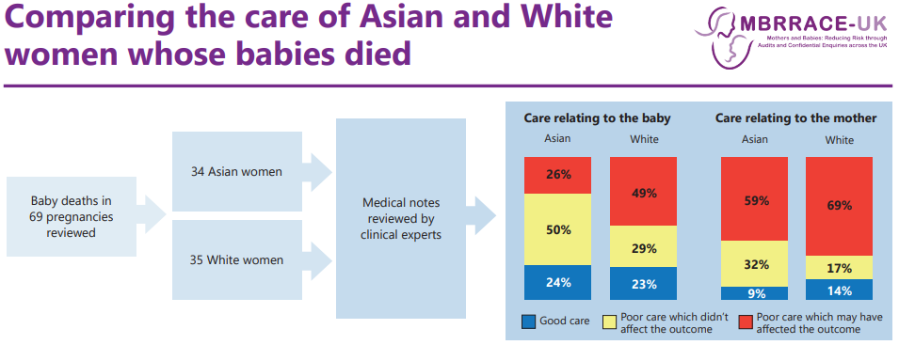
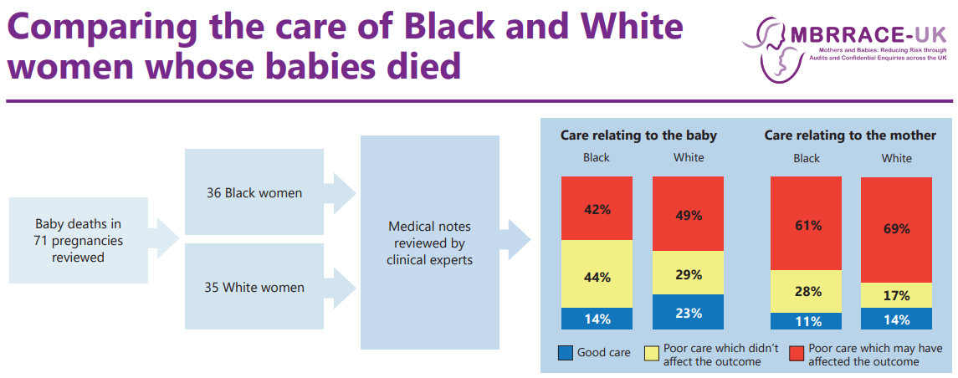
Perinatal mortality and ethnicity

Slide 40
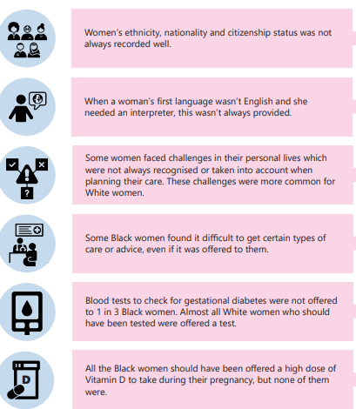
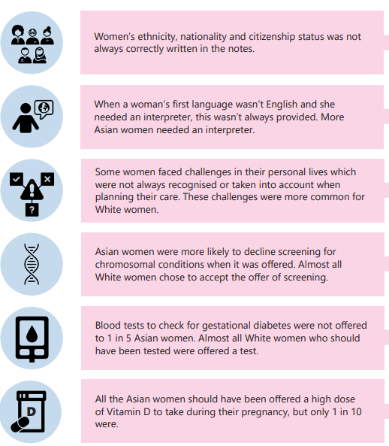
Comparing the care of Black, Asian and White women whose babies died
Black women compared to white women
Asian women compared to white women

Slide 41
Vulnerabilities identified: Key findings
Identifying and responding to language needs are inadequate across all ethnic groups
Inconsistent use of independent interpretation services was noted for all women who needed it, with inappropriate use of family members and healthcare professionals
Compared with White women, fewer Black women had evidence of routine mental health questions being asked.
Black women were more likely to experience barriers to accessing specific aspects of care or advice that were offered which resulted in some women not taking prescribed medicines, taking their own discharge against advice, and not attending specialist appointments
Congenital abnormalities and the impact of ‘close’ family relationships
Social risk factors were recorded as being present less for the Asian and Black women
There was a lack of personalised care which was both kind and compassionate

Slide 42
Birth Rights report 2022
Stereotyping
  Asian women having shorter perineum.
  Black women have a higher pain threshold
  Trans and non-binary people’s experience missing from national data
  Intersectional discrimination.
  Women of colour not being believed
  NHS staff inability to assess patients with black and brown skin for pallor and jaundice
  Microaggressions

Slide 43
A way forward:
True co-production
Routine use of independent interpreting services – WOWs!
Woman focused care – personalisation and empowering women e.g. support cultural and health intelligence: ‘In-Reaching’
Assessing the need for Vit D
Focus on DNA - reasons
Staff recognition of personal bias
Staff training about bias
Training and simulation equipment that focus care for black and brown people. Assessment specifically for people of colour

Slide 44
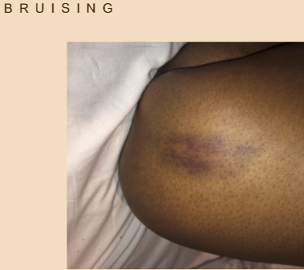
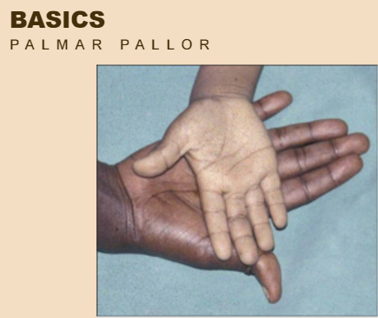
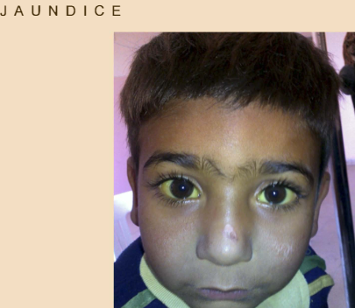
Examples of training materials for health professionals

Slide 45

Any questions?
Thank you.

Slide 46
Thank you for listening

Slide 47
Presentation three:
dr nandi Simpson, director - implementation, nhs race and health observatory
arnie puntis, research and policy manager, nhs race and health observatory

Slide 48

Translating Theory into Practice

Slide 49



NHS RHO: Addressing ethnic health inequalities
    EVIDENCE – We produce evidence about racial and ethnic inequality in health;
      commissioning original research to fill knowledge gaps
      synthesising and mobilising existing evidence
1
2
INFLUENCE – We use the evidence we commission and mobilise to
influence leaders through practical recommendations for policy and practice
3
IMPLEMENT – On the basis of our recommendations, and in response to the needs of the communities we work with, we work to support the implementation of new policies and practice at the grassroots
Notes:
Nandi

Slide 50

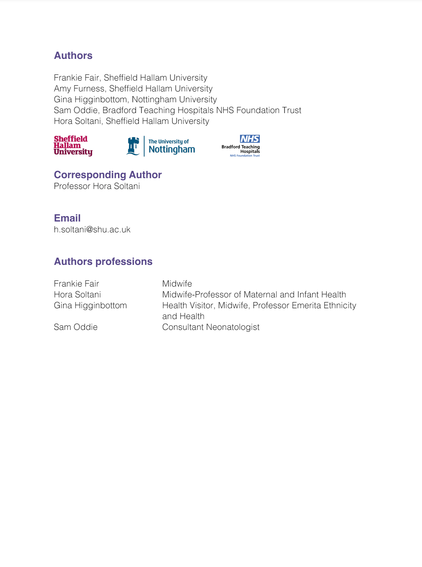
Notes:
Arnie

Slide 51
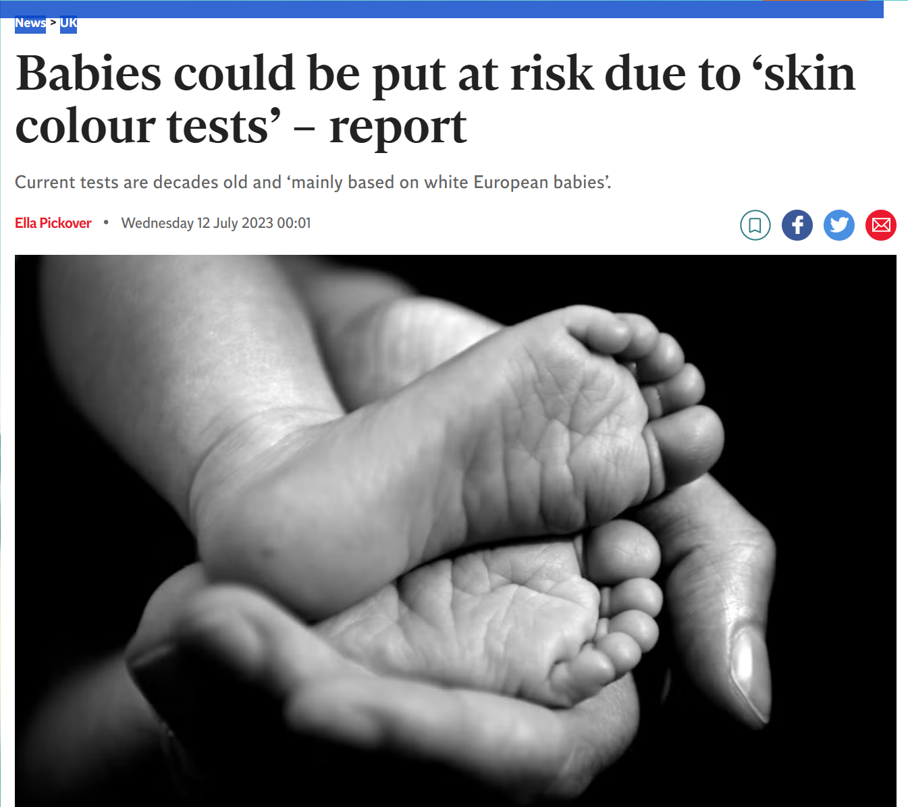
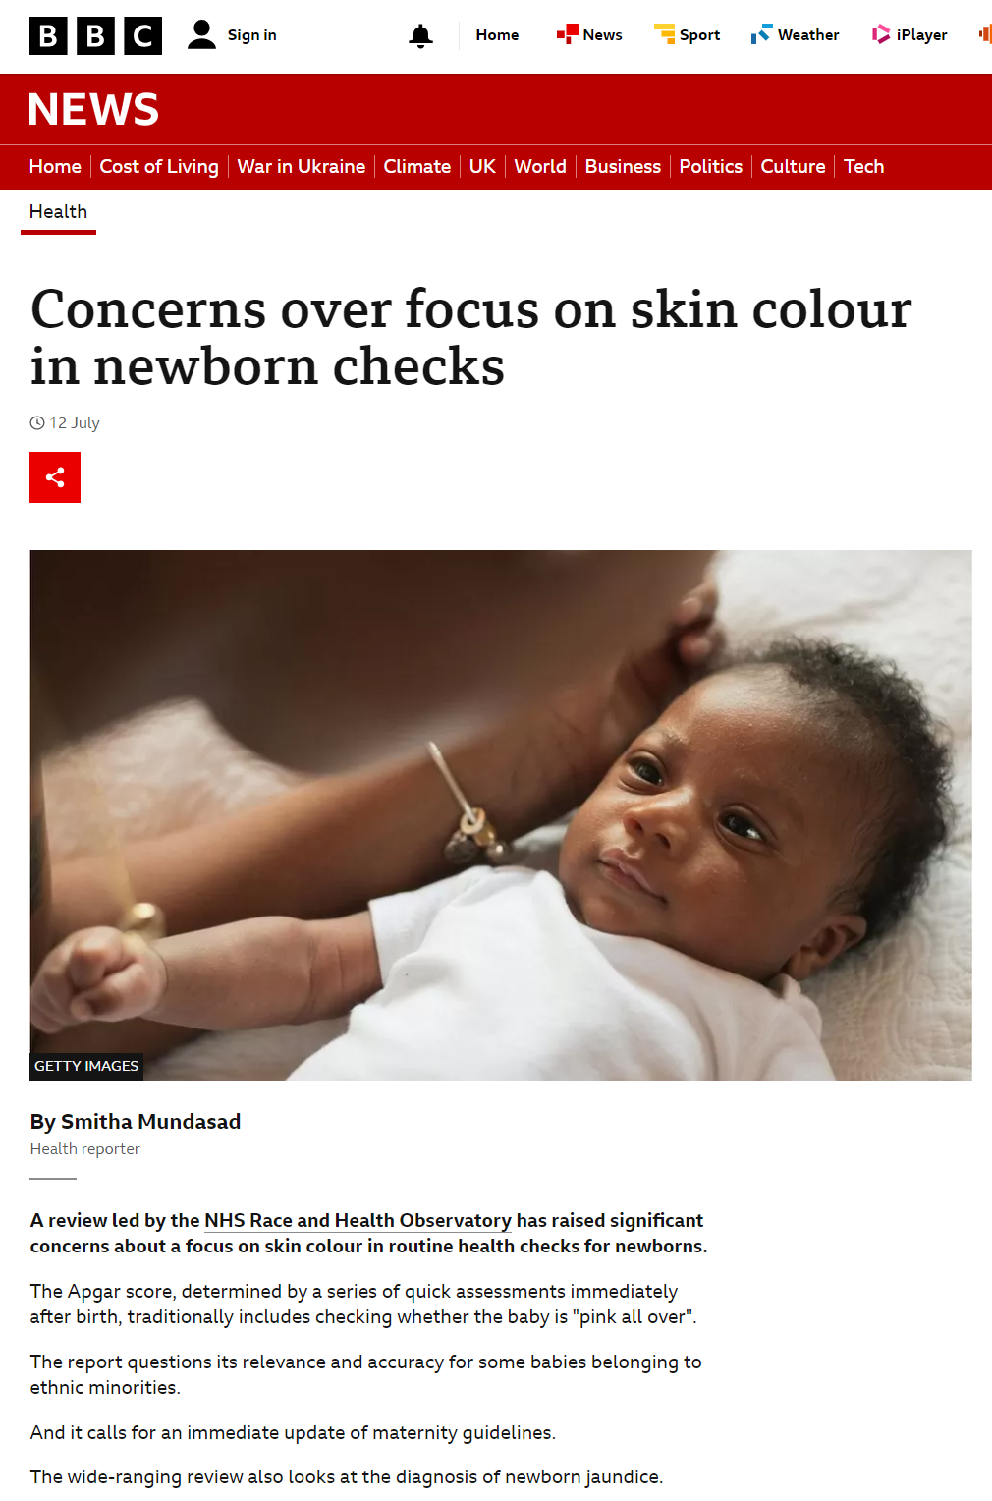

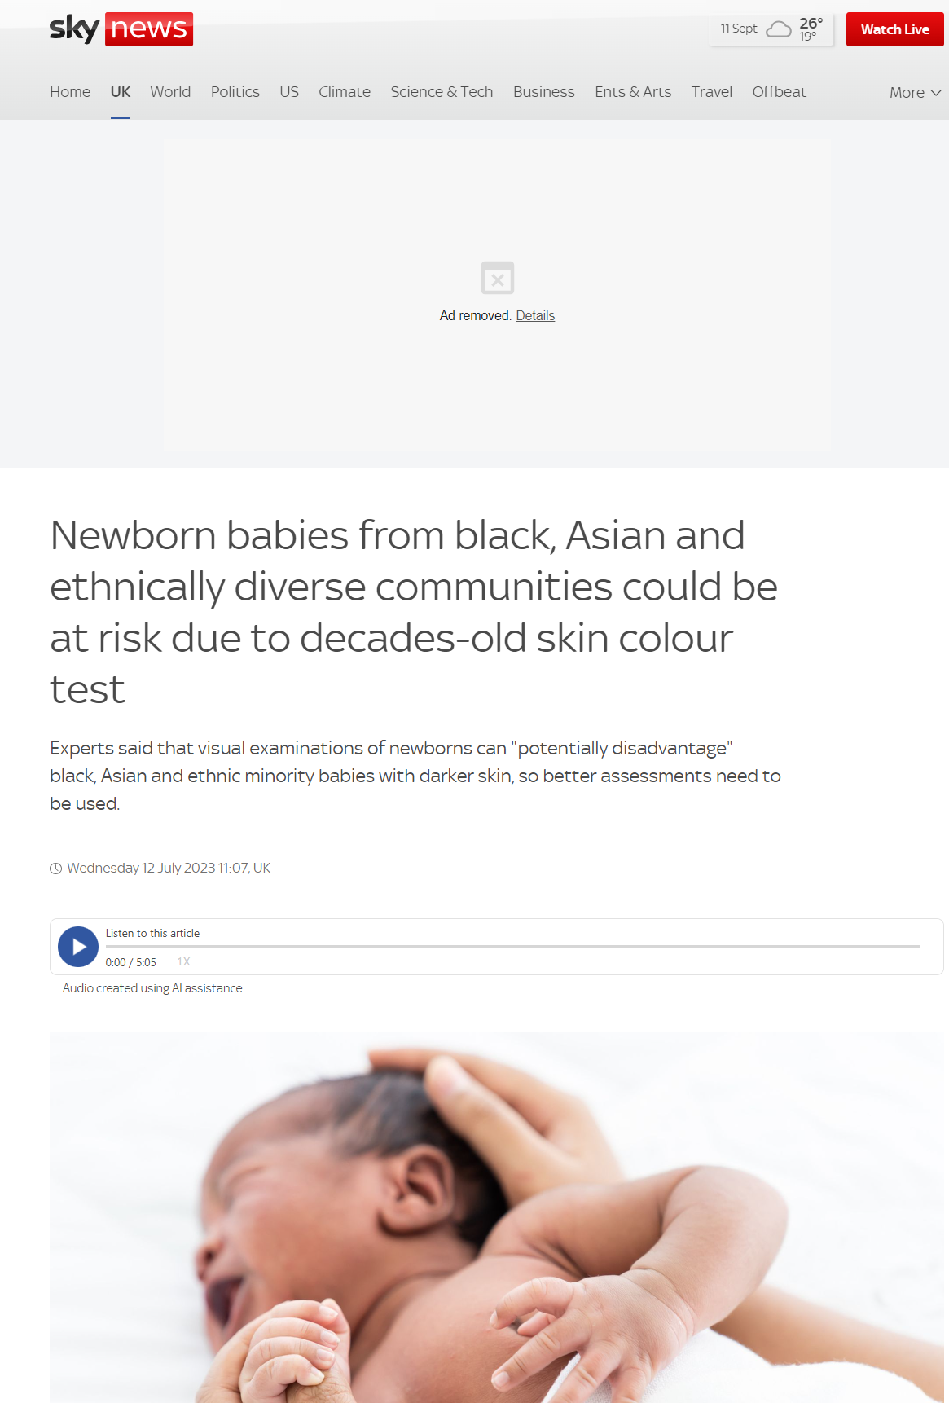

Notes:
ARNIE

Slide 52
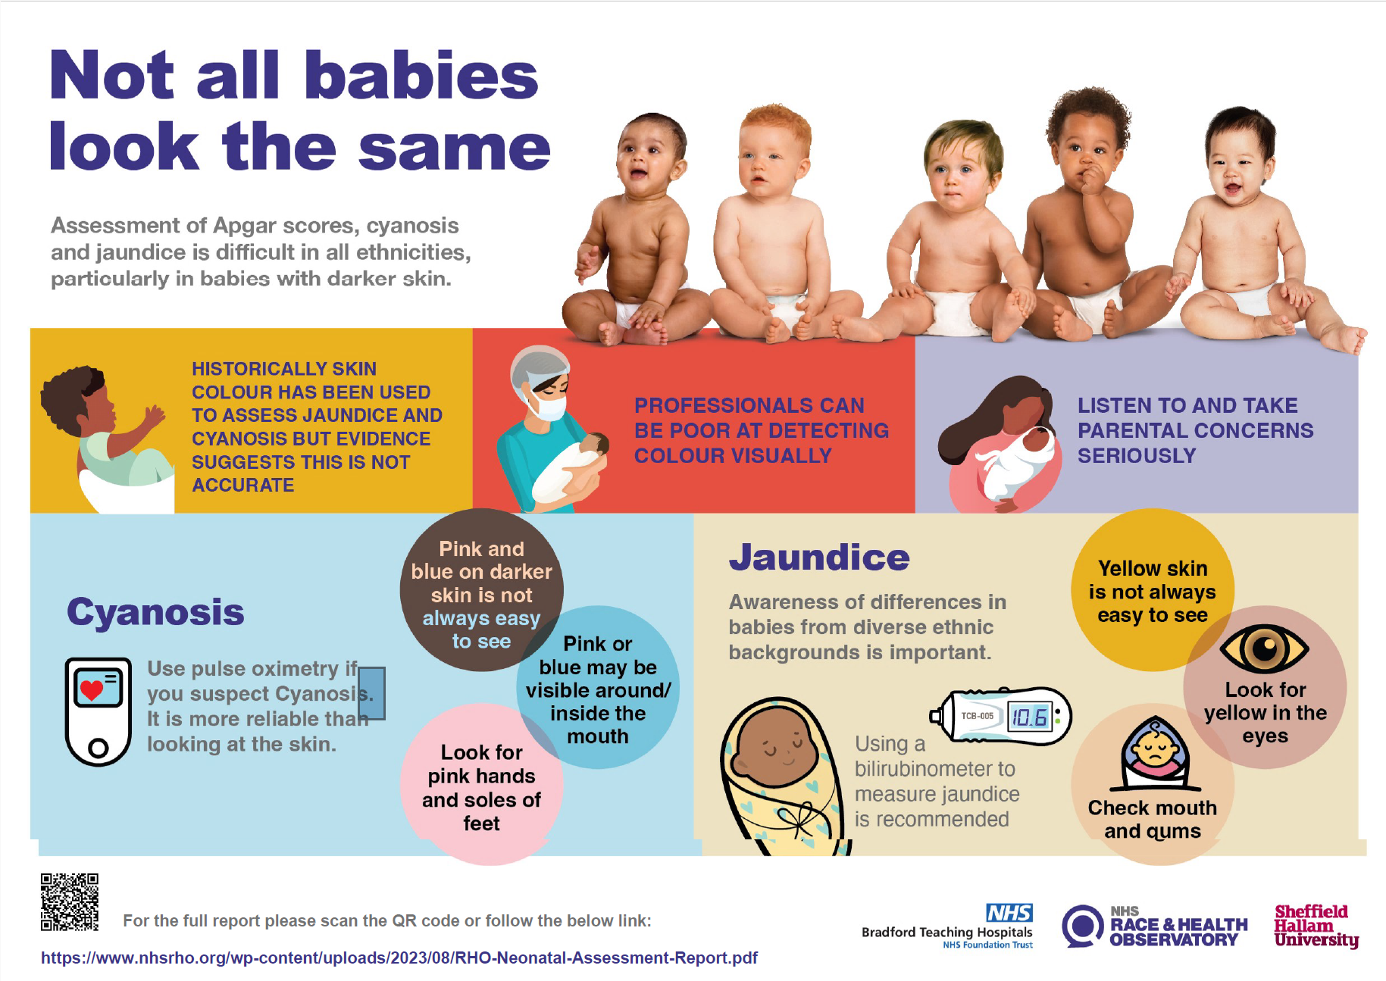
Notes:
Arnie

Slide 53
Recommendations for practice
Jaundice: Bilirubinometers
Cyanosis: pulse oximetry
Image library
Education and training
Notes:
ARNIE
Add in actions from each recommendation:
TCB project commissioned
Work with National Screening Committee
Work with NHSE and students on image library
Work with HEEs and LME networks, Teaching resources and e-modules etc with royal colleges

Slide 54
Recommendations for policy
Assessment techniques
State how to assess on Black and darker skinned babies
Images and descriptors
Screening tools
Notes:
ARNIE
NICE changing their guidelines
Decolonising curriculum

Slide 55
Recommendations for research
Apgar: Inter-rater reliability between HCPs, revie of alterative scores
Jaundice: NICU admissions, assessment tools, apps
Cyanosis : pulse oximetry accuracy
Notes:
ARNIE
Work with NIHR and research funders underway
Work with BAPM re: screening tools

Slide 56
NHS RHO Learning & Action Network
Why?
No large scale maternal and neonatal improvement programme has focused specifically on ethnic inequalities, and there are evidence gaps around translatable interventions to reduce maternal and neonatal ethnic health inequalities
Racism is one of the factors that underlies the persistence of the maternal and neonatal ethnic health inequalities
We aim, through this programme, to:
Develop an anti-racism focused QI model, that supports practitioners to identify and address racism within maternity services;
Identify, scale and spread improvement approaches that embed anti-racism into services and improve maternal and neonatal health outcomes
What?
How?
Notes:
Nandi

Slide 57



The RHO anti-racism principles
Name racism, engaging seriously and continuously with the ways in which racism impacts the lives of the patients and service users who are your focus.
Establish a mutually accepted model of racism and health, which all partners will accept and ratify.
Involve racially minoritised individuals in every stage of development, including ensuring that the improvement team themselves are racially diverse. ​
Collect and publish data on race inequity in its entirety. Where data is not available, change policies to ensure that data is collected.​
Identify racist bias in policies, decision making processes, and other areas within your organisation. ​
Apply a race-critical lens to the adoption of interventions to be tested – did underlying research involve community participation? Who were the researchers?​
Evaluate based on measures that recognise the role of racism as determinant of health.
Notes:
Nandi

Slide 58
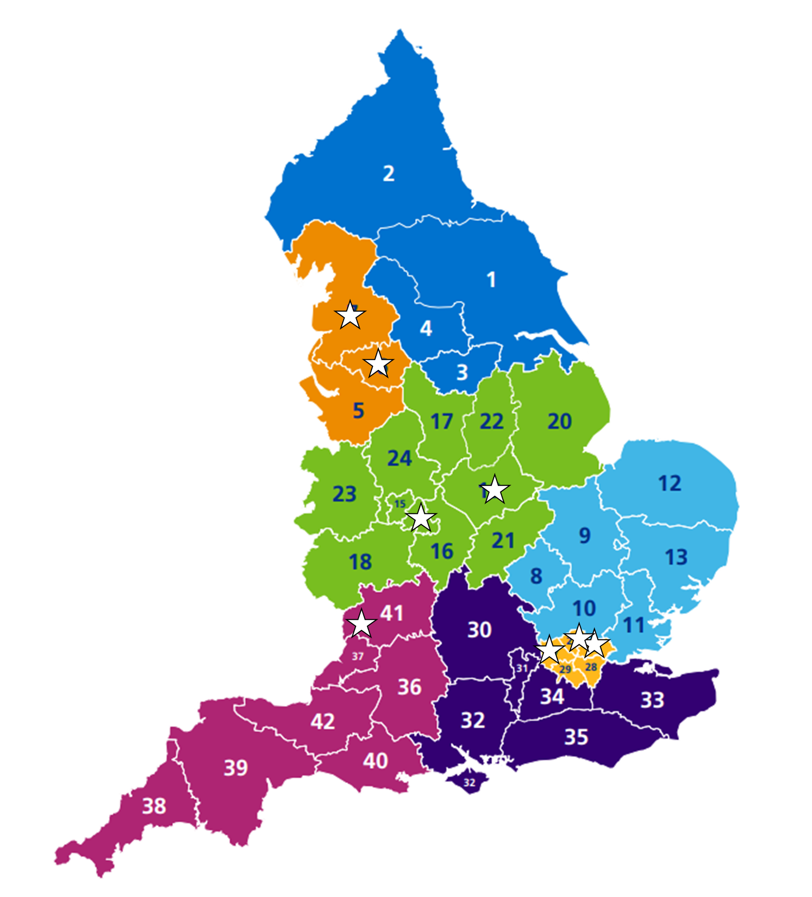

RHO LEARNING & ACTION NETWORK
  10 teams
  8 ICSs
  4 regions
  4 conditions:
    Post-partum Haemorrhage
    Gestational Diabetes
    Perinatal Mental Health
    Preterm Birth
  15 months: Jan 2024 – Mar 2025
1 aim:
To reduce clinically avoidable severe maternal morbidity, perinatal mortality and neonatal morbidity while improving experience of care for pregnant women and people from Black, Asian and minority ethnic groups
Notes:
Nandi

Slide 59


Email: info@nhsrho.org
Website: nhsrho.org
Twitter: @NHS_RHO

Slide 60
Thank you for listening

Slide 61
Presentation FOUR:
NOSHIN MENZIES, SENIOR PROJECT MANAGER,
HEALTH INNOVATION NETWORK WEST OF ENGLAND
Notes:
Noshin Menzies, Senior Project Manager, Health Innovation West of England
Tom Baker, Programme Manager – Perinatal Safety Improvement & Georgina Twist, Specialist Midwife Maternal Mental Health, University Hospitals of Leicester NHS Trust

Slide 62



Reducing Racial Disparities in Preterm Optimisation in BNSSG

Slide 63
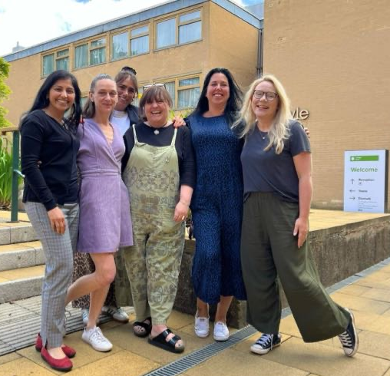
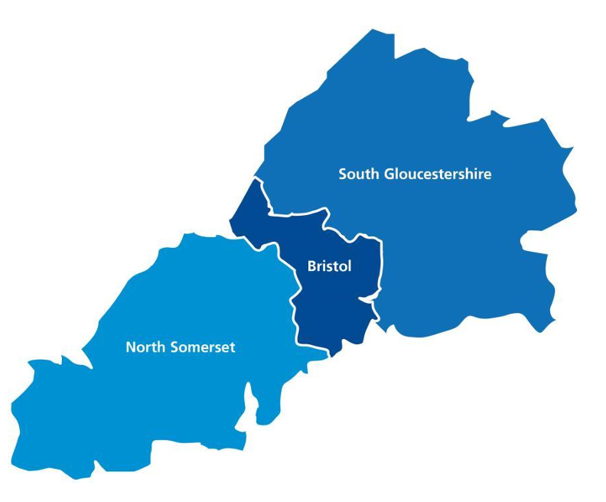


About Bristol, North Somerset & South Gloucestershire LMNS
Layla Toomer- Patient Safety Lead Maternity & Neonatology
Sneha Basude- Obstetrician
Lisa Kirk- Obstetrician
Lucy Parchment- Midwife
Terri Gnani- Midwife
Ann Remmers- Health Innovation Network West of England
Noshin Menzies- Health Innovation Network West of England
Two level 3 neonatal units
Southmead (North Bristol Trust - NBT) and
St Michael’s (University Hospital Bristol & Weston Trust - UHBW)
Southmead cares for around 770 babies each year
St Michael’s cares for around 750 babies each year.
Both units function independently and provide care to babies within the BNSSG region as well as to babies from the wider South West Operational Delivery network (SWODN) as and when needed.

Slide 64


No matter what I do to prepare, my safety is in the hands of the healthcare professionals I meet on my journey

Slide 65
Drivers for Change
In the UK, Black women still face significant disparities in maternal health outcomes, experiencing higher mortality and stillbirth rates compared to their white counterparts. These disparities are rooted in systemic biases, structural racism, and a lack of racial literacy within healthcare services
Women from the global majority have higher preterm rates, and Bristol has a 18.9% of the population identifying from within this group. Preterm birth is the largest cause of infant mortality in England (70%). Within Bristol, North Somerset and South Glos, infant mortality rate is 2-3 times higher in babies* from the global majority, compared to the White ethnic groups.
In Bristol (University Hospitals Bristol and Weston, and
North Bristol NHS Trust) there are disparities in
preterm optimisation between Black women and
white women, with the rates of antenatal magnesium
sulphate and steroids for this group not increasing
in line with PERIPrem improvements for all women.
*Bristol Vermont Oxford Benchmarking Network; 2020-2023

Slide 66
Implementation
Increase in the number of BNSSG staff undertaking Black Maternity Matters Training
Implementation of cohort 4 of BMM for BNSSG
Increase in anti racist practice and theory and acceptance of the role of unconscious bias in treatment of women racialised as Black
Alignment and acknowledgement of the negative impact of unconscious biases in achieving preterm optimisation for Black women and babies
Creation / adoption of Anti Racist Framework and Strategy for BNSSG perinatal system
Enhancement and alignment of NHSE Perinatal Culture work with Anti Racist practice and theory
Training for perinatal staff on “asking about race and ethnicity”
Increase the proportion of women racialised as Black in BNSSG at less than 34 + 0 weeks’ gestation with threatened preterm labour receiving a full course of antenatal corticosteroids and magnesium sulphate within one week prior to delivery to 80% or greater by March 2025
Improved data quality and accuracy regarding race and ethnicity and preterm birth
Accurate data completeness for women, families and babies racialised as Black
Development of “About me and my baby” conversation process to improve data on race and ethnicity for mother baby dyads
Facilitation and embedding of a safe, trusted perinatal service for Black women and babies
Expert led, race trauma informed qualitative exploration of the experiences of Black women and families
Enhanced and optimised preterm care pathway for women and babies racialised as Black in BNSSG
Consistent approach and reduction in variation of preterm birth interventions through system wide guidelines and decision-making
Retrospective audit of all Black women and preterm babies
Interrogation and identification of the system wide risk factors for bias interacting with optimised preterm care including deep dive into number of contact points by gestation (i.e. at preterm birth clinic)
Development of a BNSSG optimised preterm birth pathway for women and babies racialised as Black including unconscious bias and racism as a risk factor for morbidity and mortality
Black women and families are involved and contributing lived experience and insight
Design and implement a continuous improvement process for the review of all preterm births for Black women and babies in BNSSG
Increase in acceptability, trust and psychological safety reported by Black women and families
Identification of the touch points of the preterm pathway that are impacted by racism and unconscious bias and are barriers to optimised preterm care
Enhanced understanding and deeper knowledge regarding why Black women and babies are receiving suboptimal preterm care in BNSSG
Diversification of BNSSG MNVP membership including improving engagement with women and families racialised as Black

Slide 67

Progress to Date
Staff survey undertaken- lack of awareness of disparities of outcomes
Retrospective 3-month data collection; no themes identified -Issues identified with ethnicity data collection both on Maternal and Neonatal Badgernet (based on 2001 census, being revised)
Contemporaneous data collection with qualitative insight is required
Robustness of data segmented by ethnicity- Badgernet (both maternity and neonatal) not matching with primary care data sources & using 2001 census breakdowns which are outdated. From a neonatal viewpoint - not part of NNAP
Next steps
Trauma informed qualitative interviews with women and families by race informed research experts
Process mapping of pathway - preterm birth clinic and self-presenting to identify points that racism can modulate care

Slide 68
Thank you for listening

Slide 69
Presentation FIVE:
TOM BAKER, PROGRAMME MANAGER - PERINATAL SAFETY IMPROVEMENT, UNIVERSITY HOSPITALS OF LEICESTER NHS TRUST
GEORGINA TWIST, SPECIALIST MIDWIFE MATERNAL MENTAL HEALTH,
UNIVERSITY HOSPITALS OF LEICESTER NHS TRUST

Slide 70
Thank you for listening

Slide 71
Presentation SIX :
JENNIFER CARROLL, CONTINUOUS IMPROVEMENT CLINICAL FELLOW, LANCARSHIRE TEACHING HOSPITALS NHS FOUNDATION TRUST
JENNY CRADDOCK, MIDWIFERY TEAM LEADER, LANCARSHIRE TEACHING HOSPITALS NHS FOUNDATION TRUST
Notes:
Jennifer Carroll Continuous Improvement Clinical Fellow
Jenny Craddock Midwifery Team Leader
Lancashire Teaching Hospitals NHS Foundation Trust

Slide 72


Focused continuous improvement:
Reducing post-partum haemorrhage (≥1000mls) in women & birthing people from black & ethnic minority groups
January 2024 – March 2025
Jennifer Carroll Continuous Improvement Clinical Fellow
Jenny Craddock Midwifery Team Leader

Slide 73
Population of Focus
Black and ethnic minorities is our population of focus
Just over 2 women and birthing people from black and ethnic minorities experience PPH >1000mL per week within our services
We have explored the data and agreed at this stage to focus our continuous improvement energy upon women and birthing people from black and ethnic minorities given the number of people per week this equates to enabling change to be monitored over time at pace.
We have collected and reviewed 9 months of quantitative data, completed 3 colleague focus groups and just under 10 service user interviews

Slide 74
What change can we make that will result in improvement?
Aim
Primary Drivers
Secondary Drivers
Change ideas
We aim to reduce post-partum haemorrhage (≥1000mls) experienced by black & ethnic minority women & birthing people by 50% (from 12% to 6%) by 01.03.25.
Post delivery function
Service user experience
Awareness & education (service user & colleague)
Early Bird Booking Part A with Public Health education & screening
Service user outcomes
Review of antenatal & intrapartum risk Ax processes for PPH
Timely triage
Appropriate utilisation of resources available
Prevention of complications
Antenatal education- infographics
NHS resources
Hb optimisation between 26-32 weeks for women @ risk
Patient flow
Length of stay
Referrals to HDU/ICU
Financial sustainability

Slide 75
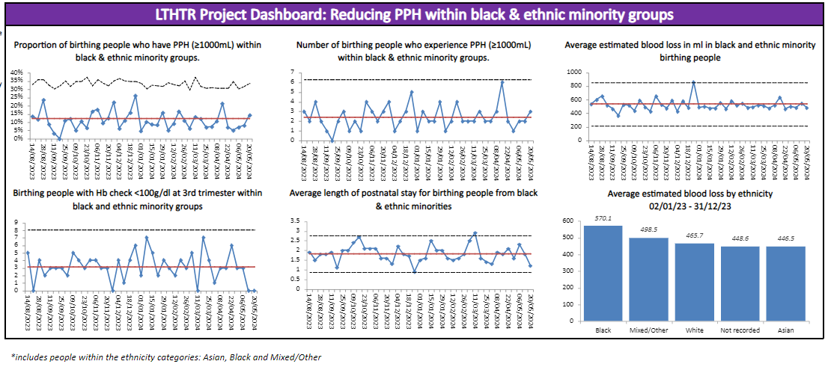
Baseline Data: Outcome Measure

Slide 76
Change Ideas and PDSAs
Active PDSAs | Learning to date
Early Bird midwifery pre-booking group education session. To support health pregnancy and birth. To enable early identification of requirement for iron treatment and ensure better optimisation of Hb throughout pregnancy. | Positive feedback from service users upon early education Opportunity to consider how service and resources could be more accessible Data collection specific to test of change in combination with global dashboard Run chart gestation in weeks and early blood testing Short & long term measurement
PPH prevention risk assessment. | Review of resources including guidance, assessment support tool, audit, patient information leaflet, colleague education Data collection specific to test of change in combination with global dashboard Run chart with percentage intrapartum PPH risk assessments completed Percentage of those identified as high risk

Slide 77
Anti-Racism Approaches We’ve Used
3-part data review in collaboration with Trust Organisational Development and Patient Experience teams: viewing this through a different lens
This is about being flexible and adaptable to support and enable service user participation and co-design of this focused improvement work
There is an opportunity for us to review our resources in respect of enhanced accessibility
This has provided opportunity for an anti-racism lens to be applied to other areas of focused improvement within the Trust

Slide 78

Our Journey to Date
How can we apply an anti-racism lens to our focused continuous improvement
Completed 3-part data review
Developing PDSA cycles for each test of change
2 active tests of change including data review ongoing
Creating opportunities to share learning locally, regionally & nationally

Slide 79
Thank you for listening

Slide 80
Q&A

Slide 81

What's something you are proud of that you
are doing in your maternity services to tackle
Health inequalities?
(please add your name)
https://app.sli.do/event/vuXGbuUbx6UvcyLaMca2p8
Notes:
Scan here to access our evaluation or use the link in the chat
URL
https://www.smartsurvey.co.uk/s/J6NN2G/

Slide 82

Tell us what you think
Scan here to access our evaluation or use the link in the chat
URL
https://www.smartsurvey.co.uk/s/J6NN2G/

Slide 83
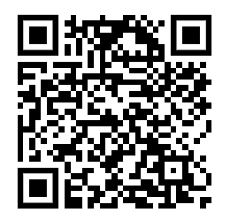
RESOURCES
Scan here to access our improvement blogs and resources
​
URL​
https://nhsproviders.org/development-offer/improvement/resources
Notes:
Resources - NHS Providers

Slide 84

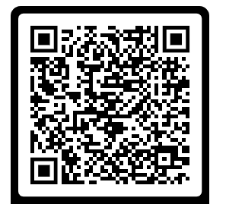
ACE CONFERENCE (12 - 13 November)
Book here - https://www.eventsforce.net/nhsproviders/frontend/reg/tSelectBookingMode.csp?

