Slide 1

Welcome to today’s event:
Reducing elective waiting lists through provider collaboration

Slide 2

Agenda
Welcome and introductions
Facilitated by chair, David Williams - Head of Policy, NHS Providers
Case study 1: North East and North Cumbria (NENC) Provider Collaborative
Nicola Thackray, Elective Programme Director
Julie Turner, Director of Elective Care Recovery and Improvement
Case study 2: The Cheshire and Merseyside Acute and Specialist Trust Alliance (CMAST)
Linda Buckley, Managing Director
Jenny Briggs, Elective Programme Director
Interactive Q&A
Facilitated by the chair

Slide 3
Housekeeping
Please note, this event is being recorded
Please keep your camera on wherever possible
If you lose connection, please re-join using the link in your joining instructions or email provider.collaboration@nhsproviders.org
Please ensure your microphone is muted during presentations to minimise background noise
We will come to questions after each speaker
Please feel free to use the chat box for questions and sharing examples of what has delivered sustained progress in your organisation
If you would like to ask a question audibly, please use the raise hand function during the Q&A section and we will bring you in
Any unanswered questions will be taken away and answered after the event
You will receive a link to an evaluation form after today’s event. Please take the time to complete it, we really do appreciate your feedback.

Slide 4
Reducing elective waiting lists through provider collaboration
4th December 2024
Nicola Thackray, Elective Programme Director
Julie Turner, Director of Elective Care Recovery and Improvement

Slide 5

What we aim to cover today
Overview of the NENC system & Provider Collaborative
The Purpose and key priorities for the Provider Collaborative
Specific challenges we faced around our elective waiting lists
What we did to overcome the challenges as a system
Benefits of collaborating within the elective space
Our future ambitions
Key messages

Slide 6

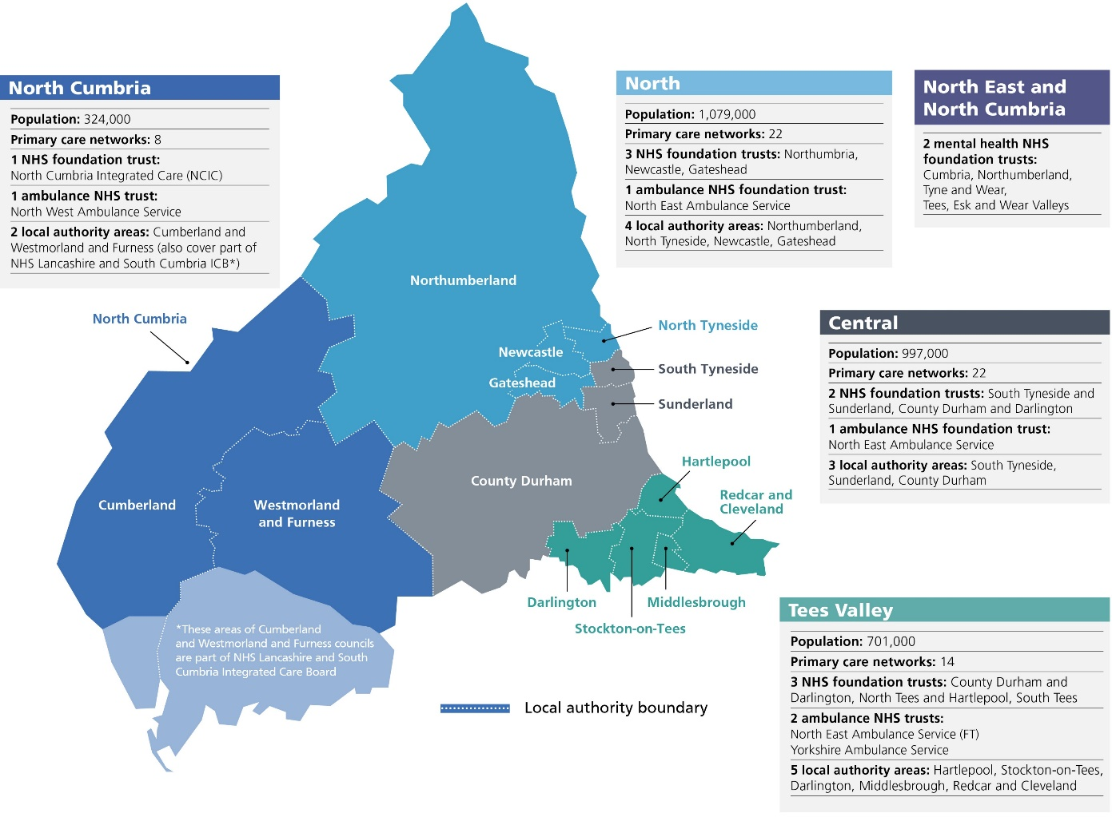
Overview of the NENC System
Stats and facts
Largest ICS in the Country
Population size 3.2M
170K staff (health and care)
85K staff (health)
358+ GP Practices
64 PCNs
8 Acute/Community Trusts
2 MH Trusts
1 Ambulance Trust
14 Local Authorities
6 Universities
3rd/Vol sector
Notes:
We are the biggest ICS and Collab in the country, both in geography, where we are the size of Wales and in the population of 3.2m. In fact, in population terms, if we were a country, we would be the 135th biggest on the planet, about the same as Puerto Rico, bigger than 100 other countries.
But why does that matter?
I think it is the challenge of ensuring we have sustainable healthcare services consistently at the highest standards everywhere across a really diverse landscape, where there are big populations that are far apart. Providing healthcare across our urban bands with a million people each across the Tyne, Wear and Tees is very different to the big isolated population centres that are in a ring around North Cumbria.
And the geographical distribution of our workforce is imbalanced, such as the consolidation of doctors who settle in the Newcastle area.
All challenges for us to think about

Slide 7

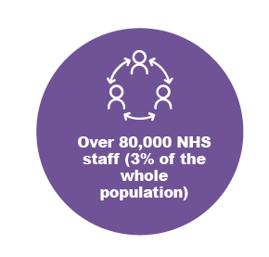
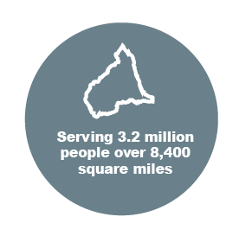
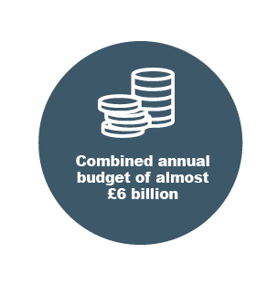


NENC Provider Collaborative Members
North (Great North Healthcare Alliance)
Northumbria Healthcare NHS FT
The Newcastle upon Tyne Hospitals NHS FT
Gateshead Health NHS FT
North Cumbria Integrated Care NHS FT
Central
South Tyneside and Sunderland NHS FT
County Durham and Darlington NHS FT
Tees Valley (University Hospitals Tees)
North Tees and Hartlepool NHS FT
South Tees Hospitals NHS FT
Mental Health, Learning Disabilities & Autism
Cumbria, Northumberland, Tyne and Wear NHS FT
Tees, Esk and Wear Valleys NHS FT
Regionwide
North East Ambulance Service
Notes:
Mention we have MH and Ambulance Trust included & Nested Collabs

Slide 8
NENC Provider Collaborative Purpose
Provider Collaborative = collaboration of providers
Focussing on things that it makes sense to work together on
Not “doing things to FTs”
Not a separate entity, but defined by what the eleven member FTs do together and the decisions they make together
Developing culture of collaboration, moving beyond collective individualism
Tackling strategic priorities and addressing unwarranted variation

Slide 9
Our principles and ways of working
Support each other and provide mutual aid in times of pressure
Make shared decisions to speed up transformation and change
Challenge each other and hold each other to account
Always act in good faith and in the best interests of the people we serve
Empower staff to work with other Trust staff to improve care
Make sure there is a strong clinical leadership and governance
Actively involve staff, patients, the public and wider stakeholders
Show solidarity when making decisions for the local population
Take responsibility for delivering on agreed priorities and manage risks together
Promote a high performing culture of teamwork, innovation and continuous improvement

Slide 10
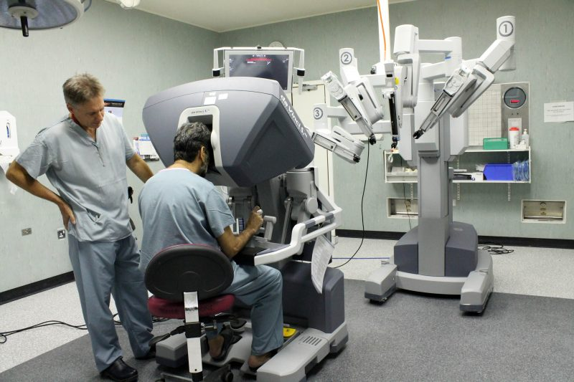

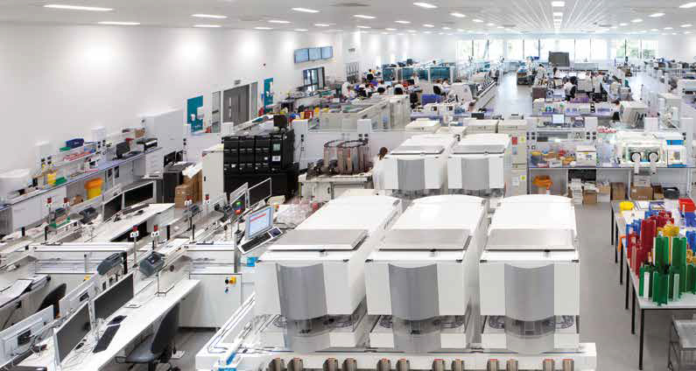
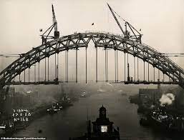
Work Programmes – key priorities for PvCv
CLINICAL
Elective Care and Recovery
Strategic Approach to Clinical Services
Urgent and Emergency Care
CORPORATE
Estates and Capital
Workforce
Digital
CLINICAL SUPPORT
DEVELOPMENT
Diagnostics
Pathology
Aseptics
Organisational Development
Culture/Collaboration
Succession Planning

Slide 11
PvCv Team
Separately funded
Clinical Lead
Chris Snowden
Managing Director
Matt Brown
Diagnostics Programme Director
Ruth James
Diagnostics Programme Team
MTFP Funded
Elective Programme Team
Director of Elective Care Recovery
Julie Turner
Elective Programme Director
Nicola Thackray
Clinical Strategy Lead
Jill Simpson
Corporate Programme Director
Lesley Currer
Operations
Programme Director
Neil Stevenson
Procurement Lead
Dan Shelley
Cancer Prog. Manager
Dani Colvin-Laws
Clinical Alliance Lead
Caroline Fieldsend
Prog Manager
Paul Whittingham
Vacant
Finance Lead
Vacant
Aseptics Project Manager
Craig Muller
Senior Project Manager
Rachael Whitton
Senior Workforce Lead
Nic Morrow
Performance & Intelligence Lead
Vacant
Project Manager
Janine Cunliffe
Senior Project Manager
Bethany Moore
Programme Support Admin
Tracey Winch
Project Manager
Vacant
Senior Project Manager
Jen Musgrave
Project Support Officer
Charlotte Herron
Comms Lead
Harry Newhouse
Analytical Support from ICB & NECS
Graduate
James Lister
Project Manager
Dani Cragg
Graduate
Peter Dowsett

Slide 12
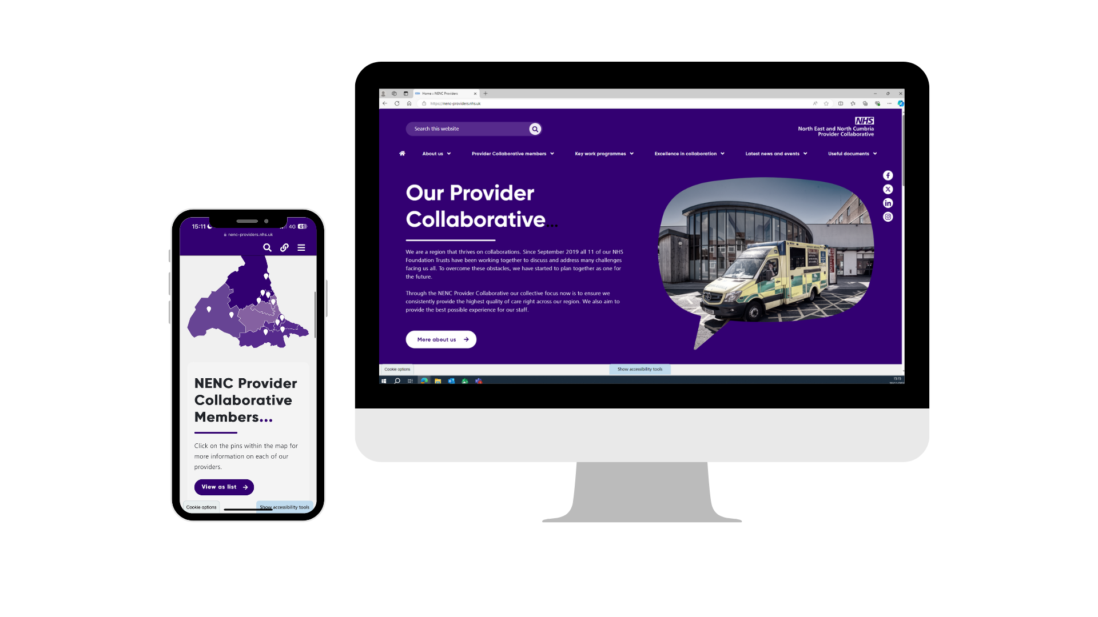
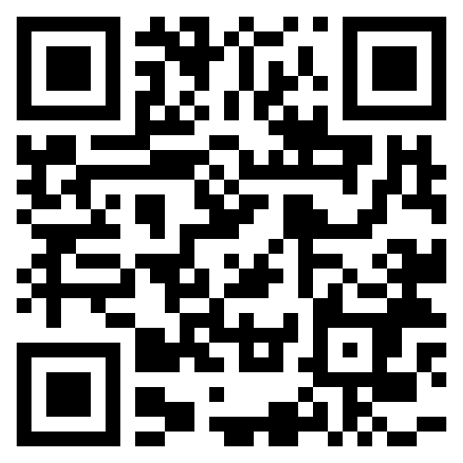
Provider Collaborative Website

Slide 13
Elective Care and Recovery Work Programme
CLINICAL
Notes:
Hand over to Nic - South Tees Picture

Slide 14

Elective Care Improvement Programme
Our Elective Care Recovery & Improvement Programme aims to restore and transform elective care services, eliminating long waits for treatment, reducing overall waiting times and addressing health inequalities by managing demand and maximising capacity.
Our Core Priorities are:
Improving Access and Eliminating Long Waits (Performance)
Improving Capacity and Productivity (Productivity)
System Transformation and Resilience (Pathways)

Slide 15
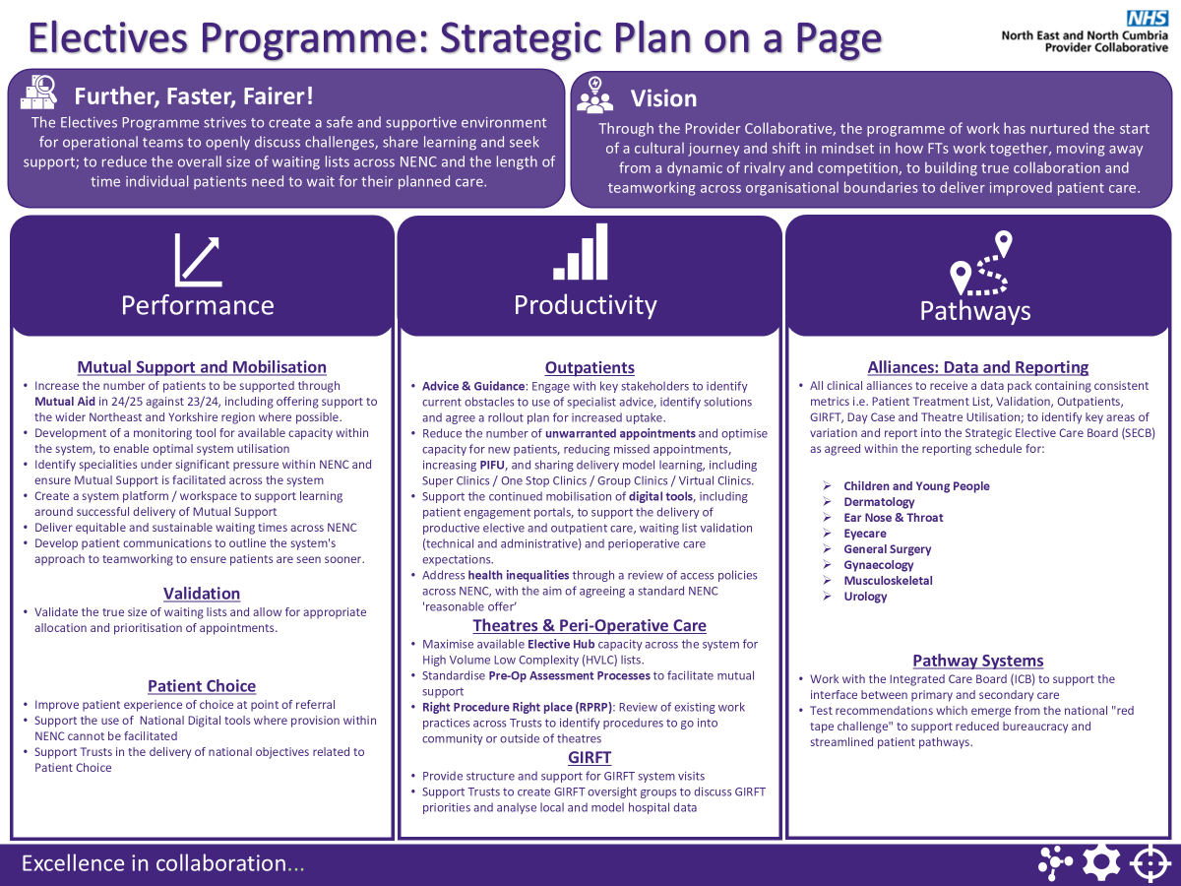
Notes:
Headlines from our Delivery Plan – felt right at the start of the year, recognise we need to refresh as national plans become more known for 25/26 and beyond
Lots of work in this space – hard to try and keep things simple

Slide 16
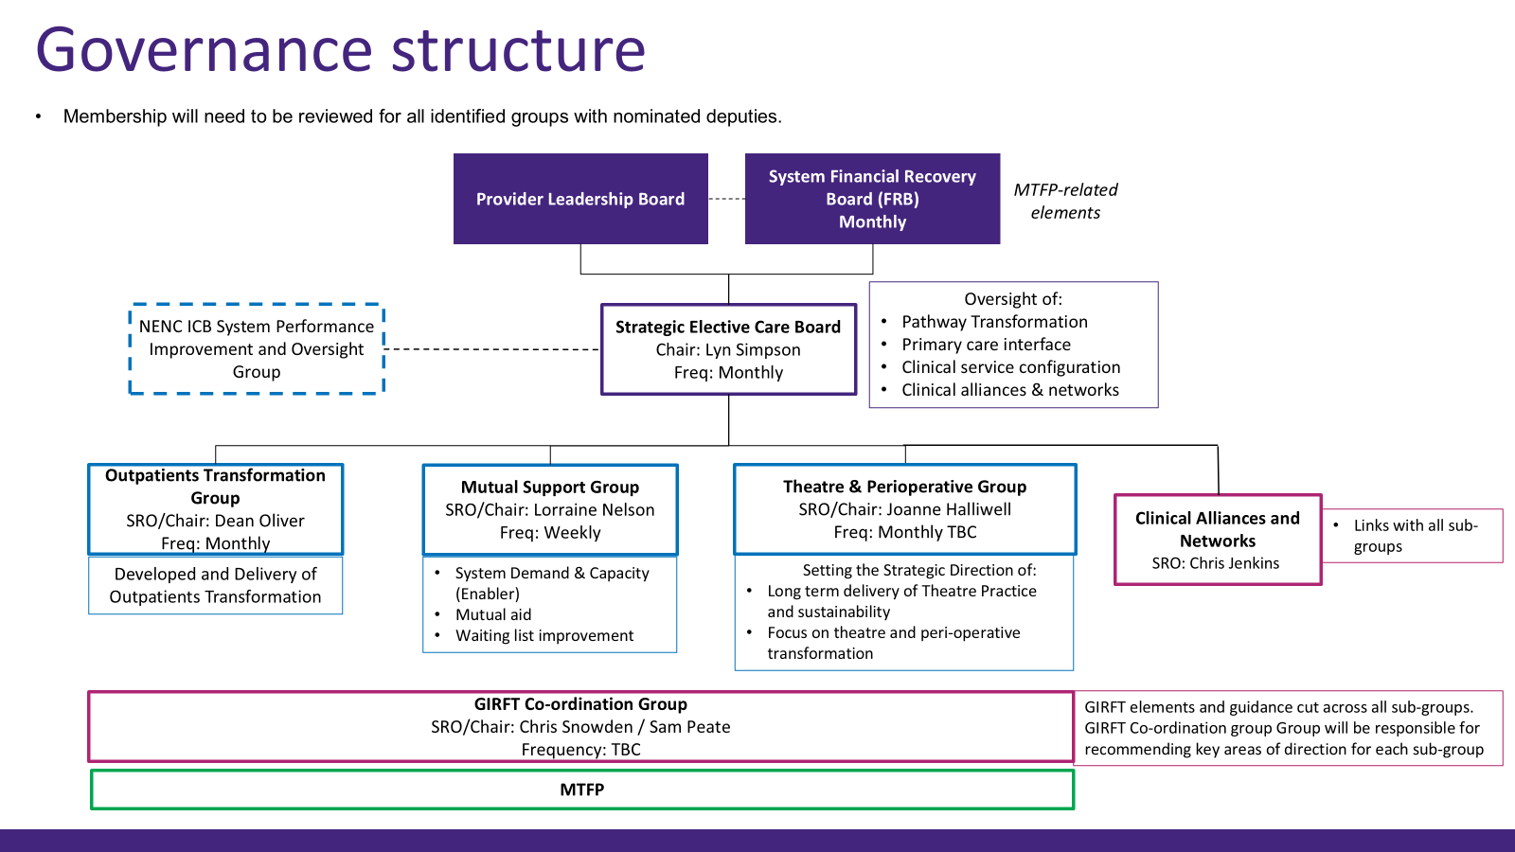

How we are working - governance
Health Inequalities
Notes:
The way we have evolved the governance around elective care has ensured that there is a clear focus on system working.
SECB membership – broad representation across the system. COOs taken on leadership roles for our subgroups – fundamental for system ownership and driving things forward – we support them and have developed strong relationships with them as individuals
The Engine room is the Mutual Support Co-ordination group – meets weekly and provides the space to have conversations about maximising capacity across the system, regular check ins and touch points alongside coordination point for patient movement and pathway transformation
Outpatients and Theatres groups are fundamental for the productivity and efficiency conversations and MTFP is driving that agenda more now than previously – have brought MTFP into our governance – a one stop shop for all things Elective!
Working as a system to ensure the interface between primary and secondary care is at the forefront of the conversation – more work we need to do on that.

Slide 17
Specific Challenges We Faced
Like others we have significant financial challenges across the system
Capital investment into our estates and hubs
Workforce shortages and impact of repeated industrial action ​
Digital technology – availability, variation and interoperability
Performance – variation and need to level up
Inequalities based on geography and between Adults and CYP, waiting list recovering at a different pace
Cultural shift in relationships with our Trusts, ICB & NHSE
Potential duplication of efforts and clarity on who does what
Clinical Leadership for our Alliances
Having the right people in our team
Notes:
Mention up front we have the best RTT performance in the country – it is still challenging for us
NUTH and Northumbria working together – the geography lends itself - IT systems have been the biggest challenge (Dave Kinnersley)
Really important to invest time and energy in the relationships with ICB & NHSE Regional teams – on the duplication point be clear re comms e.g. GIRFT team going to Trusts directly
Alliances - difficult from a standing start and how to get clinical leadership in place – funding?
However, having clinicians in the SECB has really helped us – thinking John Warrington & Chris Snowden?
Bobby mentioned about sharing our resourcing, important to have a good team – people who can be flexible, work with ambiguity and at pace

Slide 18

Benefits of Collaboration
Operational efficiency and improved communication across providers – driven by the SECB and sub-groups
Stronger and more meaningful partnerships and providers feeling more empowered
Reduced duplication as often one conversation rather than many
Culture of learning and developing - honesty and transparency leads to sharing of practice including peer review
Multi-disciplinary and collegiate working across the system, including NHS England and ICB
Growing relationships between providers against system rather than organisational risk
  MSCG have facilitated conversations regarding more than 1,150 patients across 20 specialties
  Over 535 patients have been transferred across the NENC so far in 2024/25
Evidence based decision making / strong clinical voice through alliances and networks
  Single Point of Access developed for Eyecare
  Case for Change for MSK and the National Backpain Pathway
Higher levels of trust – cannot underestimate the power of relationships and individual personal connections
Notes:
Contacts and strengthened relationships built through the MSCG have been valuable in other ways
CDDFT have had their theatres peer reviewed by Northumbria and the Uni and looking at the training programme. A really good peer as multi site and have been through hub accreditation.
CDDFT have also visited Northumbria to see their surgical recovery unit
CDDFT and STSFT corneal work

Slide 19

Our Future Ambitions
Performance – achievement of national constitutional standards
Maximising use of Elective Surgical Hubs across NENC within financial envelope
Prioritising Clinical Alliances and Clinical Leadership
Further Faster 20 with standardisation of delivery across Providers
Nested Collaboratives and aligned working
Continue excelling in cross learning & best practice via subgroups
Primary and Secondary Care interface
Empowering greater patient control

Slide 20
Future Success – what will look different?
Organisations
Achieving national planning guidance standards; RTT improved performance
Improved organisation, productivity and workforce resilience
Digitally enabled systems
Patients
Improved access, reduced waiting times and timely access to treatment leading to improved clinical outcomes
Improved choice, personalisation and experience
System
Greater collaboration and integration, driving strong system leadership
Securing system resilience using the elective surgical hubs
Strong narrative around improvement and system recovery savings

Slide 21
Key Messages
Using the people we have well and getting their commitment i.e. a triumvirate approach – CEO/SRO, Lead Director, Programme Lead
Drawing in our COOs to drive forward the subgroups
Creating the space for psychological safety – trusting and having open and honest discussions
Really valuing personal connections and strong individual relationships

Slide 22
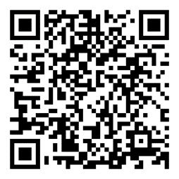
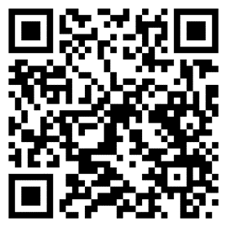



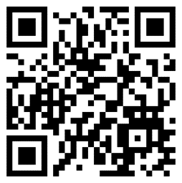
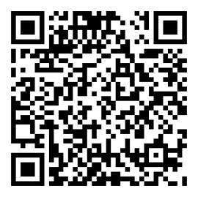


Contact Us
nenc.providercomms@nhs.net

Slide 23
Questions and Answers

Slide 24
Any questions?

Slide 25


Elective Recovery
NHS Providers Webinar
4th December 2024

Slide 26
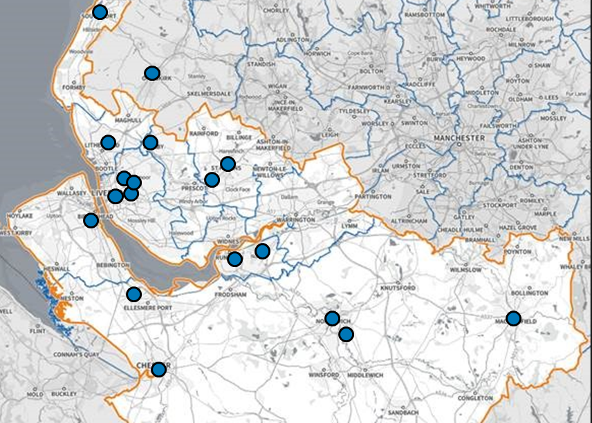
Complex provider landscape
We serve:
  2.7 million population
  High levels of deprivation
We are made up of 12 Trusts:
  5 specialist trusts
  7 DGHs
  10 CDCs
We link with:
  4 Community and MH trusts
  9 Places
  349 GP Practices
  9 Local Authorities
  590 Pharmacies
  1 Ambulance trust
  1 ICB
Notes:
Ok so a little bit more about us
Firstly we are one of the biggest, most complex & geographically challenged ICS’s in the country with significant variation in deprivation & health inequalities.
CMAST stands for is the Cheshire & Merseyside Acute and Specialist Trust Provider Collaborative.
We serve a population of 3 million over 9 places and CMAST is made up of 13 acute & specialist trust providers with multiple horizontal & vertical interdependencies.
We went from having no 52 week waits before covid, to a peak of over 1,200 people waiting over 104 week waits by February 2022.

Slide 27

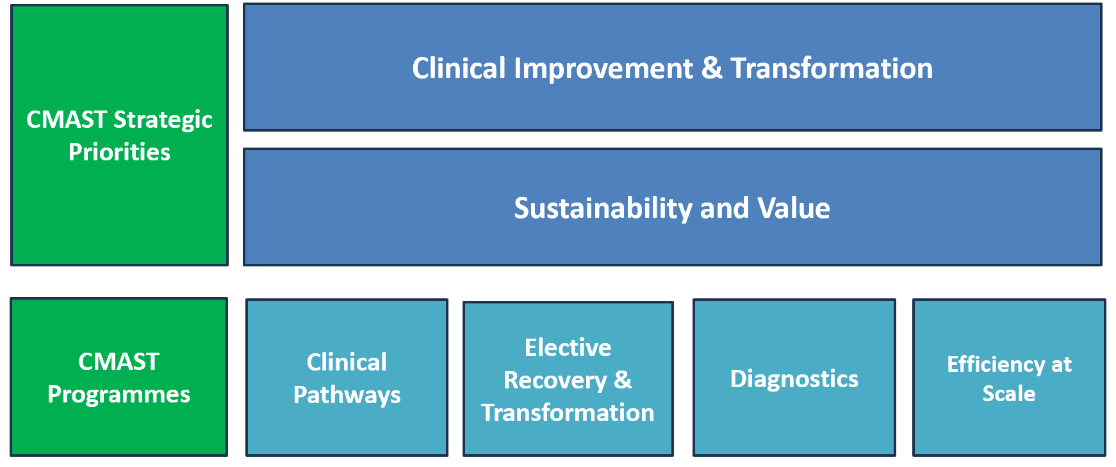
CMAST Strategic Priorities &
Programmes

Slide 28
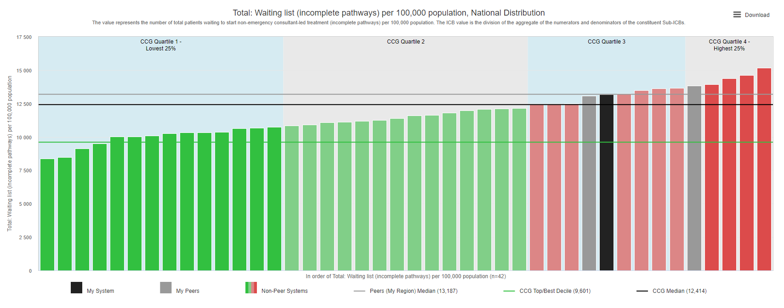
We are one of the most challenged regions

Slide 29
We set out 3 clear goals for elective recovery
Goal 1: Waiting Lists Management & Elective Recovery
Reducing long waits
Restoring activity levels
Goal 3: Reducing Variation in Care
Levelling waiting times across C&M
Mutual aid and shared resources
Goal 2: System Productivity & Resources
ERF delivery
Theatre utilisation
Elective hubs and cold site utilisation

Slide 30






We have a comprehensive programme of work
Waiting List Management
Risk stratification & cohorting
Waiting list validation & best practice
Prioritisation and reducing clinical risk of surgery
Identifying patients for HVLC pathways
Cohorting patients for elective hubs / mutual aid
Waiting well and prehabilitation
Reducing risk of decompensation while waiting
Supporting lifestyle changes to reduce clinical risk of surgery
Prehabilitation advice and support
Fitness for surgery
Maximising local capacity
4 elective hubs being mobilised
Mutual aid hub
Shared approach to PTL to reduce variation in WL
Focus on reducing 65 weeks and 52
GIRFT pathways and top decile
Local capacity as priority at peak times
Provider productivity
Top decile provider performance
Theatres improvement
Elective hub usage
Reduction in capacity-related insourcing and outsourcing
GIRFT pathways & HVLC lists
Mutual aid and partnerships
OP improvement
Digital innovation & system working
Shared PTL concepts and mutual aid
Patient Engagement Portals
Advice and guidance pathways
Digital appointments
Group consultations

Slide 31
What have we achieved together?

Slide 32
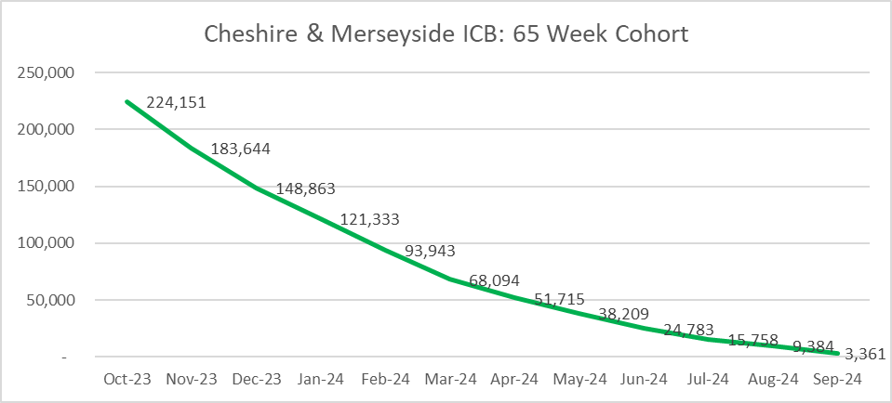
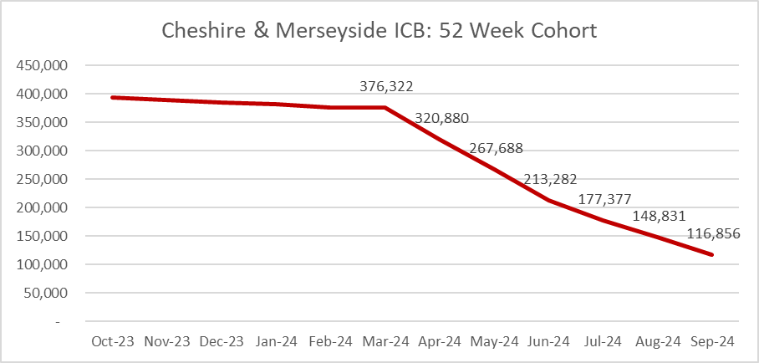
We have reduced long waits dramatically
We have sustained our zero 104 week wait position since March 2022
We do have 8 capacity breaches for 78 weeks, others are choice & complexity
We are now down to just over 1,000 65 week breaches, with 6,524 needing to be cleared by the end of December deadline. This number is decreasing week by week, as our clearance rate for 65 weeks remains around 1,400 per week.
We are clearing over 6,000 of the 52 week cohort per week, with 84,730 to clear before the end of March

Slide 33
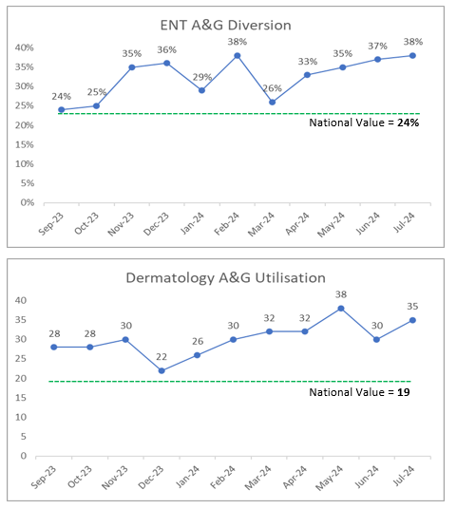
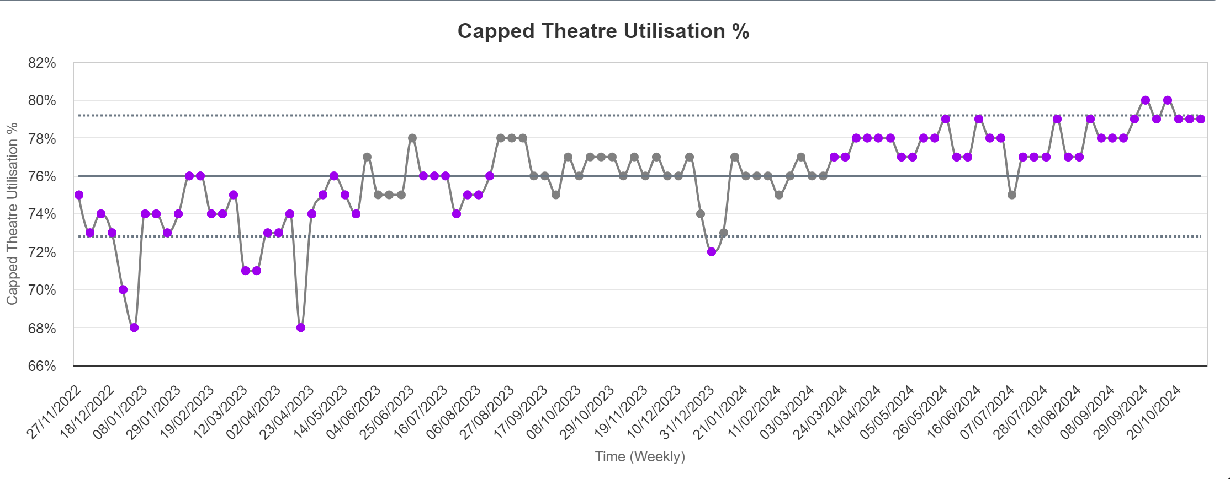
Our productivity metrics are very positive
We have consistently achieved our ERF target of 104.9%, and this secured over £40m of additional income to the system last year.
Our theatre utilisation is consistently improving, and we are achieving over 80% capped consistently, with several providers regularly in the upper quartile
Our further faster programme is tracking excellent A&G and PIFU profiles for several specialties, and we’ve avoid over 170,000 appointments so far this year (since April)

Slide 34
We have reduced variation between providers
A comparison between average waiting times last year showed a range of between 51 and 13 weeks for surgery across the C&M geography (34 weeks difference). A year later this range reduced to 15 difference.
For non-admitted (outpatients) this range went from 36 weeks difference in average wait times to just 8 weeks difference between providers.
This is fairer and more equitable for patients living in different parts of C&M, and we are committed to reducing this gap further

Slide 35
How have we done this, and what has made the difference?

Slide 36
Our approach is stitched into trust governance
Cross organisational training programmes for theatre academy, OP & Waiting List Management
CMAST governance is stitched into the heart of each trusts’ governance structures, all our workstreams are CEO and Medical Director-led.
Shared facilities: elective hubs, mutual aid hub, and joint improvement projects
CHESHIRE & MERSEYSIDE
Central point for requests and reporting,
Notes:
Our approach
So the approach we have taken is based on simplifying what we all know is a very complex system
We have NOT used performance management to deliver success
We've focussed on a collaborative improvement approach supporting all providers to maximise their existing assets (becoming best in class) rather than additionality (comply or explain)
Our approach to improvement is to build the capacity & capability of our staff to be excellent at the work they do. We run system-wide theatre, WL and OP improvement training to share knowledge and skills. We've focussed this on cohorts & teams so that staff from different organisations learn from each other . For example we’ve had 60 people on our 3 month theatre academy improvement programme
We have leadership at the highest level across all our workstreams. Our focus is on clinicians at the forefront of all that do with the wrap around of an organisational CEO, Chair & Medical Director lead (all from different organisations) to champion and move the work forward. This has been a major factor in building the trust required to enable autonomous organisations to feel comfortable to cede decision making to CMAST the provider collaborative.
This agreed governance approach has enabled us to take a system decisions to allocations of TIF and capital funding for shared use. We have developed shared cold site elective centres, and we work together on projects that can have a system benefit. For example we have treated 2,600 patients in the shared facilities so far.
One of the biggest game changers was the development of the CMAST mutual aid hub which is a central repository for the coordination of waiting list challenges, harmonising waiting lists & acts as the central point for requests and reporting which provides a buffer between trusts and the ICB/region. This in turn enables Trusts to get on and do the work rather than responding to data requests from the regional & national teams

Slide 37
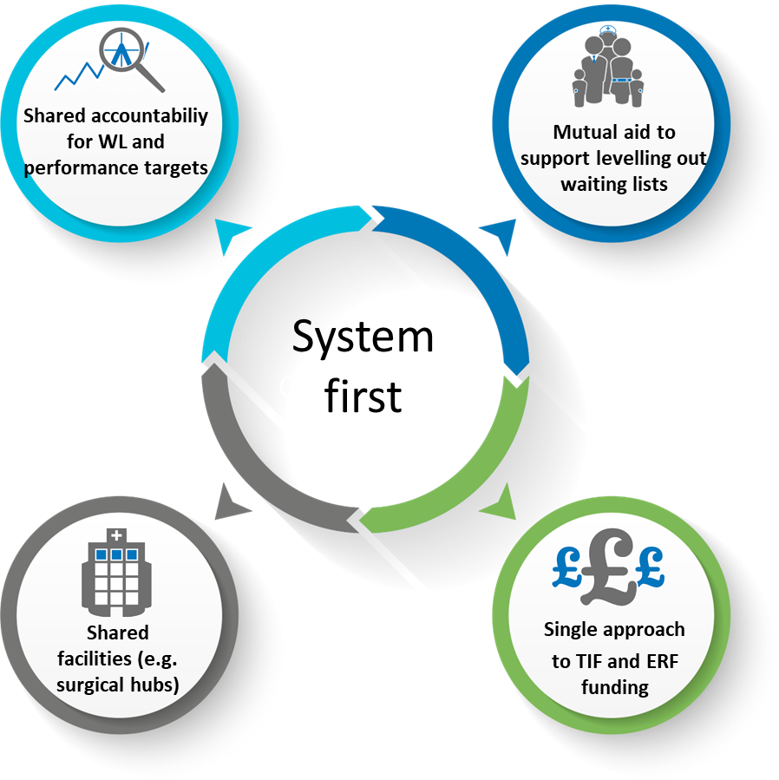
We adopted a system first approach
We take a system approach “if one fails, we all fail”
“We measure performance centrally as one, with mutual accountability for waiting list management and performance against key targets”
“We use existing networks to support communication and peer support / learning. This includes COOs, MDs, Strategy Directors, Clinical Networks”
Notes:
We have shared accountability
We work on the basis that if one fails we all fail. A good example of this in action is where some trusts have accepted higher ERF targets in order to support our other challenged organisations or harmonising waiting time by operating on other Trust patients. We have facilitated 14,000 patient moves across 8 providers on this basis.
We measure performance centrally as one – and take mutual accountability for waiting list and delivering performance targets. We have established shared PTLs across multiple organisations for certain challenged services, and for new elective hubs. Examples include paediatric dentistry and cataracts
We have networks across professional groups including COOs, Medical Directors, Strategy Directors and clinical specialties to co-ordinate pathways, share learning and offer peer support and challenge. Where this is really important is our DOF group. Their support has enabled CMAST to focus on the patients waiting not the funding streams by ensuring Trusts are incentivised to do the right thing.

Slide 38
Relationships are key
Executive
Clinical
Operational
Notes:
We have shared accountability
We work on the basis that if one fails we all fail. A good example of this in action is where some trusts have accepted higher ERF targets in order to support our other challenged organisations or harmonising waiting time by operating on other Trust patients. We have facilitated 14,000 patient moves across 8 providers on this basis.
We measure performance centrally as one – and take mutual accountability for waiting list and delivering performance targets. We have established shared PTLs across multiple organisations for certain challenged services, and for new elective hubs. Examples include paediatric dentistry and cataracts
We have networks across professional groups including COOs, Medical Directors, Strategy Directors and clinical specialties to co-ordinate pathways, share learning and offer peer support and challenge. Where this is really important is our DOF group. Their support has enabled CMAST to focus on the patients waiting not the funding streams by ensuring Trusts are incentivised to do the right thing.

Slide 39
Any questions?

Slide 40
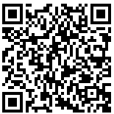
Book now:
Peer learning forum | All sectors | Tuesday 21 January 1.00pm – 2.30pm
Mental Health, Learning Disability and Autism (MHLDA) Provider Collaborative Forum | 9.45am – 3.20pm (In person) | London

Slide 41
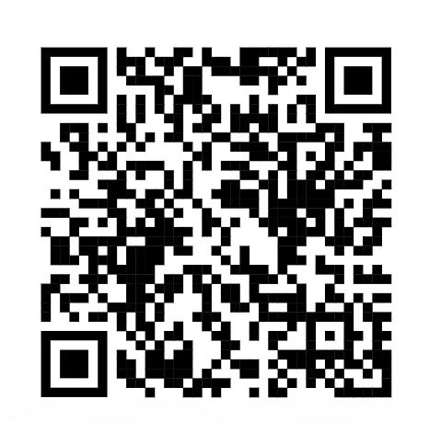
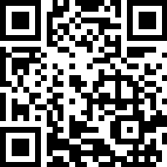
Tell us what you think
Scan here to access our evaluation or use the link in the chat

Slide 42
Thank you for attending

