Slide 1

Welcome to today’s event:
Tackling the productivity challenge through provider collaboration

Slide 2

Agenda
Welcome and introductions
Facilitated by chair, David Williams - Head of Policy, NHS Providers
Case study 1: South West Provider Collaborative
Anne Forbes, Programme Director, South West Provider Collaborative
Dr Jason Fee, Medical Director, South West Provider Collaborative
Case study 2: North West London Community Collaborative
Jean Young, Programme Director, North West Community Collaborative
Jeff Boateng, Data Improvement Programme Lead, North West Community Collaborative
Case study 3: Insights on improving productivity through collaboration in Devon
Graham Lomax, National Implementation Director Getting It Right First Time (GIRFT),NHSE
Emma Herd, One Devon Elective Pilot Programme lead
Interactive Q&A
Facilitated by the chair

Slide 3
Housekeeping
Please note, this event is being recorded
Please keep your camera on wherever possible
If you lose connection, please re-join using the link in your joining instructions or email provider.collaboration@nhsproviders.org
Please ensure your microphone is muted during presentations to minimise background noise
We will come to questions after each speaker
Please feel free to use the chat box for questions and sharing examples of what has delivered sustained progress in your organisation
If you would like to ask a question audibly, please use the raise hand function during the Q&A section and we will bring you in
Any unanswered questions will be taken away and answered after the event
You will receive a link to an evaluation form after today’s event. Please take the time to complete it, we really do appreciate your feedback.

Slide 4
NHS Providers:
Tackling the productivity challenge through provider collaboration
Monday 23 September 2024
Anne Forbes, Programme Director
Dr Jason Fee, Medical Director

Slide 5

Our purpose and key priorities
Our shared ambition is to transform outcomes for people with mental health conditions by working collaboratively, at scale
Commissioned services
CURRENT SERVICES
FUTURE SERVICES
AREAS FOR CONSIDERATION
Adult Secure
CAMHS (Tier 4)
AED
Perinatal
CTR/CETR function
Working in conjunction with (within and across) ICS
Dorset CAMHS Tier 4 (October 2024)
Remaining specialised services
Services where operating at scale could make sense clinically and financially
Regional collaboration
We also lead collaborative working as follows:
Alongside NHSE/I, develop our regional plans and priorities for MHLDA
System working with lead ICSs re £40.5m capital investment to deliver inpatient services for ICB commissioned LDA patients
Optimisation programmes – such as regional workforce planning in conjunction with NHSE
Shared learning and shared clinical pathways – live region-wide patient flow system
South West Provider Collaborative

Slide 6
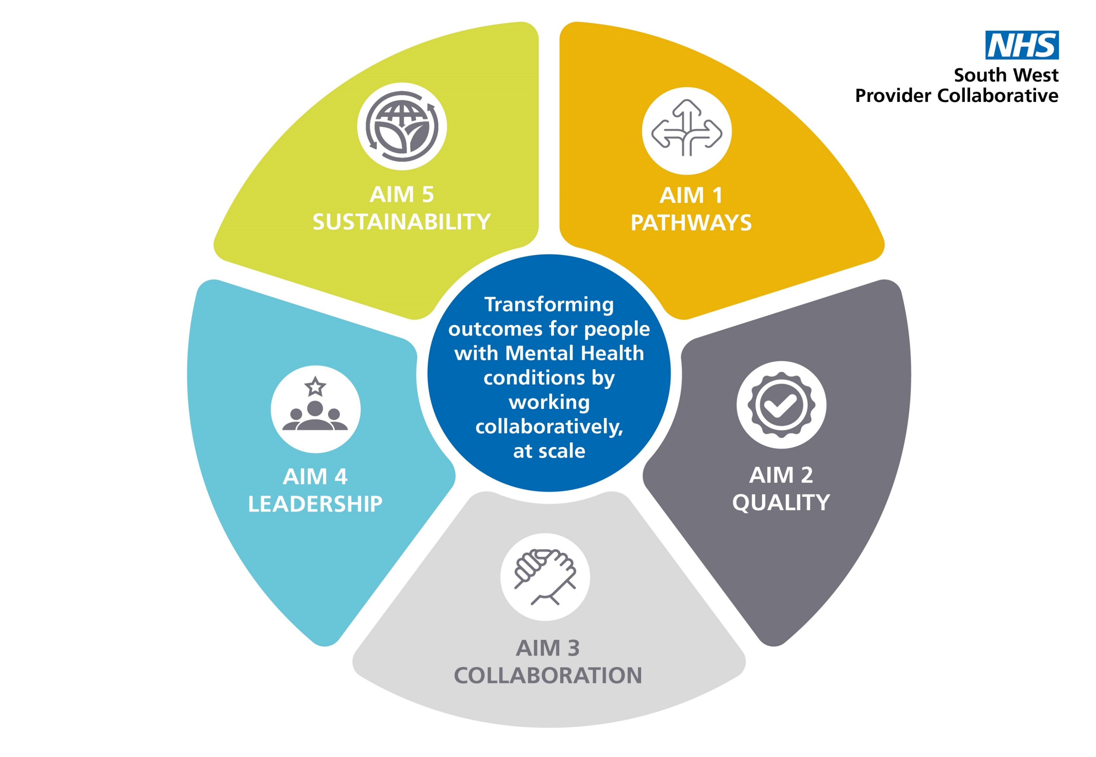
Our shared strategic aims

Slide 7
Our productivity challenge
Burning platform
  Increasing demand for forensic inpatient beds evidenced by increased referral rates and increased admission rates
  Increased complexity of assessed need evidenced by increasing length of stay and decreasing discharge rates
  Increased financial costs
Regional variation of services provided to ICB population in terms of both community forensic services and low secure and medium forensic inpatient services
Needed a solution at scale, across multiple systems and providers affording the opportunity to re-direct resources where most needed
South West Provider Collaborative

Slide 8
What did we do?
Collaborative developed a 5 point plan
Patient flow system
Consistent regional referral and bed management system - rule of ‘one’
Implementation of a nationally recognised risk assessment process to aid clinical decisions - Dundrum
Active case management
Introduction of specialist community forensic teams in each integrated care system
South West Provider Collaborative

Slide 9
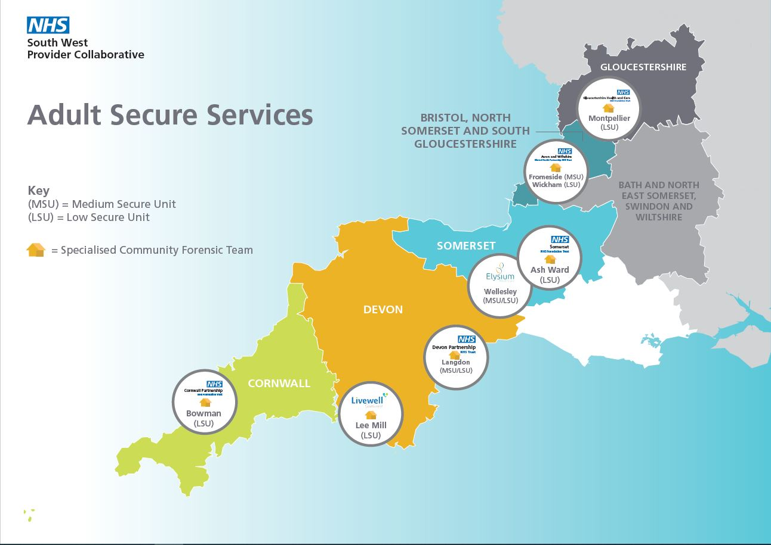
Specialised Community Forensic Teams

Slide 10
Challenges and our solutions
Collaborative partnership working
  Resistance to change – culture and model of care
  Partner buy in and belief in success
Financial
  Initial investment in area of most need to release saving to invest in next area. Area of discord
Factors outside our control
  Rapid changes in clinical presentations of need eg Spice in prison
South West Provider Collaborative

Slide 11
Benefits
More care delivered in the community
  All ICB areas now have full community forensic service
More efficient use of the inpatient bed base
  Shorter length of stay
  People treated closer to home
  People treated in lowest level of security
  Improved access to bed based care
Provider sustainability optimising income through investment in services (£10 million recurrently) and improved bed occupancy
More financially sustainable to the collaborative by reducing the high cost bed base by 20%
South West Provider Collaborative

Slide 12
Next steps and key learning
Post implementation evaluation and shared learning across the other 14 secure Provider Collaboratives.
Application of this model to our other provider collaborative service lines eg CAMHS, Eating Disorders and Perinatal
Shared learning with our regional partners to apply the learning from the model in other, non-secure settings.
Key learning is we have been able to significantly re-engineer clinical pathways, releasing efficiency saving for reinvestment and has enabled true collaboration for our partner to come together to find solutions across an entire pathway
South West Provider Collaborative

Slide 13


Slide 14
Any questions?

Slide 15
North West London Community Collaborative
Productivity
September 2024
Ref: 3405_JULY2024

Slide 16
Background
The community services trusts in north west London
– CNWL, CLCH and WLT – have come together as a provider collaborative and have formed a board in common to take forward their shared strategic agenda.
This approach supports more collaborative decision making, and helps ensure
we will make the most effective use of our collective resources to provide better care, for more people, more fairly.
We are proud of our skilled and passionate workforce, partners and communities and are committed to improving health and wellbeing as well as healthcare, tackling health inequalities and helping to join up care.

Slide 17
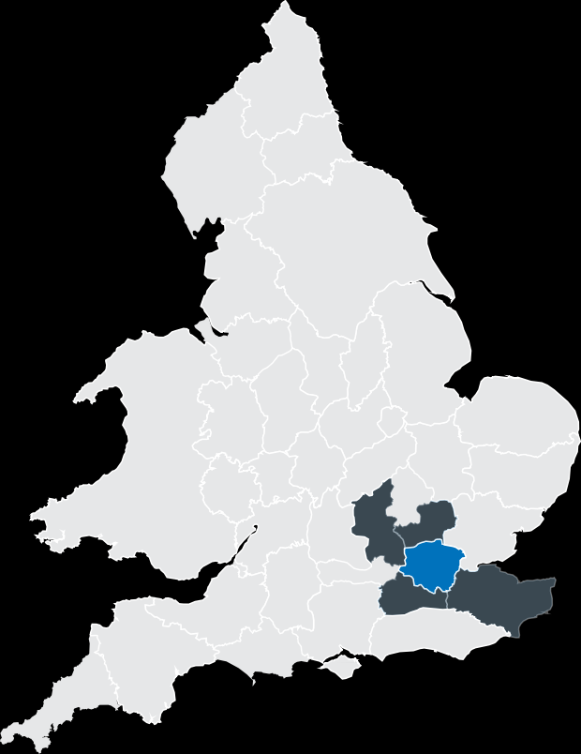




Where we are
Enfield
Barnet
Harrow
Haringey
Waltham Forest
Redbridge
Havering
Brent
Camden
Islington
Hackney
Barking &
Dagenham
Hillingdon
Ealing
City of
Tower Hamlets
Newham
City of
Hammersmith
Westminster ^{LONDON}
& Fulham
Kensington & Chelsea
Southwark
Greenwich
Bexley
Hounslow
Lambeth
Wandsworth
Lewisham
Richmond
upon Thames
Merton
Buckinghamshire
Hertfordshire
Kingston upon Thames
Greater London
Bromley
Surrey
Kent
Sutton
Croydon

Slide 18





Who we are
Caring for a population of
7.2 million across
5 counties and17 London boroughs
Over
18,900
staff members

Slide 19
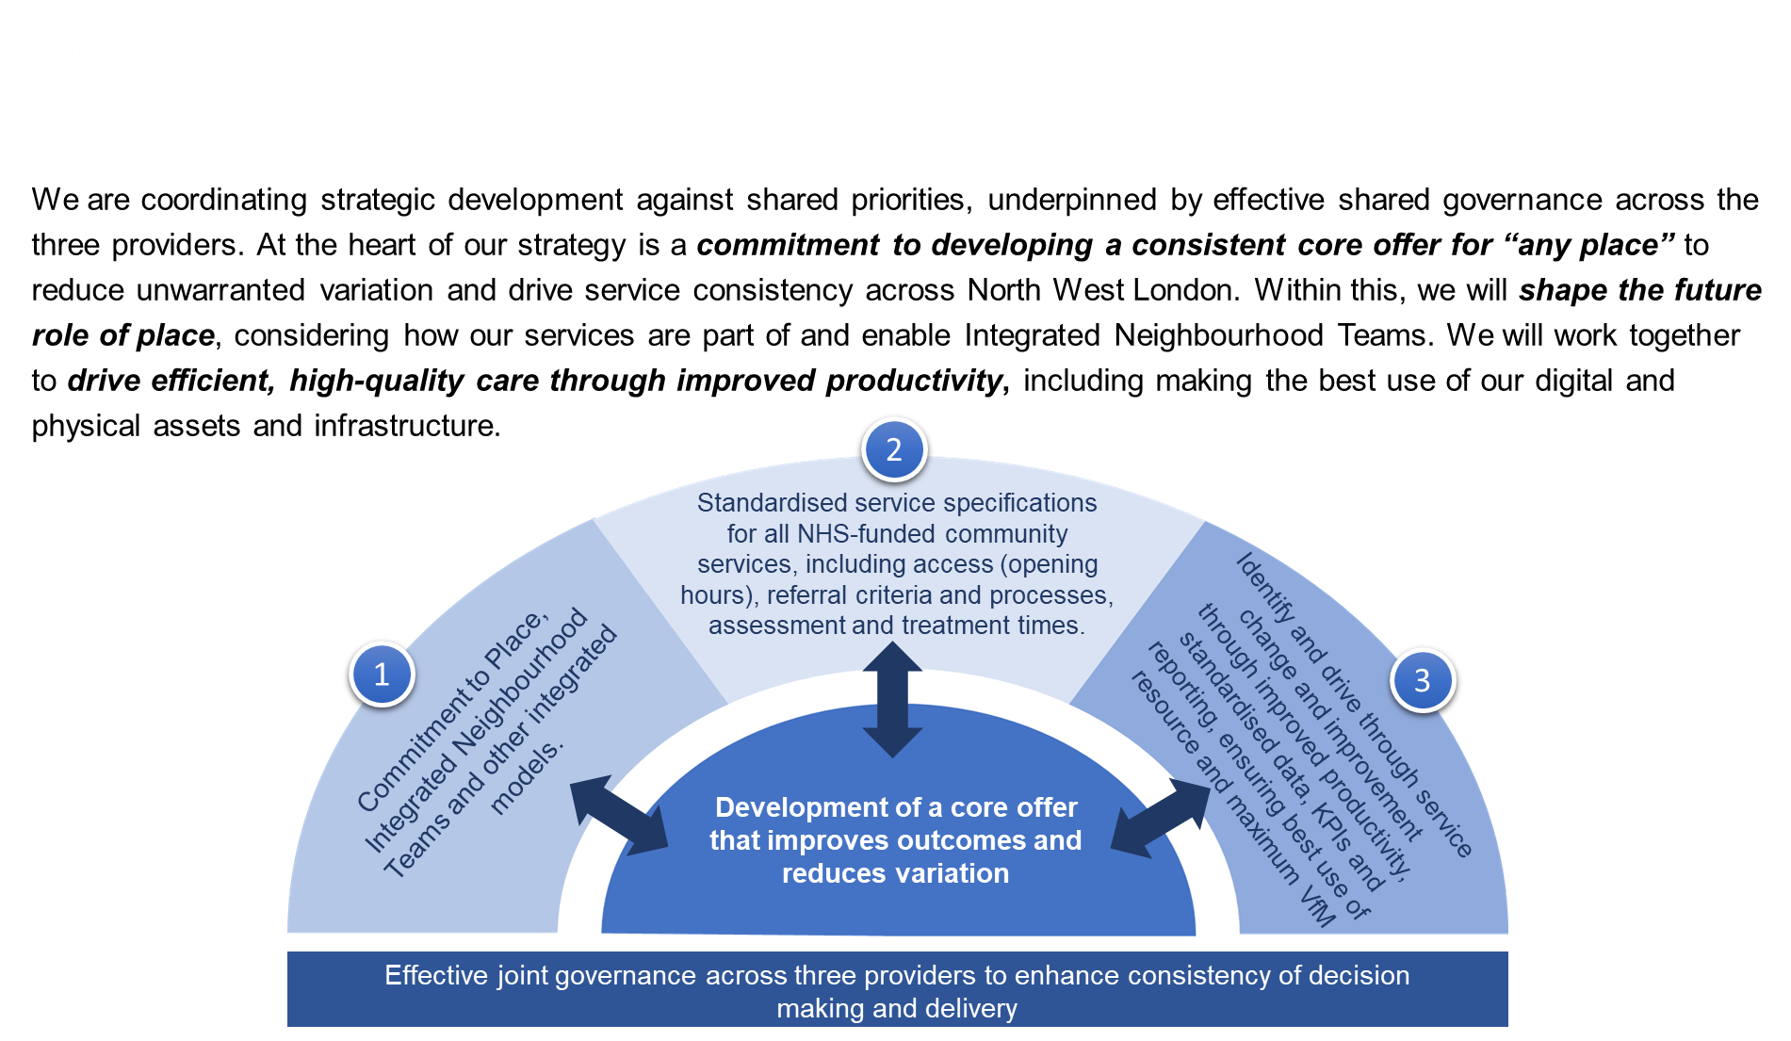
Our plans our based on three strategic priorities that support our core offer

Slide 20
Collaborative Challenges
Need to demonstrate benefit of services to the system
Poor and inconsistent data hindering decision making
ICB challenging over productivity and use of workforce
Requests for £ms investment into services with little evidence base
Inconsistent implementation
of a standardised service specification for community nursing

Slide 21
Demand & Capacity model on a page
Establish baseline
Assumptions & scenarios
Deliver outputs
Data
Demand
Assumptions
Scenarios
Model outputs
Report
Baseline (2019/2020)
Patient level data:
Referrals
Waiting times
Activity across sites, services and teams
Admissions and ward stays
Community caseload and contacts
Patient acuity/needs:
  MHA status
  Outcome measures
  Primary diagnosis
  Comorbidities
  Medical history
Current bed, clinical room and workforce capacity across services and sites
Adjustments
Covid impact
Unmet demand
Operational
Bed occupancy levels
Length of stay
Leave
Contacts per staff member
Time per contact
Trust initiatives
New models of care
Alternatives to hospital-based care
Investments
Estate plans
Workforce plans
Activity projections
Admissions
Outpatients
Community caseload and activity
Scenarios
Baseline
Business as Usual (growth only)
Clinical model opportunities
Improved patient flows/transfers
Admission alternatives
Efficiency opportunities
Digital opportunities
Demographic change
ONS patient level age, gender and location adjusted projections
Mental illness prevalence
Socio-economic factors
  Unemployment
  Deprivation
  Inequalities
  Education
  Homelessness
Capacity projections
Beds (in and out of area)
Community staffing (WTEs)
Full picture across sites, services, cohorts
Estate options/implications
Workforce options/implications
External initiatives
National policies and plans
ICS plans
Opportunities
Efficiencies
Best practice examples
Non demographic change
Referral trends
Waiting list growth
MH condition prevalence and trends
Impact of Covid on MH demand
Data quality challenges
Ensure integrity of data
Clinical and operational validation of baseline information
Understand socio-economic and other determinants of demand to inform forecasting
Review and validate operational assumptions, scenarios and best practice to meet model objectives
Complement modelling outputs with power BI dashboards to support service engagement and ongoing use

Slide 22

Data quality challenges
Data challenges, assessment and mitigation
Activity
obtain historical activity data for previous three years for all clinically relevant services, outpatient/community alongside inpatient data
Workforce
capturing workforce data that aligns to the activity undertaken for the reciprocal time period and care settings
Alignment
ensure the mapping of the appropriate service and activity data to the appropriate workforce teams
Assess and understand quality issues/gaps
Complement gaps with qualitative information
Clinical and operational validation of
findings & outputs
Clinical and operational validation of baseline
Data-driven
insights
Use public and other data sources to inform assumptions and provide context

Slide 23
Developing modelled scenarios
Clearly articulated evidence base for investment and clinical change
Do Nothing
Current growth and demand projections
Achievable
Realistic improvements in productivity and performance
Ambitious
‘Stretch’ improvements in productivity and quality metrics
Aspirational
No service or productivity changes
Transformational improvements in productivity and quality metrics
What the service can deliver on its own
Deliverable through organisational change
Requires partner support/ system transformation
Continuous Improvement
Ongoing refinement and ownership by services
Use and adapt learning to transfer to other areas
Co-developed
Clinically-led
Informed by benchmarking

Slide 24
Structured approach to identifying opportunities
Establishing ownership across clinical and operational teams
Objective
Understand current service provision and variation
Explore productivity and performance improvement opportunities
Ensure the provision for community nursing was equitable across all boroughs
Understand how demand capacity will be used to support service redesign and standardisation
Measure the impact of growth factors (aging population, disease prevalence) on a workforce with challenges (vacancy rates)
Output
A 5-year forecast identifying current workforce requirements by system, borough and provider
Identify either:
  Opportunities to redeploy resource to provide equity in service across boroughs
  Identify areas required to optimise productivity and performance to meet demand
Outline the roadmap to delivery and define the investment / efficiency gain needed
Validate baseline
Develop scenarios
Confirm outputs
Collaborative action plan
Teams feel empowered and informed in how demand and capacity can be used moving forward.
The approach is reproducible and can be rolled out across other teams

Slide 25
Community Nursing -
Understanding existing variation in performance and delivery models
Used the following metrics to compare and contrast
  Referrals per 1000 weighted population
  Referrals per FTE per year
  Contacts per FTE per day
  Contacts per referral
  Average assessment time (mins)
  Average treatment time (mins)
  % time direct clinical care
  Median DN response time (days)
Analysis was undertaken across 8 boroughs
Notes:
For example, we were able to see Referral demand per 1000 head of population varied across the sector and was highest in Hillingdon (90 referrals) and lowest in Brent and Ealing (below 50).
Average assessment and contact durations were typically below best practice levels with Hillingdon having the longest treatment (33 mins) and assessment (31 mins) times. Links to quality, outcomes and reduced time on caseload are anticipated consequences of improvements in these duration times.
In terms of the average assessment times, the clinical community felt they didn’t have enough time particularly in assessments to deliver the quality levels they would aspire to
The collaborative did not fully understand there was such wild variation across the boroughs until we did this modelling -
There was a feeling that some boroughs were not as efficient as others, and other externally commissioned reviews had made wild assertions around potential savings opportunities
Service staff recognised the challenges shown in the data but some service leaders struggled to accept this – requiring multiple rounds of validation by the GT team before it was accepted.
Positives, people did recognise there was opportunities, lots to go through from a productivity point of view
CFOs could demonstrate a detailed understanding of the current position to the ICB

Slide 26
Demand and capacity outputs managing growth and demand within existing capacity
BAU 27/28 would require an additional 65 WTE nurses.
The Achievable scenario show that the service can consume growth within its existing footprint and deliver a marginal reduction of 2 WTE.
The Achievable scenario would see an additional 12,000 referrals and over 95,000 clinical contacts per annum
Notes:
Headline outcomes from the modelling is that, through engagement with the services, we were able to demonstrate how
Based upon anticipated growth and the current service delivery models the current requirement for 27/28 would be for an additional 65 WTE nurses.
Based solely on addressing some of the variation shown on the previous slide we were able to work with services to agree a 15% improvement for the under-performing boroughs that will enable the services to consume their own smoke (Achievable)
Demonstrates that the original requests for significant investment wasn’t evidence based.
And its not about making staff working harder, but smarter by removing non-value-add, non-clinical time – no standardised approach to training, routing across boroughs, clinical supervision, etc = recognised this should be an easy ask)
This has been clinically developed and is owned by the collaboratives community nursing SRO and the COOs across the Trusts.

Slide 27
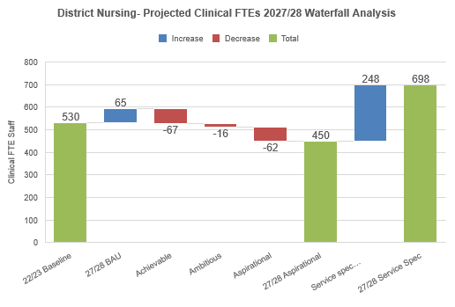
Embedding quality and wellbeing in outputs ensuring future scenarios reflect clinical feedback in improving outcomes
The Ambitious scenario includes
Quality improvements embedded into assumptions
Workforce wellbeing acknowledged with additional time allocated for assessments and treatment
Productivity improvements deliver a potential capacity release opportunity of 18 WTE against the baseline.
Notes:
The real benefit in the modelling is the conversations this has enabled within the services and across the boroughs.
Clinicians felt they didn’t have the time to deliver the quality they wanted to. Clinicians were able to embrace productivity requirements because they were also looking at improvement in care, and ultimately well being of staff, and their patients.
Making this clinically led meant it went beyond finance and savings - resulted in a shared understanding of performance but also of quality
Ultimately these workforce plans will reflect current and future reality.
----
Benchmarking and best practice evidence was fed into engagement sessions to encourage stretch and challenge, leading to the development of Achievable, Ambitious and Aspirational scenarios.
If the community providers can deliver the service delivery improvements that they have identified within the Achievable scenario, the increased capacity requirement of 65 FTE district nurses under BAU can be offset. This will require the providers to increase staff time available for direct clinical work by 15% through:
Reducing variation in productivity levels, improving caseload management processes including sharing good practice across providers
Optimising skill mix aligned with complexity of need
Minimal shifting of resources to those boroughs that would need additional support, such as Brent and Hillingdon (all other boroughs show opportunity to support this)
This would allow the management of an additional 12,000 referrals and over 95,000 clinical contacts per annum within the existing NWL district nursing headcount
The Ambitious and Aspirational scenarios identify opportunities for capacity release which could be redirected to improve other priority areas of clinical activity. These scenarios also include moving towards best practice assessment and treatment times that result in an increase in time spent on clinical interventions for all providers. This is to ensure quality interventions and support reduced time on caseload and contact frequency. They also include an NWL-wide approach to population health management, prevention, a Collaborative-wide workforce development strategy and best practice referral and caseload management including use of digital technologies.
Stretch productivity improvements see a capacity release opportunity of 80 WTE against baseline

Slide 28
Creating supportive stretch targets understanding the impact and implications of new service models
The Aspirational scenario assumes workforce support using digital technologies, self-management tools and prevention initiatives.
Stretch productivity improvements see a capacity release opportunity of 80 WTE against baseline
The Service Specification scenario sees a significant increase of a 168 WTE
This increase is to account for absolute 24 and 48 hour waiting time targets
Notes:
The Collaborative's community nursing specification includes a shift towards a 24- and 48-hour response times. Compliance with an absolute target will require additional resource to account for seasonal and weekly variation and to address the variation in response which currently ranges from 1-5 days for district nursing.
Achieving this will need an increase of 103 FTE district nurses on top of growth (168 FTE in total before productivity scenarios)
Massive variation in delivery of this already, Some crossover with the UCR team, not al cases were priority that needed to be seen within that time
Clinical leads felt that staffing to 85th percentile would introduce massive inefficiencies as the level required to be able to respond to the wait time targets would mean that at times people would be sat around not fully utilised,
The D&C programme provided an evidence base that not only was the wait time undeliverable from a workforce point of view, it was felt that is was also clinically unnecessary based on the services understanding of the patients they were treating.

Slide 29
Managing growth within existing headcount
Clinically-led productivity opportunities deliver beyond forecasted growth
Baseline position of growth over the next 3 years
required 65 extra staff
Clinically-led, ambitious scenarios now deliver within same headcount:
95,000 | 12,000 | 15%
more contacts per year | more patients accessing services | Increase in direct patient facing time
(based on current activity which is subject to change when we remove non core offer activity)
Notes:
Re affirm headline outputs
BAU – needed an additional 65 staff
We could consume 27/28 additional activity/growth in the current establishment, and see more 95k more contacts and 12000 more patients could be seen by a marginal increase in the clinic facing time (15%) which would be done by looking at the non clinical tasks being undertaken

Slide 30
Learning from our work
Turning productivity into a clinical discussion
Clinical and ops ownership is crucial
Articulate what is delivered for the workforce deployed
Understand implications of performance and service requirements
Develop evidence base to support investment decisions
Helps clinicians to not feel threatened by the process
Ensure approach is sustainable = productivity part of planning discussions
Executive interest and committee deadlines help to focus the process
Joint teams = shared view between finance, BI, ops & clinical front line

Slide 31
Any questions?

Slide 32

Moving ‘further & faster’ in elective care recovery with GIRFT
Notes:
Standard title slide

Slide 33
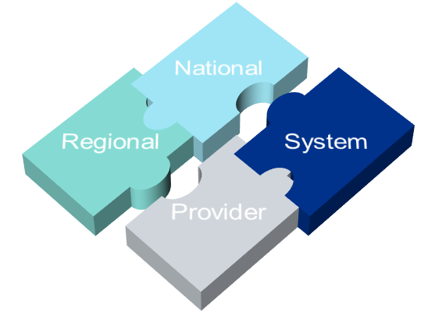
GIRFT Implementation
‘ Hands on’ operational & clinical support to frontline teams
Sharing of data & good practice, peer review, local recommendations
National Guidance, Pathways & Toolkits
How are we engaging with the system/stakeholders
3 rounds of ICB visits (4th starting in July)
C.5,000 trust/specialty specific deep dives
3 active cohorts of Further Faster interventions
Active hub accreditation programme
Stakeholder engagement on c.50 workstreams
Support for other areas of NHSE – Elective Recovery, UEC, Diagnostics, Cancer, Mental Health, Diabetes, Stroke, Trauma, Perioperative, Dental etc
Close collaboration and co-production with all professional bodies and Royal Colleges
Outpatient Transformation – Further Faster
Improving referral management & Primary Care engagement
Reducing Unnecessary Follow Ups & wasted appointments
Improving pathways with Straight to Test / One Stop
Theatres & Periop Programme
Increasing Theatre Utilisation to 85%
Increasing Daycase Surgery rates to 85%
Delivering Right Procedure Right Place
Urgent & Emergency Care
Combining Emergency Medicine, Acute & General Medicine & Geriatrics
System approach – in and out of hospital
Specialist Networks
Cancer Alliances with priority Supporting Tumour groups
Spinal Networks – delivery of ‘HVLC’, Paediatrics & Complex
Focused Support
On the ground support to drive improvements with subject matter experts.
Driving System/provider collaborative approach to maximising capacity
Supporting Elective Recovery with targeted work on ‘hard to clear’ specialties and all +78 wk waits

Slide 34
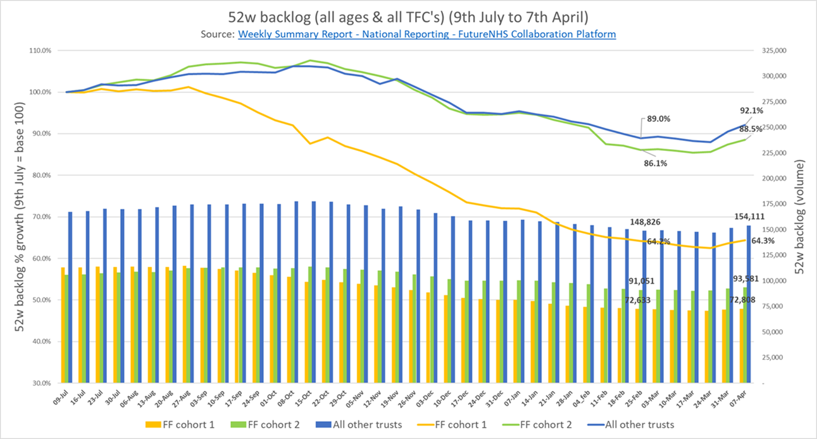

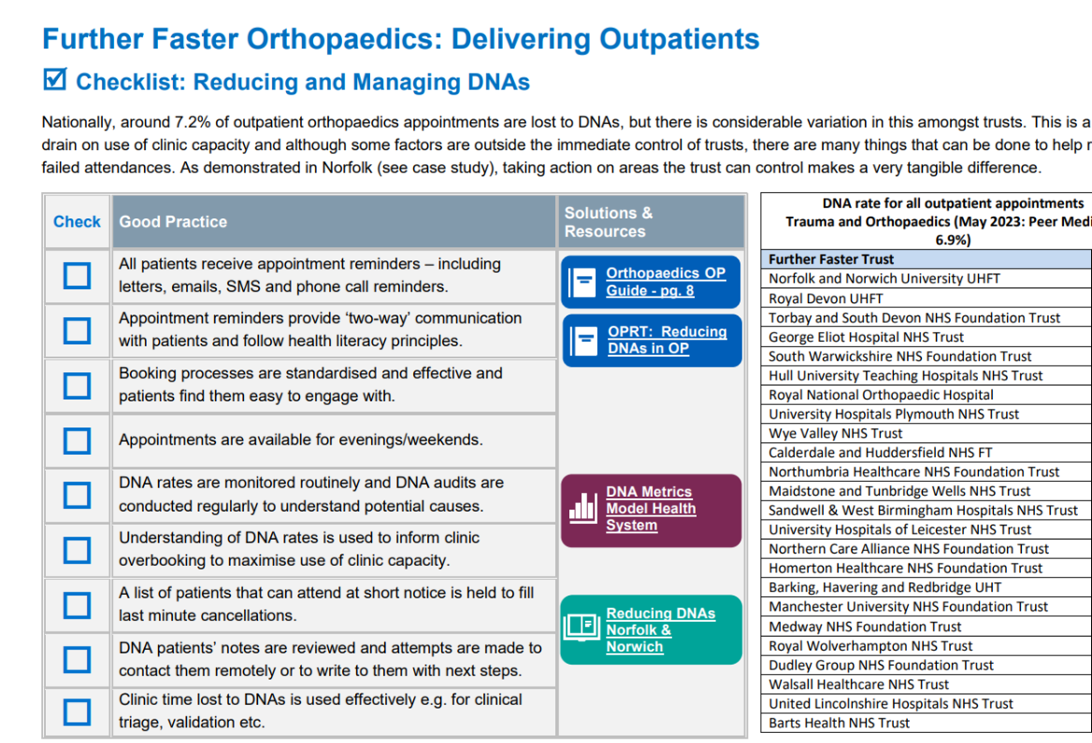
National impact of ‘Further Faster’ in outpatients
GIRFT have produced 16 x Specialty Handbooks with simple ‘checklists’ to support providers review their productivity opportunities relative to peers, with signposting to relevant best practice, guidance, toolkits and case studies. These are available to all Trusts via NHS Futures
Cohort 1: 25 trusts launched July 2023
Cohort 2: 26 trusts (all tier 1&2) launched November 2023
Cohort 3: (all other trusts) launched March 2024
Notes:
Plain slide with subhead and bullets

Slide 35
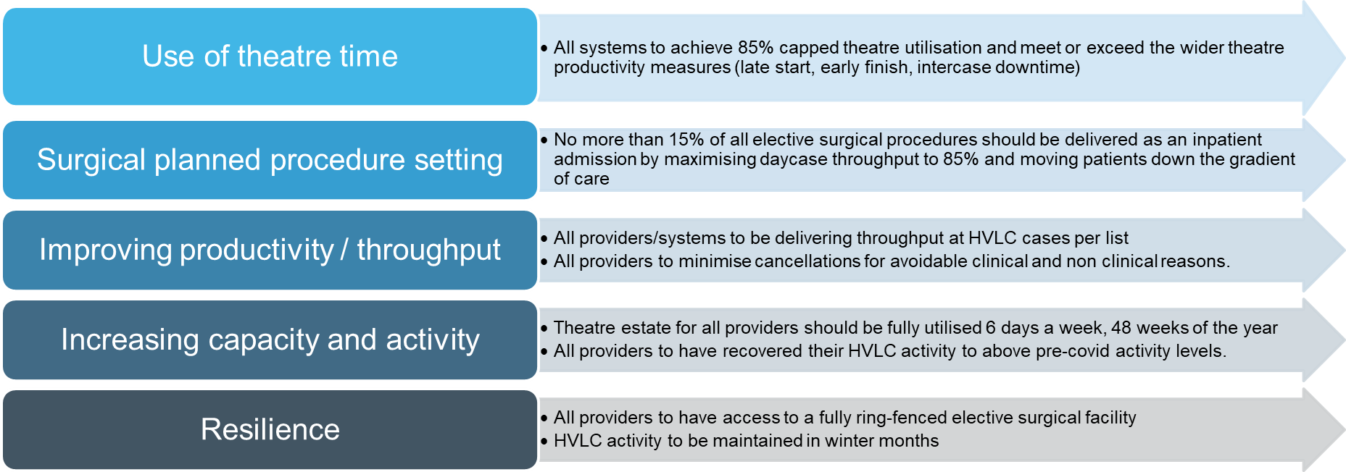
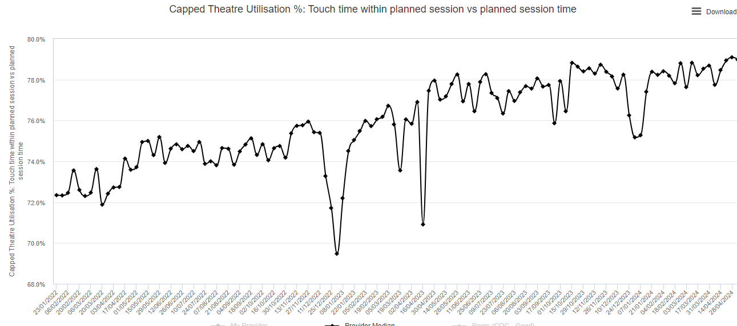
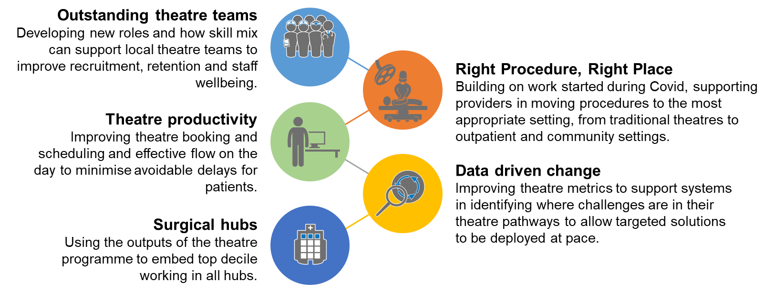
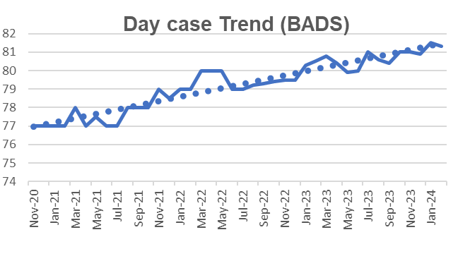
National Theatre Programme
The NHS National Theatre Programme draws together all key national workstreams engaged in improving theatre productivity, efficiency and workforce. The key aims of the programme are to support providers and systems to maximise the effectiveness and throughput of their surgical theatres through improvements across the surgical elective pathway. The programme reports to the National Elective Recovery Programme.
l
Since establishing the National Theatre Programme, Theatre utilisation has increased from a pre-covid level of 76%, to its current rate of 79%. Similarly, day case surgery rates are the highest they have ever been at 81.3% compared with pre-covid level of 78%.
Improving in session productivity
  Reducing avoidable cancellations
  Increasing cases per session
Increasing estate utilisation
  High throughput lists
  Job panning & incentivisation
Reducing Post op LoS & acuity
  Day surgery & RPRP
  Enhanced Care & Optimisation
  Enhanced Recovery
Notes:
Plain slide with subhead and bullets

Slide 36

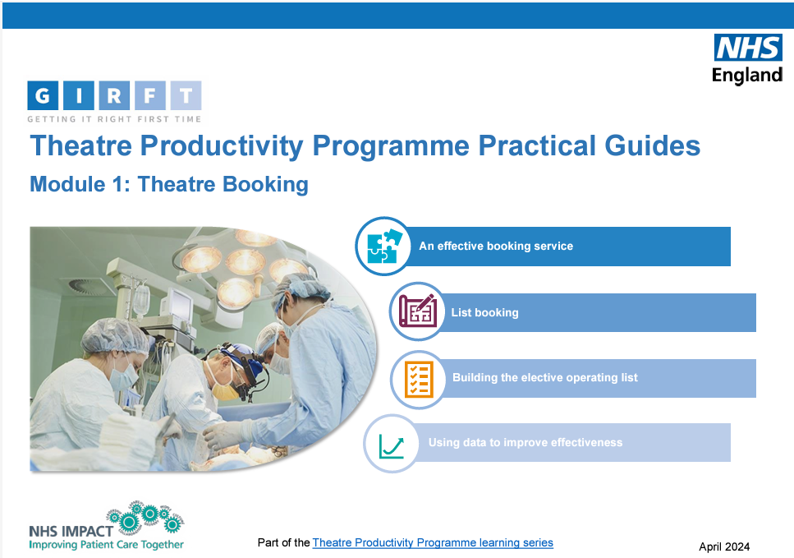
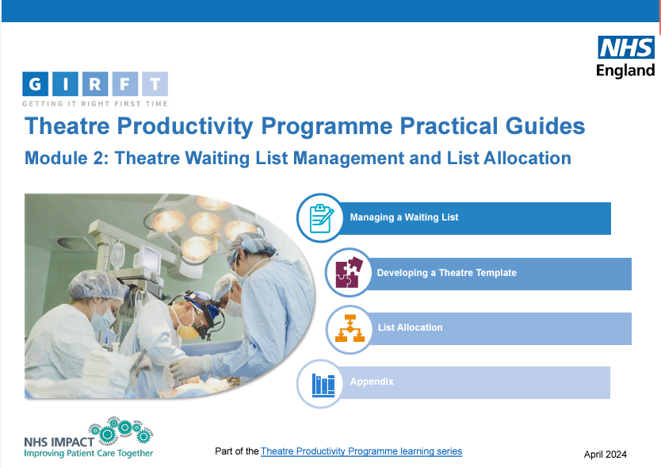
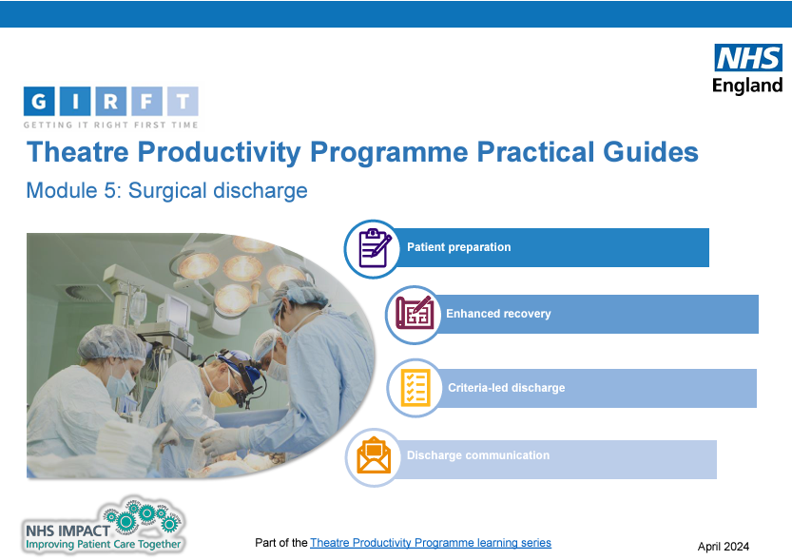
Theatre Productivity
Scan Me!
Delivering high levels of productivity in theatres, ensures that patients will be treated in the existing resource we have available and is key to the principles of the NHSE Operational Planning Guidance.
GIRFT has worked with key stakeholders to deliver a new suite of practical guides, across the whole theatre pathway to support providers deliver sustainable pathways and services.
The guides cover all aspects of the theatre journey from listing to effective surgical discharge.

Slide 37
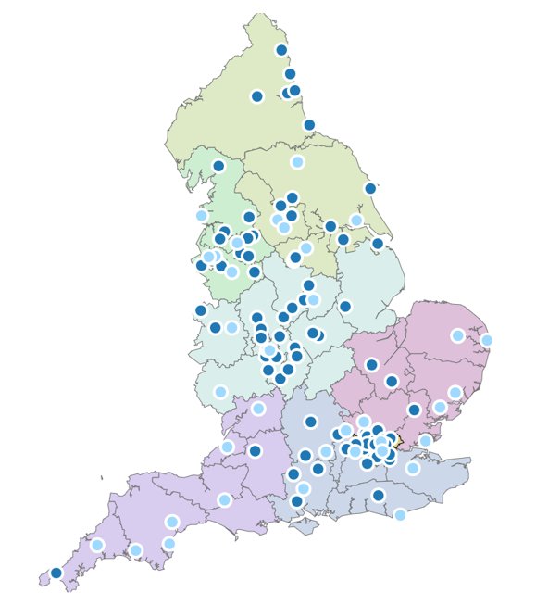
Key elements of our GIRFT Elective Surgical Hub Programme
TB
A clear concept
Clinically Led
Planned care only
Ring-fenced facilities & staff
Any complexity surgery
Paediatrics & Cancer
GIRFT standards
  Cases per session
  Best practice pathways
  Safe & effective care
Focus on improvement
Peer-to-peer led GIRFT Accreditation Programme, with 37 hubs now accredited
Quantitative analysis of impact on activity, LoS, DC, and workforce
Extensive external programme evaluations showing significant positive impact of hubs
101 operational hubs (April 24)
Increasing to 133 (by 25/26)
Plus 24 hub expansions

Slide 38
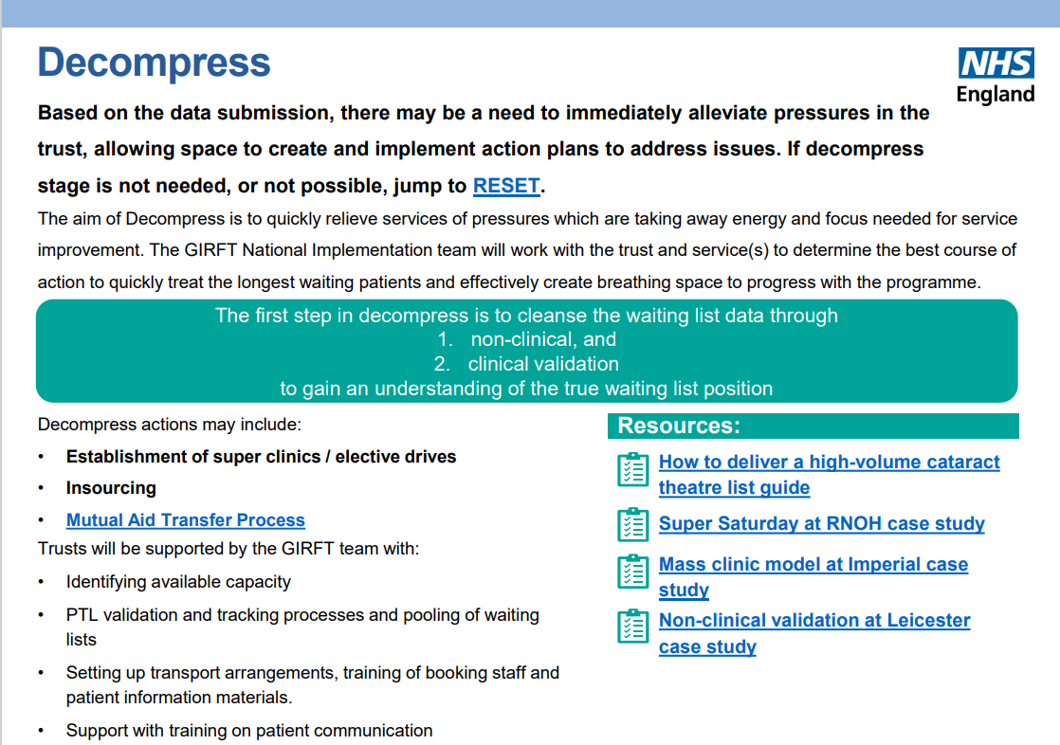
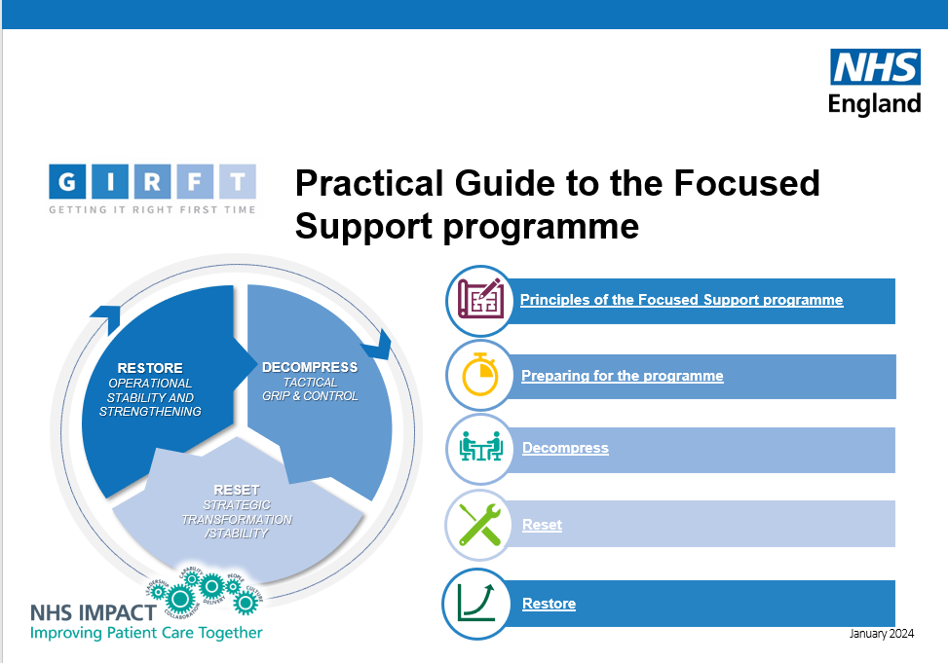
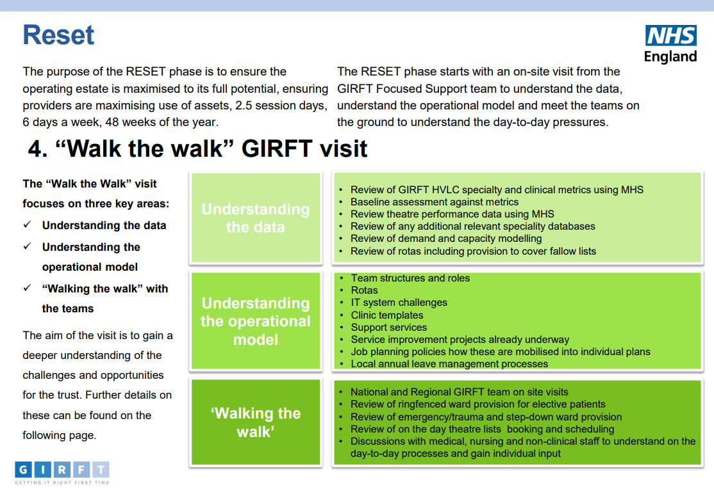
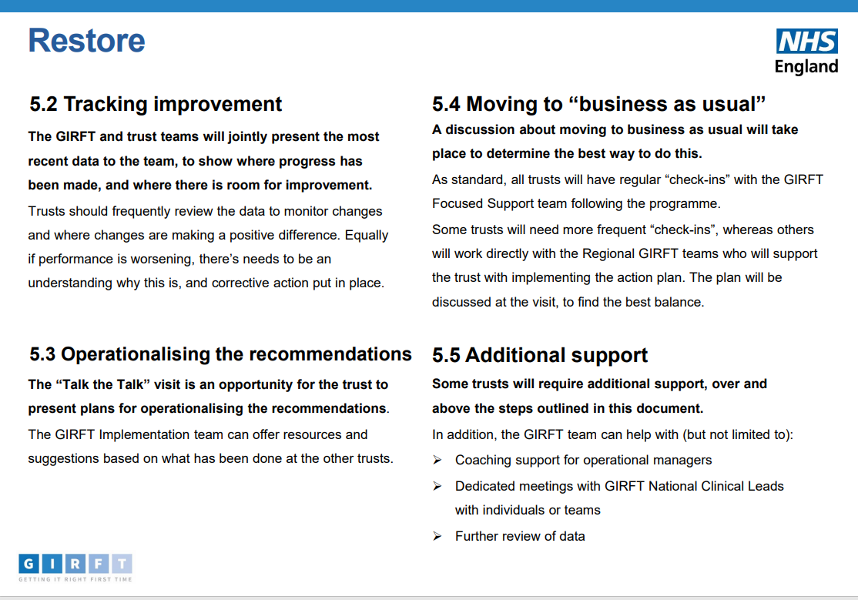
Focused Support Programme
Focused Support Handbook January 2024 - Getting It Right First Time - FutureNHS Collaboration Platform
Notes:
Plain slide with subhead and bullets

Slide 39

One Devon Elective Pilot Programme
Notes:
Standard title slide

Slide 40
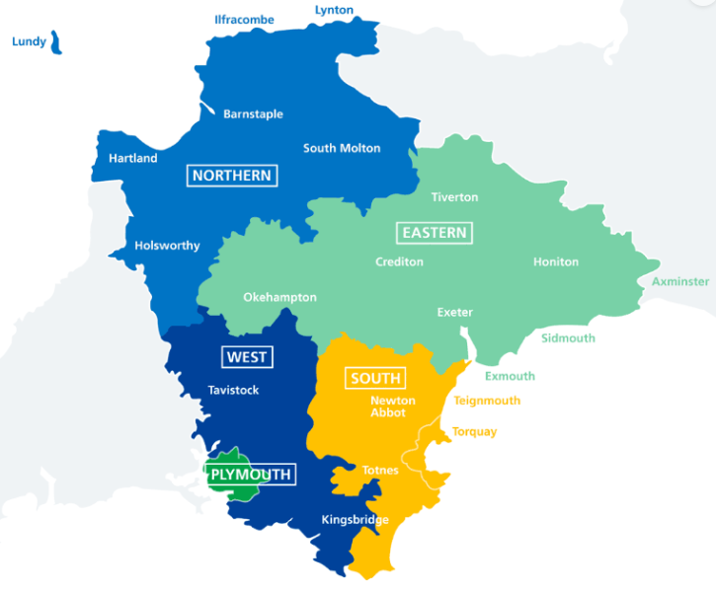
JF
One Devon Elective Pilot
The pilot started in January 2023 (pre GIRFT Further Faster) and aimed to maximise daycase and HVLC activity, standardise patient pathways, increase efficiencies in theatre utilisation and develop our ability to support cross site working.
Programme aims:
Improve access and significantly reduce waiting times for our patients, and achieve the national standards
Provide equity of access, clinical quality, outcomes, and experience for patients across Devon
Maximise the assets & resources (existing, and new investments) across all providers in Devon, making best use of workforce, theatres & bed capacity
The programme will have a focus initially on orthopaedic, ophthalmology and spinal surgical services, working closely with acute provider specialty teams.
The deliverables within the pilot have been provided following the GIRFT review processes taking place in Devon in Ophthalmology, Orthopaedics and Spinal surgery (Nov 2022)
In addition to the above specialties, Cardiology deliverables specifically for the RDUH and TSDFT following its GIRFT review have been included, in agreement with the provider and ICB
Programme approach:
4-5 deliverables agreed each specialty, System Clinical leads appointed/designated – agree scope, manage the scope creep
Deliverables well communicated, supported by Programme mandate via System Elective Board
Formal requirement via COOs to ensure designated Clinical lead and Operational lead
Fortnightly meeting drumbeat – CL and Ops leads, each specialty
Fortnightly assurance meeting/programme board (Including key senior leaders from each system organisation)
Action log, clear deadlines and expectations
Fortnightly highlight reporting by trust teams
Escalations/risks raised, and action taken via Assurance board process
Create GIRFT/system ‘team’ approach, dedicated Programme lead (ICB)
Notes:
Plain slide with subhead and bullets

Slide 41
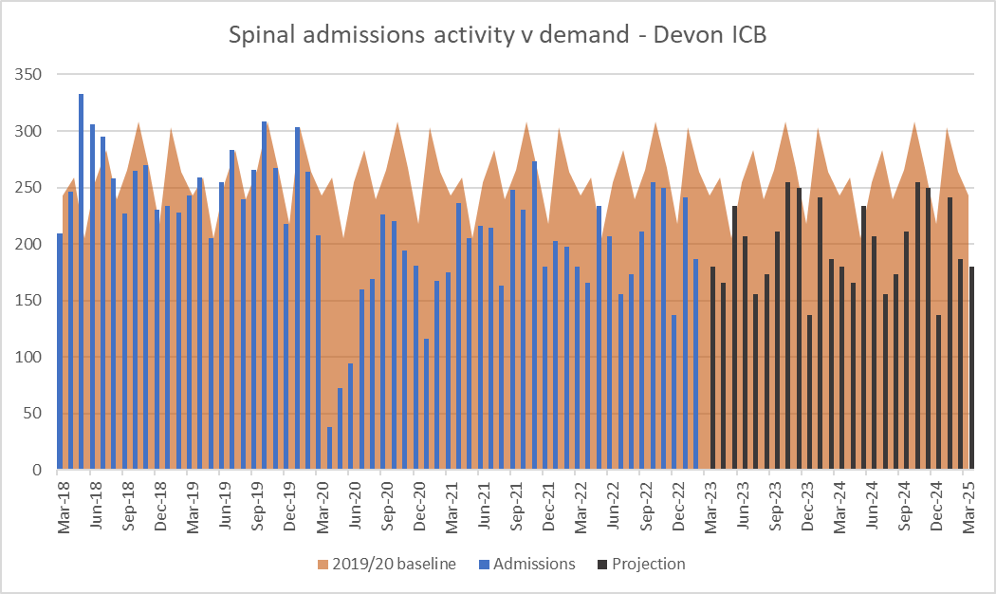
Spinal in Devon – demand/capacity case for change
JF
Demand and capacity system position – shortfall pre pandemic, recovery capacity not able to meet demand
Increasing unplanned spend with out of area providers to support demand, requiring patients to travel for HVLC procedures
Workforce capacity challenges, physical capacity challenges
Notes:
Plain slide with subhead and bullets

Slide 42
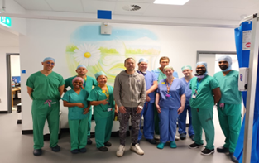
JF
Spinal: deliverables and achievements (May 23 – Mar 24)
Reducing the 78 wk./104wk RTT position to 0 by end March 2024
145 over 78 wks. in May 23 to 4 @ 7th April 24
Maximising System assets, joint working and creating capacity in NHS services HVLC @Nightingale, joint Consultant posts
Nightingale (Exeter) HVLC spinal service opens Oct 2023
Joint (UHP/RDUH) consultant posts commence spring 2024
Productivity on OP lists (11-12 per list)
Achieved and adopted consistency as BAU, both NHS surgical centres
Develop a regional deformity MDT and Devon and Cornwall complex case MDT
Implemented both MDTs in conjunction with the Peninsula Spinal ODN
Implement the national low back pain pathway and Single Point of Access
Implementation of Clinical referral guidance
Implementation of SPOA via ESP interface service – same pathway, all patients
Notes:
Plain slide with subhead and bullets

Slide 43
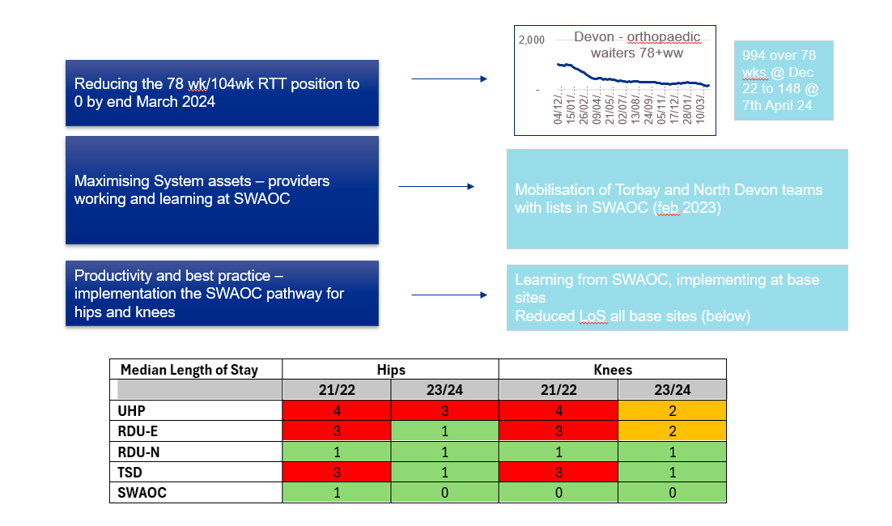
Orthopaedics: deliverables and achievements (Jan 23- Mar 24)

Slide 44
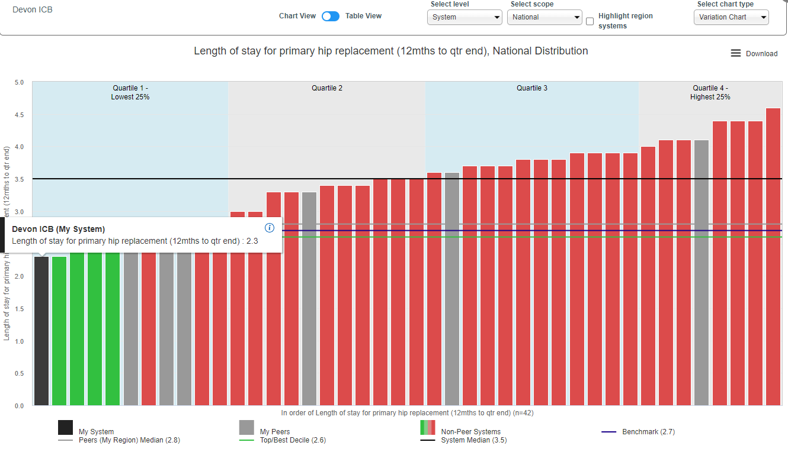
Best practice for primary hips and knees (April 2024)
RDU-N: Always national leaders in 1 night length of stay rates, now converted 25% to day cases.
RDU-E: Previous outlier for LOS, now > 60% hips and 40% knees home by day 1
UHP: Slower to implement pathways but 23% hips and 38% knees now home by day 1 and progress is accelerating.
TSD: Outstanding progress in last three months from previously static position. 64% knees and 57% hips home by day 1 with day case pathways reinvigorated.
Chart below show that Devon ICB now has a position for primary hip replacement which is better than the GIRFT benchmark

Slide 45
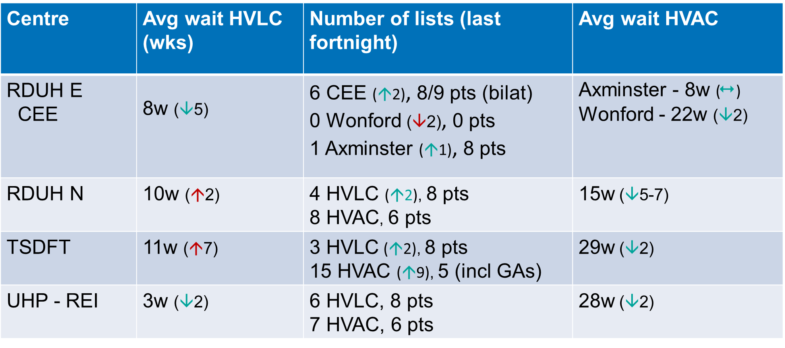
Ophthalmology : deliverables and achievements (May 23 – Mar 24)
JF
Increase HVLC provision and productivity on lists (8/10 per list min). All Trusts now have this in place
Reduction in waiting times for HVLC/HVAC – improving position
Implement linear acquisition and reporting pathways for Glaucoma/MR services (now in place for 3 out of 4 Devon hospitals, with plans for fourth in place)
Reducing backlog for Glaucoma – CEE support to TSDFT, new patient backlog reduced to 90 from 1200. Focus moving to FUs
Learning and maximising CEE (TSDFT and RDUHN for cataracts and diagnostic lanes)
Cataracts: retaining the focus….
From a position of very little HVLC cataract activity taking place in the NHS provided services in 2022 (16% of total commissioned activity) to:
All units have improved their waiting times position for simple cataracts
All units have increased their number of lists and productivity on lists
NHS offer to patients in Devon has improved, supported by new facilities which benefit patients, staff and house other complex ophthalmology surgery
Notes:
Plain slide with subhead and bullets

Slide 46
Ophthalmology – has it worked?
JF
Ophthalmology backlog numbers (new patients) have reduced – c10000 to around 1500
Patient numbers
2021 2023
Notes:
Plain slide with subhead and bullets

Slide 47
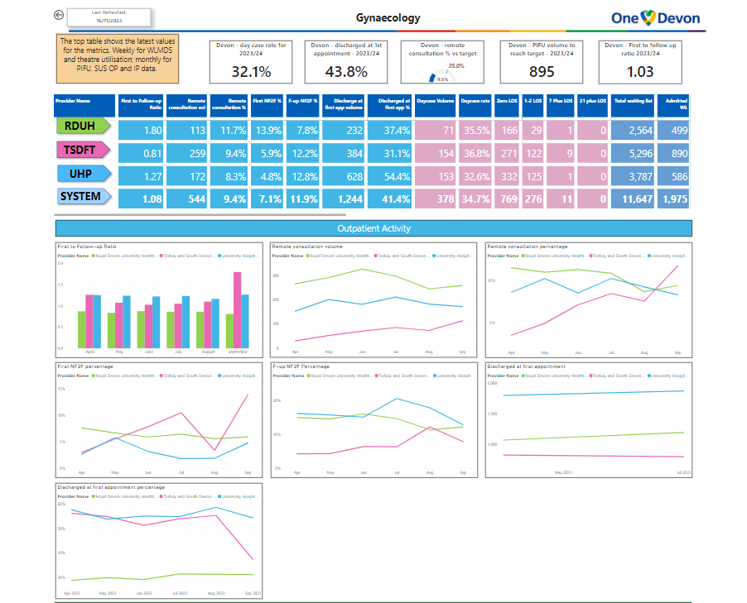
Ensuring continued performance and optimising further opportunities
JF
Power BI Dashboard nearing finalisation to ensure ICB assurance on performance across range of improvement measures (aligning to GIRFT ‘Further Faster’ checklist)
Tool for existing and proposed specialty level system groups to use to agree areas of opportunity and specific deliverables and associated timeframes
Required system clinical leadership at specialty level and dedicated programme/managerial support
‘One Devon’ what's next?
Adopt One Devon pilot approach as substantive approach to deliver system improvement at a specialty level in Devon
Retain One Devon specialties and existing deliverables with 24/25 workplan and agree any new deliverables
Extend One Devon approach into a further set of priority specialties:
Gynaecology
Urology
Dermatology
Reporting of programme – progress, risks, escalations to system elective improvement board and the Peninsula Acute Provider Collaborative
Work is part of Peninsula Acute Provider collaborative
Notes:
Plain slide with subhead and bullets

Slide 49
Any questions?

Slide 50

Book now:
Webinar | Developing shared and equitable improvement approaches within provider collaboratives| Monday 30 September 2024 2.00pm - 3.15pm
Peer learning forum | All sectors | Wednesday 30 October 1:00pm - 2.30pm

Slide 51


Tell us what you think
Scan here to access our evaluation or use the link in the chat

Slide 52
Thank you for attending

